Slide 1



Basics of Digital Forensic and Cyber Security

Slide 2



Cybercrime
Any attack on the information systems or any unlawful act
Computer or communication device or computer network is used
To commit or facilitate the commission of crime

Slide 3

Cyber Attack
Any type of offensive maneuver employed by individuals or whole organizations.
Targets computer information systems, infrastructures, computer networks, and/or personal computer devices by various means of malicious acts.
Originating from an anonymous source that either steals, alters, or destroys a specified target by hacking into a susceptible system.

Slide 4

Cyber Security
Is the body of technologies, processes, and practices designed
To protect networks, computers, and data
From attacks, thefts, damages, and unauthorized accesses
“Cyber security can be defined as the “preservation of confidentiality, integrity and availability of information in the cyberspace”

Slide 5
Why Cyber Security is Critical?
All our assets and our lives are virtualized and have gradually moved to Cyber world.
Everything is connected and everyone is connected.
Many components between sources to destination including switches, routers, protocols, software, ISPs are involved to carry the information.
Software applications can interact with each other without user intervention
Trillions of dollars of online business happen every year.

Slide 6
Different Type of Cyber Crimes
Unauthorized Access to a Computer (on the Internet or on a private network).
Causing Damage to the property of another person using a computer.
Fraudulent use of the property belonging to others using a computer.
Violation of Privacy using a computer.

Slide 7
Different Cybercrimes
Cyber Crime | Description
Spamming | Use of messaging systems to send multiple unsolicited messages (spam) to large numbers of recipients for the purpose of commercial advertising, for any prohibited purpose or repeatedly sending the same message to the same user
Phishing | Attacker sends a fraudulent email designed to trick the recipient into revealing sensitive information to the attacker or downloading malware by clicking on a hyperlink in the message that appear to be from a legitimate source
Cyber Bullying | Otherwise known as Cyber Harassment. a form of bullying or harassment using electronic or communication devices such as computer, mobile phone, laptop, etc
Cyber Stalking | Use of electronic communication by a person to follow a person, or attempts to contact a person to foster personal interaction repeatedly despite a clear indication of disinterest by such person. Includes false accusations, defamation,slander, monitoring, identity theft, threats and blackmail

Slide 8
Different Cybercrimes
Cyber Crime | Description
Cyber Warfare | Involves nationstates using information technology to penetrate another nation’s networks to cause damage or disruption fifth domain of warfare intrude networks for the purpose of compromising valuable data, degrading communications, impairing infrastructural services such as transportation and medical services, or interrupting commerce
Cyber terrorism | Disruptive use of information technology by terrorist groups to further their ideological or political agenda
Cybersquatting | Act of registering, trafficking in, or using a domain name with intent to profit from the goodwill of a trademark belonging to someone else
Espionage | Act or practice of obtaining data and information without the permission and knowledge of the owner

Slide 9
Different Cybercrimes
Cyber Crime | Description
Child Pornography/ Child sexually abusive material (CSAM) | Refers to a material containing sexual image in any form, of a child who is abused or sexually exploited.
Cyber Grooming | A person builds an online relationship with a young person and tricks or pressures him/her into doing sexual act
Vishing | An attempt where fraudsters try to seek personal information like Customer ID, Net Banking password, ATMPIN, OTP, Card expiry date, CVV etc. through a phone call
SMS Phishing/ Smishing | Fraudulent practice of sending text messages purporting to be from reputable companies in order to induce individuals to reveal personal information, such as passwords or credit card numbers

Slide 10
Different Cybercrimes
Cyber Crime | Description
Impersonation and Identity theft | An act of fraudulently or dishonestly making use of the electronic signature, password or any other unique identification feature of any other person.
Ransomware | An attack that involves encrypting data on the target system holding data as a hostage and demanding a ransom in exchange for letting the user have access to the data again by decrypting it after paying ransom.
Advanced Persistent Threats (APTs): | An attack that focuses on stealing information from the victim machine without its user being aware of it. APT attacks are slow in nature, so their effect on computer performance and Internet connections is negligible APTs exploit vulnerabilities in the applications running on computers, operating systems, and embedded systems

Slide 11
Reason for Commissioning Cyber Crime
Money : Making Quick and Easy Money
Revenge: to take revenge on other people/organization/society/ caste or religion by defaming its reputation or bringing economical or physical loss
Fun: Just to check Latest Tools encountered
Recognition: Considered to be pried if someone hack the highly secured networks like defense sites or networks
Anonymity: Cyber space provide motivates the person to commit cybercrime as it is much easy to commit a cybercrime over the cyber space and remain anonymous as compared to real world
Cyber Espoinage: At times, the government itself is involved in cyber trespassing to keep eye on other person/network/country.

Slide 12
Type of Attackers
Hacker: An individual who attempts to gain unauthorized access to network resources with malicious intent
Cracker: An individual who attempts to gain unauthorized access to network resources with malicious intent
Phreaker: An individual who manipulates the phone network to cause it to perform a function that is normally not allowed
Spammer: an individual who sends large numbers of unsolicited email messages.
Phisher: Uses email or other means in an attempt to trick others into providing sensitive information, such as credit card numbers or passwords.
White hat: individuals who use their abilities to find vulnerabilities in systems or networks and then report these vulnerabilities to the owners of the system so that they can be fixed.
Black Hat: Individuals who use their knowledge of computer systems to break in to systems or networks with the malicious intention that they are not authorized to use.

Slide 13
Different Types of Cyber Attacks
Reconnaissance
Packet Sniffers
Port scans
Ping sweeps
Internet Information Queries
Access
Password Attacks
Trust Exploitation
Port redirection
Man in the middle attacks
Denial of Services
Distributed Denial
of Service attacks
Viruses, Worms, and Trojan horses (Malwares)
Viruses
Worms
Trojan Horses
Spyware
Adware
Spam ware
Botnet

Slide 14

Recent Trends in Cybercrime Attack
Ransomware Attacks
Supply Chain Attacks: Targets organisations by focusing on weaker points in organisation’s supply chain.
Phishing and Social Engineering
Remote Work Vulnerabilities
Insider Threats

Slide 15
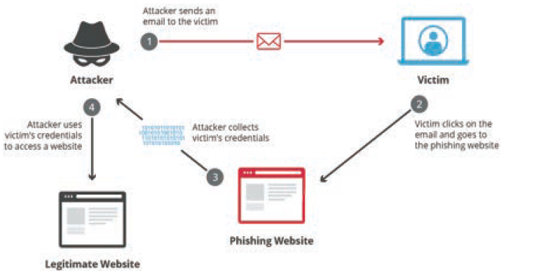
Phishing and Social Engineering

Slide 16
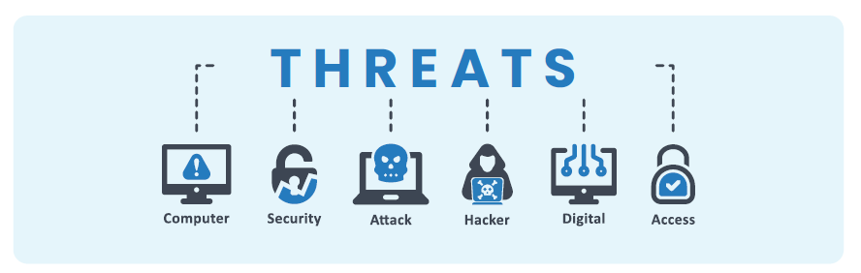
Insider Threats

Slide 17
Preventing Finance Sector from Cyber Attack
Rethink Cyber Security Frameworks
Implement Security protocols
Implement Multi Factor Authentication
Dual and Triple Controls
Raise Fraud Awareness among employees
Reconcile Transactions regularly
Set Transaction Limits
Higher Quality IT Tools
Threat Detection Tools
Incident Response System
Zero Trust Network Model
Third Party Risk Management

Slide 18
Elements: Modus Operandi of Cybercrime
Ensure Success of the Crime
Protect and Identity
Effect Escape

Slide 19

Case Study: Dani Data App Scam
Introduction
The Dani Data app scam highlights the risks of investing in unregulated apps and websites.
The app promised high returns on football betting investments but turned out to be a Ponzi scheme.
Launched in December 2021 by Chinese national Woo Uyanbe, the app claimed to use AI for match predictions.
It attracted over 1,200 users who invested Rs. 1,400 crore (about US$180 million) by June 2022.
The scam defrauded thousands of people, emphasizing the importance of due diligence in investment decisions.

Slide 20

Case Study: Dani Data App Scam
How the scam worked
The Dani Data app scam operated as a classic Ponzi scheme, using new investors' money to pay returns to existing investors.
This created the appearance of a profitable investment, attracting more investors.
The scheme collapsed when new investor numbers declined, leading the operators to vanish with the funds.
Investors were left emptyhanded, underscoring the risks associated with Ponzi schemes and unregulated investments.

Slide 21
Case Study: Dani Data App Scam
Victims of the Scam
The Dani Data app scam had a widespread impact, affecting thousands of individuals in India.
Victims came from diverse backgrounds, including young people, professionals, and retirees.
Many victims had invested their life savings, particularly for retirement, making the loss devastating for them.
The scam highlights the need for caution and awareness when investing, especially in unregulated schemes.

Slide 22

Case Study: Dani Data App Scam
Leeson's Learned
Be wary of any investment that promises high returns with little or no risk.
Do your research before investing your money.
Only invest in regulated apps and websites.
Be suspicious of any investment that requires you to make a large upfront payment.
Be aware of the signs of a Ponzi scheme, such as the use of fake testimonials and the Promise of guaranteed returns.

Slide 23

Case Study: Dani Data App Scam
Conclusion
Don’t invest in unregulated apps and websites
Never invest money that you cannot afford to lose.
Be patient. Don't expect to get rich quick.
Diversify your investments. Don't put all your eggs in one basket.
Get professional advice. If you're not sure about an investment, talk to a financial advisor.

Slide 24
Methods : Successful commission of Cyber Crimes
Viruses and Worms/ Trojan Horses
Infringment of Privacy
Econimic & Industrial Espionage
Computer Sabotage & Computer Extoration
Electronic Money Laudenring & Tax Evasion
Child Pornography
Unauthorised Access

Slide 25
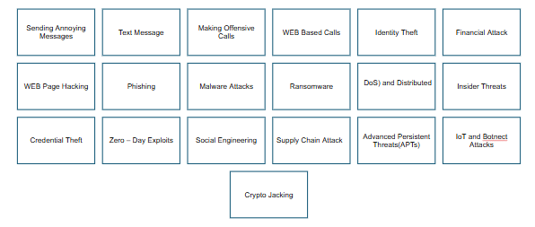
Methods: Successful Commissioning of Fraud

Slide 26
Scenario
Fraudsters use keywords like "Earn Online" and "PartTime Job" in advertisements displayed during peak internet usage hours in India to lure victims to websites with domains like 'xyz' and 'Wix site', which then redirect to chat platforms for engaging with potential victims.
Fraudsters used multiple Indian mobile numbers, with owners sometimes unaware of their use for fraudulent activities, while in other cases, owners knowingly shared OTPs for money.
Money mules use bank accounts, opened with real or fake identification, to receive stolen funds, often by sharing OTPs, while rented accounts are sourced by agents who pay fixed rent, commission, or lump sums to account owners (money mules).

Slide 27
Scenario
Layering of transactions
Presence of Shell Companies with dummy directors, rented companies with MCA registration certificates, fintech companies, payment gateways, SMS aggregators.
UPI addresses are used to create layering behind Payment Aggregators thereby facilitating end of day settlement.
Gold, crypto currencies, international money transfers are observed by LAW Enforcement Agencies (LEAs) to be usual termination points of the fraud trials

Slide 28

Digital Forensic
A branch of cybersecurity focused on the recovery and investigation of material found in digital devices and cybercrimes.
Concerned with the identification, preservation, examination and analysis of digital evidence, using scientifically accepted and validated processes, to be used in and outside of a court of law.

Slide 29

PURPOSE OF DIGITAL FORENSICS
Electronic Discovery (E Discovery)
Most common use of digital forensics is to support or refute a hypothesis in a Criminal Court or Civil Court.
Part of Cyber security and information security teams to identify the cause of data breaches, data leaks, cyberattacks and other cyber threats.
Part of incident response to help recover or identify any sensitive data or personally identifiable information (PII) that was lost or stolen in a cybercrime.

Slide 30

Digital Forensic Investigation Process
Comprises of four stages
Seizure: Prior to actual examination digital media is seized
Acquisition: After a forensic duplicate of the data is created using a hard drive duplicator or software imaging tool, the original hard drive is returned to secure storage to prevent tampering, while the acquired image is verified with SHA1 or MD5 hash functions and will be checked again throughout analysis to ensure the evidence remains in its original state.
Analysis: After acquisition, files are analyzed to identify evidence supporting or contradicting a hypothesis, with the forensic analyst recovering evidence, often starting with deleted information, and analyzing data types such as email, chat logs, images, internet history, and documents from accessible disk space, deleted space, or the operating system cache.
Reporting: After completing the investigation, the information is compiled into a report that is accessible to nontechnical individuals and may include audit information or other metadata documentation.

Slide 31
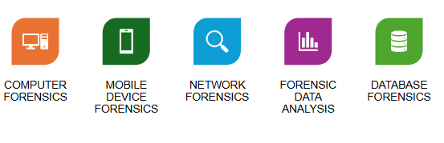
Different Branches of Digital Forensics

Slide 32
Computer Forensics
Computer forensics is a branch of digital forensics concerned with evidence found in computers and digital storage media.
The goal of computer forensics is to examine digital data to identify, preserve, recover, analyze, and present facts and opinions about digital information.
It is used in both computer crime and civil proceedings.
Computer forensics uses techniques similar to data recovery but includes additional guidelines and practices to create a legal audit trail with a clear chain of custody.
Evidence from computer forensics investigations is subjected to the same guidelines and practices as other digital evidence.

Slide 33
Mobile Forensics
Mobile device forensics is a branch of digital forensics focused on recovering digital evidence from mobile devices using forensically sound methods.
"Mobile device" generally refers to mobile phones but can include devices with internal memory and communication abilities like PDAs, GPS devices, and tablets.
Growing Needs of Mobile Forensics is driven by:
Use of mobile phones to store and transmit personal and corporate information
Use of mobile phones in online transactions

Slide 34
Challenges in Mobile Forensics
Changes in mobile phone form factors, operating systems, data storage, services, peripherals and even pin connectors and cables
Storage capacity growth
Their proprietary nature

Slide 35
Network Forensics
Network forensics is a branch of digital forensics that focuses on monitoring and analyzing computer network traffic for information gathering, legal evidence, or intrusion detection.
Unlike other branches of digital forensics, network data is volatile and dynamic, meaning once transmitted, it is gone, making network forensics often a proactive investigation.
Network forensics has two general uses:
Monitoring a network for anomalous traffic and identifying intrusions.
Law enforcement may analyze capture network traffic as part of criminal investigations.

Slide 36
Forensic Data Analysis
Forensic Data Analysis (FDA) is a branch of digital forensics focused on examining structured data for incidents of financial crime, aiming to discover and analyze patterns of fraudulent activities.
Structured data comes from application systems or their databases, contrasting with unstructured data from communication, office applications, and mobile devices, which lacks an overarching structure and requires keyword application or pattern mapping for analysis.
Unstructured data analysis is typically performed by computer forensics or mobile device forensics experts.

Slide 37

Database Forensics
Database forensics is a branch of digital forensics concerning databases and their metadata, including live analysis of cached information in a server's RAM.
It involves examining timestamps related to updates in a relational database to verify actions of a database user or identifying transactions indicating evidence of wrongdoing, such as fraud, within a database or application.

Slide 38
Reasons: Challenges Faced by Digital Forensics
Increasing variety of file formats and Oss
Emergence of smart phones that increasingly utilize encryption
Crime as a Service (CaaS)

Slide 39
Challenges: Digital Forensics
Technical Challenges
Different Media format
Encryption
Antiforensics
Steganography.
Live acquisition and analysis
Legal Challenges
Jurisdictional issue.
Lack of standard legislation creates the legal challenges.
Status as scientific evidence.
what is the known or potential rate of error of the method used.
whether the theory or method has been generally accepted by the scientific
Resource Challenge
Volume of data.
Time taken to acquire and analyze forensic media.
To ensure to satisfied critical investigative and prosecutorial needs at all levels of government

Slide 40
Information Security
The state of the wellbeing of information and infrastructure in which the possibility of theft, tampering, or disruption of information and services is kept low or tolerable.
Five elements of Information Security are:
  Confidentiality
  Integrity
  Availability
  Authenticity
  Nonrepudiation

Slide 41
Classification of Attacks
Passive Attacks
  Passive attacks involve intercepting and monitoring network traffic without tampering with the data.
  Attackers use sniffers to perform reconnaissance on network activities.
  These attacks are challenging to detect as there is no active interaction with the target system.
  Passive attacks enable attackers to capture data or files being transmitted, including unencrypted data and cleartext credentials, for use in active attacks.
  Example: Foot Printing, Sniffing and eavesdropping, Network traffic analysis, Decryption of weakly encrypted traffic
Active Attacks
  Active attacks involve tampering with data in transit or disrupting communication to bypass or break into secured systems.
  Attackers launch these attacks by actively sending traffic that can be detected.
  The goal is to exploit information in transit on the target network.
  They penetrate or infect the target's internal network to compromise systems.
  Example: Denial of Service (Dos) attack, Malware attacks, Spoofing attacks, Passwordbased attacks, Maninthe middle attack, Cryotography attacks, SQL injection, XSS attack, Directory Traversal attacks, Insider Attacks, Distribution Attacks

Slide 42
Hacking
Hacking in computer security involves exploiting system vulnerabilities and compromising security controls to gain unauthorized access to system resources.
It often entails modifying system or application features to achieve a goal outside the creator's original purpose.
Hacking can be used to steal, pilfer, or redistribute intellectual property, resulting in business losses.

Slide 43
Hacker Classes/ Threat Actors
Black Hats: Individuals who use their extraordinary computing skills for illegal or malicious purposes
White Hats: Individuals who use their hacking skills for defensive purposes
Gray Hats: individuals who work both offensively and defensively at various times

Slide 44
Hacking Phases
Reconnaissance
Scanning
Gaining Access
Maintaining Access
Clearing Tracks

Slide 45
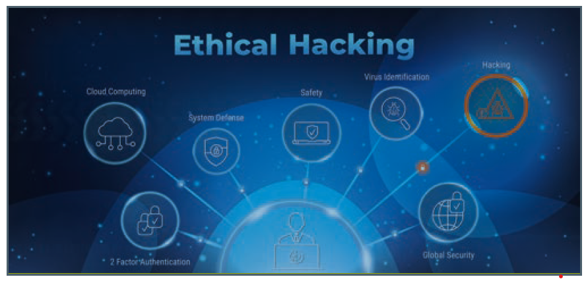
Ethical Hacking
Practice of employing computer and network skills in order to assist organizations in testing their network security for possible loopholes and vulnerabilities
White Hackers performs Ethical Hacking
Involves the use of hacking tools, tricks, and techniques typically used by an attacker to verify the existence of exploitable vulnerabilities in system security.

Slide 46
Why Ethical Hacking is necessary ?
To prevent hackers from gaining access to the organization’s information systems
To uncover vulnerabilities in systems and explore their potential as a risk
To analyze and strengthen an organization’s security posture, including policies, network
protection infrastructure, and enduser practices
To provide adequate preventive measures in order to avoid security breaches
To help safeguard the customer data
To enhance security awareness at all levels in a business

Slide 47
Scope of Ethical Hacking
To identify risks and highlight remedial actions
To reduce Information and Communications Technology (ICT) costs by resolving vulnerabilities.
to perform a fullscale test covering all aspects of the network, as well as physical and system intrusion.

Slide 48
Limitations of Ethical Hacking
Without a clear understanding of what they are looking for and why they are hiring an outside vendor to hack their systems, businesses may not gain much from the experience.
An ethical hacker can help an organization better understand its security system, but it is up to the organization to implement the right safeguards on the network.

Slide 49
Rules to be followed by Ethical Hacker
Gain authorization from the client and have a signed contract giving the tester permission to perform the test
Maintain confidentiality when performing the test
Follow a Nondisclosure Agreement (NDA) with the client
Perform the test up to but not beyond the agreed upon limits

Slide 50
Framework for performing a security audit of an organization
Talk to the client and discuss the needs to be addressed during the testing
Prepare and sign NDA documents with the client
Organize an ethical hacking team and prepare the schedule for testing
Conduct the test
Analyze the results of the testing and prepare a report
Present the report findings to the client

Slide 51
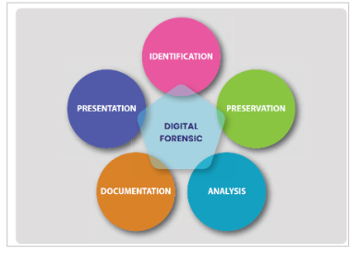
Digital Forensic Process

Slide 52
Digital Forensic Investigation Process
Divided into two parts:
At Crime Scene Investigation
  Identification
  Collection
  Preservation
In Lab Investigation
  Examination
  Analysis
  Report

Slide 53
Identification
Starting point of the digital forensic process
Helps the person conducting the investigation to get ready and plan the steps
Steps Involved
Case Intake
Case Assessment
Objective Definition
Legal and Ethical Considerations
Resource Allocation
Risk Assessment
Scope Definition
Initial Documentation

Slide 54
Preservation
Preserving digital evidence (DE) poses unique challenges compared to traditional evidence preservation, as DE includes any binary information useful in legal investigations.
While digital evidence resides on physical media, it is the content and related information, not the media, that are most important.
Digital storage can hold a vast amount of information in a small space, and its relevance is growing due to the widespread use of cell phones, social media, and Internet of Things (IoT) devices.
Digital data can be easily altered, but there are effective techniques for preventing and detecting changes.

Slide 55
Examination
The examination method aims to extract and analyze digital evidence, involving the recovery of data from its media.
Before addressing the information, it's crucial to understand the types of data and conduct a systematic search of evidence related to the incident being investigated.
The outputs of the examination are data objects found within the collected information, including system and user generated files.
Analysis involves interpreting the recovered data and placing it in a logical and useful format, such as understanding how it got there, where it came from, and what it means.
The concepts presented are meant to assist the examiner in developing procedures and structuring the examination of digital evidence, with the recognition that not all techniques may be used in a case, leaving it to the examiner's discretion to select the appropriate approach.

Slide 56
Analysis
Digital evidence is examined not only to understand what happened but also how it happened, using complex techniques to uncover hidden, deleted, or encrypted data.
Must be conducted in a forensically sound manner to ensure that the results are reliable and admissible in court.
Requires handling the data carefully to avoid alteration, contamination, or loss, and thoroughly and accurately documenting the process.

Slide 57
Documentation
Documentation in digital forensic investigations is crucial for recording all relevant information generated during the investigation.
Recorded data assists decision makers, legal authorities, and administrative bodies in their respective processes.
The documentation process is continuous throughout the investigation, recording the location and status of computers, storage media, and other electronic devices.
Computers play a central role in criminal investigations, with email and internet activities analyzed in cases such as murder or rape, and investigations into unauthorized actions by employees in the corporate world.
Fraud investigations often involve collecting transaction history evidence from servers.
The documentation process is crucial in both digital and physical investigations, with unique differences in implementation between the two.

Slide 58
Presentation/ Reporting
Formulating a coherent and comprehensive digital forensics report is crucial to present evidence in a way the court deems admissible and bring the guilty to justice.
A digital forensics report is essential for retelling events in a structured manner and backing up claims with concrete evidence, which is a requirement in court proceedings.
These reports facilitate coordination between multiple investigators, law enforcement officers, administrative, and legal personnel involved in the case, who may not all share the same professional background and expertise.
They serve as an interdisciplinary focal point that documents findings and presents them in a factual yet understandable manner, revealing the truth of what happened.

Slide 59
Contents of Report
Details of the reporting agency
Case identifier
Forensic investigator
Identity of the submitter
Date of evidence receipt
Details of the device seized for examination including serial number, make, and model.
Details of the equipment and tools used in the examination
Description of steps taken during examination
Chain of custody documentation
Details of findings or issues identified
Evidence recovered during the examination, ranging from chat messages, browser history, and call logs to deleted messages, and so on
Any images captured during the examination
Examination and analysis information
Report conclusion

Slide 60
Chain of Custody
A written or electronic document within which the acquisition, custody and transfers of any piece of proof square measure recorded.
Should embrace all basic data relating to:
  Acquisition: who, when, wherever and the way.
  Custody: who, where however and the way long
  Processing: What was done to the proof (cloning, analysis, etc.)
  Transfer: Transfer of the proof from one human to a different, recorded alongside the signature of the new keeper.
  Final Fate: Destruction, secure deletion of proof, come back of proof to owner, etc.

Slide 61
Steps to Analyzing Digital Forensic Report
Understand the Scope
Review the Methodology
Examine the Findings
Check the Conclusions
Verify the Chain of Custody
Consider Expert Assistance

Slide 62
Evidence Handling Procedure
If examining the contents of a tough drive presently placed at intervals a pc, record data regarding the pc system beneath examination.
Take digital images of the first system and/or media that's being duplicated.
Fill out associate in nursing proof tag for the first media or for the rhetorical duplication (whichever drive you may keep as best proof and store in your proof safe).
Label all media fitly with associate in nursing proof label.
Store the simplest proof copy of the proof media in your proof safe.
A proof keeper enters a record of the simplest proof into the proof log. for every piece of best proof, there'll be a corresponding entry within the proof log.
All examinations square measure performed on a rhetorical copy of the simplest proof, referred to as an operating copy.
Ensures backup copies
Ensures each one disposition dates square measure met
Performs monthly audit to confirm all of the simplest proof is gifted, properly held on, and labelled.

Slide 63
10 Critical Steps in preserving Digital Evidence
Do not change the current state of the device
Power down the device
Do not leave the device in an open area or unsecured place
Do not plug any external storage media in the device
Do not copy anything to or from the device
Take a picture of the piece of evidence
Make sure you know the PIN/ Password Pattern of the device
Do not open anything like pictures, applications, or files on the device
Do not trust anyone without forensics training
Make sure you do not Shut down the computer, if required Hibernate it.

Slide 64
Real World Examples of Cyber Crimes
Equifax Breach: Unveiling Vulnerability at Scale
WannaCry Ransomware: A Global Digital Hostage Crisis
Nigerian Prince Scam: Exploiting Human Trust
The Rise and Fall of Silk Road: Unveiling the Dark Web Underbelly

Slide 65
The Information Technology Act, 2000
The Information Technology Act, 2000 (IT Act), is central to India's response to cybercrimes.
It provides legal recognition to electronic transactions and facilitates e-governance.
The IT Act establishes a legal framework to address cybercrimes, defining offenses such as hacking, data theft, unauthorized access, and damage to computer systems.
The act introduces the concept of digital signatures and electronic records, enhancing the credibility of electronic transactions.
Significant amendments to the IT Act in 2008 broadened the scope of cybercrimes, introducing provisions to penalize offenses like cyber terrorism, child pornography, and identity theft.
The amendments also introduced intermediary liability, establishing the responsibilities of online platforms and service providers to prevent the proliferation of illicit content.

Slide 66
Legal Consequences of IT Crimes
Legal consequences in Information Technology crimes vary widely, reflecting the complexity of modern digital malfeasance.
Criminal penalties, such as monetary fines and imprisonment, vary based on the severity of the crimes, aiming to equate the loss with a tangible price.
Some jurisdictions impose life sentences for cybercrimes of significant magnitude, highlighting the harm that can be caused by malicious code.
Civil remedies offer avenues for victims to reclaim lost ground, with courts decreeing restitution to victims of digital pillaging.
Extradition and jurisdiction complexities arise in cybercrime cases due to the elusive nature of cybercriminals operating across international boundaries.
Extradition becomes a delicate process involving legal intricacies and diplomatic protocols, complicated by diverse legal standards across nations.
The digital frontier blurs the notion of jurisdiction, as cybercriminals can orchestrate transgressions across borders without physical constraints, challenging legal systems to determine the reach of the law.

Slide 67
Technological Innovation
Innovation is crucial in the ongoing battle between cyber attackers and defenders, with technological advancements providing tools to combat IT crimes.
Artificial Intelligence (AI) and Machine Learning (ML) algorithms can detect patterns of cyber threats in realtime, automating threat identification and response.
Behavioral analysis tools monitor deviations from normative user behavior, alerting to unauthorized access.
Blockchain technology enhances the integrity of digital transactions and data storage, deterring data tampering and fraud with its immutable nature.

Slide 68
Guidelines Given by SEBI For Market Infrastructure Institutions (MIIS)
Robust Cyber security Framework
Interconnectedness Awareness
Guideline Compliance
Compliance Reporting
Testing and Preparedness

Slide 69
Future Trends
Quantum computing stands out as an enigmatic technology in the realm of cyber security, offering both revolutionary encryption capabilities and threats.
Its computational power, manipulated through quantum bits or qubits, could break existing cryptographic methods, making digital security vulnerable.
Quantum cryptography, however, promises unbreakable codes, setting a high standard for cyber resilience.
Adaptation is crucial in both legal and technological spheres to address quantum threats, requiring agile legal frameworks and technical advancements.
The cybersecurity community must stay ahead of cybercriminals, developing resilient defenses against evolving threats.
Collaboration between nations, organizations, and individuals is essential in the fight against cybercrime, emphasizing global cooperation, information sharing, and mutual support as key elements of a united front.

Slide 70
Categories of Digital Forensic Tools
Disk and File Analysis Tools: These tools delve into storage media, recover erased files, and scrutinize file metadata.
Memory Analysis Tools: Memory forensics tools unravel the secrets of volatile memory, unveiling running processes, network connections, and potential traces of malware.
Network Analysis Tools: Network forensics tools capture and analyze network traffic, shedding light on malicious activities and offering insights into network behavior.
Malware Analysis Tools: These tools dissect and scrutinize malware samples, enabling analysts to fathom their behavior and impact.
Timeline Generation Tools: These tools orchestrate the construction of chronological timelines, vital for unraveling the sequence of digital incidents

Slide 71
Digital Forensic Tools
Encase
Digital Forensic Framework (DFF)
ProDiscover
Forensic Toolkit (FTK)
Quest Change Auditor
The Sleuth Kit
Computer Online Forensic Evidence Extractor (COFEE)
Bulk Extractor
Cellebrite UFED
Cellebrite Physical Analyser
Magnet Forensics for Federal Agencies

Slide 72
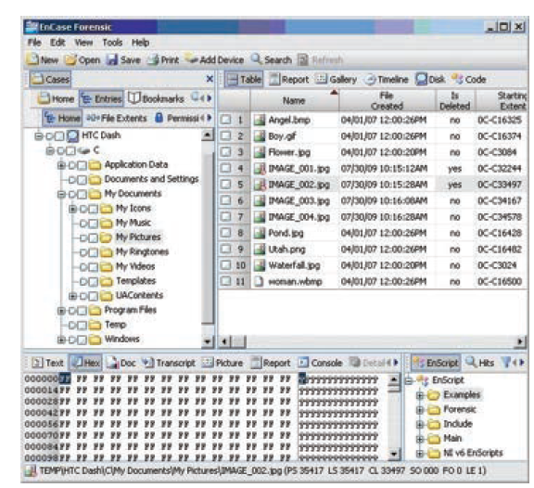
Encase
Features
Can gather data from vast variety of sources like network, cloud, mobile devices
Can produce largescale of reports on findings while keeping the integrity of the evidence
It uses metadata, keywords and hash values to conduct on targeted device and collection
Memory acquisition
Can perform Disk Imaging
EnCase Forensic Imager can be used through USB drive and can acquire data from live device
Data Carving can be performed
Password Recovery
Remote data collection and processing

Slide 73
Digital Forensic Framework (DFF)
Features
Open source Forensics Platform
It can perform Cryptographic hash calculation
Can perform EXIF metadata extraction
Can import all Microsoft Outlook mailboxes
Memory Dump analysis
Scripting and batching capabilities
Instinctive reporting of valuable information and web browsing
Can automatically extract data
Can perform investigation during live and static analysis

Slide 74
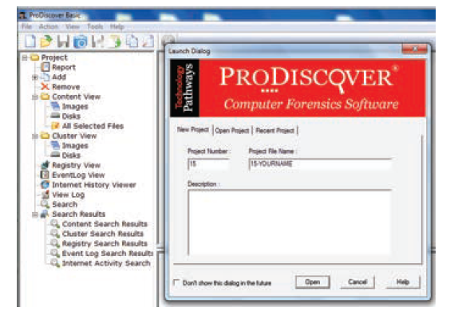
ProDiscover
Features
It allows inspection, image capture and search of Hardware Protected Area
To find the data, it uses Boolean search capability to search for regular expressions and keywords
It is flexible and fast
Pro Discover Incident Response Edition can help to stop the threat within the minutes of alert
One can install the SMART AGENT when required and can remove when it is done
It also comes with malware discovery hash sets
Uses Perl Scripts for performing investigation tasks
It creates automatic reports with the information required to be presented as evidence.

Slide 75
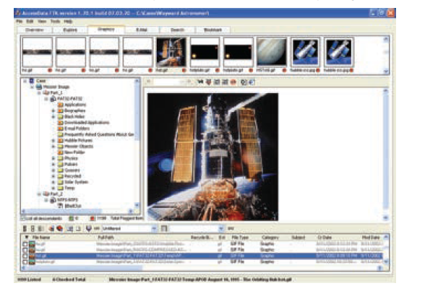
Forensic Toolkit (FTK)
Features
It can obtain and store the data across the network
It can acquire information from 3,500 mobile devices
It can easily detect missing data, spiteful behaviour and data leakage
If suppose, data is stored in different location from the original, FTK can identify how
did it get there, who has changed the location and even identify if any changes had
been done to the original.
It can easily identify if any data has been transferred from the system or mobile
device.
It can even gather information during static analysis
One can run FTK from an USB drive
It has the option of expert review, where reviewing will be done and compared with
the witness on the final analysis of the evidence.
Password recovery
With the help of FTK Imager, disk imaging is done
By using hashing techniques and Boolean, it can search data
By using FTK Internal viewer, the forensic officer can view Excel, PowerPoint and Word.
It can perform email analysis
It can support multi languages
The customer can choose pdf format or tiff format for exporting the evidence

Slide 76
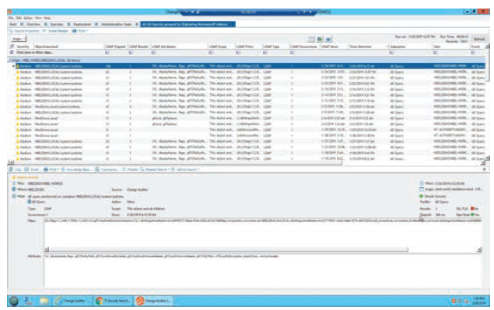
Quest Change Auditor
Features
To track the realtime analysis with complete visibility
Can easily detect an insider attack and a report is generated
Can check if the object has changed or not.
It displays the previous values and the altered values and can restore them with previous clicks.
Dynamic investigation paths are taken.
Can do full text search saving the time to check if file is changed and which.

Slide 77
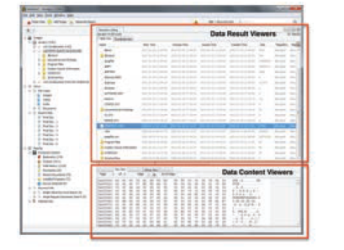
The Sleuth Kit
The Sleuth Kit is a library of command line tools used for analyzing file system data, particularly in digital forensics.
Added support for Virtual Machine formats using libraries such as libvmdk and libvhdi.
It allows users to analyze copies of disk images from systems under investigation to recover files.
Commonly used by law enforcement, military, and corporate examiners to explain what occurred on a device.
It can also recover digital media and files from memory cards.
The Sleuth Kit framework provides an open platform for application layer modules to operate, enabling users to build automated, endtoend digital forensic applications.
It supports detailed and complex disk image analysis through plugin pipelines.
Originally intended for use in distributed environments for job splitting among computers, the framework can also be used to create desktop applications.

Slide 78
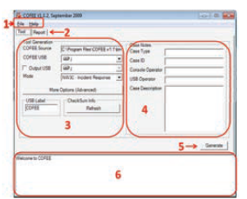
Computer Forensic Evidence Extractor (COFEE)
COFEE (Computer Online Forensic Evidence Extractor) was developed by Microsoft to extract evidence from Windows systems.
Forensic investigators can perform live analysis by installing COFEE on a pen drive or hard disk.
Microsoft collaborates with Interpol and the National White Collar Crime Center (NW3C) for forensic investigations.
COFEE is exclusively available to law enforcement agencies and is not made available to the general public.

Slide 79
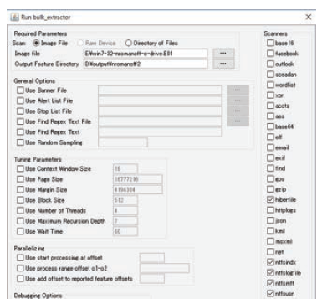
Bulk Extractor
A window, Linux and MAC based tool
It can perform disk imaging
Can Recover the data
Data carving is possible
Password can be recovered
It can make an analysis on email
Live analysis on any system can be performed
And can decrypt the file if it is encrypted

Slide 80
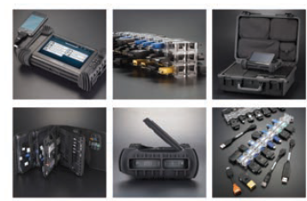
Cellebrite UFED
Extract device keys which can be used to decrypt raw disk images, as well as keychain items
Revealing device passwords, although this is not available for all locked devices
Passcode recovery attacks
Analysis and decoding of application data
Generating reports in various formats such as PDF and HTML
Dump the raw file system for analyzing it in other applications
Supported by a management suite that keeps a strict activity log and audit trail.

Slide 81
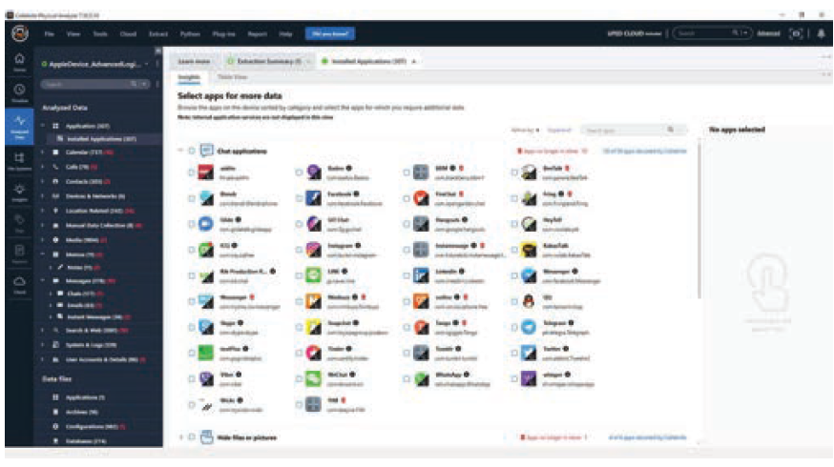
Cellebrite Physical Analyser
It supports physical and advanced logical acquisition (file system acquisition)
It extracts device keys required to decrypt raw disk images as well as keychain items
It decrypts raw disk images and keychain items
It reveals device passwords (not available for all locked devices)
It allows the examiner to open an encrypted raw disk image file with a known
password
It supports passcode recovery attacks
It supports advanced analysis and decoding of extracted application data
The platform provides access to physical and logical data extracted in the same
user interface, making analysis easier
It reports generation in several popular
Advanced Capabilities for ios/ Blackberry/Android/ GPS

Slide 82
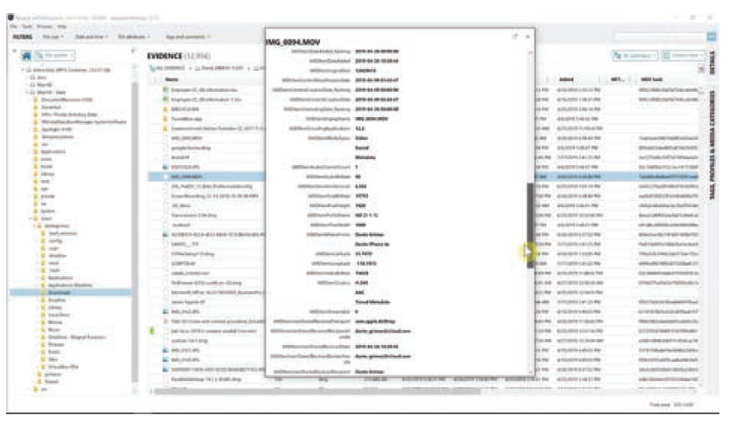
Magnet Forencis for Federal Agencies
Magnet AXIOM is a digital investigation platform that allows examiners to acquire, analyze, and share forensic data.
It offers an artifacts first approach and built-in remote collection for corporate cyber security investigations.
Magnet AXIOM Cyber helps organizations quickly understand security events to investigate them efficiently.
It is the evolution of Magnet IEF, providing enhanced capabilities and features for digital forensic investigations.

Slide 83
Open Source Intelligence(OSINT) Tools
Open Source Intelligence (OSINT) involves systematically collecting and analyzing information from publicly accessible sources.
OSINT tools enable investigators to gather data from websites, social media, public records, and other sources.
OSINT enriches traditional digital forensics by providing context and depth to investigations.
In cyber forensics, OSINT tools extend data collection beyond local devices, gathering information on individuals, organizations, and events.
OSINT insights help establish timelines, identify suspects, and corroborate digital evidence, enhancing the investigative process.

Slide 84
Benefits of OSINT Training
Development of Practical Skills: OSINT training is synonymous with handson experience, fostering the development of practical proficiencies encompassing data collection, analysis, and visualization.
Contextual Comprehension: OSINT tools broaden the context surrounding digital evidence, enabling investigators to fathom the larger narrative encompassing a case.
Real World Relevance: The practical deployment of OSINT tools mirrors real world investigations, rendering training in these tools directly applicable and pertinent.
Versatility: OSINT tools are versatile, transgressing various investigative contexts, spanning criminal investigations to cyber security incident response.

Slide 85
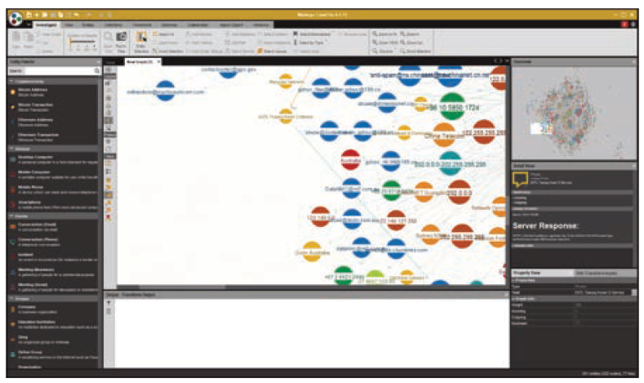
Maltego: Visualizing Data Relationships
A strong information gathering tool for people, organizations, and their interactions.
It can be utilized for the following uses:
  Data Gathering: Collect information from various sources.
  Visualization: Create visual maps of entities and relationships.
  Link Analysis: Identify patterns and associations in data.
  Enrichment: Enhance data with additional details.
  Threat Tracking: Hunt for threats and malicious actors.
  Documentation: Organize findings and create reports.
  Alerts: Set up monitoring for changes in entities.
  Incident Response: Assess and respond to security incidents.
  Collaboration: Support teamwork among investigators.
  Evidence Presentation: Use visuals for court presentations.

Slide 86
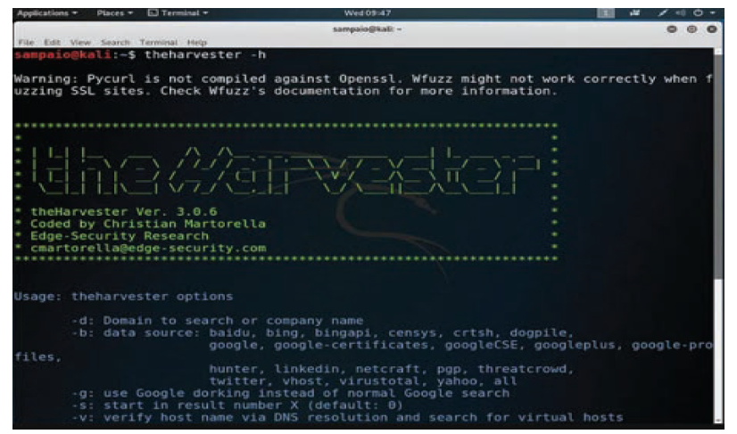
The Harvester: Profiling Digital Identities
Email and Contact Discovery: Find email addresses and employee names associated with a target domain.
Subdomain Identification: Discover subdomains to understand the scope of an investigation.
Host Location: Identify hosts linked to a domain, aiding in evidence location.
Social Media Profiling: Locate social media profiles related to the target.
Data Compilation: Generate a consolidated report for efficient analysis.
Source Verification: Crosscheck and verify data from publicly available sources
Evidence Collection: Identify potential digital evidence sources.
Digital Footprint Analysis: Build a profile of the target's online presence.

Slide 87
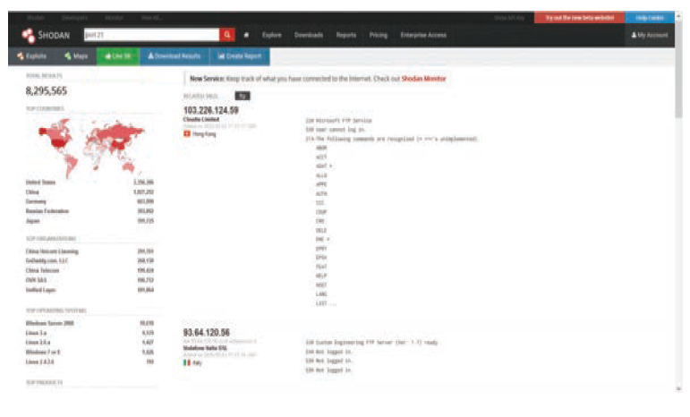
Shadon: Uncovering Vulnerabilities
Identifying Vulnerable Devices: Shodan can identify internetconnected devices with open ports, highlighting potential security vulnerabilities.
Banner Information:It provides banner information for open ports, detailing application and version details for further analysis.
Network Reconnaissance: Investigators can use Shodan for network reconnaissance, gathering data like IP addresses and domains.
Device profiling: Shodan enables the generation of profiles for internetconnected devices, including operating system and location, aiding in attack surface examination.
Vulnerability Assessment: Shodan helps in identifying machines running outdated or known vulnerable software, aiding investigators in prioritizing analysis tasks.
Historical Information: Shodan offers historical data to monitor changes in a device's configuration and security posture over time, assisting in understanding the development of security incidents.
Analysis of IoT Devices: Shodan is useful for locating and examining IoT devices, which are often vulnerable. Investigators can evaluate the security of IoT devices connected to a network.
Alerts and Monitoring: Shodan provides alerting tools for monitoring changes or newly discovered vulnerabilities in devices, services, or IP addresses, aiding in early detection of security issues.
Evidence Gathering: By identifying devices that may have been hacked or used in cyberattacks, Shodan helps investigators locate potential sources of digital evidence.

Slide 88
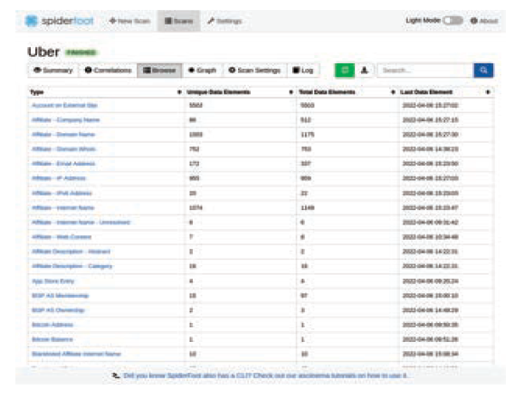
Spider Foot: Comprehensive Data Gathering
Data Collection: SpiderFoot gathers information from various sources like search engines, openaccess databases, and social media, aiding investigators in compiling data about a target entity.
Entity Profiling: Investigators can profile entities by aggregating data about them, such as email addresses, domain names, and IP addresses, to build a comprehensive understanding of the target's online presence.
Threat Intelligence: SpiderFoot searches threat intelligence feeds and databases for indicators of compromise (IoCs) related to a target, helping to identify potential security breaches.
Geolocation Information: SpiderFoot retrieves geolocation information related to IP addresses and domains, allowing investigators to track the physical location of servers or equipment connected to the investigation.
Vulnerability Scanning: The tool can find known vulnerabilities in target entities, aiding in understanding potential attack vectors and security flaws.
Historical Information: SpiderFoot offers historical information, enabling investigators to monitor changes to entities over time, which can be useful in understanding changes in a target's online presence.
Data Correlation: SpiderFoot can combine data from multiple sources to identify relationships and trends that may not be apparent when looking at the data separately, providing a more comprehensive picture of the situation.
Dark Web Scanning: The tool searches for mentions of the target on the dark web, providing insights into potential illicit activities.
Collaboration: SpiderFoot supports teamwork among investigators working on the same case, facilitating collaboration and information sharing.

Slide 89
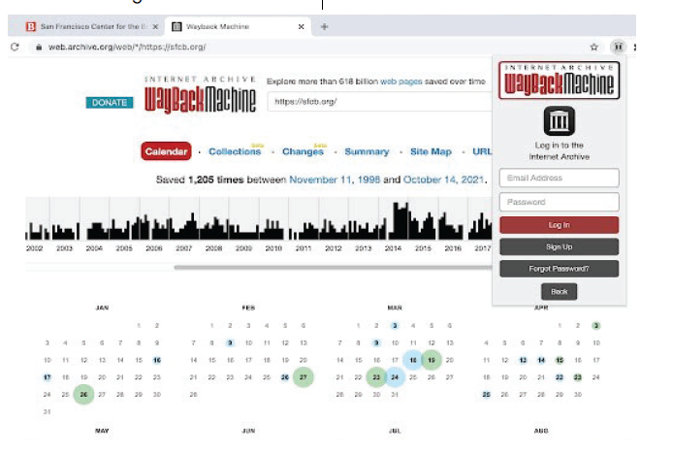
Wayback Machine
Primary Applications are:
Website History: The Wayback Machine allows users to view past versions of websites and web pages, providing a historical record of site evolution.
Research: Researchers and scholars use it to study changes in web content, track trends, and access historical data for academic purposes.
Content Recovery: Users can retrieve deleted or altered content from the internet, making it valuable for content recovery.
Content Verification: It helps verify the authenticity and accuracy of web content by comparing current versions with archived snapshots.
Historical References: Journalists and writers use it to provide historical references and context when reporting on events or trends.
Legal and Copyright Issues: It can serve as evidence in legal proceedings, intellectual property disputes, or cases involving online content.
Website Maintenance: Web developers and site owners use it to view previous versions of their websites and ensure they are functioning correctly.
Digital Forensics: In digital forensics investigations, it can be used to retrieve and verify historical web data as evidence.
Educational Purposes: Educators use it to teach students about the evolution of the internet and the importance of preserving web history.
Recreating Lost Websites: The Wayback Machine can assist in recreating websites that are no longer live on the internet.

Slide 90
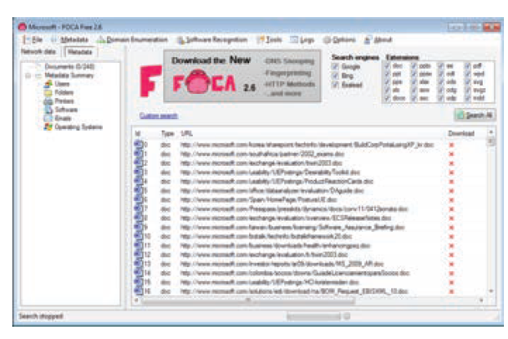
Fingerprinting Organisations with Collected Archives(FOCA)
Helpful in:
Metadata Analysis: Extract metadata from documents for authorship and creation date verification.
Document Version Tracking: Reconstruct document histories and track changes over time.
Geolocation Information: Extract and use geolocation data embedded in documents.
Email Address Extraction: Identify communication channels and contacts related to the case.
Network Enumeration: Discover network shares and repositories containing sensitive documents.
Organizational Profiling: Create profiles of organizations using document metadata.
Keyword and Content Analysis: Assist in identifying relevant files and content for investigation.
Vulnerability Assessment: Identify potentially vulnerable files and documents.
Evidence Collection: Locate and collect digital evidence from documents and files.
Historical Analysis: Analyze metadata changes to understand document repository evolution.
Security Auditing: Assess security posture by flagging documents with sensitive metadata to improve data security.

Slide 91
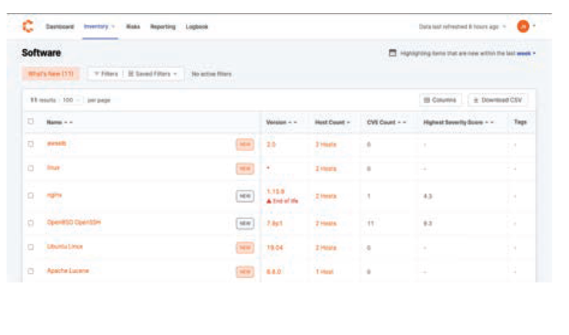
Censys
Can be applied as:
Asset Discovery: Censys can find everything connected to a target IP address or domain, aiding in creating an inventory of resources.
Vulnerability Assessment: It can find well-known flaws in services and products connected to networks, helping understand potential attack vectors and security flaws.
Historical Information: Censys offers historical information on devices and services, aiding in determining when an incident took place or when assets were compromised.
Indicators of Compromise (IoC) Identification: Investigators can search Censys for IoCs, such as malicious IP addresses or domains, aiding in locating an attack's origin or other compromised assets.
SSL/TLS Certificate Analysis: It can examine SSL/TLS certificates connected to a target, aiding in locating safe services, understanding encryption procedures, and recognizing potential security flaws.
Network Mapping: Censys facilitates mapping a target organization's or entity's network infrastructure, including finding open ports, services, and subdomains on various devices.

Slide 92
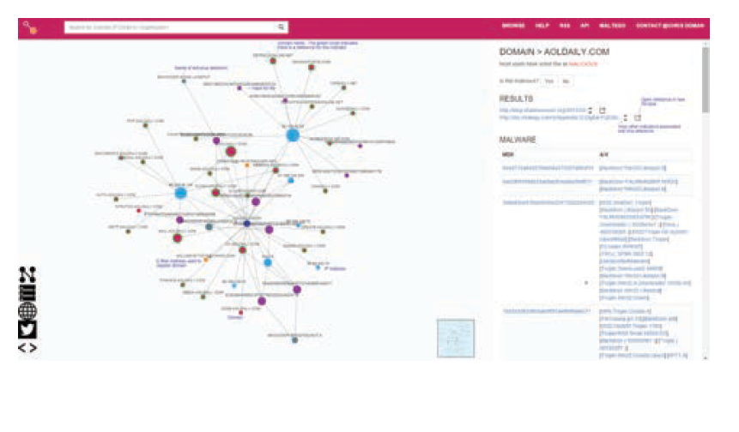
ThreatCrowd
Helps in:
Data Aggregation: Collects threat data from multiple sources.
IoC Search: Helps find indicators of compromise (IoCs) like IP addresses and domains.
Malware Analysis: Provides insights into malware behavior and patterns.
Domain and IP Analysis: Analyzes reputation and history of websites and IPs.
Historical Data: Offers historical insights into threat evolution.
Phishing and Malicious URLs: Identifies and tracks phishing and malicious sites.
Threat Intelligence Sharing: Enables collaboration with the security community.
Alerts and Monitoring: Provides real-time threat alerts.
Digital Footprint Analysis: Tracks online presence of individuals and organizations.
Incident Response: Aids in incident scope identification and infrastructure tracking.
Threat Assessment: Assists in evaluating threat severity and impact.
Security Awareness: Educates security teams about emerging threats.

Slide 93
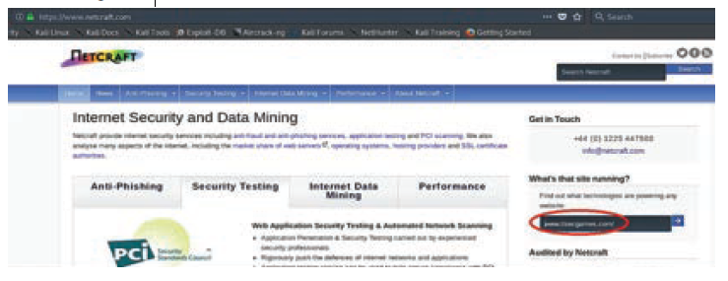
Netcraft
Utilises in:
Phishing Site Detection: Netcraft keeps an extensive database of recognized phishing sites, which is useful for recognizing and validating phishing sites in online fraud investigations.
Malicious Website Analysis: Netcraft's tools can be used to examine websites for indications of malicious behavior, such as malware presence or shady redirects.
Site Reputation Analysis: Netcraft provides data on the reputation of websites and hosting infrastructure, aiding in determining the trustworthiness of websites and identifying potentially compromised servers.
SSL Certificate Analysis: Investigators can use Netcraft to analyze SSL/TLS certificates associated with websites, helping in understanding encryption procedures and confirming website legitimacy.
Historical Information: Netcraft maintains records on website infrastructure over time, which can be useful for monitoring changes and understanding how web content evolves.
DDoS Attack Monitoring: Netcraft offers tools to track Distributed Denial of Service (DDoS) attacks and identify targeted websites, aiding in cyberattack investigations and mitigation.
Hosting Provider Identification: Netcraft can identify data centers and hosting companies connected to specific IP addresses and websites, helping trace the source of malicious activity.
Email Tracking: Netcraft's services can monitor domains and email senders, useful in identifying the origin of phishing emails and other email-based cyber risks.

Slide 94
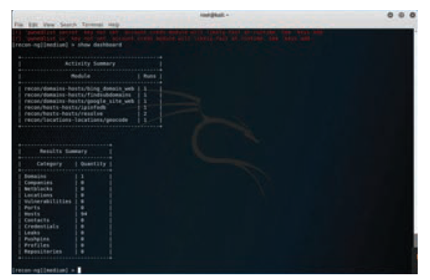
Reco-ng
Used in:
Passive Reconnaissance: Can collect publicly available information about a target, including domain names, subdomains, email addresses, and employee names, aiding in understanding the digital footprint of a target entity.
Open-Source Intelligence (OSINT) Gathering: The framework integrates with various OSINT sources and modules, allowing investigators to gather data from social media, search engines, and other publicly accessible repositories, aiding in profiling individuals or organizations under investigation.
Metadata Collection: Can retrieve metadata from web pages and documents, useful in verifying document authenticity, tracking document origins, and understanding document histories.
Vulnerability Scanning: Can identify potential security weaknesses in a target's online presence, aiding in assessing the attack surface and identifying areas of potential vulnerability.
Link Analysis: Can perform link analysis, helping investigators identify relationships and connections between different pieces of information, aiding in uncovering patterns and associations in a digital forensics case.

Slide 95
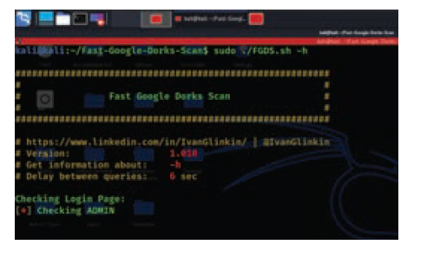
Google Dorks
Locating Sensitive Information: Google Dorks can help locate confidential documents, databases, login credentials, and other sensitive information that may have been exposed inadvertently.
Identifying Vulnerabilities: Google Dorks can search for websites and systems with vulnerabilities or misconfigurations, aiding in understanding breaches or identifying security weaknesses.
Gathering Evidence: Google Dorks can search for specific keywords or file types related to a case, such as documents or emails containing evidence of a crime.
Tracking Online Activity: Google Dorks can trace a suspect's online activity by searching for usernames, email addresses, or other identifiers.
Detecting Malware and Malicious Websites: Google Dorks can identify websites hosting malware or indicators of compromise related to cyberattacks.
Identifying Fake or Counterfeit Goods: Google Dorks can locate websites selling counterfeit goods or distributing copyrighted material without permission.
Reconstructing Historical Data: Google Dorks can reconstruct historical data by searching for cached or archived web pages.
Mapping Online Footprints: Google Dorks can map a person's or organization's online presence, including social media profiles, blog posts, and forum comments.

Slide 96
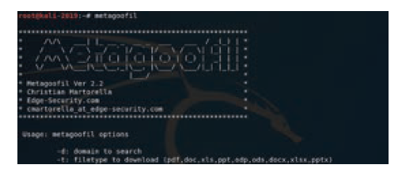
Metagoofil
Uses
Collecting File Metadata: Extracts metadata like author names, timestamps, document titles, and revision histories from various file formats, aiding in document analysis.
Gathering Evidence: To retrieve crucial information for building cases, such as linking a document's metadata to specific individuals or entities.
Tracking Document Ownership: Document metadata helps trace file ownership and history, assisting in identifying the source of leaked or confidential information.
Determining File Origins: Helps to establish the source or origin of files found on suspect devices or networks, aiding in establishing the chain of custody.
Assessing File Authenticity: Metadata verification, including timestamps and creation dates, helps investigators determine if a file has been tampered with or is authentic.
Locating Hidden Information: Can uncover hidden or deleted information in file metadata that may be relevant to investigations.
Mapping Relationships: Reveals relationships between individuals, organizations, or files, aiding in establishing connections between different pieces of evidence.
Identifying Insider Threats: Helps to identify employees or individuals responsible for leaking sensitive information by analyzing metadata associated with leaked documents.
Reconstructing File Histories: In incidents involving data theft or leakage, Metagoofil reconstructs file histories, including creation, modification, and access times.

Slide 97
Enhancing Investigations with OSINT Tools
Digital Footprint Analysis: OSINT tools construct detailed digital footprints by amalgamating information from various online sources, shedding light on behavioral patterns, associations, and potential motivations.
Social Media Profiling: OSINT tools delve into social media platforms, analyzing profiles, posts, and interactions to uncover insights into individuals' interests, relationships, and potential links to cybercrimes.
Email Header Examination: OSINT tools enable investigators to analyze email headers, tracing the origin, path, and authenticity of emails, crucial for verifying their legitimacy and contextual relevance.

Slide 98
Ethical and Legal Considerations in OSINT
Respecting Privacy in OSINT Activities: Ethical OSINT practices prioritize privacy rights, ensuring responsible information gathering that avoids intrusive or unethical data collection methods.
Adhering to Legal Frameworks: Ethical OSINT practices include strict adherence to legal frameworks and regulations governing data protection, online privacy, and data collection, ensuring compliance across diverse jurisdictions to prevent legal issues and maintain the admissibility of evidence.

Slide 99
Preparing for the Future: OSINT In An Evolving Cyber Landscape
Adapting to Technological Advancements: In a rapidly changing digital landscape, OSINT tools must be adaptable to new technologies, platforms, and threats to remain effective. Investigators must stay updated and ready to use emerging tools and techniques to enhance their investigative capabilities.
Lifelong Learning and Skill Development: The field of cyber forensics is constantly evolving, requiring ongoing learning. Lifelong learning involves participating in workshops, engaging in online communities, and exploring new tools and methods to remain relevant and effective in OSINT for cyber forensics.

Slide 100
Digital Evidence
Any electronic data that can be used to prove or disprove a fact in a legal proceeding.
Can include emails, text messages, financial records, and other electronic documents.

Slide 101
Usage of Digital Evidence
Trace the movement of money
Identify patterns of suspicious activity
Recover deleted files
Establish a timeline of events
Identify the perpetrators of fraud

Slide 102
Specialized Skills In Modern Financial Investigations
Strong financial expertise
Proficiency in digital forensics tools
Knowledge of relevant laws and regulations
Understanding of fraudsters' behavior
Cultural awareness for contextual understanding

Slide 103



THANK YOU

