Slide 1
UNIT-4: DATA ANALYTICS USING CAAT
Mastering Microsoft Excel for Financial Data Management and Analysis

Slide 2
Agenda
Introduction to Microsoft Excel and Data Formatting
Learning Objectives
The Significance of Data Formatting
Historical Perspective and Relevance of Excel in Data Presentation
Key Topics Overview
Excel's Utility for Chartered Accountants
Introduction to Microsoft Excel
Excel's Importance in Accounting, Finance, and Data Analysis
Data Organization in Excel - An Example
Understanding Excel Versions and Platforms
Compatibility Considerations Across Excel Versions
Navigating the Excel Interface

Slide 3
INTRODUCTION TO MICROSOFT EXCEL AND DATA FORMATTING

Slide 4
Learning Objectives
Understanding Excel's Role
Versions and Compatibility
Excel Interface Components
Navigation Skills
Effective Selection Techniques
Data Entry Methods
Editing and Deleting Data
AutoFill and Flash Fill
Data Formatting Importance
Formatting Options and Styles
Conditional Formatting Rules
Data Types and Calculations

Slide 5
The Significance of Data Formatting
Essential Excel Management
Focus on data formats and layouts for financial information
Accurate data representation and appealing presentation
Techniques for Structured Worksheets
Ensuring well-organized data for ease of comprehension
Adherence to formal standards in data formatting
Facilitating Analysis
Formatted data aids in efficient analysis and decision-making

Slide 6
Historical Perspective and Relevance of Excel in Data Presentation
Early Spreadsheet Software Focus
Primarily centered around raw data input and calculations
Excel's Pioneering Role
Introduced robust formatting options for data customization
Current Importance of Data Presentation
Clear, structured presentation is crucial in the information era

Slide 7
Key Topics Overview
Number Formatting Precision
Crucial for accurate financial data representation
Date and Time Formatting
Essential for accounting accuracy
Conditional Formatting
Visualizes data trends and outliers
Cell Alignment and Orientation
Enhances presentation through merging and centering
Application of Cell Styles and Themes
Ensures consistent formatting across spreadsheets
Formatting Columns and Rows
Borders and Gridlines Usage

Slide 8
EXCEL'S UTILITY FOR CHARTERED ACCOUNTANTS

Slide 9
Excel's Utility for Chartered Accountants
Essential Formatting Skills
Crucial for creating accurate and comprehensible financial reports.
Enhances the clarity of key insights in audits and statements.
Impact on Professional Practice
Consistent formatting elevates the standard of reports.
Reflects positively on the CA's expertise and reliability.
Stakeholder Communication
Formatted reports facilitate better understanding among stakeholders.
Professional Aesthetics
A well-formatted report underscores the CA's attention to detail.
Mastering Excel
A vital skill for financial statement preparation and presentations.

Slide 10
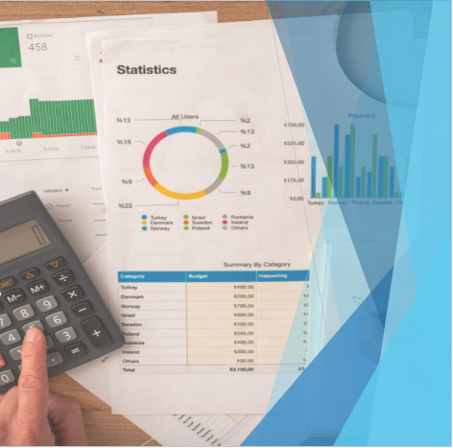
EXCEL'S IMPORTANCE IN ACCOUNTING, FINANCE, AND DATA ANALYSIS

Slide 11
Introduction to Microsoft Excel
Understanding Microsoft Excel
A spreadsheet application for data organization and analysis
Features a structured grid with cells for data storage
Utility for Financial Professionals
Crucial for managing numerical and financial data
Enables data manipulation and evaluation

Slide 12
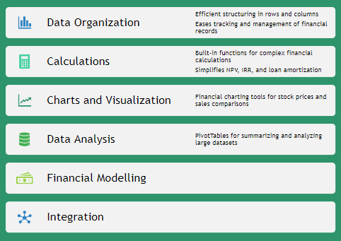
Excel's Importance in Accounting, Finance, and Data Analysis

Slide 13
COMPATIBILITY CONSIDERATIONS ACROSS EXCEL VERSIONS

Slide 14
Understanding Excel Versions and Platforms

Slide 15
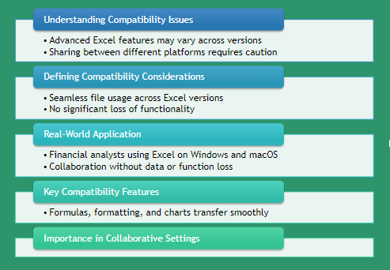
Compatibility Considerations Across Excel Versions

Slide 16
Navigating the Excel Interface

Slide 17
Navigating the Excel Interface: Worksheets and Cells

Slide 18
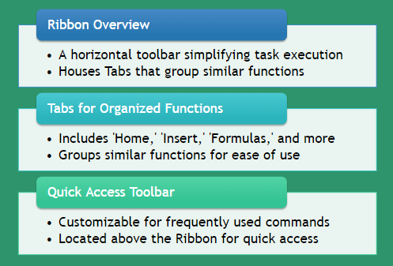
Navigating the Excel Interface: Ribbon, Tabs, and Quick Access Toolbar

Slide 19
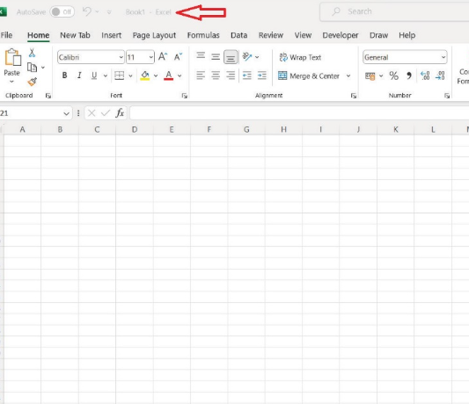
Excel Interface - Visual Guide
Figure: Basic layout of MS Excel
Above is the example of home screen of Excel with multiple sheets added to the default workbook named “ Book1”.
Figure: Basic layout of MS Excel

Slide 20
Navigating Excel: Starting Excel and Opening Workbooks
Key Features of the Excel Start Screen
Feature | Description
Recent Documents | Displays a list of recently opened workbooks for quick access
Templates | Offers various templates for creating new workbooks
New Workbook Creation | Option to start a new workbook from scratch or a template
Initiating Microsoft Excel
For Windows: Use the Start button and search for 'Excel'
For macOS: Find Excel in the Applications folder
Using the Excel Start Screen
Access recent documents and templates
Create new workbooks from scratch or templates

Slide 21
NAVIGATING EXCEL: SCROLLING AND ZOOMING TECHNIQUES
Scrolling Techniques
Use scroll bars to navigate through worksheets
Scroll wheel on mouse allows vertical movement
Zooming Techniques
Adjust worksheet view with zoom slider
Ideal for managing large datasets

Slide 22
Navigating Excel: Switching Between Worksheets and Workbooks

Slide 23
Navigating Excel: Selecting Cells, Ranges, and Columns
Selecting Individual Cells
Click directly on the cell to highlight it.
Choosing a Range of Cells
Click and drag to cover the desired cells.
Selecting Entire Columns
Click the column header, such as 'A' for the first column.
Selecting Non-Adjacent Cells/Ranges
Use 'Ctrl' (Windows) or 'Command' (macOS) while selecting each cell or range.

Slide 24
DATA ENTRY AND EDITING IN EXCEL

Slide 25
DATA ENTRY AND EDITING IN EXCEL: METHODS OF DATA ENTRY
Manual Data Entry
Direct typing into Excel cells
Useful for individual financial transactions
Copy-Paste Method
Copying from external sources like PDFs
Ensures alignment with Excel's layout
Data Import Options
Importing from CSV files or databases
Ideal for large datasets or external systems

Slide 26
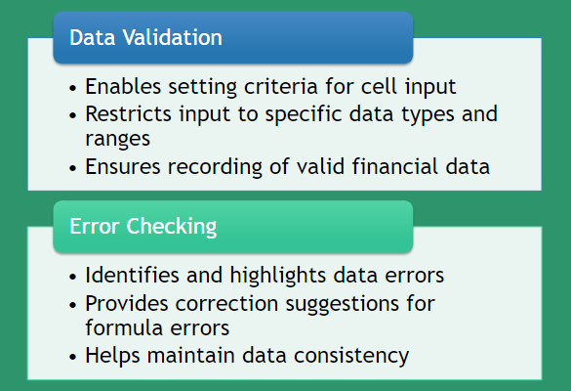
Data Entry and Editing in Excel: Data Validation and Error Checking

Slide 27
Data Entry and Editing in Excel: Editing and Deleting Data
Editing Data in Cells
Double-click the desired cell
Modify the data as needed
Press “Enter” to save changes
Deleting Data
Select the cell, row, or column
Press the “Delete” key to remove

Slide 28
AUTOFILL AND FLASH FILL FOR EFFICIENT DATA MANAGEMENT

Slide 29
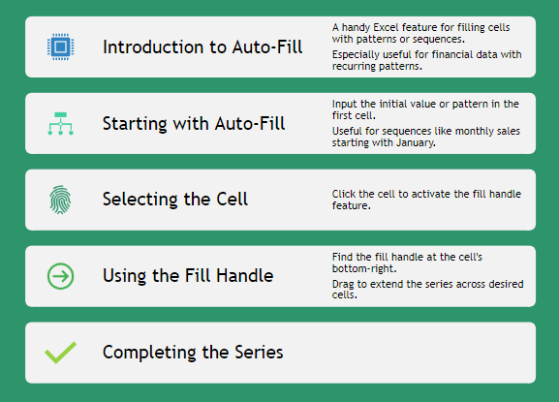
AutoFill and Flash Fill for Efficient Data Management: Utilizing AutoFill for Series and Patterns

Slide 30
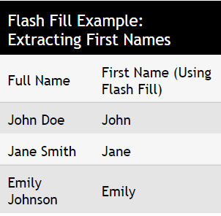
AutoFill and Flash Fill for Efficient Data Management: Introduction to Flash Fill for Data Transformation
Introduction to Flash Fill
An automated tool for data transformations in Excel
Useful for financial data extraction and reformatting
Step-by-Step Guide
Enter the desired pattern for data transformation
Activate Flash Fill with shortcuts or through the Ribbon
Watch as Excel applies the pattern to your data
Practical Example
Extract first names from a list of full names using Flash Fill

Slide 31
Data Formatting for Financial Analysis

Slide 32
Data Formatting for Financial Analysis: Importance of Data Formatting
Significance of Proper Data Formatting
Boosts readability and interpretability in financial analysis
Benefits of Clear Data Presentation
Organized data aids stakeholder comprehension and insight extraction
Highlighting Critical Data Points
Draws focus to vital information and trends

Slide 33
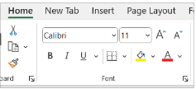
Data Formatting for Financial Analysis: Formatting Options in Excel
Font Customization
Select readable fonts for clarity
Font group adjustments for text appearance
Number Formats
Display numbers with precision
Includes currency, decimals, symbols
Alignment for Readability
Position data neatly within cells
Options for text alignment and orientation
Cell Fill for Emphasis
Use background colors to highlight data
Create visual distinctions in cells

Slide 34
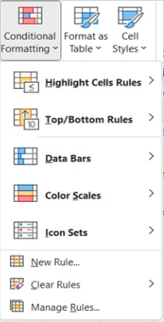
Data Formatting for Financial Analysis: Conditional Formatting
Select the Data Range
Choose cells for conditional formatting application
Access Conditional Formatting Options
Find in 'Home' tab on the Ribbon
Set the Rule
Decide on rule type (e.g., highlight cells above a value)
Define the Rule Parameters
Specify criteria and formatting details
Example Use Case
Highlight sales figures above a threshold

Slide 35
UNDERSTANDING DATA TYPES AND CELL REFERENCES: DIFFERENTIATING DATA TYPES
Text Data
Includes non-numeric and non-date information
Examples: names, addresses, descriptions
Numeric Data
Used for mathematical operations
Types: whole numbers, decimals, percentages
Date Data
Specific type of numeric data for calendar dates
Other Data Types
Specialized types like currency, percentages
Boolean and error values also included

Slide 36
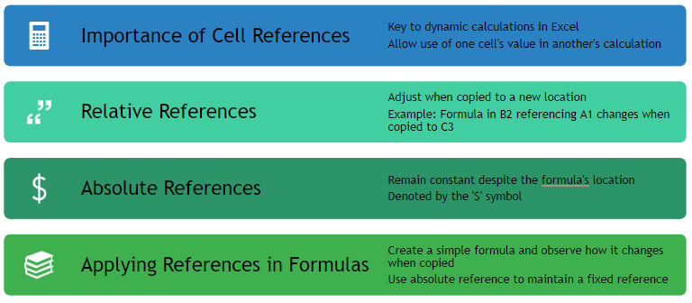
Understanding Data Types and Cell References: Cell References

Slide 37
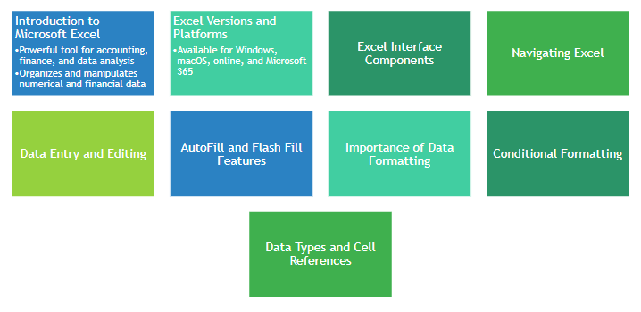
Summary of Microsoft Excel and Data Formatting

Slide 38
Mastering Excel for Financial Analysis
Formatting, Tables, and Formulas

Slide 39
Agenda
Title Slide
Introduction to Excel Tables
Utility of Tables for Chartered Accountants
Formatting Steps and Image
Merging and Centering Cells
Using Borders and Gridlines
Adding Data to a Table
Resizing and Formatting Tables
Formulas in Excel
Summary of Chapter 2
Historical Perspective and Relevance of Data Consolidation
Totalling Across Multiple Sheets

Slide 40
Learning Objectives - Chapter 2
Accurate Data Representation in Finance
Understanding its importance in financial spreadsheets
Number Formatting Skills
Applying formats for currency, percentages, and decimals
Date and Time Precision
Conditional Formatting for Visualization
Enhancing Readability with Alignment
Creating Professional Headers
Consistent Cell Styles and Themes
Optimizing Data Presentation
Using Borders and Gridlines
Efficient Data Management with Tables

Slide 41
Introduction to Excel Tables
Introduction to Excel Tables
Essential for organizing and analyzing data
Crucial for financial and accounting tasks
Creating Tables in Excel
Structured information with defined headers
Intrinsic functionalities for data manipulation
Managing Tables Efficiently
Guidance through the process
Enhances spreadsheet tasks

Slide 42
Historical Perspective and Relevance of Tables

Slide 43
Topics at-a-Glance for Excel Tables
Introduction to Table Creation
Structured approach to data management
Adding Data to Tables
Efficient data entry methods
Filtering and Sorting Data
Enhanced data navigation and organization
Integrating Total Rows
Simplified calculations within tables
Resizing and Formatting Tables
Optimizing data presentation
Converting Tables to Ranges
Flexibility in data management

Slide 44
Utility of Tables for Chartered Accountants

Slide 45
Formatting in Excel
Essential Excel Formatting Techniques
Focus on financial data accuracy and presentation
Adherence to formal standards for better analysis
Worksheet Structuring
Organize data for easy comprehension
Implement formal formatting guidelines
Data Representation
Ensure data is visually appealing
Facilitate easier data analysis

Slide 46
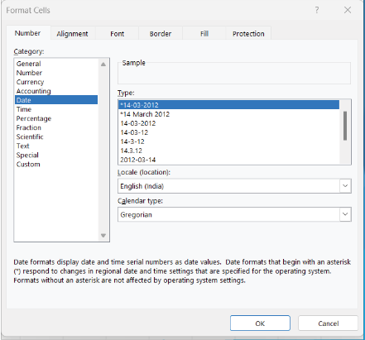
Date and Time Formatting: Formatting Steps and Image
Select Cells for Formatting
Choose the specific cell or range of cells for date and time formatting.
Accessing Format Options
Navigate to the 'Home' tab to find formatting tools.
Number Format Dropdown
Use the dropdown to pick formats like 'Short Date' or 'Long Date.'
Custom Formatting
For uniformity, apply custom formats such as 'yyyy-mm-dd' for dates.

Slide 47
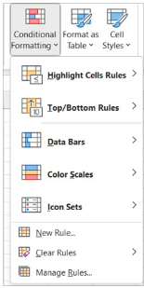
Conditional Formatting
Intelligent Data Visualization
Automatically highlights cells based on criteria
Facilitates quick insight discovery
Applying Conditional Formatting
Select desired cell range
Use 'Home' tab and 'Conditional Formatting' options
Practical Uses
Color differentiation for threshold values
Color scales and data bars for comparison

Slide 48
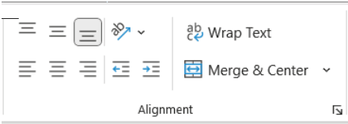
Cell Alignment and Orientation
Selecting Cells for Alignment
Choose the cell or range to align.
Alignment Options
Access 'Alignment' options in the 'Home' tab.
Align text left, center, or right as needed.
Text Orientation for Fit
Use the 'Orientation' dropdown to rotate text.
Select an angle for better text fit within cells.

Slide 49
Merging and Centering Cells
Selecting Cells for Merging
Choose the specific cells you want to merge.
Utilizing the 'Home' Tab
Navigate to the 'Home' tab for merging options.
Merging & Centering Dropdown
Click on 'Merge & Center' and select your desired merge type.
Centering Content
Ensure the content of the merged cell is centered for a clean look.

Slide 50
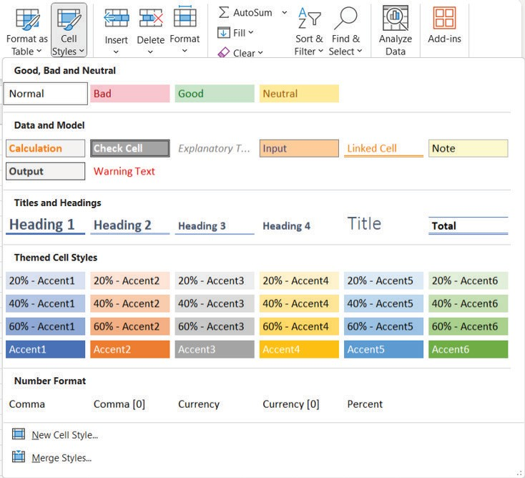
Cell Styles and Themes
Importance of Consistent Formatting
Essential for professional appearance
Cell styles ensure systematic uniformity
Applying Cell Styles
Select cells or range for styling
Use 'Home' tab in the toolbar
Choose from 'Cell Styles' gallery

Slide 51
Formatting Columns and Rows
Adjusting Column and Row Dimensions
Drag column borders to fit content width
Modify row height by hovering and adjusting at the boundary
Enhancing Spreadsheet Readability
Optimize column widths for content accommodation
Adjust row heights to improve content visibility
Autofit Columns for Content Length
Use the 'Format' menu in the 'Home' tab for autofitting

Slide 52
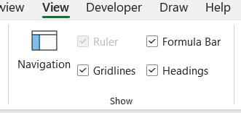
Using Borders and Gridlines
Selecting Cells for Border Formatting
Choose cells to highlight with borders
Access 'Home' tab for formatting options
Applying Borders to Cells
Use 'Borders' dropdown for style selection
Gridlines for Cell Differentiation
Toggle gridlines in 'View' tab for clarity

Slide 53
Creating and Managing Tables
Excel Table Creation and Management
Enhanced Financial and Accounting Tasks
Essential for organizing and analyzing data
Structured information with defined headers
Intrinsic functionalities for data manipulation
Guidance for adept table management in spreadsheets

Slide 54
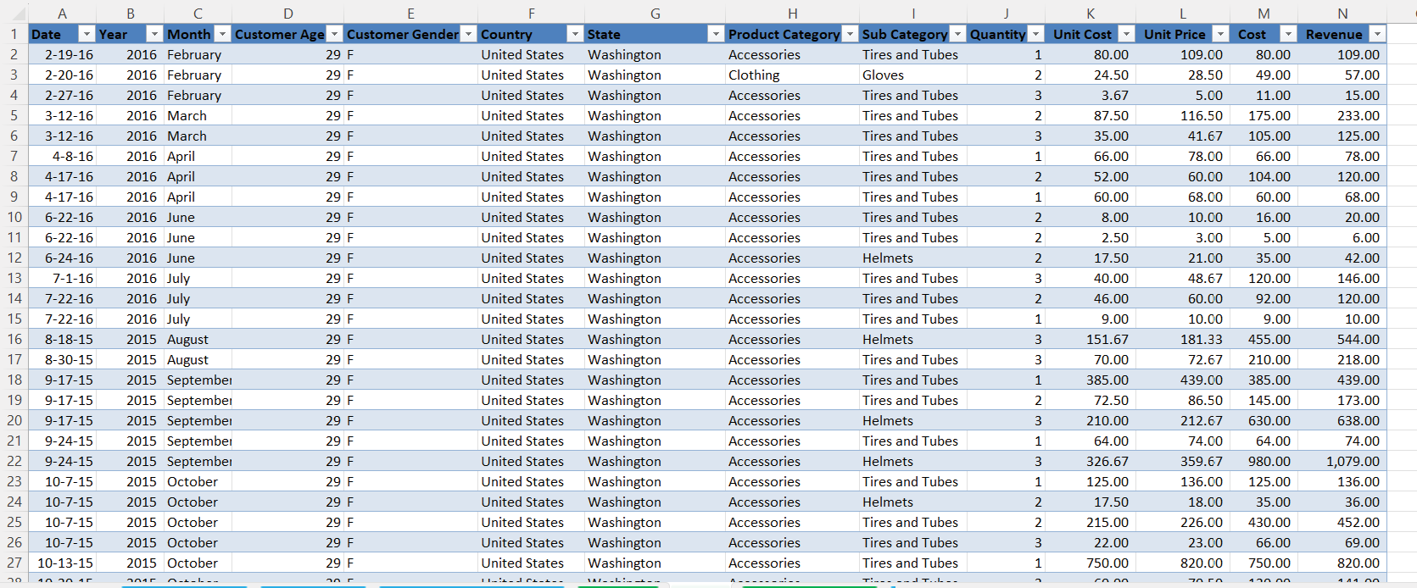
Creating a Table: Image and Explanation

Slide 55
Adding Data to a Table
Seamless Data Addition Process
Initiate by typing in the last table row
Automatic table expansion for new data
Step-by-Step Data Entry
Navigate to the table's end
Begin typing to include a new row

Slide 56
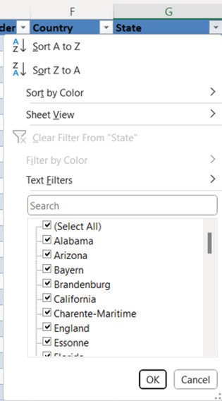
Filtering and Sorting in Tables
Essential Data Analysis Tools
Tables with filtering and sorting capabilities
Facilitate extraction of insights
Filtering Data
Use dropdown arrow on column header
Select criteria to refine data display
Sorting Data
Click sort icon on column header
Arrange data in desired order

Slide 57
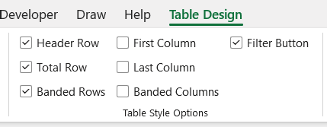
Total Row in Tables
Selecting the Table
Activate the table to enable total row addition
Accessing Table Design
Navigate to the 'Table Design' tab for options
Enabling Total Row
Tick the 'Total Row' checkbox to add a new row
Inserting Calculations
Click the desired cell in the Total Row for calculations
Choosing Calculations
Select from sum, average, etc., via the dropdown

Slide 58
Resizing and Formatting Tables
Adjusting Table Dimensions
Click on the table to access resize handles.
Easily modify the table size to fit your needs.
Enhancing Table Appearance
Utilize the 'Table Design' tab for style options.
Choose from a variety of styles to improve readability.
Step-by-Step Formatting Process
Select the table and adjust size with handles.
Apply styles from the 'Table Design' tab.

Slide 59
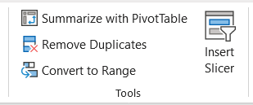
Converting Tables to a Range
Excel Table Conversion Flexibility
Capability to revert a table back to a range format
Step-by-Step Conversion Process
Select the table to initiate conversion
Access 'Table Design' tab for tools
Use 'Convert to Range' button for action
Confirm conversion through prompt

Slide 60
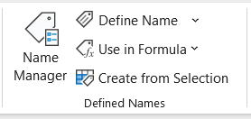
Named Ranges Within Tables
Enhancing Data Analysis
Named ranges streamline complex formulas
Facilitate efficient data analysis and calculations
Creating a Named Range
Select cell range for naming
Use 'Formulas' tab and 'Create from Selection'
Opt for 'Top row' with headers
Confirm with 'OK' to establish named range
Figure Reference
Defined names group illustration

Slide 61
Formulas in Excel
Essential Excel Proficiency
Formulas and functions are crucial for accounting and finance.
Streamlining Data Tasks
Key operations enhance effective data processing.

Slide 62
Basic Arithmetic Operations
Introduction to Basic Arithmetic in Excel
Essential for calculations within formulas
Begin formulas with equals sign (=)
Core Mathematical Computations
Addition (+) for summing values
Subtraction (-) to deduct values
Multiplication (*) for product calculation
Division (/) to divide values

Slide 63
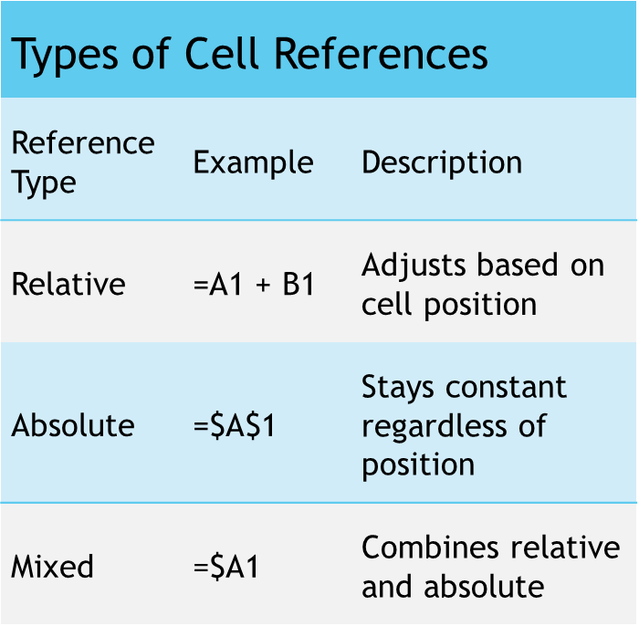
Cell References in Formulas
Consistent Calculations with Cell References
Use A1, B2 for specific cells
Relative references like A1 adjust when copied
Absolute references like $A$1 remain fixed
Types of Cell References
Relative References: =A1 + B1
Absolute References: =$A$1
Mixed References: =$A1
Dynamic Calculations in Formulas
Referencing cells allows for automatic adjustments
Mixed references combine relative and absolute aspects

Slide 64
Summary of Chapter 2
Number Formatting
Essential for accurate financial data representation
Includes currency, percentages, and decimals
Date and Time Formatting
Crucial for precise accounting records
Detailed guidance on formatting
Conditional Formatting
Cell Alignment and Orientation
Merging and Centering Cells
Cell Styles and Themes
Formatting Columns and Rows
Using Borders and Gridlines

Slide 65
Learning Objectives - Chapter 3
Comprehensive Data Totalling
Use cell references to total data from multiple sheets.
Excel's Consolidate Tool
Combine data from various sheets for in-depth financial analysis.
Mathematical & Statistical Functions
Learn functions like SUM, AVERAGE, MIN, and MAX.
Text Manipulation Functions
Master CONCATENATE, LEFT, RIGHT, and LEN for text data analysis.
Date & Time Calculations
Handle functions like TODAY, NOW, EOMONTH, DATEDIF.
Specialized Financial Functions
Practical Application

Slide 66
Introduction to Data Consolidation
Essential Financial Analysis Techniques
Consolidation of data from multiple sources is key.
Excel is a vital tool for financial professionals.
Streamlining Data Processes
Excel techniques enhance decision-making.
Professionals gain insights from diverse datasets.
Module Focus
Exploration of totalling across sheets and key functions.
Indispensable for analysts and accountants.

Slide 67
Historical Perspective and Relevance of Data Consolidation
Historical Background of Data Consolidation
Originated from traditional accounting practices with ledgers and manual records.
Required extensive efforts to compile data from different sectors.
Transformation with Spreadsheet Software
Excel introduced in the late 20th century, changing financial reporting.
Enhanced efficiency and accuracy in data analysis.
Modern-Day Economic Implications
Globalized economy demands data consolidation from varied sources.
Crucial for informed decision-making in organizations worldwide.

Slide 68
TOPICS AT-A-GLANCE FOR DATA CONSOLIDATION
Totalling Across Multiple Sheets
Summing data using cell references
Essential for financial professionals
Excel's Consolidation Function
Combines data from multiple sheets
Streamlines data management
Essential Financial Functions
Covers basic to specialized operations
Enables complex financial analyses

Slide 69
Utility for Chartered Accountants - Data Consolidation
Essential Techniques for Chartered Accountants
Consolidation of financial data crucial for audits and statements
Facilitates extraction of insights from large datasets
Impact on Decision-Making
Enables informed decisions for clients and organizations
Enhancing Accuracy and Efficiency
Streamlines complex calculations in financial analysis
Ensures precision in managing financial information
Professional Practice Benefits
Improves proficiency and effectiveness in accounting roles

Slide 70
Using Excel’s Consolidation Functionality
Select the Target Cell
Choose the cell for the total to appear
Navigate to the Data Tab
Find the 'Data' tab on the Ribbon
Utilize the Consolidate Option
Open the 'Consolidate' dialog box via the option
Define Range and Function
Select cell range and desired function (SUM, AVERAGE, etc.)
Identify Reference Sheets
Select sheets for data consolidation
Customize Settings
Execute Consolidation

Slide 71
Functions in Excel
Essential for Excel Proficiency
Key in accounting and finance for accurate calculations
Vast Library of Built-in Functions
From simple arithmetic to complex statistical analysis
Streamlined Calculations with Functions
Ensures accuracy and simplifies complex processes
Using Excel Functions
Start with '=' followed by function name and arguments in parentheses
Example: =SUM(A1:A10) to add values from A1 to A10
Press Enter to execute and display the result

Slide 72
Math and Statistical Functions
SUM Function
Adds up a range of values
Example: =SUM (A1:A10)
AVERAGE Function
Calculates the average of values
Example: =AVERAGE (B1:B10)
MIN and MAX Functions
Identify the smallest and largest values
Examples: =MIN (C1:C5), =MAX (C1:C5)
Function | Description | Example
SUM | Adds up a range of values | =SUM (A1:A10)
AVERAGE | Calculates the average of values | =AVERAGE (B1:B10)
MIN | Finds the smallest value | =MIN (C1:C5)
MAX | Finds the largest value | =MAX (C1:C5)

Slide 73
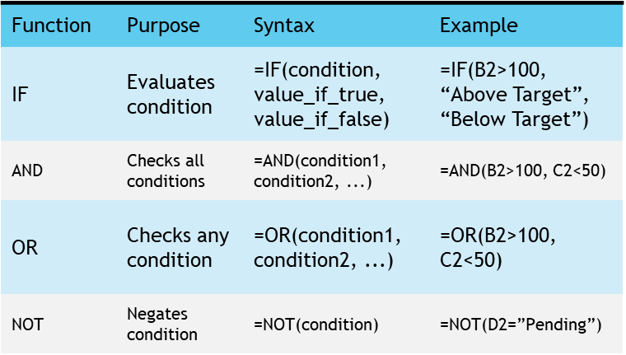
Logical Functions
Essential for Condition-Based Calculations
Automate decisions with specific criteria
IF Function: Decision-Making Tool
Returns values based on a true or false condition
Example: =IF(B2>100, “Above Target”, “Below Target”)
Combining Multiple Conditions
AND checks if all conditions are true
OR checks if any condition is true
NOT Function: Negating Conditions
Inverts the given condition's result
Example: =NOT(D2=”Pending”)

Slide 74
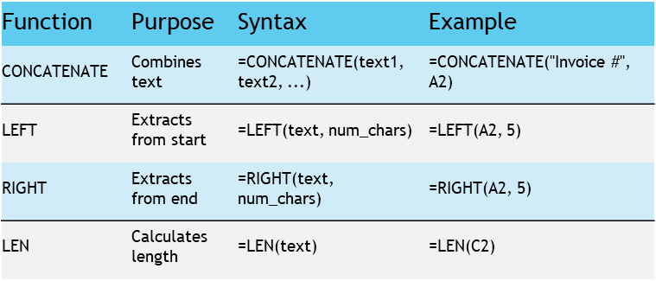
Text Functions
Text Function Utilities
Manipulate, extract, and analyze text data in financial tasks
CONCATENATE Function
Combines text from multiple cells
LEFT & RIGHT Functions
Extract specific characters from text ends
LEN Function
Calculates text string length

Slide 75
Date and Time Functions
TODAY and NOW Functions
Provide current date and time
Syntax for TODAY: =TODAY()
Syntax for NOW: =NOW()
EOMONTH Function
Calculates month-end date from a start date
Syntax: =EOMONTH(start_date, months)
Example: =EOMONTH(A2, 3)
DATEDIF Function
Computes difference between two dates
Syntax: =DATEDIF(start_date, end_date, unit)
Example: =DATEDIF(B2, C2, "d")

Slide 76
Financial Functions
PMT Function for Loan Payments
Calculates periodic payments with a given rate, number of periods, and present value.
FV Function for Investment Future Value
Computes the future value of regular investments over time at a specified rate.
NPV Function for Cash Flow Valuation
Determines the net present value of a series of cash flows at a given discount rate.

Slide 77
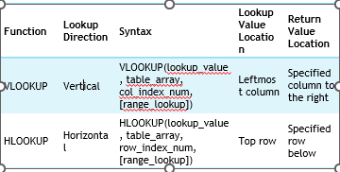
Lookup and Reference Functions
VLOOKUP Function
Searches for a value in the leftmost column
Returns a corresponding value from a specified column
HLOOKUP Function
Searches for a value in the top row
Returns a corresponding value from a specified row
INDEX & MATCH Functions
Provide flexible lookup capabilities

Slide 78
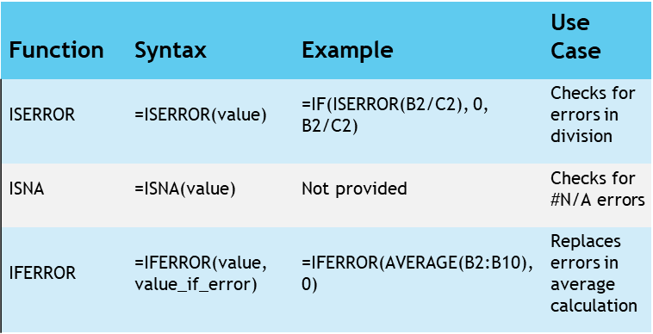
Error Handling Functions
Importance of Error Handling
Crucial for accurate financial calculations
Ensures reliability and precision in accounting
Error Checking Functions
ISERROR and ISNA identify formula errors
IFERROR replaces errors with alternative values
Function Syntax and Examples
ISERROR: =ISERROR(value)
ISNA: =ISNA(value)
IFERROR: =IFERROR(value, value_if_error)
Practical Usage
Example formulas demonstrate error handling in action

Slide 79
Mastering Excel Functions for Financial Analysis

Slide 80
Agenda
Title Slide
Historical Perspective and Relevance
SUMIF and COUNTIF Functions
COUNTIF Function
SUMIFS Function
COUNTIFS Function Example
Image
Utility for Chartered Accountants
LEN Function Example
SEARCH and SUBSTITUTE Functions
Creating Data Validation Rules
Configure Input Message and Error Alert

Slide 81
Overview: Introduction to Advanced Functions
Understanding Advanced Functions
Learn the purpose and usage of SUMIF, COUNTIF, SUMIFS, COUNTIFS
Calculating with SUMIF
Sum values based on a single condition
Counting with COUNTIF
Count cells meeting a specific condition
Multi-criteria Summing with SUMIFS
Sum values based on multiple conditions
Complex Counting with COUNTIFS
Count cells that meet multiple criteria

Slide 82
Overview: Learning Objectives
Understanding Advanced Excel Functions
Grasp the purpose and application of functions like SUMIF, COUNTIF, SUMIFS, and COUNTIFS.
Applying SUMIF
Calculate sums based on a single condition.
Utilizing COUNTIF
Count cells meeting a specific condition within a range.
Implementing SUMIFS
Sum values based on multiple criteria.
Applying COUNTIFS
Count cells that meet multiple conditions for complex data analysis.

Slide 83
Introduction to Advanced Functions
Key Excel Functions in Financial Analysis
SUMIF: Performs conditional sum calculations
COUNTIF: Counts cells that meet a specific condition
Advanced Data Aggregation
SUMIFS: Sums data based on multiple conditions
COUNTIFS: Counts cells matching multiple criteria
Enhancing Precision and Accuracy
Enables detailed financial calculations
Facilitates informed decision-making

Slide 84
Historical Perspective and Relevance
Transformation of Financial Analysis
Automated data extraction and summarization
Reduced manual effort and human error
Historical Perspective
Manual, time-consuming tasks in the past
Advancements in Productivity
Excel functions enable swift, accurate calculations
Significant enhancement in analyst productivity

Slide 85
Topics at-a-Glance
SUMIF & COUNTIF Functions
Enable conditional aggregation and counting
SUMIF sums values based on a condition
COUNTIF counts cells meeting a criterion
SUMIFS & COUNTIFS Functions
Crucial for multi-condition financial analysis
Allow application of several criteria
Provide detailed data insights in complex scenarios

Slide 86
Utility for Chartered Accountants
Crucial Financial Reporting Tools
SUMIF and COUNTIF for transaction evaluation
SUMIFS and COUNTIFS for revenue analysis
Ensuring compliance with financial regulations
Advanced Functions for Precision
Handle intricate calculations effortlessly
Indispensable for Chartered Accountants

Slide 87
SUMIF and COUNTIF Functions
Essential Excel Functions
SUMIF: Sums data meeting a specific condition
COUNTIF: Counts data entries that match a given condition
Single Condition Analysis
Both functions operate based on a single criterion
Useful for targeted data analysis within spreadsheets
Streamlining Data Management
Automates calculation processes
Enhances efficiency in handling large data sets

Slide 88
SUMIF Function
Function Purpose
SUMIF sums values based on a condition.
Syntax Overview
Format: =SUMIF(range, criteria, [sum_range])
Parameter Details
range: Cells to check against criteria.
criteria: Condition for summing cells.
sum_range: Cells to sum (optional).

Slide 89
SUMIF Function Example
Understanding SUMIF Function
Used for conditionally summing values based on criteria
Applicable in sales data analysis
Calculating Revenue for 'Product A'
Utilize the formula =SUMIF(A1:A100, “Product A”, B1:B100)
Targets a specific product within a dataset
Steps for Execution
Select the range of product names (A1:A100)
Specify the target product (“Product A”)
Choose the corresponding revenue range (B1:B100)

Slide 90
COUNTIF Function
Essential Excel Functionality
COUNTIF function is crucial for data analysis in Excel.
Function Purpose
It counts cells that fulfill a specific condition within a range.
Range Specification
User defines the range of cells for the function to assess.
Condition Criteria
Criteria determine which cells are counted.
Application in Data Analysis
Useful for summarizing and extracting insights from data.

Slide 91
COUNTIF Function Example
Definition of COUNTIF Function
Counts cells that meet a specified condition
Syntax Components
Range: Cells to evaluate
Criteria: Condition for counting
Practical Example
Count transactions over $1,000
Use criteria ">1000" for selection

Slide 92
SUMIFS and COUNTIFS Functions
Multiple Conditions in Excel
SUMIFS and COUNTIFS functions allow for applying various criteria.
Essential Excel Functions
These functions are crucial for complex data analysis.

Slide 93
SUMIFS Function
Function Purpose
Sums values based on multiple criteria
Function Syntax
Uses sum_range, criteria_range1, criteria1, etc.
Parameter Details
sum_range: Values to sum
criteria_range1, criteria_range2, ...: Ranges to evaluate
criteria1, criteria2, ...: Conditions for summing

Slide 94
SUMIFS Function Example
Using SUMIFS for Targeted Revenue Calculation
Focus on 'Product A' sales in the 'North' region.
Utilize sales dataset with product names, regions, and revenue details.
Excel Formula Breakdown
Apply =SUMIFS(B1:B100, A1:A100, “Product A”, C1:C100, “North”).
Sum revenue where conditions for product and region match.
Benefits of SUMIFS
Enables precise revenue tracking for specific criteria.
Facilitates data analysis and financial reporting.

Slide 95
COUNTIFS Function
Function Overview
COUNTIFS function is used for counting cells.
It operates based on multiple criteria.
Comparison with SUMIFS
Similar functionality to SUMIFS.
Focuses on counting rather than summing.
Application in Spreadsheets
Essential for data analysis tasks.
Enhances productivity by automating counts.

Slide 96
COUNTIFS Function Example
Syntax of COUNTIFS
criteria_range1, criteria_range2, ...: Ranges to check against criteria
criteria1, criteria2, ...: Conditions to count cells
Example Use-Case
Count transactions over $1,000 in 'January'
Formula: =COUNTIFS(A1:A100, ">1000", B1:B100, "January")

Slide 97
Summary of Advanced Functions
Essential Advanced Functions
Focus on SUMIF and COUNTIF for conditional calculations
Introduction to SUMIFS and COUNTIFS for multi-condition analysis
Module 4 Highlights
Crucial for financial analysis and data management
Enhances efficiency in handling large datasets
Learning Outcomes
Ability to perform complex calculations with ease
Improved analytical skills for financial data

Slide 98
Introduction to Text Functions and Data Validation
Introduction
Learning Objectives
Focus on Text Functions
Understanding Data Validation
Setting the stage for educational goals
Preparing for instructional content

Slide 99
Historical Perspective and Relevance
Essential Text Handling in Financial Analysis
Historical Significance of Text Manipulation
Modern Financial Landscape Demands
Accurate text data management is crucial for financial professionals.
Excel offers powerful text functions and validation tools for data precision.
Textual data volume grew with business expansion, requiring advanced processing.
Excel's development reflects the ongoing need for robust text functions.
Data integrity is critical in current financial analysis.
Excel's tools ensure reliable data for financial modelling and analysis.

Slide 100
Topics at a Glance
Advanced Text Functions
Crucial for manipulating and analyzing text data
Key functions: LEN, LEFT, RIGHT, SEARCH, SUBSTITUTE
Data Validation
Prevents incorrect data entry
Enforces data type and range rules

Slide 101
Utility for Chartered Accountants
Indispensable Tools for Accuracy
Crucial for maintaining precision in financial data handling
Mandatory for validating textual data efficiently
Key Functions for Chartered Accountants
Verification of invoice numbers and currency codes
Setting stringent rules for data entry processes
Value in a Chartered Accountant's Toolkit
Tools that are invaluable assets for financial professionals

Slide 102
Advanced Text Functions
Essential Tools for Data Management
Advanced text functions are crucial for efficient data manipulation.
They play a significant role in analyzing descriptive financial data.

Slide 103
LEN Function
Function Overview
LEN function determines character count in a text string.
Syntax Details
Use: =LEN(text) to apply the function.
Parameter Explanation
'text' refers to the string for character counting.

Slide 104
LEN Function Example
Invoice Number Verification
Ensure all invoice numbers meet a specific character length requirement.
Data Validation Rule
Utilize the LEN function in Excel for this purpose.
Example Character Length
For instance, verifying that each number has 10 characters.

Slide 105
LEFT and RIGHT Functions
Character Extraction Functions
LEFT function extracts from the beginning of a text string
RIGHT function extracts from the end of a text string
Syntax Overview
LEFT: =LEFT(text, num_chars)
RIGHT: =RIGHT(text, num_chars)
Function Parameters
text: The text string for character extraction
num_chars: Number of characters to extract

Slide 106
LEFT and RIGHT Functions Example
Utilizing the LEFT Function in Excel
Designed to extract specific text from a cell
Useful for isolating currency codes from financial data
Application in Financial Data Analysis
Handles data with currency codes followed by amounts
Example: 'USD 1000, EUR 500'
Step-by-Step Extraction Process
Formula: =LEFT(A1, 3) to extract the first three characters
Efficiently retrieves the currency code from the data

Slide 107
SEARCH and SUBSTITUTE Functions
SEARCH Function Overview
SUBSTITUTE Function Usage
Key Parameters Explained
Finds the position of a character or substring
Uses syntax: =SEARCH(find_text, within_text, [start_num])
Replaces specific text within a string
Applies syntax: =SUBSTITUTE(text, old_text, new_text, [instance_num])
find_text: Text to find or replace
within_text: String to search within
start_num: Optional start position for SEARCH
old_text/new_text: Text to be replaced and replacement text

Slide 108
SEARCH and SUBSTITUTE Functions Example
Text Replacement in Product Descriptions
Replace 'Inc.' with 'Incorporated' in dataset
Excel SUBSTITUTE Function
Use formula: =SUBSTITUTE(A1, 'Inc.', 'Incorporated')
Efficient Data Editing
Streamlines text modifications in spreadsheets
Enhanced Readability
Improves clarity of product information
Consistency in Documentation
Ensures uniformity across all product descriptions

Slide 109
Data Validation
Essential for Data Integrity
Ensures accuracy and consistency in data
Rules for Data Entry
Allows specification of data types and ranges
Prevents Data Errors
Minimizes the risk of incorrect data input

Slide 110
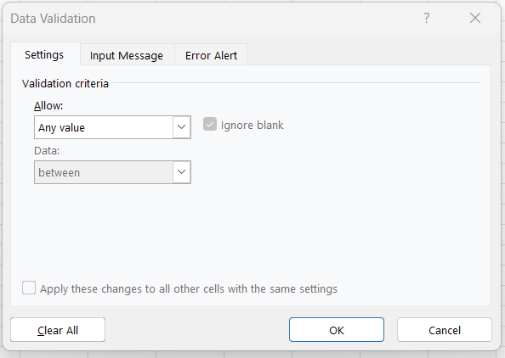
Creating Data Validation Rules: Image

Slide 111
Set the Validation Criteria
Accessing Data Validation Dialog Box
Initiate the dialog box to begin setting criteria
Specifying Criteria
Choose the type of data, such as whole numbers or date ranges

Slide 112
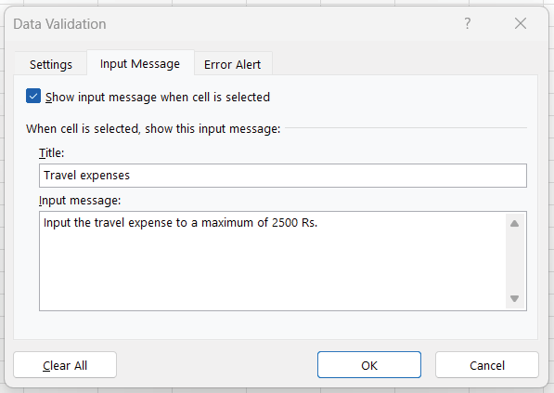
Configure Input Message and Error Alert: Image

Slide 113
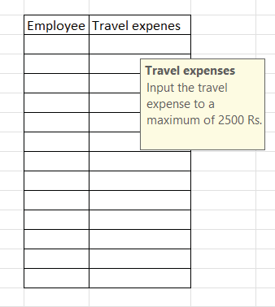
Configure Input Message and Error Alert: Image

Slide 114
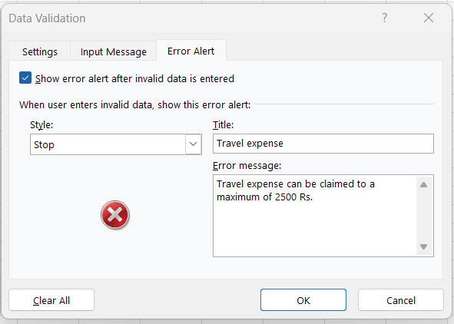
Configure Input Message and Error Alert: Image

Slide 115
Configure Input Message and Error Alert: Image

Slide 116
Summary of Text Functions and Data Validation
Key Aspects of Financial Analysis
Understanding Text Functions in Excel
Implementing Data Validation for Accuracy

Slide 117
Mastering Lookup Functions in Financial Analysis

Slide 118
Agenda
Title Slide
Overview
Introduction to Lookup Functions
Historical Perspective and Relevance
Topics at-a-Glance
Utility for Chartered Accountants
VLOOKUP (Vertical Lookup)
HLOOKUP (Horizontal Lookup)
INDEX Function
MATCH Function
INDEX and MATCH Functions
Summary of Lookup Functions

Slide 119
Overview
Understanding Lookup Functions
Grasp core concepts and applications in financial analysis
Vertical and Horizontal Data Retrieval
Use VLOOKUP for vertical and HLOOKUP for horizontal data retrieval
Fetching Data with INDEX
Learn to retrieve specific data points using INDEX and criteria
Locating Values with MATCH
Acquire skills to locate precise values in datasets
Real-world Financial Scenarios
Enhance analytical capabilities by applying lookup functions
Critical Evaluation of Lookup Functions
Choose the right function for financial analysis tasks

Slide 120
Introduction to Lookup Functions
Essential Tools for Financial Analysis
Lookup functions are crucial for efficient data retrieval.
They enhance the precision of financial analyses.
Swift and Accurate Data Access
Allows quick pinpointing of specific data within large datasets.
Comprehensive Module Coverage
Provides skills to navigate and extract relevant financial data.

Slide 121
Historical Perspective and Relevance
Evolution of Computational Tools
Shift from manual calculations to spreadsheet software
Introduction of functions like VLOOKUP, HLOOKUP, INDEX, and MATCH
Impact on Financial Analysis
Streamlined analysis process with improved accuracy and speed
Essential for managing vast datasets in modern finance
Essential Skills for Professionals
Ability to extract specific data quickly
Lookup functions as the backbone of efficient analysis

Slide 122
Topics at-a-Glance
VLOOKUP: Vertical Data Retrieval
Excels in searching for data in columns
HLOOKUP: Horizontal Data Search
Specializes in finding data across rows
INDEX: Flexible Value Fetching
Retrieves values based on specific criteria
MATCH: Precise Value Location
Identifies exact values within a dataset

Slide 123
Utility for Chartered Accountants
01
02
03
Essential Skills for Chartered Accountants
Lookup functions enable precise analysis of financial data.
They play a critical role in reducing errors in data management.
Benefits of Mastery in Lookup Functions
Allows for efficient dissection of large financial datasets.
Indispensable for extracting vital financial figures.
Impact on Financial Analysis
Facilitates in-depth financial analyses.
Enhances accuracy and reliability in financial reporting.

Slide 124
VLOOKUP (Vertical Lookup): Explanation
Lookup Function Parameters
lookup_value: Value to find in the table's leftmost column
table_array: Cell range with data to search
col_index_num: Column number to return value from
range_lookup: Specifies exact or approximate match
Lookup Function Parameter Details
Parameter | Description | Optional
lookup_value | Value to find in first column | No
table_array | Range with data to search | No
col_index_num | Column number for return value | No
range_lookup | TRUE for approximate, FALSE for exact match | Yes

Slide 125
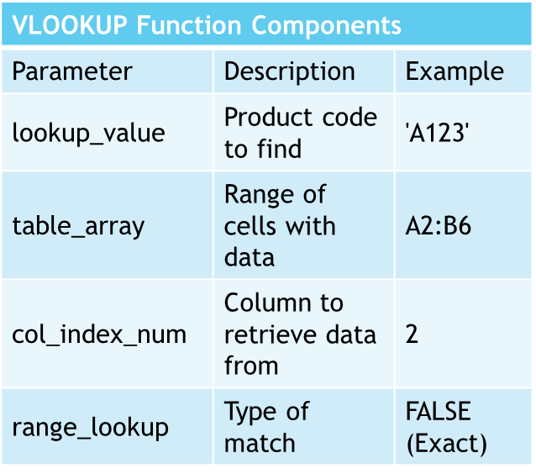
VLOOKUP (Vertical Lookup): Example - Product Prices
Understanding VLOOKUP Function
Locate price with product code 'A123'
Formula: =VLOOKUP('A123', A2:B6, 2, FALSE)
Components of VLOOKUP
lookup_value: 'A123'
table_array: A2:B6
col_index_num: 2
range_lookup: FALSE for exact match
Result Interpretation
Returns price for specified product code

Slide 126
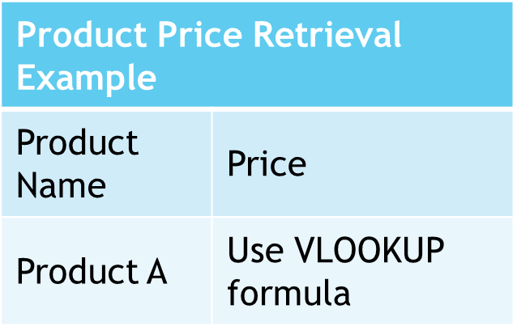
VLOOKUP (Vertical Lookup): Example - Retrieving Product Prices
Excel VLOOKUP Function
Retrieve prices from a table
Column A: Product names, Column B: Prices
Example: Find Price of 'Product A'
Use formula: =VLOOKUP("Product A", A1:B100, 2, FALSE)
Searches in range A1:B100
Returns value from 2nd column

Slide 127
HLOOKUP (Horizontal Lookup): Explanation
Lookup Value Definition
The value to search for in the table's top row
Table Array Explanation
A cell range containing searchable data with the lookup value in the top row
Row Index Number
Specifies the row number from which to return a value, starting from the top
Range Lookup (Optional)
Determines the match type: TRUE for approximate, FALSE for exact

Slide 128
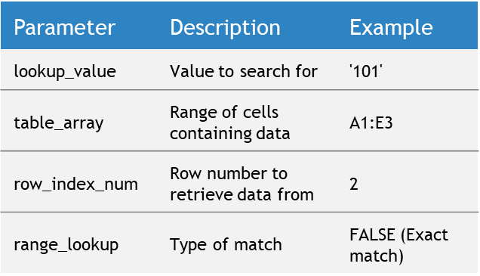
HLOOKUP (Horizontal Lookup): Example - Employee Department
Understanding HLOOKUP Function
Used for horizontal data lookup in Excel
Efficient for finding specific table data
Example Use Case
Locate department of employee with ID '101'
Formula Breakdown
lookup_value: '101' for employee ID
table_array: A1:E3 for data range
row_index_num: 2 to get department info
range_lookup: FALSE for exact match

Slide 129
HLOOKUP (Horizontal Lookup): Example - Retrieving Quarterly Sales Figures
Understanding HLOOKUP Function
Retrieves specific data from a horizontal array
Useful for comparing quarterly sales figures
Spreadsheet Application
Product names as headers in the first row
Sales figures in subsequent rows
Function Syntax
=HLOOKUP(lookup_value, table_array, row_index_num, [range_lookup])
Example Usage
Retrieve 'Product A' sales in Q3: =HLOOKUP("Product A", A1:D100, 3, FALSE)

Slide 130
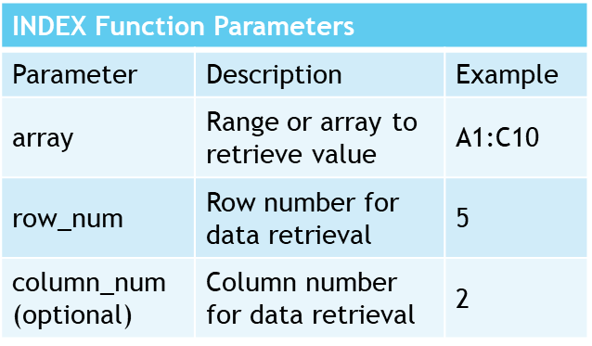
INDEX Function
Function Overview
Fetches specific values from a data range
Designates row and column for data retrieval
Function Syntax
Basic format: =INDEX(array, row_num, [column_num])
Parameter Details
array: Defines the data range
row_num: Specifies the row for data extraction
column_num (optional): Specifies the column, if needed

Slide 131
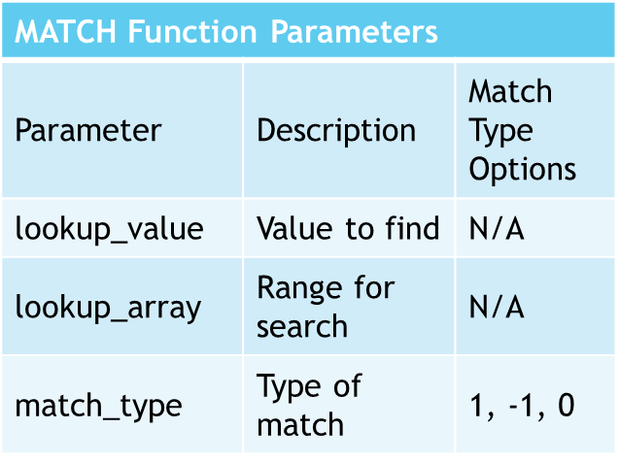
MATCH Function
Function Purpose
Locates specific value within a range
Returns relative position of value
Syntax and Parameters
Standard format: =MATCH(lookup_value, lookup_array, [match_type])
lookup_value: Target value to find
lookup_array: Range to search in
match_type: Defines match criteria
Match Types
1 or omitted: Largest value ≤ lookup_value
-1: Smallest value ≥ lookup_value
0: Exact match

Slide 132
INDEX and MATCH Functions: Syntax and Explanation
Flexible Lookup Capabilities
INDEX function syntax: =INDEX(array, row_num, col_num)
MATCH function syntax: =MATCH(lookup_value, lookup_array, match_type)
Combining INDEX and MATCH
Example formula: =INDEX(C2:E10, MATCH("Product B", B2:B10, 0), 3)
Uses MATCH to determine row number
INDEX retrieves value from specified column

Slide 133
INDEX and MATCH Functions: Example - Retrieving Revenue
Excel Data Retrieval Techniques
Using INDEX and MATCH for precise data extraction
Essential for financial analysts' toolkit
Example: Revenue Lookup
Retrieve 'Product B' revenue in 'Q2' with a formula
Formula structure: =INDEX(range, MATCH(row criteria, row range, 0), MATCH(column criteria, column range, 0))
Advantages of INDEX & MATCH
Allows specific data point retrieval within large datasets
Enhances accuracy and efficiency in financial analysis

Slide 134
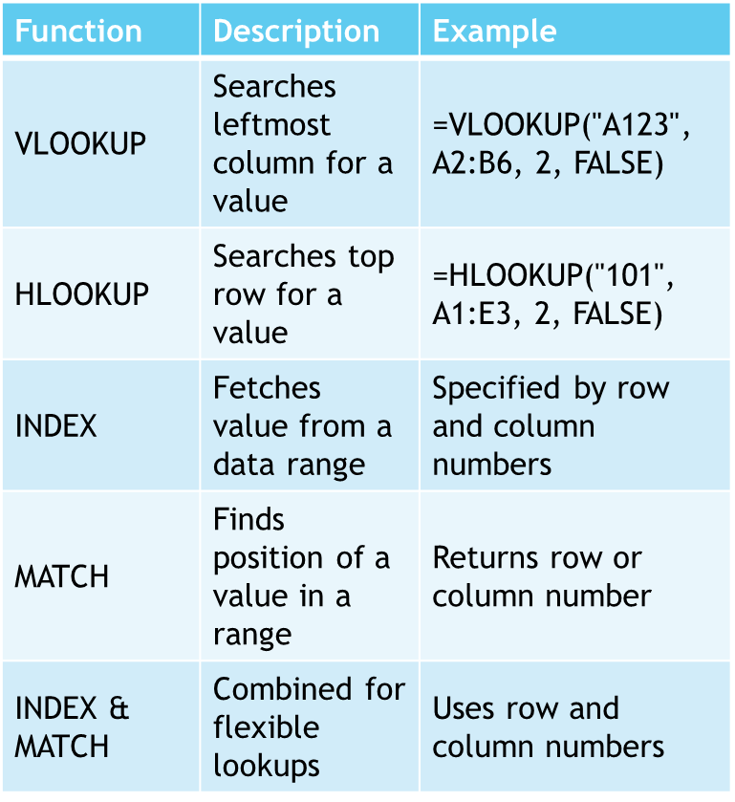
Summary of Lookup Functions
VLOOKUP (Vertical Lookup)
Searches for values in the leftmost column
Retrieves data from specified columns to the right
HLOOKUP (Horizontal Lookup)
Searches for values in the top row
Retrieves data from specified rows below
INDEX Function
Fetches specific values from a data range
MATCH Function
Finds the relative position of a value in a range
INDEX and MATCH Functions
Combined for flexible data retrieval

Slide 135
Data Arrangement, Data Security, and Pivot Tables in Excel

Slide 136
Agenda
Title Slide
Topics at-a-Glance
Sorting Data
Protecting Worksheets
Introduction to Pivot Tables
Introduction to Pivot Tables
Exercise on Pivot Tables
Creating a Pivot Table
Managing Data Source
Custom Calculations and Calculated Fields
Applying Filters
Conditional Formatting

Slide 137
Introduction to Data Arrangement and Data Security
Essentials of Data Management in Finance
Efficient data arrangement as the foundation for analysis
Imperative data security for confidentiality
Historical Shift in Data Handling
From manual errors to transformative spreadsheet tools
Sorting and filtering advancements in Excel
Excel's Role in Modern Financial Analysis
Indispensable techniques for financial analysts
Organizing data for insights and protecting sensitive information

Slide 138
Historical Perspective and Relevance
Historical Shift in Data Management
Transition from manual to software-based data arrangement
Spreadsheet tools like Excel brought accuracy and speed
Increasing Importance of Data Security
Growth in sensitive financial data handling
Need for robust security measures
Excel's Role in Modern Finance
Essential for data-driven financial analysis
Indispensable techniques for financial analysts

Slide 139
Topics at-a-Glance
Data Arrangement Techniques
Sorting and filtering for efficient data analysis
Data Security and Protection
Protecting worksheets and workbooks with passwords
Utility for Chartered Accountants
Streamlining analytical processes and ensuring data integrity
Crucial for audits, financial reports, and handling sensitive client data

Slide 140
Expertise in Data Arrangement
Security of Financial Information
Skills Vital for Professional Practice
Streamlines analytical processes for financial data.
Enhances efficiency in handling audits and financial reports.
Ensures integrity and confidentiality of client data.
Crucial for maintaining trust in financial services.
Indispensable in managing sensitive financial information.
Contributes to the overall reliability of Chartered Accountants.

Slide 141
Data Arrangement Techniques
Importance of Data Arrangement
Facilitates smoother analysis
Enhances reporting efficiency
Select Data Range
Choose the cells you wish to organize.
Utilize Data Tab
Find the 'Data' section in the menu.
Sorting Order
Opt for 'Sort A to Z' for ascending or 'Sort Z to A' for descending.

Slide 142
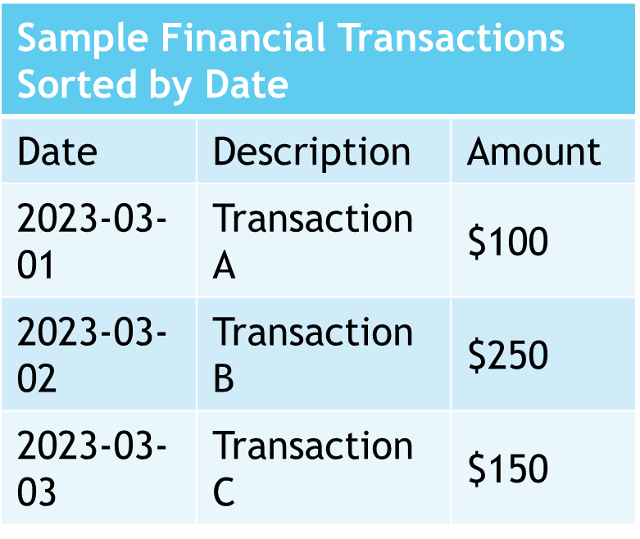
SORTING DATA: EXAMPLE - SORTING FINANCIAL TRANSACTIONS
Financial Transaction Analysis
Sort transactions by date for chronological review
Facilitates better understanding of financial activity over time

Slide 143
Filtering Data: Steps to Apply Filters
Select Data Range
Choose cells with data for filtering
Access Data Tab
Navigate to the 'Data' tab on the interface
Initiate Filter
Click 'Filter' to apply to selected cells

Slide 144
Filtering Data: Example - Filtering Expenses for a Specific Month
Yearly Expense Dataset Overview
Contains complete financial data for the year
Monthly Filtering Method
Enables focused expense analysis for any given month
Benefits of Filtering
Facilitates targeted financial review and management

Slide 145
Data Security and Protection
Essentiality of Data Security
Crucial for maintaining confidentiality
Especially significant in financial sectors

Slide 146
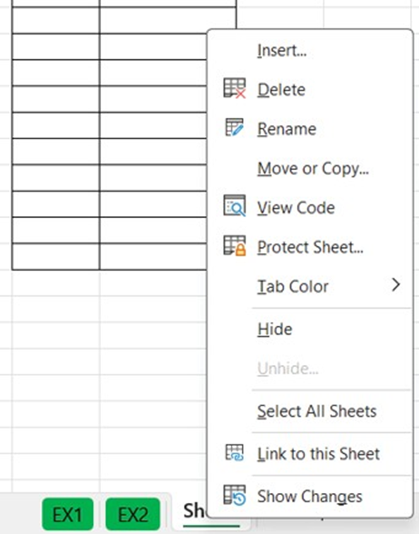
Worksheets: Steps to Protect a Worksheet
Initiate Worksheet Protection
Right-click on the desired sheet tab
Select the 'Protect Sheet' option from the menu
Password and Permissions
Choose to set a password (this is optional)
Specify user permissions for the worksheet

Slide 147
Protecting Worksheets: Example - Protecting a Financial Summary Sheet
Importance of Sheet Protection
Prevents accidental alterations of critical financial data
Viewing Access
Allows users to view essential financial information without editing

Slide 148
Password Protection for Workbooks: Steps to Password Protect a Workbook
Accessing the Protection Feature
Open the Review Tab in the workbook.
Locating the Protection Menu
Find the Protect workbook menu within the Review tab.
Setting a Password
Choose a secure password to protect your workbook.

Slide 149
Password Protection for Workbooks: Example - Password Protecting a Financial Report
Password Protection for Confidentiality
Ensures financial report security
Restricts access to authorized individuals

Slide 150
Summary of Data Arrangement and Data Security
Key Techniques in Excel
Organizing data for accuracy
Securing data for confidentiality
Importance in Financial Analysis
Ensures precise analysis
Facilitates efficient reporting
Module 7 Overview
Focuses on data arrangement skills
Emphasizes data security measures

Slide 151
Introduction to Pivot Tables
Significance of Pivot Tables
Crucial for efficient data analysis in Excel
Benefits of Pivot Tables
Summarize data, offer flexibility, and enable quick analysis
Use Cases for Pivot Tables
Ideal for large datasets, exploratory analysis, and reporting
Creating Pivot Tables
Select data, configure layout, and categorize effectively
Customization and Formatting
Data Management
Conditional Formatting and Pivot Charts
Design and Formatting Principles

Slide 152
HISTORICAL PERSPECTIVE AND RELEVANCE OF PIVOT TABLES
Origins of Pivot Tables
Introduced in the 1980s by Lotus Improv.
Pioneered multidimensional data analysis.
Excel's Contribution
Refined and popularized pivot tables.
Became a key tool for data manipulation.
Modern-Day Relevance
Crucial for handling large, complex datasets.
Enables extraction of insights from data.

Slide 153
Topics at-a-Glance for Pivot Tables
Overview of Pivot Tables
Benefits and applications in data organization
Practical exercises for creation and management
Structure and Components
Detailed layout insights
Techniques for updating and connecting to data sources
Data Handling Techniques
Sorting, filtering, and visualizing data
Working with various data fields
Utility for Chartered Accountants
Efficiency in financial analysis and reporting
Visual representation of financial trends with pivot charts

Slide 154
Introduction to Pivot Tables
Dynamic Data Analysis Tool
Pivot tables allow quick reorganization and summarization of complex datasets.
User-Friendly Interface
Designed for easy use with minimal technical knowledge required.
Efficient Decision-Making
Facilitates understanding of large data volumes for better insights.
Accessible Data Summaries
Transforms data into clear summaries, making analysis accessible to many.

Slide 155
Benefits of Pivot Tables
Efficient Data Summarization
Flexibility in Data Handling
Quick Ad-Hoc Analysis
Automates data aggregation, eliminating manual calculations
Ensures accuracy and time efficiency
Easy modification of data field arrangements
Provides various perspectives and insights
Allows interactive data dissection
Enables refining analysis without changing original data

Slide 156
When to Use Pivot Tables
Handling Large Datasets
Excel in managing substantial data
Impractical for manual analysis
Data Exploration
Discover trends, patterns, and outliers
Indispensable for exploratory analysis
Summary Reporting
Create concise, informative reports
Facilitate communication of insights

Slide 157
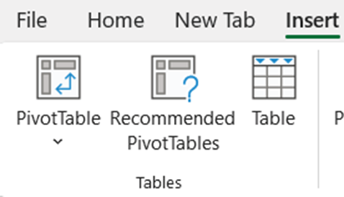
Source Data Selection for Pivot Tables
Select Data Range
Click any cell within your dataset to begin.
Insert PivotTable
Use the 'Insert' tab and select 'PivotTable.'
Define Data Range
Check the 'Table/Range' field for accuracy.
Choose Location
Decide on a new or existing worksheet for the pivot table.
Confirm Creation
Click 'OK' to finalize the pivot table setup.

Slide 158
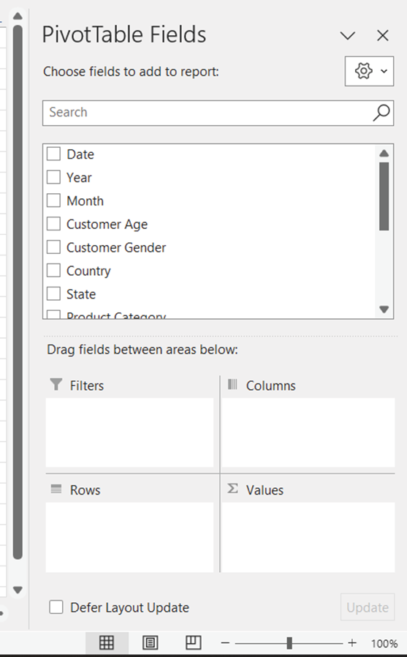
Creating a Pivot Table
PivotTable Field List
Appears on the right after creating the pivot table
Drag and Drop Fields
Drag fields into Rows, Columns, and Values areas
View the Pivot Table
Excel generates the table based on field selections
Modify Layout and Format
Use 'PivotTable Analyze' tab for customization

Slide 159
Exercise on Managing HR Data
HR Data Management
Focus on employee details, departments, and salaries
Pivot Table Creation
Display average salary by department
Salary Analysis
Examine variations in salary across departments

Slide 160
Pivot Table Layout and Structure
Key Areas of Pivot Tables
Rows organize data horizontally by criteria
Columns arrange data vertically as headers
Values display summarized data
Filters apply limitations on data
Modifying Pivot Table Structure
Drag fields between areas in the Field List
Exercise: Analyzing Sales Trends
Move 'Region' field to analyze trends by region

Slide 161
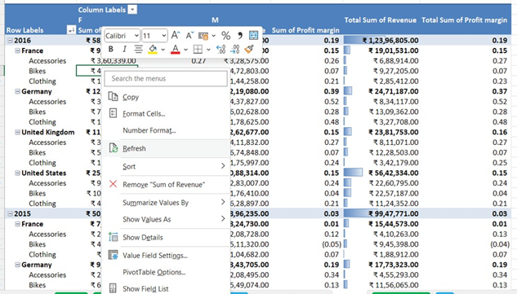
Managing Data
Updating and Refreshing Data
Automatic refresh upon file opening
Manual refresh via right-click option
Handling Data Changes
Refresh to include added, removed, or modified data
Example: Incorporate new monthly sales data

Slide 162
Connecting to External Data
External Data Source Integration
Link pivot tables to databases or other Excel workbooks
Exercise: SQL Database Connection
Analyze up-to-date sales records by connecting to a SQL database

Slide 163
Working with Pivot Table Fields
Types of Pivot Table Data Fields
Value Fields: Summarized numeric data like total sales
Label Fields: Categorical data for organizing rows/columns such as product categories
Calculated Fields: Custom calculations derived from existing fields

Slide 164
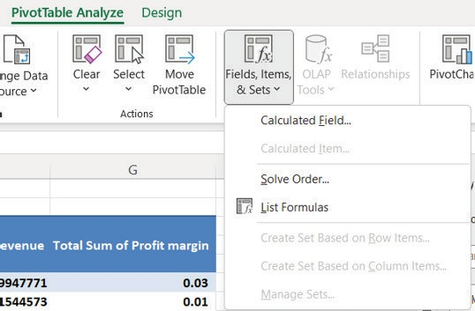
Custom Calculations and Calculated Fields
Understanding Calculated Fields
Utilize mathematical expressions
Involve existing data fields
Profit Margin Calculation
Subtract cost from revenue
Divide the result by revenue
Application in Business Analysis
Enhance data insights
Support decision-making processes

Slide 165
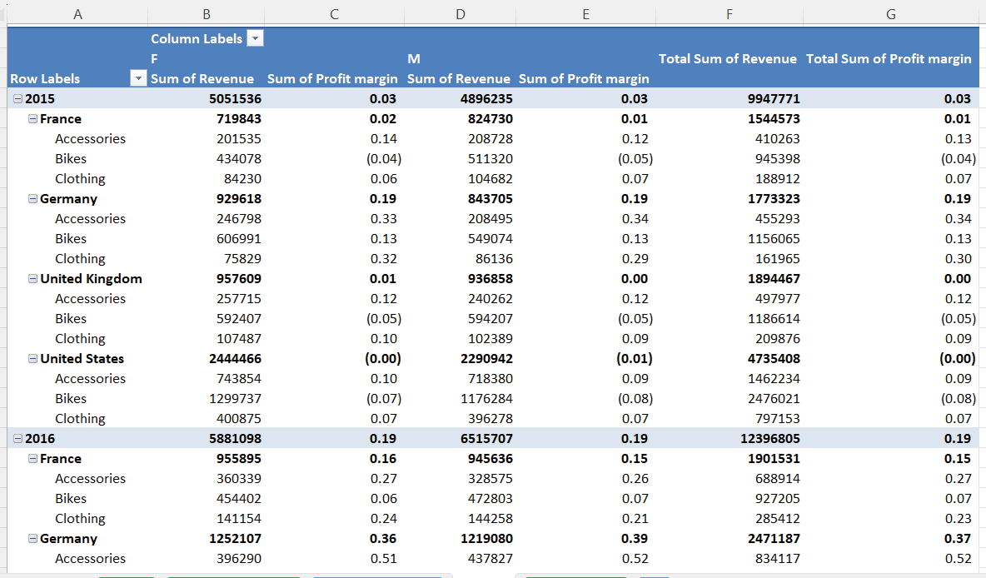
Formatting and Summarizing Values
Value Field Formatting
Apply currency symbols for financial data
Adjust decimal places for precision
Summarization Techniques
Select methods like sum, average, or count
Example: Summarize 'Sales' with sum total
Practical Application
Format 'Profit' as currency for clarity
Enhance data comprehension with summaries

Slide 166
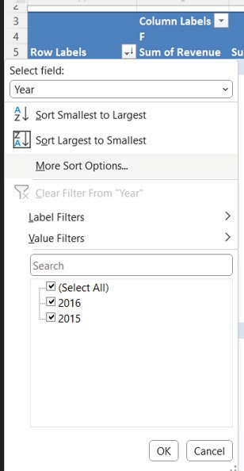
Sorting, Filtering, and Slicing Data
Sorting Data
Organize data within rows or columns
Identify trends effectively

Slide 167
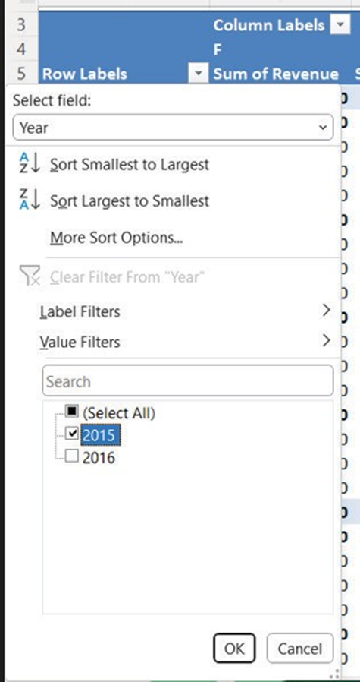
Applying Filters
Focus on Specific Data Subsets
Utilize filters to concentrate on particular segments within the pivot table.
Filtering Sales Data
Example: Implement a filter to isolate sales information from a designated year.

Slide 168
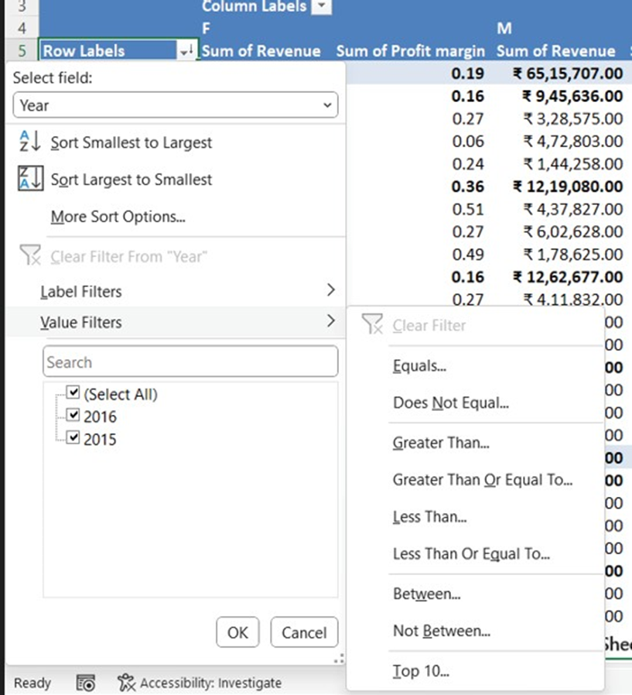
Applying Value-Based Filters
Importance of Value-Based Filters
Allows for displaying specific data ranges
Application in Sales Data
Useful for highlighting products with sales surpassing a threshold

Slide 169
Interactive Data Filtering Tools
Slicers provide visual filters for categories
Timelines enable date field filtering
Enhancing Data Analysis
Insert slicers for fields like regions
Use timelines for efficient date filtering

Slide 170
Conditional Formatting
Visual Enhancement with Conditional Formatting
Highlights cells based on predefined rules
Improves pivot table data readability
Application in Pivot Tables
Identifies high and low-profit areas
Color scales aid in data analysis

Slide 171
PIVOT CHARTS
Introduction to Pivot Charts
Excel's Chart Wizard simplifies chart creation from pivot tables.
Customizable options to meet specific visualization needs.
Chart Creation Process
Follows the concept of normal chart creation.
Applicable to Pivot table data for enhanced data representation.

Slide 172
Steps to Create Charts
Select Data for Your Chart
Highlight both labels and values you wish to include.
Insert Chart from the 'Insert' Tab
Choose a chart type that best represents your data.
Customize Design Elements
Add titles, legends, and data labels for clarity.
Extensive Formatting Options
Adjust colors, styles, and fonts to suit your document.

Slide 173
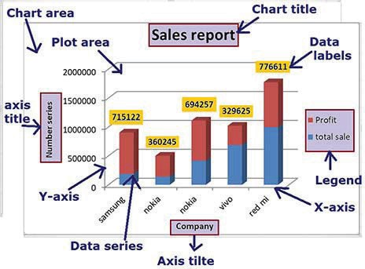
Chart Design and Formatting
Colors and Themes
Select visually appealing, readable color schemes.
Use Excel themes for design consistency.
Labels and Titles
Include descriptive chart titles and axis labels for context.
Gridlines and Axes
Adjust to match data scale and granularity.
Ensure gridlines are present but subtle.
Data Labels
Display exact values for clarity.
Choose between values, percentages, or custom labels.
Legend Placement

Slide 174
Summary of Pivot Tables
Understanding Pivot Tables
Powerful Excel tool for data analysis
Enables quick reorganization and summarization
Benefits of Using Pivot Tables
Extract insights from complex datasets
Enhances data visualization
Practical Applications
When to utilize Pivot Tables effectively
Exercises for hands-on experience

Slide 175
Macros in Excel
Automating Financial Modelling

Slide 176
Agenda
Overview
Introduction to Macros
Benefits of Macros in Financial Modelling
Handling Large Datasets with Macros
Types of Macros
Enabling Developer Tab in Excel
Recording Macros
Running Macros
Summary of Macros in Excel
Conclusion

Slide 177
Overview: Learning Objectives
Understanding Macros in Excel
Benefits in Financial Modelling
Hands-on Macro Experience
Scalability with Macros
Macro Proficiency
Automating with Macros
Grasp the concept and role of Macros in task automation
Enhance efficiency and accuracy with Macros
Learn to record and run macros for financial data formatting
Handle large financial datasets effectively
Master naming, describing, and shortcut key assignment
Ensure consistent formatting of financial statements

Slide 178
Overview: Introduction to Macros
1
2
3
Macros: Excel's Automation Powerhouse
Set of instructions for automating repetitive tasks
Uses simple keystrokes to complex VBA programming
Historical Development of Macros
Originated from early computing batch processing
Evolved with spreadsheet software advancements
Macros in Today's Data-Driven World
Crucial for financial modelling and data analysis
Enables handling of large datasets efficiently

Slide 179
Overview: At-a-Glance Topics in the Chapter
Introduction to Macros in Excel
Understanding the basics and applications of macros
Types of Macros
Recorded Macros: Capturing a series of user actions
VBA Macros: Involving custom programming for advanced tasks
Hands-On Learning
Practical examples and guides for an interactive experience

Slide 180
Overview: Utility for Chartered Accountants
Essential Skill for Chartered Accountants
Macros provide a strategic edge in accounting tasks.
Essential for precision and timeliness in work.
Enhancing Efficiency
Automate complex financial models.
Speed up data processing tasks.
Error Mitigation
Reduce the risk of human error in calculations.
Applications in Accounting
Macros have diverse uses in analytical and reporting tasks.
Professional Empowerment
Macro proficiency equips accountants for demanding tasks.

Slide 181
Introduction to Macros
Definition of Macros
Automate repetitive Excel tasks
Range from simple keystrokes to complex VBA programming

Slide 182
Benefits of Macros in Financial Modelling
Enhanced Efficiency and Precision
Macros minimize human errors, saving time for consistent, error-free financial models.
Automated Complex Calculations
Macros can swiftly update data and calculations across multiple sheets in complex models.

Slide 183
Handling Large Datasets with Macros
Scalable Financial Modeling
Macros facilitate efficient processing of extensive datasets.
They enhance model scalability for financial analysis.
Automation in Data Handling
Macros automate tasks like data cleansing and sorting.
They enable quick derivation of insights from financial data.

Slide 184
Types of Macros
Recorded Macros
Created by recording actions in Excel
Automates repetitive tasks efficiently
VBA Macros
Uses Visual Basic for Applications language
Enables complex, customized automation

Slide 185
Enabling Developer Tab in Excel
Initiating Developer Tab Activation
Start by opening Excel on your computer
Navigating Excel Options
Click 'File' and select 'Options' from the dropdown
Customizing the Ribbon
Choose 'Customize Ribbon' in the Excel Options dialog
Enabling the Developer Tab
Check the 'Developer' box in the main tabs list
Finalizing the Setup
Save changes by clicking 'OK'

Slide 186
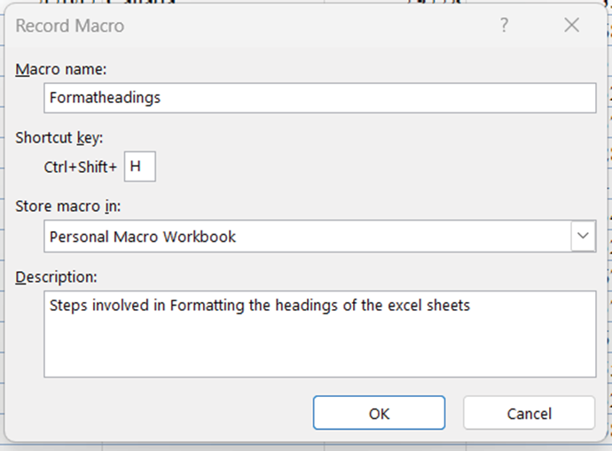
Recording Macros
Navigate to Developer Tab
Enable the tab if it's not visible in the Excel menu
Initiate Macro Recording
Select 'Record Macro' option
Macro Setup
Provide a name and assign a shortcut key if desired
Perform Recorded Actions
Carry out the tasks you want the macro to automate
Finalize Recording
Click 'Stop Recording' to save the macro
Example Use Case
Automate data formatting tasks in financial statements

Slide 187
Running Macros
Executing Macros
Use shortcut keys or the 'Macros' dialog box for execution
Applying to Financial Data
Record macro for consistent data formatting
Apply to new data sets for uniformity and time-saving
Steps for Macro Usage
Start and stop recording for specific formatting tasks
Run the macro for instant formatting on similar data

Slide 188
Summary of Macros in Excel: Introduction to Macros
Automating Repetitive Tasks
Practical Application
Macros are designed to simplify repetitive operations in Excel.
They range from basic keystroke recordings to advanced VBA scripts.
For instance, macros can automate the monthly formatting of extensive financial datasets.

Slide 189
Summary of Macros in Excel: Benefits of Macros in Financial Modelling
Efficiency and Accuracy
Reduces human error and saves time
Ensures consistent, error-free financial modelling
Automates data updates and calculations
Handling Large Datasets
Processes large financial datasets effectively
Enhances scalability of financial models
Automates data cleansing, sorting, and analysis

Slide 190
Summary of Macros in Excel: Types of Macros
Recorded Macros
Automate repetitive tasks in Excel
Created by recording a sequence of actions
VBA Macros
Enable complex, customized automation
Utilize VBA programming language

Slide 191
Summary of Macros in Excel: Recording and Running Macros
Enabling
Recording
Running
Enabling Developer Tab in Excel
Follow steps to access macro tools via Developer tab
Recording Macros
Guidance on naming and assigning shortcut keys
Automate tasks like data formatting in financial statements
Running Macros
Use shortcut keys or Macros dialog box for execution
Apply macros to new financial datasets efficiently

Slide 192
THANK YOU

