Slide 1
Data Analytics using CAAT Tools – IDEA

Slide 2
How we will cover the Topic
2. What is IDEA?
What is CAAT?
2. What is IDEA?
3. Pre-requisite to use IDEA
A. Functional Specification
B. Relational Data Base
4. IDEA Functionalities

Slide 3
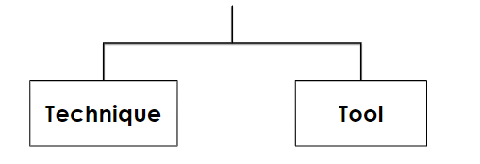
What is CAAT?
Computer Assisted Audit Techniques & Tools

Slide 4
What is Technique? Technique is way of doing something makes our life easy. We can also call technique as Steps, Process, Algorithm, Knowledge etc
What is Technique?
Technique is way of doing something makes our life easy. We can also call technique as
Steps, Process, Algorithm, Knowledge etc

Slide 5
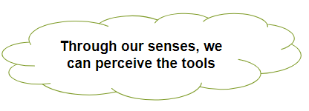
What is Tool? Tool is any physical resource, which helps to implement the technique to get desired results
What is Technique?
Technique is way of doing something makes our life easy. We can also call technique as
Steps, Process, Algorithm, Knowledge etc

Slide 6
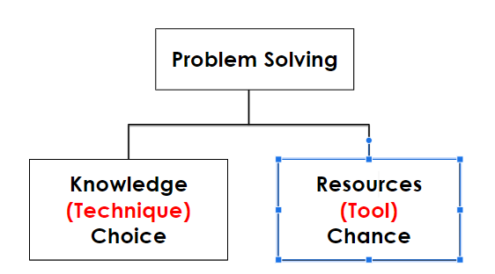
What is Technique?
Technique is way of doing something makes our life easy. We can also call technique as
Steps, Process, Algorithm, Knowledge etc

Slide 7
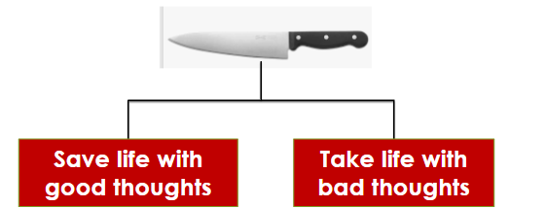
What is Technique?
Technique is way of doing something makes our life easy. We can also call technique as
Steps, Process, Algorithm, Knowledge etc
Why tools are useless on Stand-alone basis
Tools are neither good nor bad.
It all depends on Technique with which it works

Slide 8
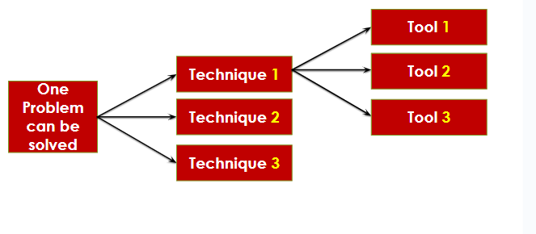
What is Technique?
Technique is way of doing something makes our life easy. We can also call technique as
Steps, Process, Algorithm, Knowledge etc
Technique & Tools in Problem Solving

Slide 9
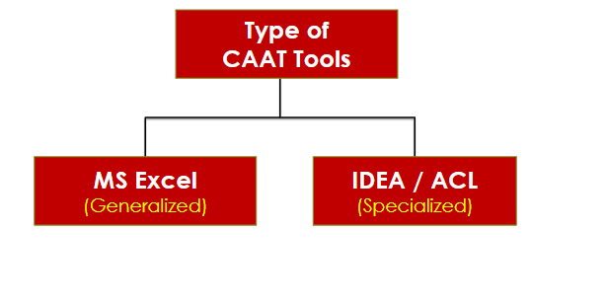
What is Technique?
Technique is way of doing something makes our life easy. We can also call technique as
Steps, Process, Algorithm, Knowledge etc

Slide 10
1. What is CAAT? 2. What is IDEA?
1. What is CAAT?
How we will cover the Topic

Slide 11
Interactive Data Extraction & Analysis
1. What is CAAT?
What is IDEA® ?
This is a specialized application software designed by a Canadian company – “Case Ware Inc”
IDEA is a powerful and comprehensive tool in the hands of Internal / External auditor to assess risk, gather evidence, uncover trends, and provide the intelligence needed to make more informed decisions.

Slide 12
1. What is CAAT?
When we have Excel, why we need IDEA?
Data limitation in Excel
No standard format in Excel – makes organization person dependent
Data Modification in excel undermines its reliability
No change log available in Excel for Documentation

Slide 13
1. What is CAAT? 2. What is IDEA? 3. Pre-requisite to use IDEA
1. What is CAAT?
How we will cover the Topic

Slide 14
1. What is CAAT?
Pre-requisite to use IDEA Tool
Knowledge of Excel
Knowledge of Relational Data Base
To design STEPS
for problem solving
(Functional Spec)
To understand DATA

Slide 15
1. What is CAAT?
What is Functional Specification?
It is a step-by-step process which when followed, helps to get pre-defined results
Everything starts with STEPS
Ex: Cooking Rice
STEP 1: Take Vessel
STEP 2: Put Water
STEP 3: Switch on Gas …………so on
If we don’t follow steps, Outcome is not Accurate

Slide 16
1. What is CAAT?
What Defines Success ?
Accuracy
Timelines
STEPS gives Accuracy
Minimum number of STEPS (short cut)
Will discuss more while working with IDEA

Slide 17
1. What is CAAT? 2. What is IDEA? 3. Pre-requisite to use IDEA A. Functional Specification B. Relational Data Base
1. What is CAAT?
How we will cover the Topic

Slide 18
1. What is CAAT?
What is DATA?
Data is a piece of Information / raw Fact
Information is processed / organized Data.
We need information to take Decisions
Data is useless on its own (no conclusion can be drawn)

Slide 19
1. What is CAAT?
What is your Decision about below? (Good / Bad)
₹ 50 Crores Profit of RIL Per day
Each time, new DATA is added, Decision Changes

Slide 20
1. What is CAAT?
What is your Decision about below? (Good / Bad)
₹ 50 Crores Profit of RIL Per day
Each time, new DATA is added, Decision Changes

Slide 21
1. What is CAAT?
Data Processing Techniques
Financial Data
Non-Financial Data

Slide 22
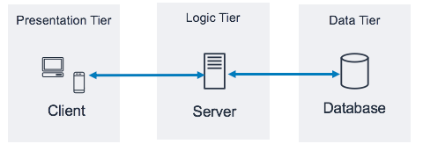
1. What is CAAT?
3 Tier Architecture
99% of world’s application suite use RDBMS

Slide 23
1. What is CAAT?
Tally
MS Dynamics
SAP
RDBMS
RAMCO
Finacle
Oracle

Slide 24
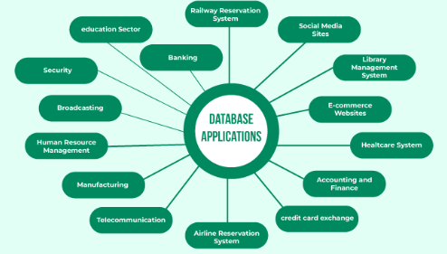
1. What is CAAT?

Slide 25
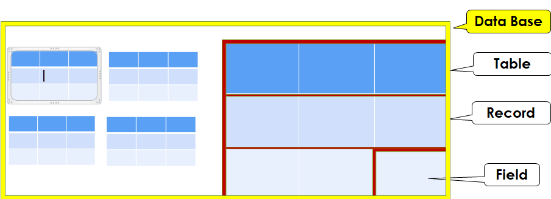
1. What is CAAT?
Relational Data Base?
Data base is Collection of DATA organized in the form of Tables

Slide 26
1. What is CAAT?
MOB_NO | NAME | STATE | OTHER
99999 | Raja | Delhi | ABCD
88888 | Rani | Kerala | ABCD
77777 | Ramesh | Bihar | ABCD
66666 | Suresh | Goa | ABCD
Master Table
TXN_ID | MOB_NO | AMOUNT | COURSE | BOOKS_GIVEN
100001 | 99999 | ₹ 7,500 | AITT | Yes
100002 | 77777 | ₹ 7,500 | GMCS | -NA-
100003 | 77777 | ₹ 7,500 | AITT | No
100004 | 66666 | ₹ 7,500 | AITT | Yes
Transaction Table
Business Decision Required
How many books to be ordered?
Who did not get the book?

Slide 27
1. What is CAAT?
Primary Key
Foreign Key
MOB_NO | NAME | STATE | OTHER
99999 | Raja | Delhi | ABCD
88888 | Rani | Kerala | ABCD
77777 | Ramesh | Bihar | ABCD
66666 | Suresh | Goa | ABCD
TXN_ID | MOB_NO | AMOUNT | COURSE | BOOKS
100001 | 99999 | ₹ 7,500 | AITT | Yes
100002 | 77777 | ₹ 7,500 | GMCS | -NA-
100003 | 77777 | ₹ 7,500 | AITT | No
100004 | 66666 | ₹ 7,500 | AITT | Yes
STEP 1: Go to TXN TABLE – FILTER
COURSE = AITT AND
BOOKS = NO
STEP 2: JOIN the output with MASTER TABLE – GET NAME

Slide 28
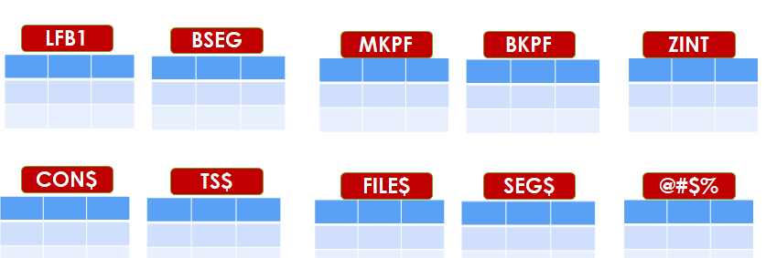
1. What is CAAT?
Know the Tables (Which data where?)
Know Primary Key & Foreign Key Relationships

Slide 29
1. What is CAAT? 2. What is IDEA? 3. Pre-requisite to use IDEA A. Functional Specification B. Relational Data Base 4. IDEA Functionalities
1. What is CAAT?
How we will cover the Topic

Slide 30
YES
Are we supposed to be EXPERTs in Problem Solving?
Technique
(STEPS)
Tool
(IDEA)
Compulsory
(No choice)
Optional
(But need to know how to communicate with Technical Person)

Slide 31
What functionalities we are going to discuss?
Data Import / Folder creation
Appending Field with Script (Add column with Equations)
Data Extractions (Filter)
Duplicate / Gap detection
Summarization
Table Join (V Lookup)
Benford’s Law / Skewness

Slide 32
Let’s start the Journey…………………

Slide 33
THANK YOU

