Slide 1



UNIT-1: MS Power BI
CHAPTER-1
Introduction To Power BI

Slide 2


Learning objectives
Understand Power BI's role-specific benefits.
Create a report and dashboard.
Explore role-based features.
Collaborate and share reports.
See real-world role customization examples.

Slide 3
Is Excel enough for Data Analytics?
We CAs use Excel predominantly for data analysis.
When it comes for enterprise data Excel is having the following limitations:
        Row limitation of 1048576 rows.
        Pivot Table can handle only a single flat table.
        Data visualization is not effective and synchronised or at least not interactive to each other.
        Data from multiple sources cannot be imported (like json, pdf etc.).
        OLAP and Data Modelling requires Robust Columnar Databases for optimizing the performance of reporting.

Slide 4
Need for a Tool like Power BI
Increasing Business Challenges
Availability of Data
Multidimensional approach – Data Cube
Online Analytical Processing
Possibility of Data Driven Decision Making
Handling Big Data
Continuous Monitoring of KPIs
Decision Making
Online
Accurate
Data driven
Intelligent
Integrated
Automated

Slide 5
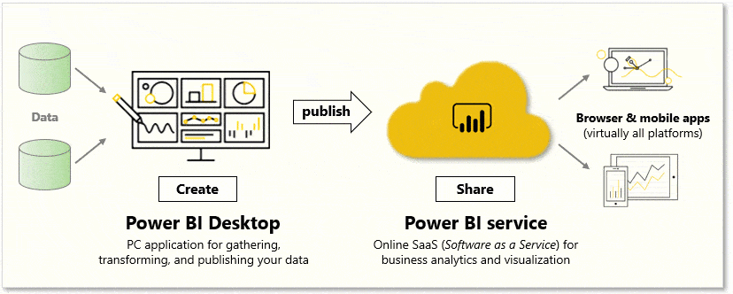
Elements of Power BI
Power BI Desktop (Free) – Used by Developers of Power BI Reports
Power BI Service – Online SaaS – a web service to share Reports
Power BI Apps - available on phones and tablets.

Slide 6
Power BI Capabilities
Capacities – Set of Resources to share content
Workspaces – Containers of datasets, reports etc.,
Datasets – Collection of underlying data for reports
Reports – Data Visualizations and other elements
Dashboards - single interactive canvas with tiles and widgets.
Template Apps – Out of the box content to publish for Power BI Partners
Capabilities of Power BI
Reports
Dashboards
Template Apps
Capacities
Workspaces
Datasets

Slide 7
Conceptual Understanding
Data Modelling
Relationships
OLAP
Fact
Visualization
DAX
Power Query
Extract
Dimension
Hierarchy
Measures
Transform
Load
M Language
Interactive Visuals
Star/Snowflake Schema
Fact Centered

Slide 8

Other Related Concepts
Columnar Databases
SQL & NoSQL
Data Flow
Filter Context
Row Evaluation Context
Context Transition
Data Cube Operations

Slide 9
Power BI Reporting
Data sets
Extract
Transform
Load
Data Modelling
Build Report
Pin visuals to Dashboard
Share link to the users
Report Consumption

Slide 10
UNIT-1: MS POWER BI
CHAPTER-2 Connecting to Data Sources

Slide 11
Learning Objective
Explore the data-centric features and tools of Power BI.
Explore ways to find data.

Slide 12
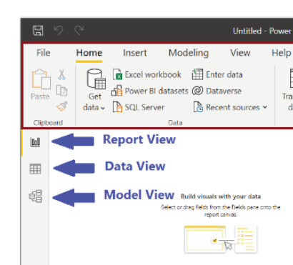
Getting Ready …
Download Power BI Desktop (free from Microsoft Website)
      https://powerbi.microsoft.com/en-us/downloads/
Sign-in to Power BI Service
Launch Power BI Desktop
Three major views of Power BI Desktop
      Report View (Default)
      Data View
      Model View

Slide 13
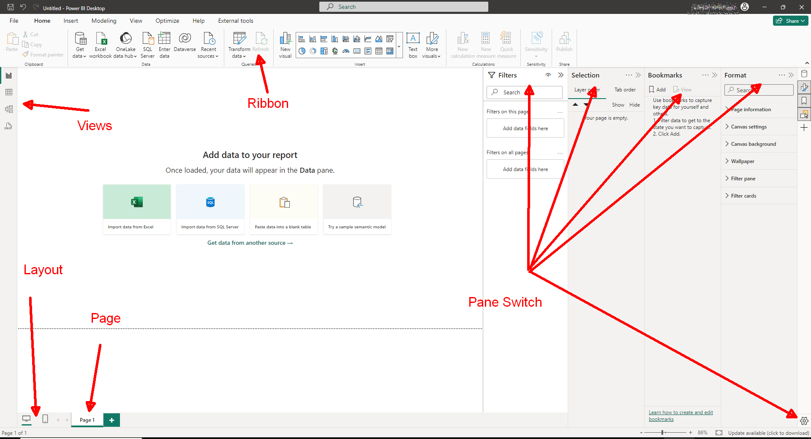
Get familiar with the interface
Ribbon
Report View or Canvas
Page Tab
Panes
Layout

Slide 14
Power BI Workflow
Create and Connect Visuals
Publish to PBI Service
Report Consumption
Data Source
ETL
Data Modelling & Creating Measures

Slide 15
Data Preparation and Process
Need for ETL
    Data coming from different sources like Text, CSV, XML, JSON, PDF, ODBC, Web, Cloud, Dataverse, Big Data, Images etc.,
    Clean and standardize the data to integrate with multiple sources
    Moving from Entity Centred approach to Fact Centred approach
          In RDBMS > Entity in the centre Attributes in the surrounding
          In OLAP > Fact in the centre, Dimensions in the surrounding
    Load only the data relevant for the reports to optimize space and process

Slide 16
What is ETL?
ETL stands for Extract – Transform – Load
Data Extraction
Full or incremental extraction methods used to get the required data.
Ensuring data quality and consistency during the extraction phase.
Data Transformation
Convert data into a format that is compatible with the schema.
Applying business rules, data validation, and data enrichment processes
Data Loading
Loading transformed data into the data model.
Data Quality Assurance
Handling exceptions and errors encountered during the ETL process.
Data profiling and cleansing to improve data quality before loading.
Metadata Management
Managing metadata to track data lineage, transformations, and dependencies.
Documentation of ETL processes and data mappings for transparency and governance.
Data Governance and Security
Ensuring compliance with data governance policies and regulations.
Implementing data security measures during the ETL and entire reporting process.
Role-based access controls for sensitive data handling.

Slide 17
ETL IN POWER BI
Power Query Editor
ETL Tool integrated in Power BI
It is a Process Flow Modelling Software
Running in M Language (Data Mashup Language)
Output of Step 1 becomes in input of Step 2
No coding necessary by the user. commands are GUI/Menu based.
Like recording a macro in Excel.
It automates the ETL process by designing one time using many times.

Slide 18
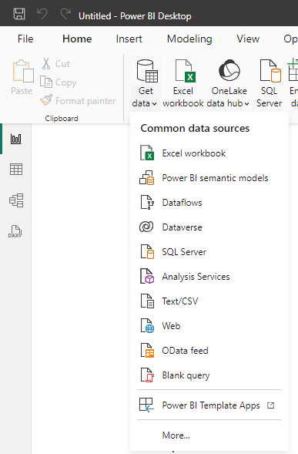
EXTRACT DATA
Using various kinds of data connectors available in Power BI we can extract from almost any form of digital data.
This is the starting point of using Power BI.
Use Home Menu -> Get Data for Common Data Sources
Click More if needed to get data from further many sources

Slide 19
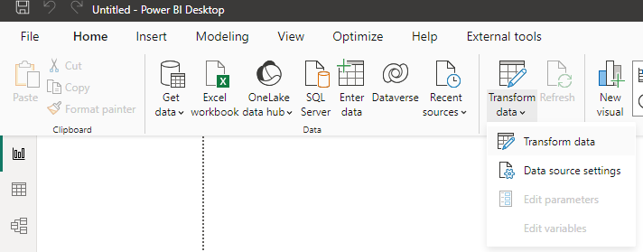
CLEAN AND TRANSFORM
If we need to clean the data, we can use Power Query Editor.
Click Home->Transform Data to enter Power Query Editor.

Slide 20
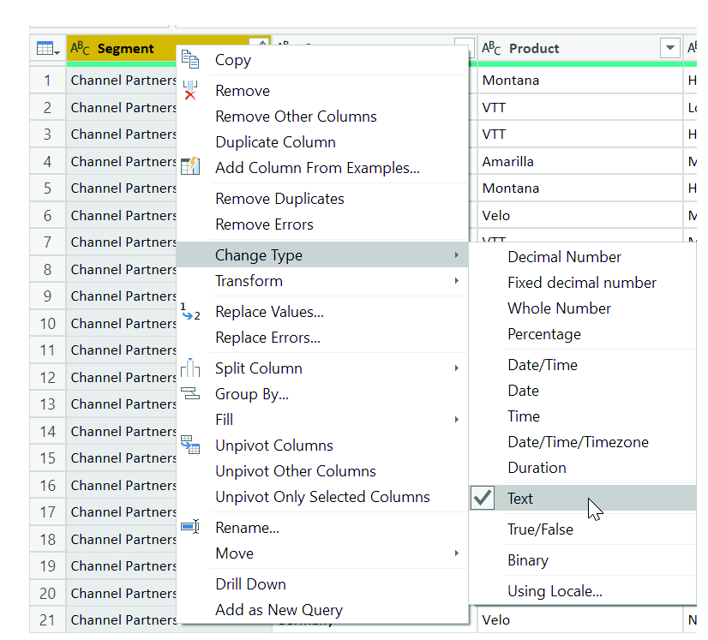
Uses of Power Query Editor
Clean the data
  Removing unwanted rows/columns/data
  Replacing values
Transform the data
  Splitting a Column into two
  Adding a calculated column
  Transpose
  Pivot
  Unpivot etc.,
Merge and Append multiple Queries from same or different source of data.
  Change the Format or Type
  Extract day, month, year
  Do time related calculations

Slide 21
UNIT-1: MS POWER BI
CHAPTER-3.1
Querying and Shaping the Data

Slide 22
LEARNING OBJECTIVES:
Identify and connect to a data source
Get data from a relational database, such as Microsoft SQL Server
Get data from a file, such as Microsoft Excel
Get data from applications
Get data from Azure Analysis Services
Select a storage mode
Fix performance issues
Resolve data import errors

Slide 23
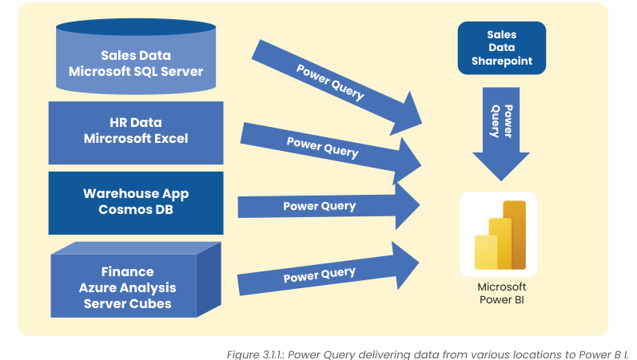
Get data from multiple sources
An organization may have data in multiple sources, but they are related. Getting the data into Power Query is the first step.

Slide 24
Get data from Flat Files
Flat files are individual data files.
Data from external sources may also be required for analysis (like) GST/Bank account data for reconciliation)
These files are usually in one of the following formats.
  Txt (Fixed width)
  Csv (Delimited)
  XLSX (Excel Files)
  XML (Tree Structure Data)
  PDF (Portable Document Format)
  Json (Nested Tables/Key Value pairs)

Slide 25
Get data from Flat Files … Contd.
Flat files may be in
  Local drives
  OneDrive for Business
  OneDrive Personal
  Sharepoint Folder
Data source can be changed later by clicking Home->Transform Data-> Data Source Settings
Make sure the same structure of the data is being loaded every time.

Slide 26
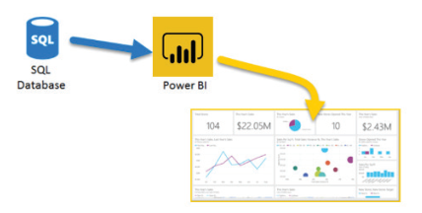
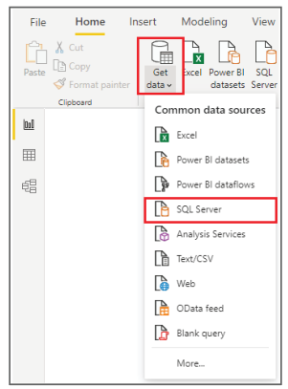
Get data from RDBMS
Transaction data of an organization (like a typical ERP) is stored mainly in RDBMS.
Power BI can connect any RDBMS data as source of data using specific database-oriented connector or through ODBC (Open DataBase Connectivity)
Example, Tally data can be connected through TallyODBC.

Slide 27
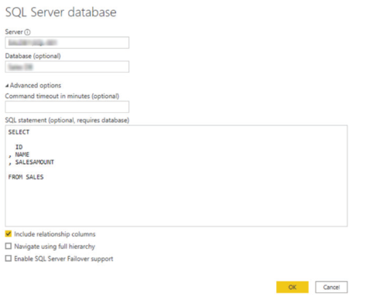
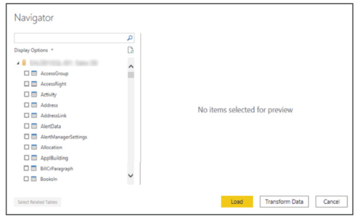
Get data from RDBMS
First connect to the RDBMS Server using Data connectors
Two ways to get data from RDBMS
  Selecting required individual tables
  Running a customized query

Slide 28
Dynamic Reports with Parameters
Dynamic Reports can be created by passing Parameters to SQL Queries
Steps to be followed:
  Create a query with parameter
  Create a Parameter (Home->Manage Parameters->New Parameter)
  Convert the Query to a Function (Right Click Query->Create Function)
  In any other query having the parameters as a column, Add a Column by Invoking Custom Function

Slide 29
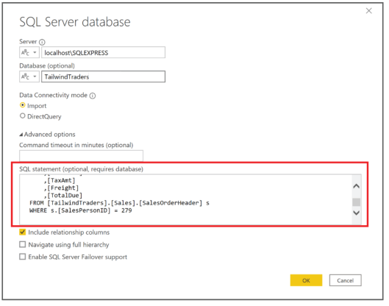
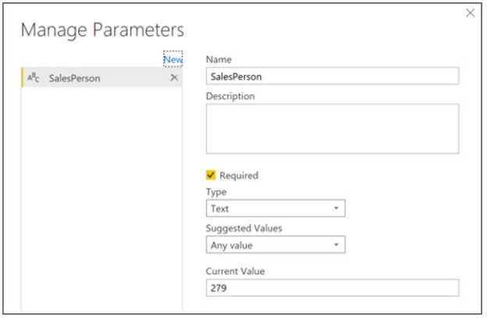
Dynamic Reports with Parameters
Step 1
Step 2

Slide 30
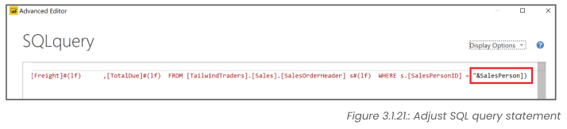
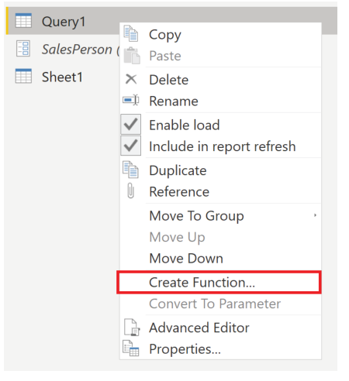
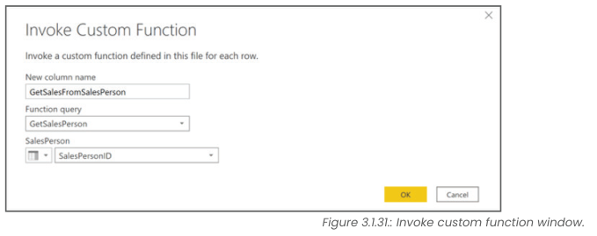
Dynamic Reports with Parameters
Step 3
Step 4

Slide 31
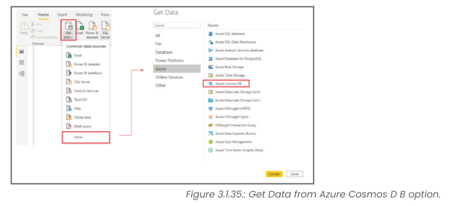
Get Data from NoSQL (Not only SQL) Database
Data can be extracted from NoSQL Databases like Azure Cosmos DB.

Slide 32
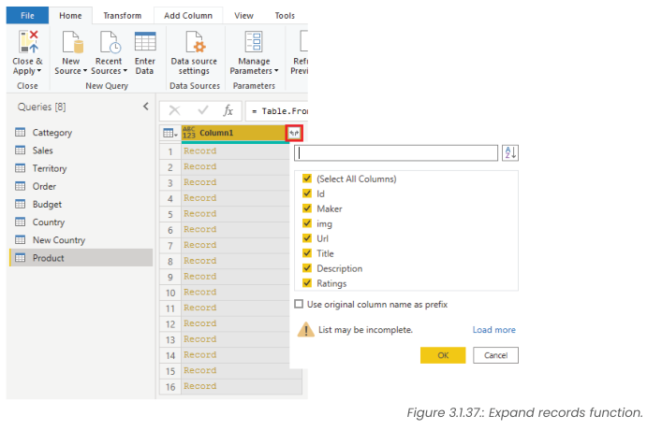
JSON DOCUMENTS
In NoSQL databases, data is stored in the form of JSON documents which can be easily extracted into Power Query Editor
By pressing Expand button we can extract the records with selected columns

Slide 33
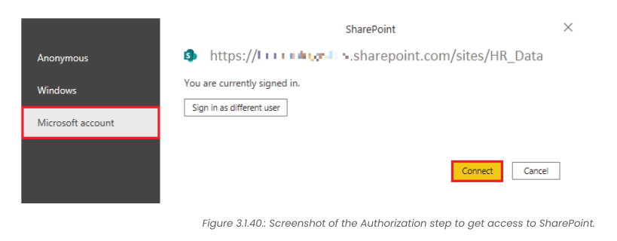
Get Data from Online Services
Data can be downloaded from online services like SharePoint, OneDrive, Google Analytics, Dynamics 365 etc.,

Slide 34
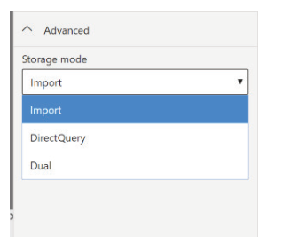
Storage Modes
Data can be stored in three modes in Power BI Services
  Import Mode (Create a local copy of data)
  Direct Query (Make a query whenever required)
    Used for viewing the most up-to-date data
  Dual (Composite of above two)
    Some part is copied
    Balance is queried

Slide 35
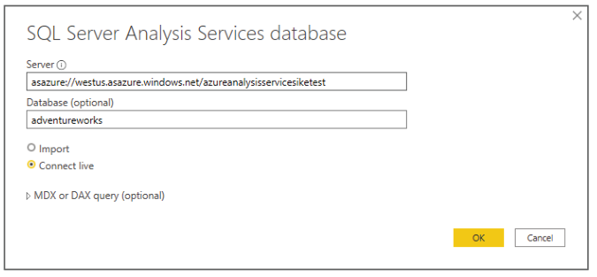
Get data from Azure Analysis Services
Azure Analysis Services is a fully managed platform as a service (PaaS) that provides enterprise-grade data models in the cloud.
Create a Semantic Model to perform ad hoc data analysis

Slide 36
Fix Performance Issues
Use Performance Analyzer to fix tune performance issues.
To optimize the performance use performance tuning techniques
  Index Creation
  Hardware Upgrades
  Query Execution Plan Tuning
  Data Compression etc.,

Slide 37
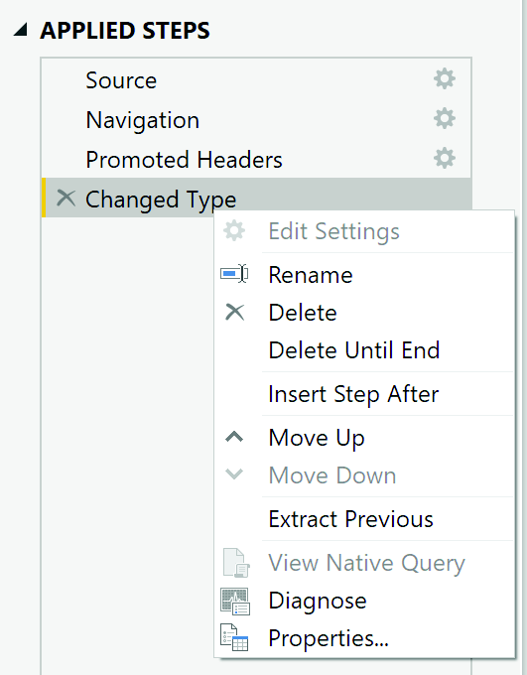
Fix Performance Issues
Query Folding
  A method used by the Power Query Editor to convert internally Power Query steps to Native SQL Query.
  Useful only for SQL Query connectors and not flat file connectors.
  If Query Folding is possible, View Native Query option will be enabled.
  The idea is to run the steps in SQL server itself if possible, instead of running the steps by Power Query.

Slide 38
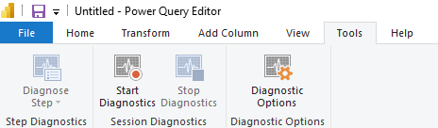
Query Diagnostics
This tool is useful when you want to analyse performance on the Power Query side for tasks such as loading datasets, running data refreshes, or running other transformative tasks.

Slide 39
Optimize Performance
Process as much possible in the native source itself instead of Power Query
Instead of CTE (Common Table Expressions) or Stored Procedures, use Native SQL Queries.
Column separation like Date and Time into two columns can be done in the source itself.

Slide 40
Resolve Data Import Errors
Common Errors
  Query Timeout Expired
  Couldn’t find data formatted as table (in Excel files)
  Couldn’t find file
  Data Type mismatch errors
  Date format errors (importing US date format (mm/dd/yyyy) in Indian date format (dd/mm/yyyy) without using locale.
These errors can be resolved if we properly follow the help and documents.

Slide 41
UNIT-1: MS Power BI
CHAPTER-3.2
Clean, Transform, and Load Data in Power Bi

Slide 42
Learning objectives
Resolve inconsistencies, unexpected or null values, and data quality issues.
Apply user-friendly value replacements.
Profile data so you can learn more about a specific column before using it.
Evaluate and transform column data types.
Apply data shape transformations to table structures.
Combine queries.
Apply user-friendly naming conventions to columns and queries.
Edit M code in the Advanced Editor.

Slide 43
Clean, Prepare and Process the data
Cleaning the data is a challenging task for the data analyst since Garbage In is Garbage Out.
We need to systematically treat
    Null values
    Duplicates
    Multiple column values in a single column like address containing PIN code, City, State etc.,
    Blank Rows/Columns etc.,

Slide 44
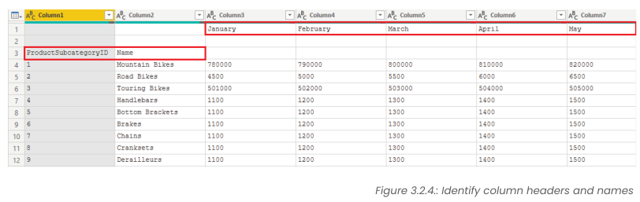
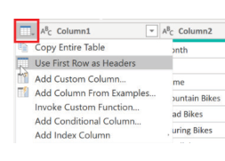
Identify Columns and Names
From the chunk of data imported (especially if it is not from structured data) we need to identify columns and names.
Promote the column headers when needed

Slide 45
Clean, Prepare and Process Data
Power Query is having transformation tools like
  Remove Top Rows, Blanks
  Keep Rows
  Remove Duplicates
  Remove Columns
  Choose Columns
  Transpose
  Pivot
  Unpivot
  Parse
  Split

Slide 46
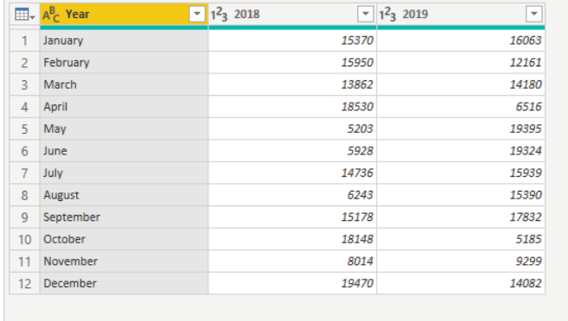
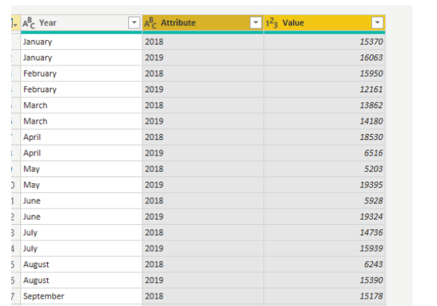
Unpivot Columns
Unpivot is an important feature in Power Query Editor
Data before Unpivot
Data after Unpivot

Slide 47
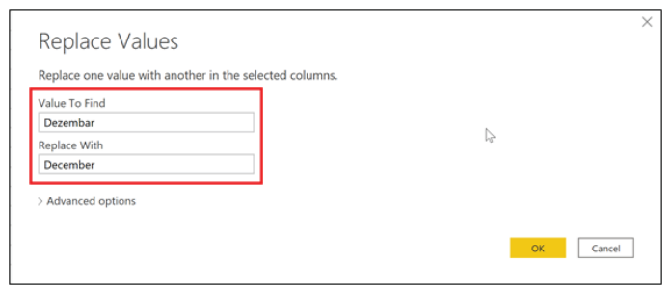
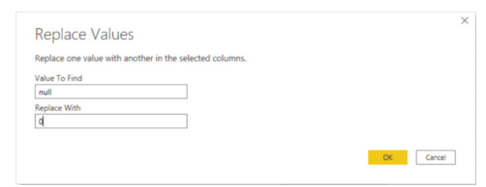
Replace Values
Replace any value with any value even in multiple columns together is a handy tool

Slide 48
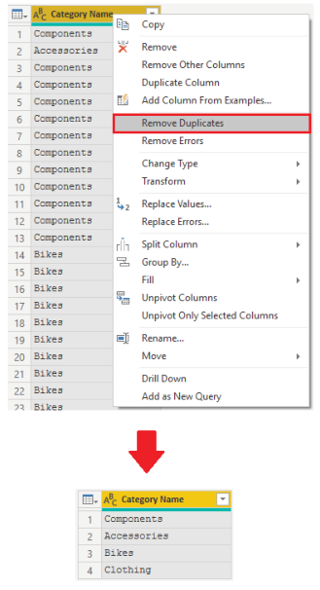
Remove Duplicates
Duplicates can be removed either for a single column or multiple columns together.

Slide 49
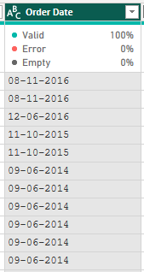
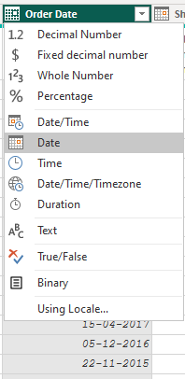
Change Column Types
Choose appropriate column types to make the reports accurate.
Date formatted as Text
Date formatted as Date
Using Locale can be used for
Date from different countries

Slide 50
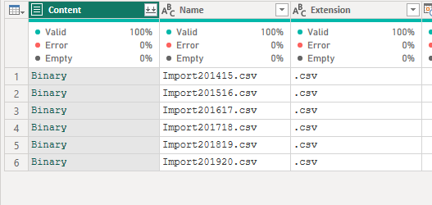
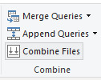
Combine Files
Multiple Tables can be made into a single table by the following ways:
  Combine
    When all the source files are having same structure, it is useful to combine into a single table.

Slide 51

Append Queries
Append is Row wise addition of Tables
It is assumed that column names are same in all the tables. Note: Power Query is case sensitive.
Columns need not be in the same order.
Two or more queries can be appended.
Queries can be appended to an existing query, or a new query can be created by appending all the queries.

Slide 52
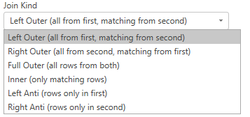
Merge Queries
Merging two queries is like the typical SQL Join.
It is column wise addition.
It is like vlookup function in Excel.
Six kinds of Join can be done
  Left Outer
  Right Outer
  Full Outer
  Inner
  Left Anti
  Right Anti

Slide 53
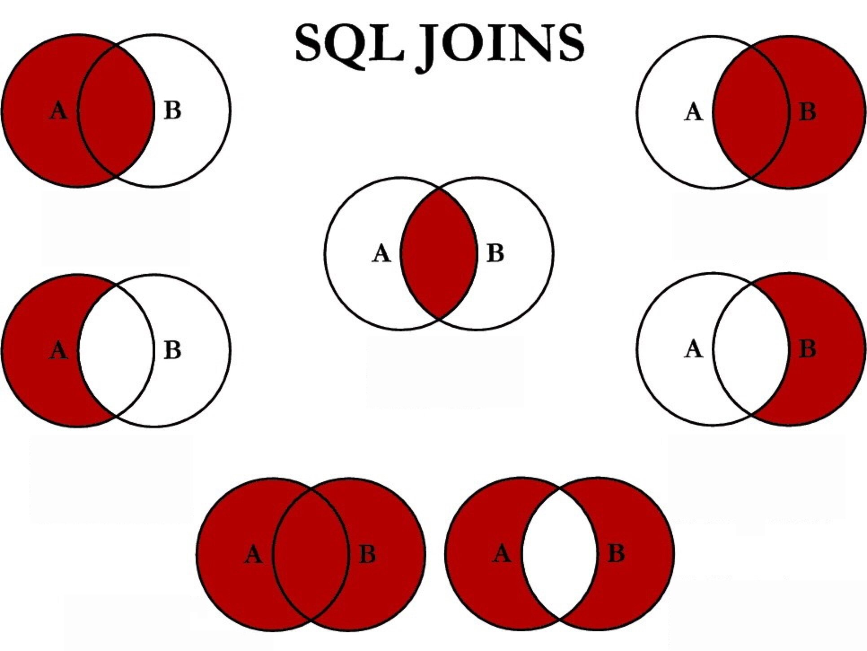
Various kinds of Merging Queries
Left Outer
Inner
Right Outer
Left Anti
Right Anti
Full Outer

Slide 54
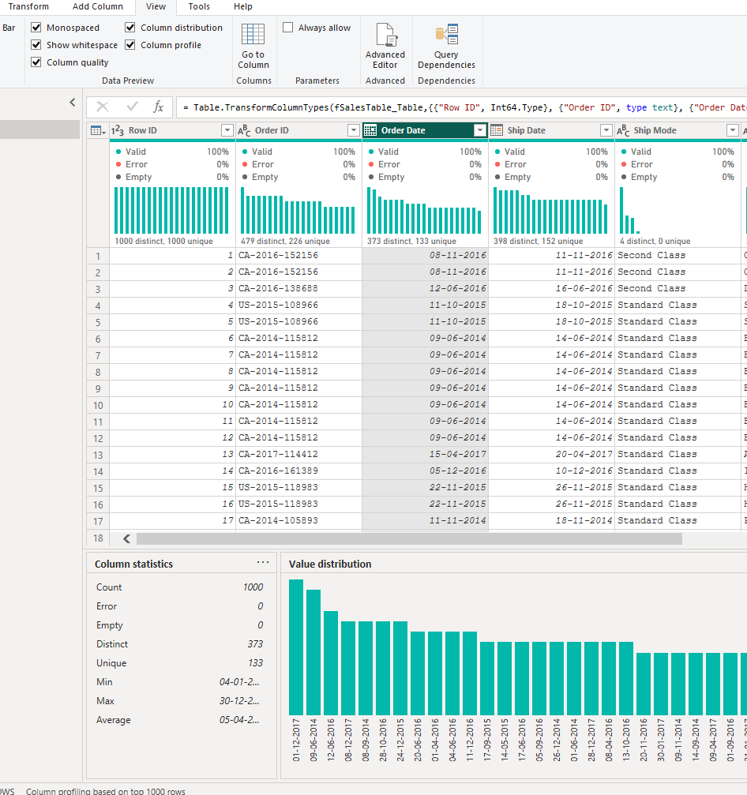
Column Profile
Distribution & Quality
Column Profile
  Helpful to find nuances of data
    Anomalies
    Outliers
    Unique and Distinct Count
Column Distribution
  View of value distribution of all the columns
Column Quality
  Composition of valid, error, empty data column wise.

Slide 55
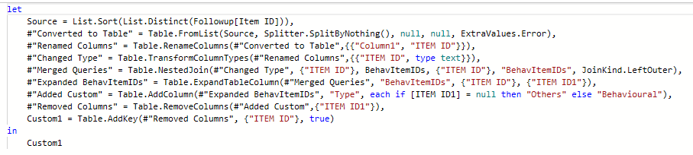
Use Advanced Editor to modify M Code
Each time you shape data in Power Query, you create a step in the Power Query process.
It is rarely used.
Sometimes easy to modify M Code directly.
View->Advanced Editor will show the M Code for the current query.

Slide 56
UNIT-1: MS POWER BI
CHAPTER-4
Data Visualizations and Data Extractions

Slide 57
LEARNING OBJECTIVES:
Explore Power BI Visuals
Create Power BI Visuals
Create and import a custom report theme.
Create custom visuals with R or Python.
Enable personalized visuals in a report.
Review report performance using Performance Analyzer.
Design and configure Power BI reports for accessibility.

Slide 58
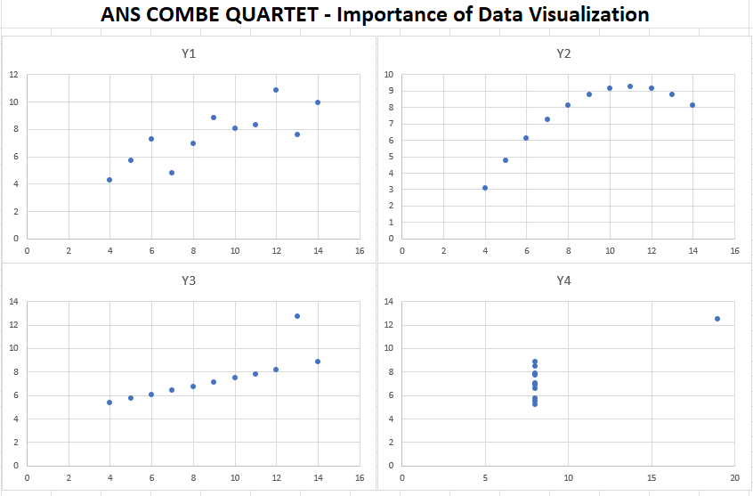
Introduction to Power BI Visuals
“A picture is worth a thousand words”
Complex data can be depicted in a simple visual.
X1 | Y1 | X2 | Y2 | X3 | Y3 | X4 | Y4
10 | 8.04 | 10 | 9.14 | 10 | 7.46 | 8 | 6.58
8 | 6.95 | 8 | 8.14 | 8 | 6.77 | 8 | 5.76
13 | 7.58 | 13 | 8.74 | 13 | 12.74 | 8 | 7.71
9 | 8.81 | 9 | 8.77 | 9 | 7.11 | 8 | 8.84
11 | 8.33 | 11 | 9.26 | 11 | 7.81 | 8 | 8.47
14 | 9.96 | 14 | 8.1 | 14 | 8.84 | 8 | 7.04
6 | 7.24 | 6 | 6.13 | 6 | 6.08 | 8 | 5.25
4 | 4.26 | 4 | 3.1 | 4 | 5.39 | 19 | 12.5
12 | 10.84 | 12 | 9.13 | 12 | 8.15 | 8 | 5.56
7 | 4.82 | 7 | 7.26 | 7 | 6.42 | 8 | 7.91
5 | 5.68 | 5 | 4.74 | 5 | 5.73 | 8 | 6.89
Average X | 9 |  | XY Correlation | 0.816
Average Y | 7.5 |  | R Squared | 0.67
Sample Variance | 11 |  | Linear Regression | 3.00+0.50x

Slide 59
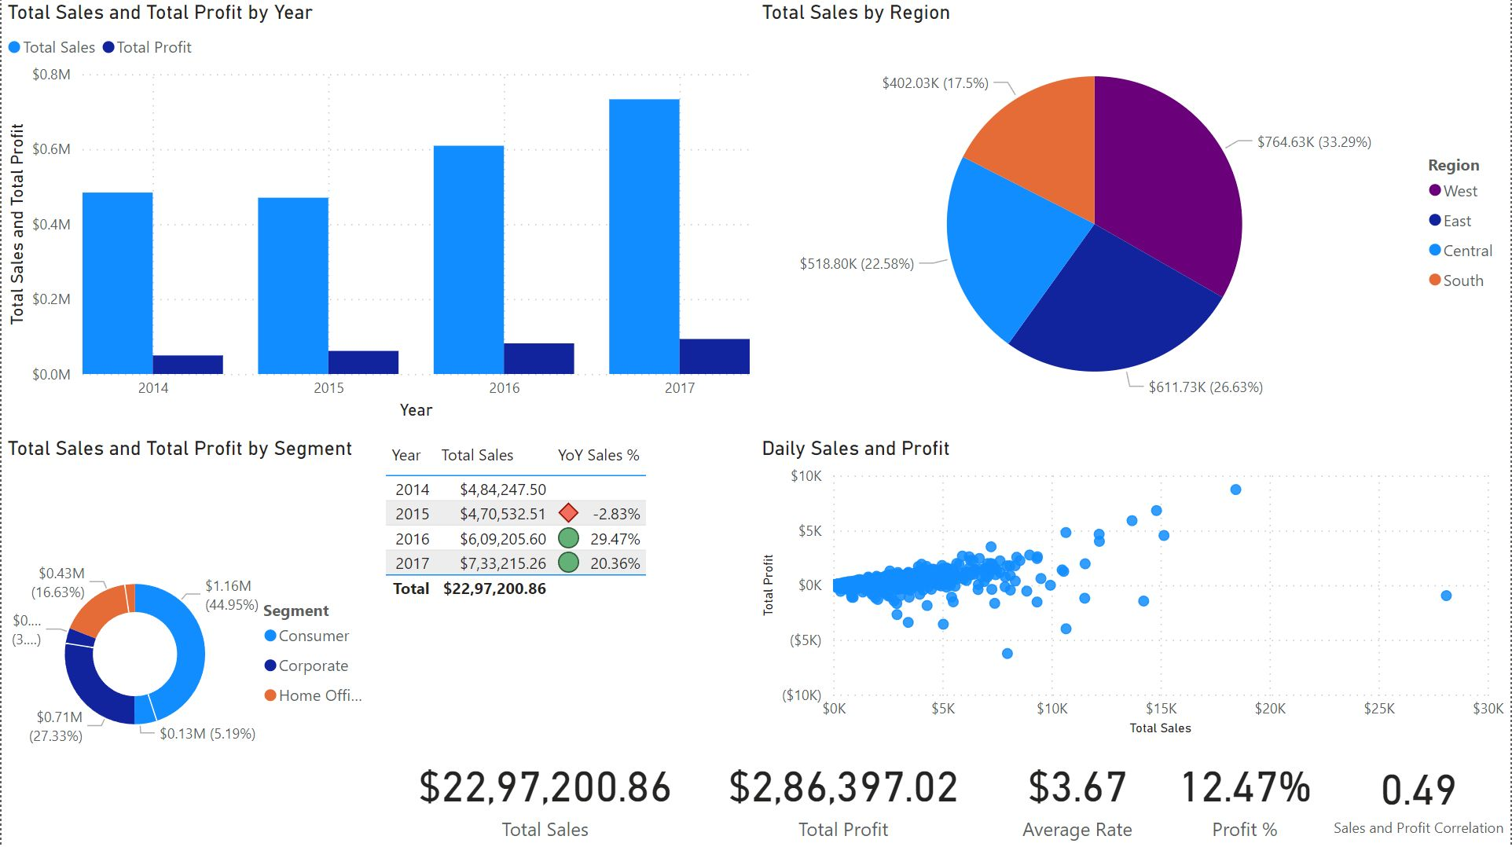
Power BI Visuals
Power BI Visuals are
  Dynamic
  Interactive
  Customizable and Flexible
  Wide in variety
  AI Powered
  Easy to Share

Slide 60
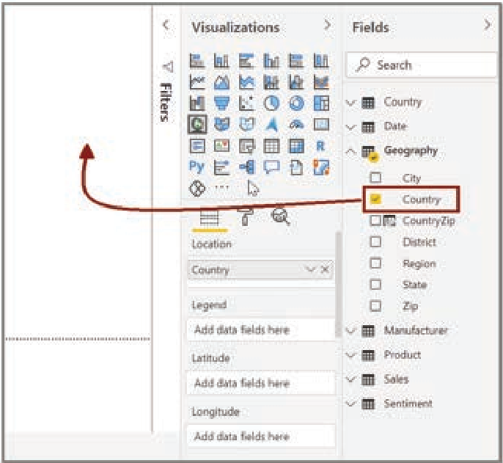
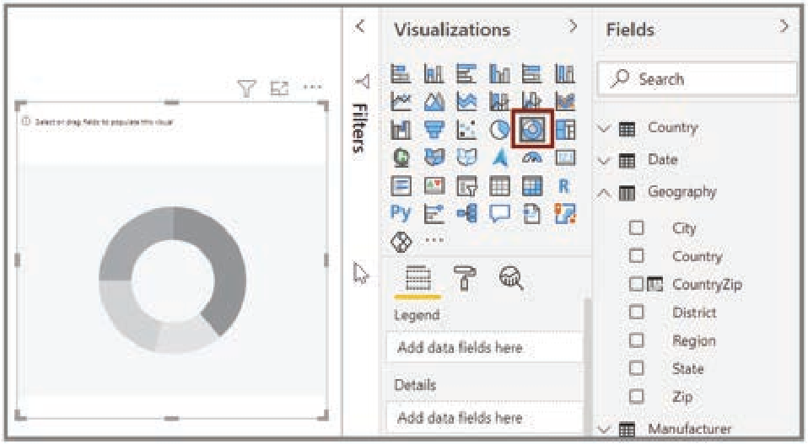
Create Visuals in Power BI
Two ways to create a visual
  Drag and Drop any field from data to report canvas area, then select the type of visual.
  Select the Visual and then drag and drop the relevant category fields (dimensions) or value fields (measures) to the visual.

Slide 61

Create Slicers
Slicers are Interactive Filters
In Power BI, slicers are also visuals.
Apart from slicers, every visual element is (for example a table cell, bar in a bar chart, pie in a pie chart etc.,) a slicer too!

Slide 62
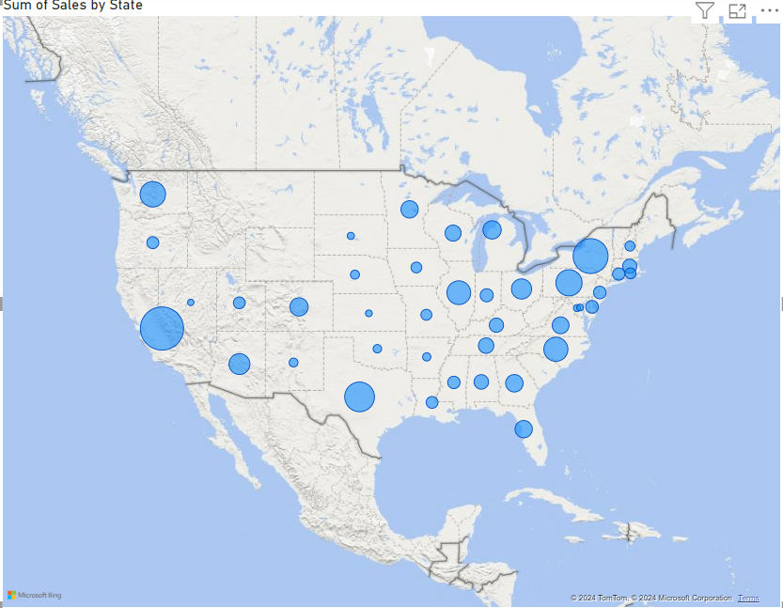
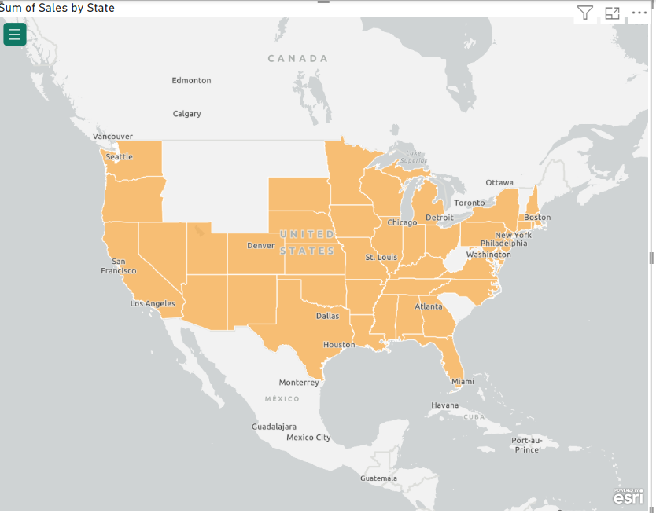
Create Map Visuals
Map visuals are useful for showing geographical data.
Bubble map, filled map are examples of map visuals.

Slide 63
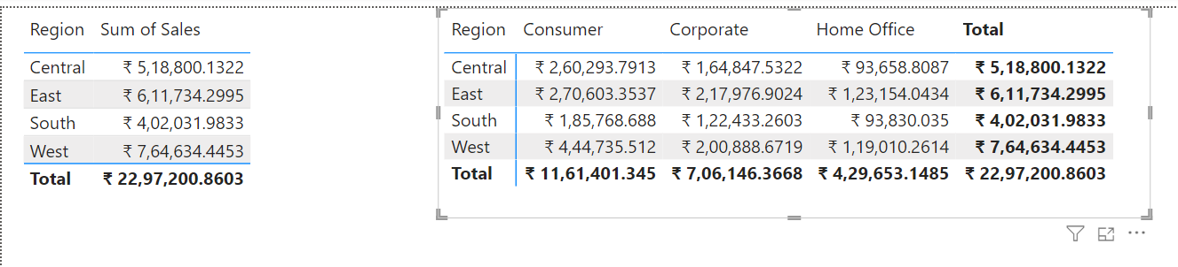
Tables and Matrices
Tables are used to show values in a row/column format.
Matrices are pivot tables, where rows and columns are used for grouping the values in a summary form or any showing any measure.

Slide 64
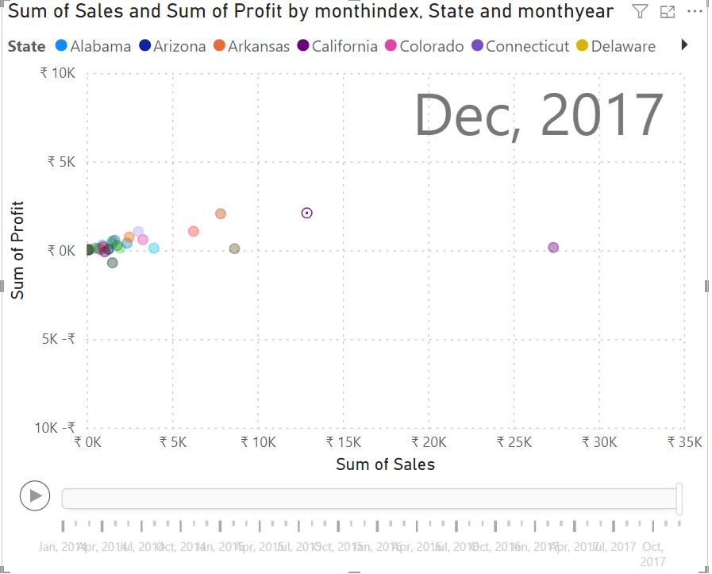
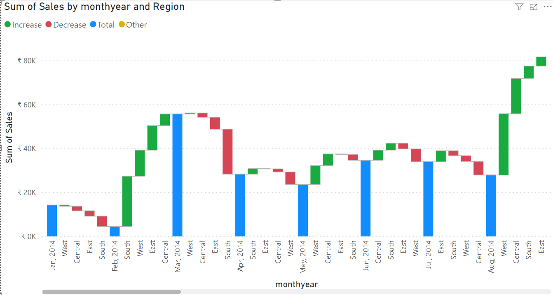
Scatter, Waterfall, Funnel, Tree map charts
Scatter – Correlation/Relationship (Can be animated by Play Axis)
Waterfall – Changes over time
Funnel – Process Changes

Slide 65
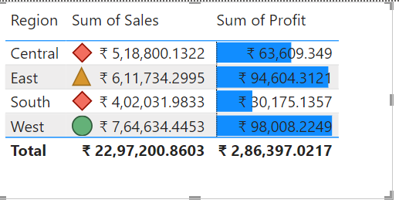
Modify Colours, Conditional Formatting
Just like Excel, we can modify any colour in any visual.
Conditional formatting, data bar, icon sets, and sparklines are also possible.

Slide 66
Other points to be noted
Page Layout and Formatting (Mobile view layout is helpful for designing the report for mobiles)
Adding Static elements like textbox, images etc.,
Navigation Buttons
Manage overlapping elements

Slide 67
4.2 Advanced Data visualization Concepts
Report Themes
  There are so many themes available in the gallery
  We can create custom themes by modifying existing themes or creating new themes.
  Themes can be saved in JSON files.
Power BI Template (.pbit file)
  Power BI Template files can be used to save the themes and meta data like DAX Measures and Calculated Tables but without data.
Personalized Visuals
  Visuals can be modified by Report consumers (if allowed) to change the type, measures, dimensions, legends, aggregations etc.

Slide 68
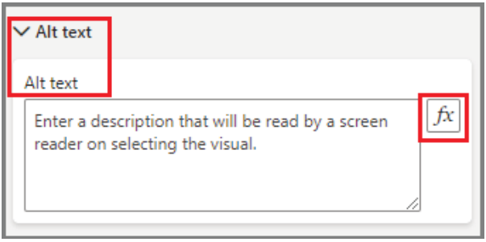
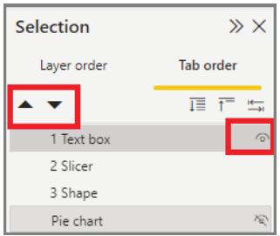
Design the reports with accessibility features
Alt text for visuals, shapes, and images
Set tab order for visuals, shapes, and images
Consistent font, colors, positioning
Colorblind-friendly color schemes
Using text or icons in addition to color
Avoid jargon and acronyms
Set sort order for visuals
Disable auto-start videos and audio
Provide captions and transcripts for videos and audio
Avoid excess decorative shapes and images

Slide 69
Custom visuals, Performance Analyzer
Custom Visuals using R/Python
  Advanced R or Python visuals can also be included in Power BI if installed.
Review the reports and performance Analyzer
  Performance Analyzer is a built-in feature in Power BI Desktop that measures how long report elements take to update and refresh
  Monitor the performance with performance analyzer.
  To improve
    Limit visuals per page. If the entire page is slow to load, consider spreading visuals across multiple pages instead.
    Remove unnecessary columns and rows. For slower queries, review the data and determine if anything can be
    removed.

Slide 70
Data Extractions
Launch Power BI
Get Data and
Connect to data
Load and Transform data
Data modelling
Data Refresh
Create Visualizations
Publish to Power BI Service
Save Power BI File
Data Security
Select Data Source

Slide 71
UNIT-1: MS Power BI
CHAPTER-5
Creating Reports and Output Options

Slide 72
Learning objectives
Create a report in Power BI
Share Power BI reports in various formats

Slide 73
Power BI Reports Output Options
The main purpose of Power BI Software is to provide right information to the right person at the right time to take data driven decision making.
Power BI Reports can be shared in many ways.
The common way to share a report of an Enterprise is Publishing to Web service.
  Browser or even mobile is enough to consume the reports.
  Collaboration and sharing of reports
  Automatic refreshing of data
  Secured access to reports.

Slide 74
Export to PDF
Power BI Reports can be exported to a Static PDF file.
To export to PDF, go to "File" > "Export" > "PDF."

Slide 75

Export to PowerPoint
From online service we can export to PowerPoint presentation.
In PowerPoint there is a Power BI Add-in to showcase any Power BI Report.

Slide 76
Export data to Excel
Every visual is having the feature to export the underlying data as a csv file and can be imported into Excel for further analysis easily.

Slide 77
Email Subscription
Users can get report updates in email if subscribed to Email subscription service of Power BI

Slide 78

Print Report Pages
Any report page can be printed from online services directly.

Slide 79
Power BI Embedded
Power BI Reports can be embedded and integrated into any web page or portal using Azure resources.
This may be useful for having a wider reach.

Slide 80



THANK YOU

