Slide 1



PYTHON FOR DATA SCIENCE

Slide 2


Learning Objectives
UNDERSTANDING THE FUNDAMENTALS OF PYTHON AND ITS VERSATILITY.
UNDERSTANDING VARIABLES, THEIR USAGE, AND IMPORTANCE WHILE CODING.
DIFFERENT TYPES OF EXPRESSIONS AND ITS USE IN ARITHMETIC OPERATIONS.
VARIOUS METHODS OF STRING OPERATIONS.
PROPERTIES OF LIST AND TUPLE. VARIOUS OPERATIONS PERFORMED ON BOTH LIST AND TUPLE.
CONDITIONED-BASED USE OF LOOPS LIKE “IF”, “FOR” AND “WHILE”.
FILE HANDLING AND ITS MANIPULATION.

Slide 3
Introduction – Python Basics Why Python
why python?
It’s more productive.
It has an expansive, supportive community of users (over 1,37,000 libraries)
It has high corporate demand.
High level (human friendly rather than computer friendly).
General purpose (solves any problem).
Open source and free.
Easy to learn.
Cross platform compatibility and integration capabilities.
Rapid prototyping and development.

Slide 4
Introduction
Programming Language:
A programming language is a way for programmers (developers) to communicate with computers.
High-Level Language:
A high-level language is any programming language that allows program development in a much more user-friendly programming context and is generally independent of the computer’s hardware architecture.
Eg: Python, java script, VBA, php, C#, java
Low-Level Language:
A low-level language is a programming language that works with the hardware elements and limitations of a computer. It works to administer a computer’s operational definition and has either a low level of abstraction in relation to a computer or no level of abstraction at all.
Eg: C, C++, Assembly, and Fortran.

Slide 5
How Python is a high-level Programming Language
Example of high level programming language: The below code emails sales report from system.
#Example of a Script
import yagmail
user = yagmail.SMTP(user=‘testmail@gmail.com',password='zpsgowuwqlansmfv’)
user.send(to ='accounts@techca.app', subject ='Sales_Reports',contents ='This is test mail for python automation', attachments = 'Sales.xlsx')
From above piece of code its easy to guess in Line no 1 yagmail laibrary is imported
In Line 2 the from mail id ‘testmail@gmail.com’, and password is set as 'zpsgowuwqlansmfv’
Line 3 send the email to 'accounts@techca.app’, with subject Sales report and with body of email and attachment of file named Sales.xlsx
Chat GPT Prompt
Explain how the code <Paste code here> works in Python..

Slide 6
Introduction – Use case scenarios
Data analytics
Office automation
Web scrapping
Machine learning
Share market (data analytics)
Application development
Web applications (Django and Flask)
For further reading refer https://brochure.getpython.info/media/releases/python-brochure-current

Slide 7
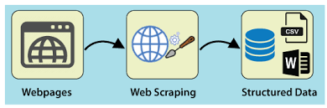
Introduction – Use case scenarios
How web scraping works! - Refer RPA Chapter for more Examples

Slide 8
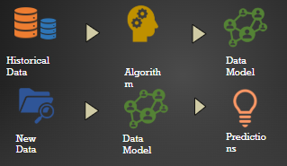
Introduction – Use case scenarios
Methodology for DA and ML

Slide 9
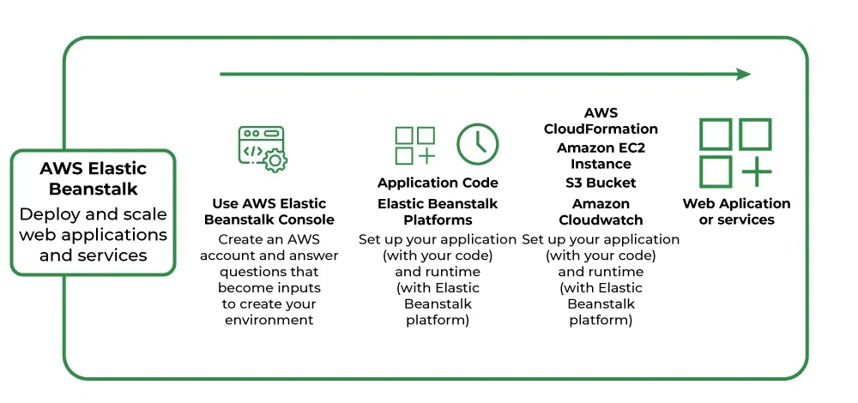
Introduction – Use case scenarios

Slide 10
Some Ways to run python code
Jupyter Notebook Deloyment Mode
.py File – Idle mode
CoLab – Google (https://colab.google/)
For further reading the students may refer
- IDLE - https://docs.python.org/3/library/idle.html
- Jupyter Notebook - https://jupyter.org/try
- Google Co Lab https://colab.google/

Slide 11
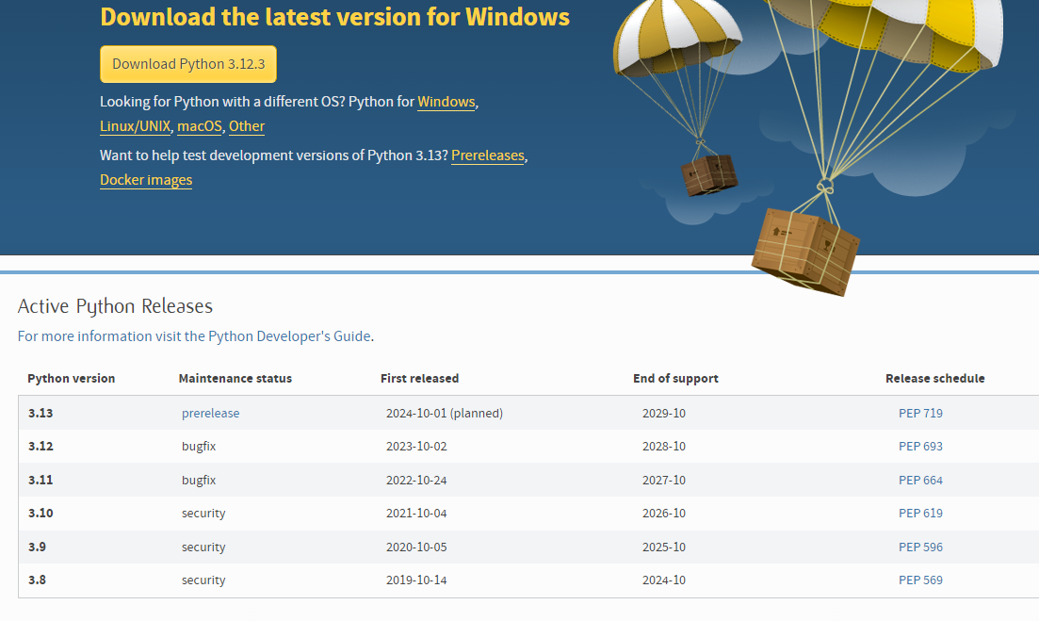
How to Install Python
Go to https://www.python.org/downloads/
Click download the relevant files based on the OS and version

Slide 12
12. Pip in Python
pip is the package installer for Python, which stands for "Pip Installs Packages" (originally "Pip Installs Python"). It's a tool used to install and manage Python packages (libraries or modules) that are not part of the Python standard library.
Eg
pip install package_name
Pip install Django
Pip install pandas
Note : Python Libraries are discussed in Module 2

Slide 13
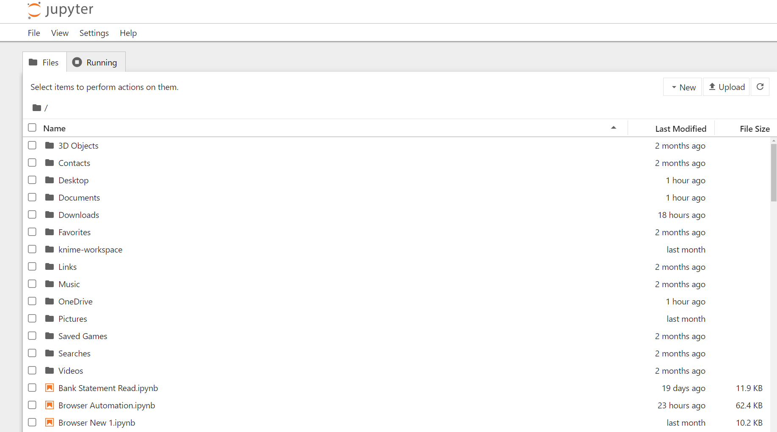
13. Jupyter Notebook Deloyment Mode
The common convention is to alias NumPy as `np`.
pip install jupyterlab
pip install notebook

Slide 14
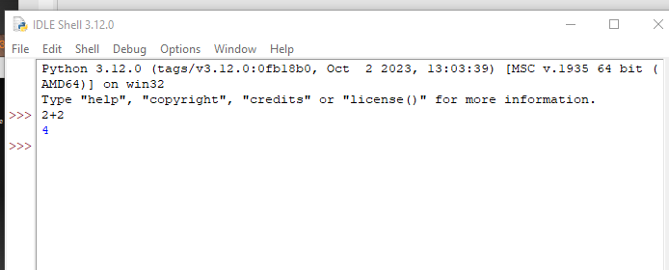
14. PYTHON IDLE
The common convention is to alias NumPy as `np`.
IDLE is an Integrated DeveLopment Environ-ment for Python, typically used on Windows.
Multi-window text editor with syntax highlighting, auto-completion, smart indent and other.
Python shell with syntax highlighting.
Integrated debugger with stepping, persis-tent breakpoints,and call stack visibility
- IDLE - https://docs.python.org/3/library/idle.html

Slide 15
15. COLAB - GOOGLE
The common convention is to alias NumPy as `np`.
Refer this url to use notebook by Colab in Google
https://colab.google/

Slide 16
Introduction - Python Comments and Variables
The common convention is to alias NumPy as `np`.
Python Comments: Comments can be used to explain Python code. Comments can be used to make the code more readable. Comments can be used to prevent execution when testing code.
Example: #This is a comment
print("Hello, ICAI!")
Variables: Variables are containers for storing data values. Python has no command for declaring a variable. A variable is created the moment you first assign a value to it.
Example: x = 5
y = "John"
print(x)
print(y)
Refer more for Variables naming in - https://www.w3schools.com/python/python_variables_names.asp

Slide 17
Introduction - Python Comments and Variables
The common convention is to alias NumPy as `np`.
Exercise:
Comments – (INT18)
Variables – (INT19)

Slide 18
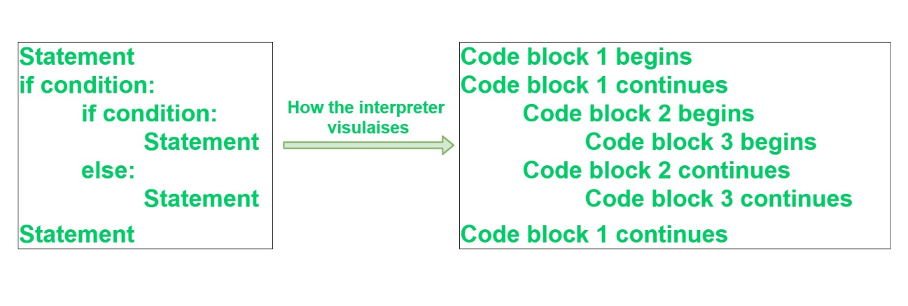
Introduction - Python Indendation
The common convention is to alias NumPy as `np`.
Indentation is a very important concept of Python because without properly indenting the Python code, you will end up seeing Indentation Error and the code will not get compiled.
To indicate a block of code in Python, you must indent each line of the block by the same whitespace.

Slide 19
Introduction - Python Operators
The common convention is to alias NumPy as `np`.
Python Operators: Operators are used to perform operations on variables and values.
Python divides the operators in the following groups:
Arithmetic operators
Assignment operators
Comparison operators
Logical operators

Slide 20
Introduction - Python Operators
The common convention is to alias NumPy as `np`.
Python Operators: Operators are used to perform operations on variables and values.
Python divides the operators in the following groups:
Arithmetic operators
Assignment operators
Comparison operators
Logical operators
Identity operators
Membership operators
Bitwise operators

Slide 21
Introduction - Python Operators
The common convention is to alias NumPy as `np`.
Arithmetic Operators: Arithmetic operators are used with numeric values to perform common mathematical operations.
Operator | Name | Example
+ | Addition | x + y
- | Subtraction | x - y
* | Multiplication | x * y
/ | Division | x / y
% | Modulus | x % y
** | Exponentiation | x ** y
// | Floor division | x // y

Slide 22
Introduction - Python Operators
The common convention is to alias NumPy as `np`.
Assignment Operators: Assignment operators are used to assign values to variables:
Operator | Example | Same As
= | x = 5 | x = 5
+= | x += 3 | x = x + 3
-= | x -= 3 | x = x - 3
*= | x *= 3 | x = x * 3
/= | x /= 3 | x = x / 3
%= | x %= 3 | x = x % 3
//= | x //= 3 | x = x // 3
**= | x **= 3 | x = x ** 3
&= | x &= 3 | x = x & 3
|= | x |= 3 | x = x | 3
^= | x ^= 3 | x = x ^ 3
>>= | x >>= 3 | x = x >> 3
<<= | x <<= 3 | x = x << 3

Slide 23
Introduction - Python Operators
Logical Operators: Logical operators are used to combine conditional statements:
Comparison Operators: Comparison operators are used to compare two values:
Operator | Name | Example
== | Equal | x == y
!= | Not equal | x != y
> | Greater than | x > y
< | Less than | x < y
>= | Greater than or equal to | x >= y
<= | Less than or equal to | x <= y
Logical Operators: Logical operators are used to combine conditional statements:
Operator | Description | Example
and | Returns True if both statements are true | x < 5 and x < 10
or | Returns True if one of the statements is true | x < 5 or x < 4
not | Reverse the result, returns False if the result is true | not(x < 5 and x < 10)

Slide 24
Introduction - Python Operators
Logical Operators: Logical operators are used to combine conditional statements:
Identity Operators: Identity operators are used to compare the objects, not if they are equal, but if they are actually the same object, with the same memory location:
Operator | Description | Example
is | Returns True if both variables are the same object | x is y
is not | Returns True if both variables are not the same object | x is not y
Membership Operators: Membership operators are used to test if a sequence is presented in an object:
Operator | Description | Example
in | Returns True if a sequence with the specified value is present in the object | x in y
not in | Returns True if a sequence with the specified value is not present in the object | x not in y

Slide 25
Introduction - Python Operators - Precedence
The common convention is to alias NumPy as `np`.
Operator Precedence: Operator precedence describes the order in which operations are performed. Parentheses has the highest precedence, meaning that expressions inside parentheses must be evaluated first, Example: print((6 + 3) - (6 + 3)).
If two operators have the same precedence, the expression is evaluated from left to right.
The precedence order is described in the table below, starting with the highest precedence at the top:
Operator | Description
() | Parentheses
** | Exponentiation
+x -x ~x | Unary plus, unary minus, and bitwise NOT
* / // % | Multiplication, division, floor division, and modulus
+ - | Addition and subtraction
<< >> | Bitwise left and right shifts
& | Bitwise AND
^ | Bitwise XOR
| | Bitwise OR
== != > >= < <= is is not in not in | Comparisons, identity, and membership operators
not | Logical NOT
and | AND
or | OR

Slide 26
Introduction - Python Operators
The common convention is to alias NumPy as `np`.
Operator Precedence: Operator precedence describes the order in which operations are performed. Parentheses has the highest precedence, meaning that expressions inside parentheses must be evaluated first, Example: print((6 + 3) - (6 + 3)).
If two operators have the same precedence, the expression is evaluated from left to right.
The precedence order is described in the table below, starting with the highest precedence at the top:
Operator | Description
() | Parentheses
** | Exponentiation
+x -x ~x | Unary plus, unary minus, and bitwise NOT
* / // % | Multiplication, division, floor division, and modulus
+ - | Addition and subtraction
<< >> | Bitwise left and right shifts
& | Bitwise AND
^ | Bitwise XOR
| | Bitwise OR
== != > >= < <= is is not in not in | Comparisons, identity, and membership operators
not | Logical NOT
and | AND
or | OR

Slide 27
Introduction - Python Operators
The common convention is to alias NumPy as `np`.
Exercise
Arithmetic operators - (INT20)
Comparison operators - (INT20)
Logical operators - (INT20)
Membership operators - (INT20)

Slide 28
Introduction – String operations
The common convention is to alias NumPy as `np`.
String: Python uses string operations to work with strings. Strings in python are surrounded by either single quotation marks, or double quotation marks.
Function Name | Description
Capitalize () | Converts the first character of the string to a capital (uppercase) letter
Count () | Returns the number of occurrences of a substring in the string.
Index () | Returns the position of the first occurrence of a substring in a string
Isalnum () | Checks whether all the characters in a given string are alphanumeric or not
Isalpha () | Returns "True" if all characters in the string are alphabets
Isdecimal () | Returns true if all characters in a string are decimal
Isdigit () | Returns "True" if all characters in the string are digits
is lower () | Check if all characters in the string are lowercase
isnumeric () | Returns "True" if all characters in the string are numeric characters
is join () | Returns a concatenated String
is lower () | Converts all uppercase characters in a string into lowercase
Replace () | Replace all occurrences of a substring with another substring
Startswith () | Returns "True" if a string starts with the given prefix
Strip () | Returns the string with both leading and trailing characters
Swapcase () | Converts all uppercase characters to lowercase and vice versa
title () | Convert string to title case
Upper () | Converts all lowercase characters in a string into uppercase

Slide 29
Introduction – String operations
The common convention is to alias NumPy as `np`.
Escape character: To insert characters that are illegal in a string, use an escape character. An escape character is a backslash \ followed by the character you want to insert.
Code | Result
\' | Single Quote
\\ | Backslash
\n | New Line
\r | Carriage Return
\t | Tab
\b | Backspace
\f | Form Feed
\ooo | Octal value
\xhh | Hex value

Slide 30
Introduction – String operations
The common convention is to alias NumPy as `np`.
Exercise:
Print a string – (INT01)
Print a string with a variable – (INT02)
Multiline Strings – (INT03)
String position – (INT04)
String slicing – (INT05)
Modify string – (INT06)
Concatenate string – (INT07)
Escape character – (INT07A)

Slide 31
Introduction - Numeric
The common convention is to alias NumPy as `np`.
Numeric: The numeric data type in Python represents the data that has a numeric value. A numeric value can be an integer, a floating number, or even a complex number. These values are defined as Python int, Python float, and Python complex classes in Python.
Integers – This value is represented by int class. It contains positive or negative whole numbers (without fractions or decimals). In Python, there is no limit to how long an integer value can be. Example: X = 1
Float – This value is represented by the float class. It is a real number with a floating-point representation. It is specified by a decimal point. Optionally, the character e or E followed by a positive or negative integer may be appended to specify scientific notation. Example: Y = 2.8
Complex Numbers – A complex number is represented by a complex class. It is specified as (real part) + (imaginary part)j. For example – 2+3j

Slide 32
Introduction - Numeric
The common convention is to alias NumPy as `np`.
Exercise
Numeric examples – (INT08)

Slide 33
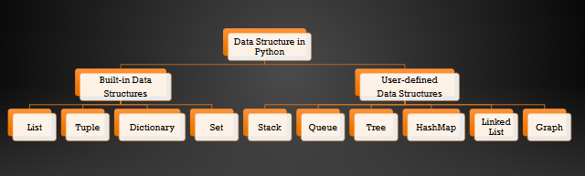
Introduction – Data Strutcture
The common convention is to alias NumPy as `np`.

Slide 34
Introduction - List
The common convention is to alias NumPy as `np`.
List: In Python, the sequence of various data types is stored in a list. A list is a built-in data structure in Python, which is the collection of different kinds of values or items. Every item in the list, also known as the Index, has an address allocated to it. The index value begins at 0 and continues until the final component, which is the positive index. You can also retrieve elements from last to first using negative indexing, which starts at -1. Integers – This value is represented by int class. It contains positive or negative whole numbers (without fractions or decimals). In Python, there is no limit to how long an integer value can be.
Lists are created using square brackets, and then the elements are added accordingly. If none of the elements are entered in the square brackets, then an empty list would be created.
The most common associated method of lists are list(), append(), insert(), extend(), sort(), reverse(), remove(), pop(), clear() etc.
Example: Var = [10, 20, 14]

Slide 35
Introduction - List
The common convention is to alias NumPy as `np`.
Exercise:
List – (INT09)
Modification of list – (INT10)
Length of list - (INT11)
Sorting of list - (INT11)
Reverse of list - (INT11)

Slide 36
Introduction - Tuples
The common convention is to alias NumPy as `np`.
Tuples: A tuple is a built-in data structure in Python similar to lists but also has some significant differences. The difference between the two is that once the elements are assigned to the tuple can’t be changed. Tuples are used to store an ordered series of elements and are defined by parentheses (). The most common associated method of tuples are tuple(), count(), index() etc. Tuples allow duplicate values:
Examples of Tuple: thistuple = ("apple", "banana", "cherry", "apple", "cherry")
Python Lists | Python Tuples
Lists are mutable. | Tuples are immutable.
Since lists are mutable, they have several built-in methods. | Due to their immutability, tuples have fewer built-in functions than other data types.
Iterations are time-consuming | Iterations are comparatively Faster
Python lists are created using square brackets []' | Python tuples are created using parentheses ()'

Slide 37
Introduction - Tuples
The common convention is to alias NumPy as `np`.
Exercise
Tuple – (INT12)
Tuple iterations – (INT13)
Tuple functions concatenate and repeating – (INT14)
Tuple coordinates – (INT15)

Slide 38
Introduction – Dictionary
The common convention is to alias NumPy as `np`.
Dictionary: A dictionary in Python is a data structure that stores the value in value:key pairs. The most common associated method of dictionaries are get(), keys(), values(), items(), update(), pop(), clear() etc.
Example: Dict = {1: ‘ICAI', 2: 'For', 3: ‘CA’}
As you can see from the example, data is stored in key: value pairs in dictionaries, which makes it easier to find values.
Dictionary vs Json
Json | Dictionary
JSON keys can only be strings. | The dictionary’s keys can be any hashable object.
The keys in JSON are ordered sequentially and can be repeated. | The keys in the dictionary cannot be repeated and must be distinct.
The keys in JSON have a default value of undefined. | There is no default value in dictionaries.
The values in a JSON file are accessed by using the “.” (dot) or “[]” operator. | The subscript operator is used to access the values in the dictionary. For example, if ‘dict’ = ‘A’:’123R’,’B’:’678S’, we can retrieve data related by simply calling dict[‘A’].
For the string object, we must use double quotation marks. | For string objects, we can use either a single or double quotation.
In JSON, the return object type is a’string’ object type. | The ‘dict’ object type is the return object type in a dictionary.

Slide 39
Introduction - Python Functions
The common convention is to alias NumPy as `np`.
Functions: A function is a block of code which only runs when it is called. You can pass data, known as parameters, into a function. A function can return data as a result. In Python a function is defined using the def keyword: def my_function():
In Python a function is defined using the def keyword:
A function is a block of code which only runs when it is called.
You can pass data, known as parameters, into a function.
A function can return data as a result.
Arguments in a Function

Slide 40
Introduction - Python Functions
The common convention is to alias NumPy as `np`.
Exercise:
Function Basic – (INT21)
Function with Operators - (INT22)
Functions with default parameters - (INT23)
Functions with Variable Number of Arguments - (INT24)

Slide 41
Regex
The common convention is to alias NumPy as `np`.
Regex: A RegEx, or Regular Expression, is a sequence of characters that forms a search pattern. RegEx can be used to check if a string contains the specified search pattern.
RegEx Functions:
Function | Description
findall | Returns a list containing all matches
search | Returns a Match object if there is a match anywhere in the string
split | Returns a list where the string has been split at each match
sub | Replaces one or many matches with a string

Slide 42
Regex
The common convention is to alias NumPy as `np`.
Meta Characters:
Character | Description | Example
[] | A set of characters | "[a-m]"
\ | Signals a special sequence (can also be used to escape special characters) | "\d"
. | Any character (except newline character) | "he..o"
^ | Starts with | "^hello"
$ | Ends with | "planet$"
* | Zero or more occurrences | "he.*o"
+ | One or more occurrences | "he.+o"
? | Zero or one occurrences | "he.?o"
{} | Exactly the specified number of occurrences | "he.{2}o"
| | Either or | "falls|stays"
() | Capture and group

Slide 43
Regex
The common convention is to alias NumPy as `np`.
Special Sequences:
Character | Description | Example
\A | Returns a match if the specified characters are at the beginning of the string | "\AThe"
\b | Returns a match where the specified characters are at the beginning or at the end of a word | r"\bain"
 | (the "r" in the beginning is making sure that the string is being treated as a "raw string") | r"ain\b"
\B | Returns a match where the specified characters are present, but NOT at the beginning (or at the end) of a word | r"\Bain"
 | (the "r" in the beginning is making sure that the string is being treated as a "raw string") | r"ain\B"
\d | Returns a match where the string contains digits (numbers from 0-9) | "\d"
\D | Returns a match where the string DOES NOT contain digits | "\D"
\s | Returns a match where the string contains a white space character | "\s"
\S | Returns a match where the string DOES NOT contain a white space character | "\S"
\w | Returns a match where the string contains any word characters (characters from a to Z, digits from 0-9, and the underscore _ character) | "\w"
\W | Returns a match where the string DOES NOT contain any word characters | "\W"
\Z | Returns a match if the specified characters are at the end of the string | "Spain\Z"

Slide 44
Regex
The common convention is to alias NumPy as `np`.
Sets:
Set | Description
[arn] | Returns a match where one of the specified characters (a, r, or n) is present
[a-n] | Returns a match for any lower case character, alphabetically between a and n
[^arn] | Returns a match for any character EXCEPT a, r, and n
[0123] | Returns a match where any of the specified digits (0, 1, 2, or 3) are present
[0-9] | Returns a match for any digit between 0 and 9
[0-5][0-9] | Returns a match for any two-digit numbers from 00 and 59
[a-zA-Z] | Returns a match for any character alphabetically between a and z, lower case OR upper case
[+] | In sets, +, *, ., |, (), $,{} has no special meaning, so [+] means: return a match for any + character in the string

Slide 45
Regex
The common convention is to alias NumPy as `np`.
Exercises:
Regex Simple Match (REG01) – Search
Regex extract Email - (REG02)
Regex Split REG03
Regex Date Split REG04

Slide 46
Date and Time in Python
The common convention is to alias NumPy as `np`.
In Python, date and time are not data types of their own, but a module named DateTime in Python can be imported to work with the date as well as time.
Python Datetime module comes built into Python, so there is no need to install it externally.
Examples
Date – 01
Date -02
Date - 03
For further Reading :
https://www.w3schools.com/python/python_datetime.asp

Slide 47
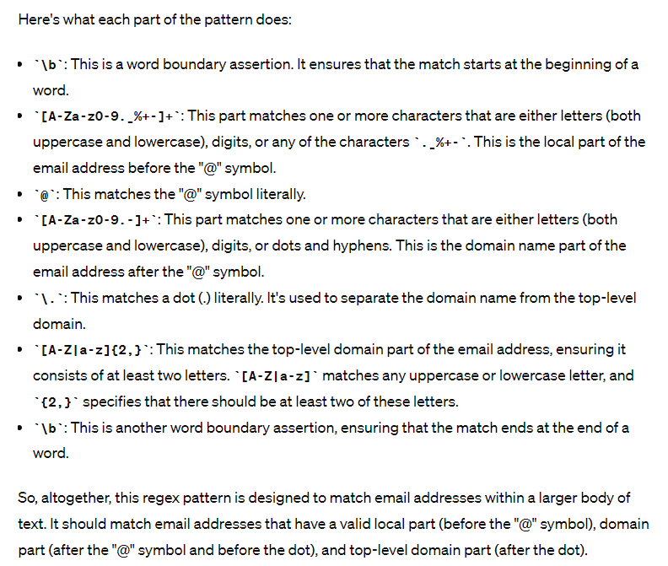
Regex – Ai
The common convention is to alias NumPy as `np`.
Use any Ai tool like https://chat.openai.com
Prompt
Explain the below attached regex patten
pattern = r'\b[A-Za-z0-9._%+-]+@[A-Za-z0-9.-]+\.[A-Z|a-z]{2,}\b'

Slide 48
Python If and Else
The common convention is to alias NumPy as `np`.
Python supports the usual logical conditions from mathematics:
Equals: a == b
Not Equals: a != b
Less than: a < b
Less than or equal to: a <= b
Greater than: a > b
Greater than or equal to: a >= b
These conditions can be used in several ways, most commonly in "if statements" and loops. Python relies on indentation (whitespace at the beginning of a line) to define scope in the code.

Slide 49
Python If and Else
The common convention is to alias NumPy as `np`.
An "if statement" is written by using the if keyword.
Example: a = 55
b = 400
if b > a:
print("b is greater than a")
The elif keyword is Python's way of saying "if the previous conditions were not true, then try this condition".
Example: a = 55
b = 55
if b > a:
print("b is greater than a")
elif a == b:
print("a and b are equal")

Slide 50
Python If and Else
The common convention is to alias NumPy as `np`.
The else keyword catches anything which isn't caught by the preceding conditions.
Example: a = 400
b = 55
if b > a:
print("b is greater than a")
elif a == b:
print("a and b are equal")
else:
print("a is greater than b")

Slide 51
Python If and Else
The common convention is to alias NumPy as `np`.
If you have only one statement to execute, you can put it on the same line as the if statement. (Short hand if)
Example: if a > b: print("a is greater than b")
If you have only one statement to execute, one for if, and one for else, you can put it all on the same line. (Short Hand If ... Else)
Example: a = 4
b = 550
print("A") if a > b else print("B")
And - The and keyword is a logical operator, and is used to combine conditional statements:
Example: a = 200
b = 33
c = 500
if a > b and c > a:
print("Both conditions are True")

Slide 52
Python If and Else
The common convention is to alias NumPy as `np`.
OR - The or keyword is a logical operator, and is used to combine conditional statements:
Example: a = 200
b = 33
c = 500
if a > b or a > c:
print("At least one of the conditions is True")
Not - The not keyword is a logical operator, and is used to reverse the result of the conditional statement:
Example: a = 33
b = 200
if not a > b:
print("a is NOT greater than b")

Slide 53
Python If and Else
The common convention is to alias NumPy as `np`.
Nested If - You can have if statements inside if statements, this is called nested if statements.
Example: x = 41
if x > 10:
print("Above ten,")
if x > 20:
print("and also above 20!")
else:
print("but not above 20.")

Slide 54
Python If and Else
The common convention is to alias NumPy as `np`.
Exercises:
Basic if statement (IFEL01)
Indentation in if (code to explain error) (IFEL02)
Elif (IFEL03)
Else (IFEL04)
IF And (IFEL05)
IF Or (IFEL06)
IF Not (IFEL07)
Nested IF (IFEL08)

Slide 55
Python Loop – For and While
The common convention is to alias NumPy as `np`.
Loop: Python has two primitive loop commands:
while loops
for loops
The while loop: With the while loop we can execute a set of statements as long as a condition is true.
Example: i = 1
while i < 6:
print(i)
i += 1
The For loop: A for loop is used for iterating over a sequence (that is either a list, a tuple, a dictionary, a set, or a string).
Example: fruits = ["apple", "banana", "cherry"]
for x in fruits:
print(x)

Slide 56
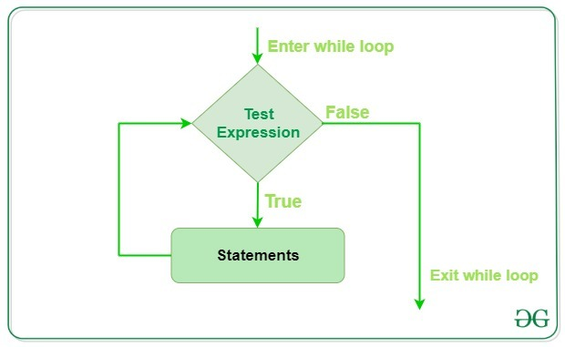
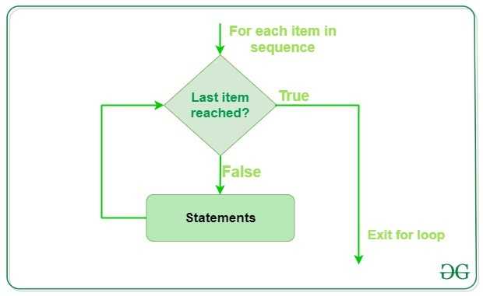
Python Loop – For and While
The common convention is to alias NumPy as `np`.

Slide 57
Python Loop – For and While
The common convention is to alias NumPy as `np`.
Exercises:
While loop (FW01)
For loop (FW02)

Slide 58
File operations
The common convention is to alias NumPy as `np`.
“r” – Read
“w” – Write
“a” – Append
“x” – Create
Exercises:
“ r“ – FAR 01
“w” - FAR 02
“a” – FAR 03
“x” – FAR 04

Slide 59
DATA ANALYSIS FOR PYTHON

Slide 60
Learning Objectives
TO UNDERSTAND THE IMPORTANCE OF PYTHON LIBRARIES IN DATA ANALYSIS.
LEARN HOW TO IMPORT AND UTILIZE EXTERNAL LIBRARIES IN PYTHON.
MASTER NUMPY'S ROLE IN NUMERICAL COMPUTING AND ARRAY MANIPULATION.
TO UNDERSTAND PANDAS' IMPORTANCE FOR STRUCTURED DATA MANIPULATION AND ANALYSIS.
TO UNDERSTAND THE IMPORTANCE OF DATA PREPROCESSING IN PREPARING DATA.
RECOGNIZE EDA'S ROLE IN DATA UNDERSTANDING AND VISUALIZATION.

Slide 61
Introduction – Libraries
A python library is a collection of related modules.
It contains bundles of code that can be used repeatedly in different programs.
It makes python programming simpler and convenient for the programmer.
As we don’t need to write the same code again and again for different programs.
Python libraries play a very vital role in fields of machine learning, data science, data visualization, etc.

Slide 62
Introduction – Important Libraries/Packages
Pandas - Data Analysis
Numpy – Data Analysis
Matplotlib - Visualisation
Seaborn - Visualisation
Scikit-learn - ML
Requests – Api
Selenium – Web scrapping / Browser Automation
Pyodbc
xml.etree.ElementTree
Openpyxl
Xlsxwriter

Slide 63
Numpy
NumPy, short for "Numerical Python," is a foundational library for numerical and scientific computing in the Python programming language.
It is the go-to library for performing efficient numerical operations on large datasets, and it serves as the backbone for numerous other scientific and data-related libraries

Slide 64
Numpy
Array Representation
Data Storage
Vectorized Operations
Universal Functions (ufuncs)
Broadcasting
Indexing and Slicing
Mathematical Functions

Slide 65

BASIC METHODS IN NUMPY
The common convention is to alias NumPy as `np`.
1. Importing NumPy
To use NumPy in Python, you first need to import it
The common convention is to alias NumPy as `np`.

Slide 66
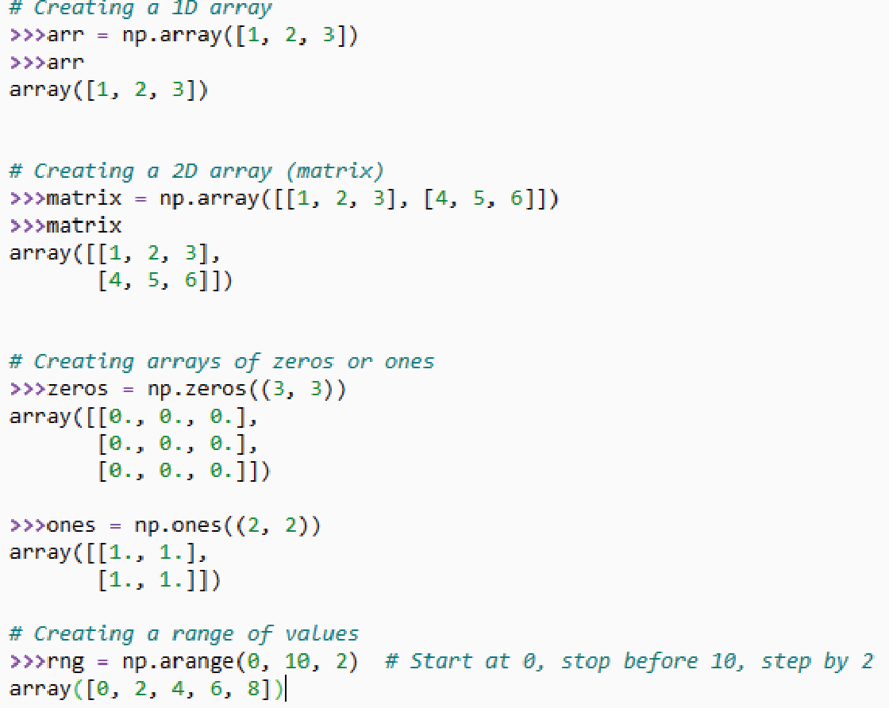
BASIC METHODS IN NUMPY
The common convention is to alias NumPy as `np`.
2. Creating Arrays
NumPy arrays are the fundamental data structure. You can create arrays using various methods, such as:

Slide 67
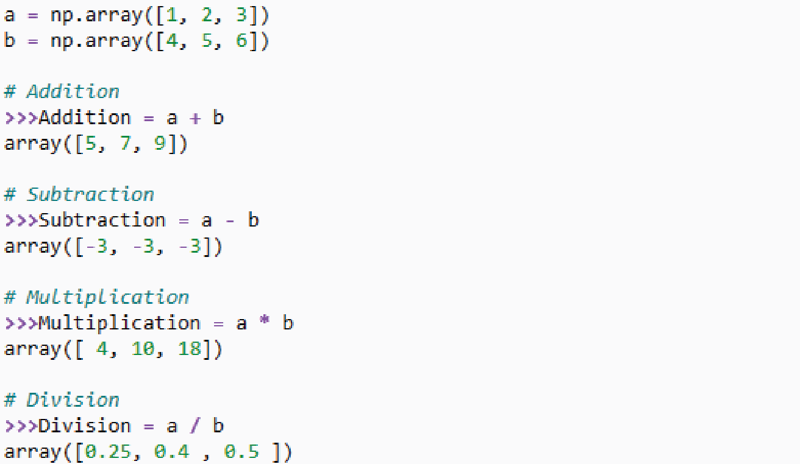
BASIC METHODS IN NUMPY
The common convention is to alias NumPy as `np`.
3. Basic Operations
NumPy allows you to perform element-wise operations on arrays. For example:

Slide 68
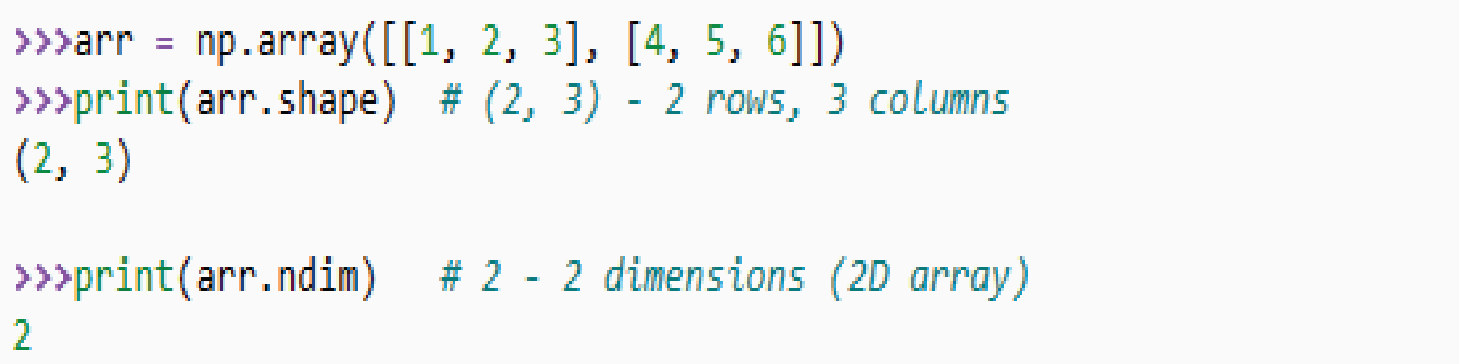
BASIC METHODS IN NUMPY
The common convention is to alias NumPy as `np`.
4. Array Shape and Dimensions:
Check the shape and dimensions of an array using the `shape` and `ndim` attributes:

Slide 69
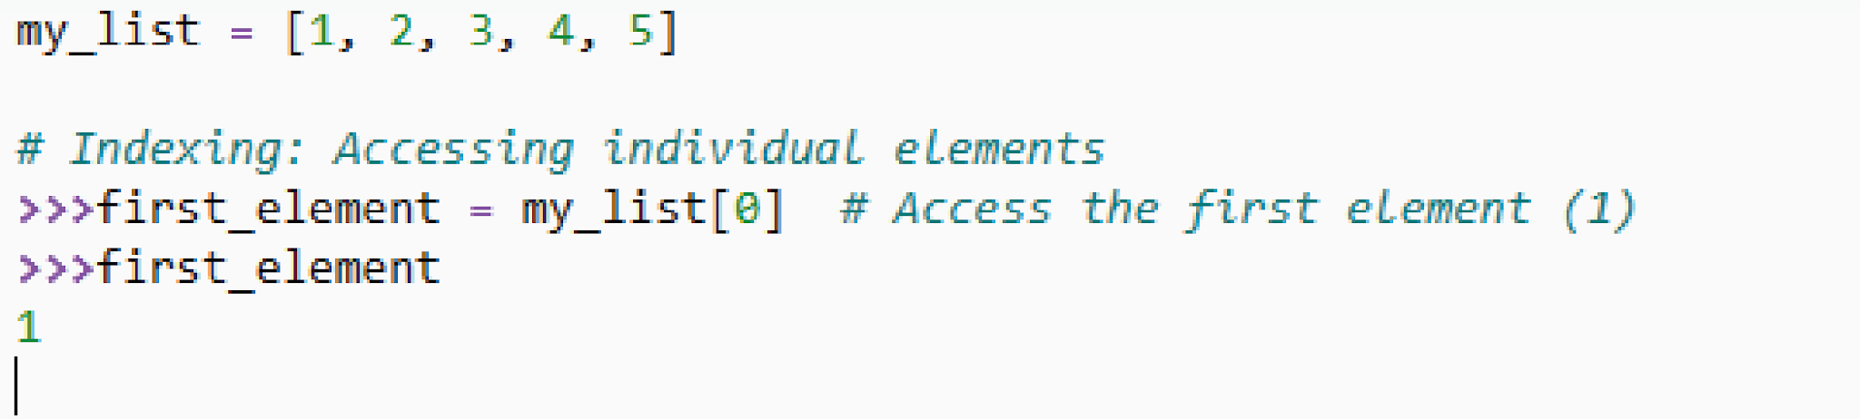
BASIC METHODS IN NUMPY
The common convention is to alias NumPy as `np`.
5. Indexing and Slicing
NumPy supports indexing and slicing to access elements or subsets of arrays.
Indexing starts at:

Slide 70
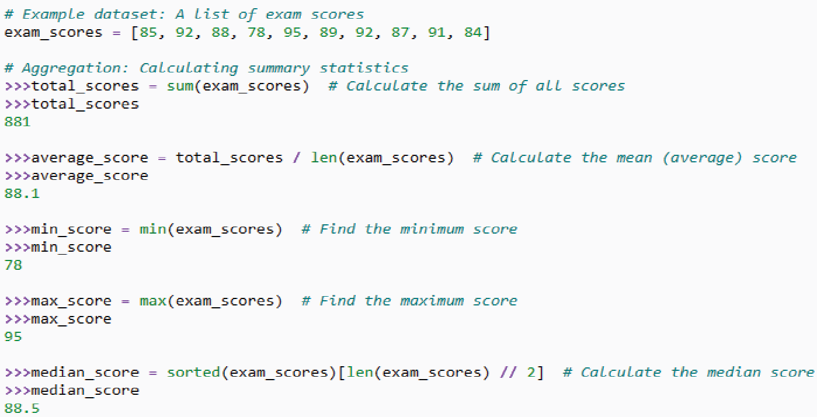
BASIC METHODS IN NUMPY
The common convention is to alias NumPy as `np`.
6. Aggregation and Statistics
NumPy provides functions for computing various statistics on arrays
i. Aggregation

Slide 71
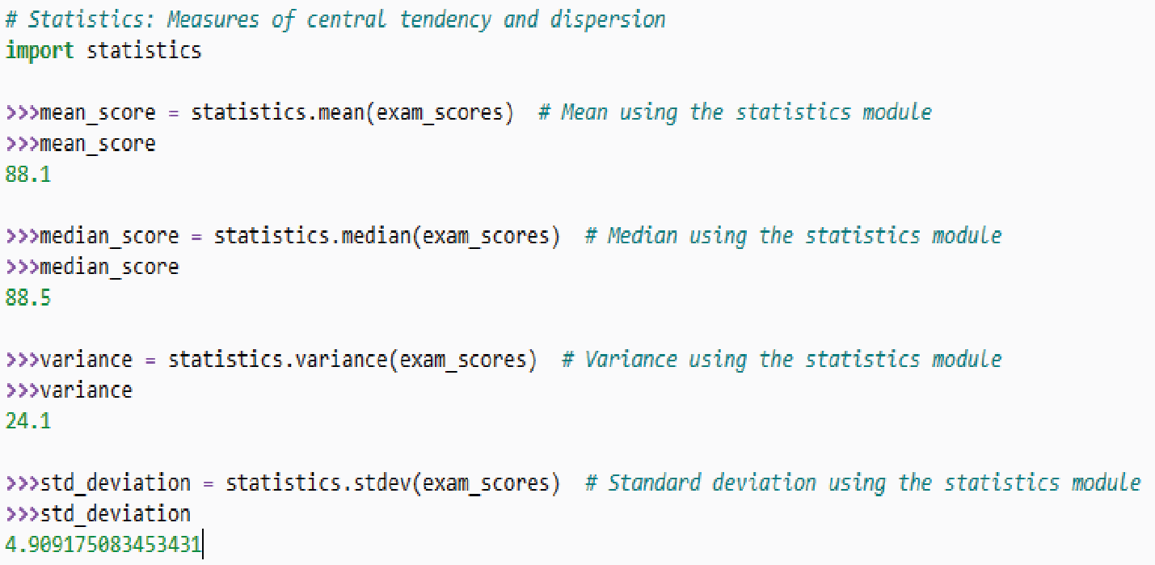
BASIC METHODS IN NUMPY
The common convention is to alias NumPy as `np`.
ii. Statistics

Slide 72
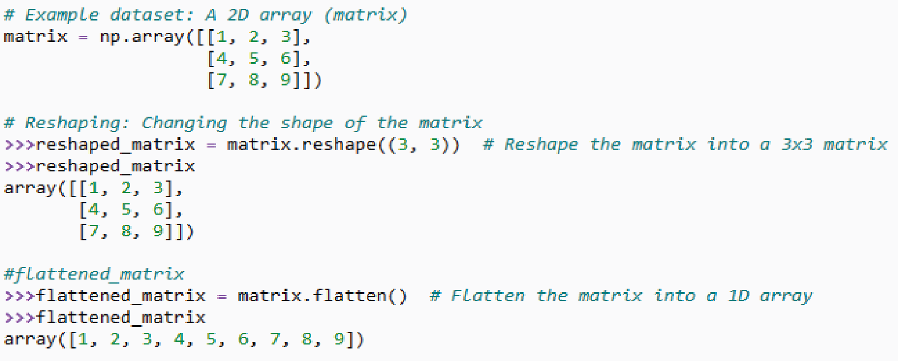
The common convention is to alias NumPy as `np`.
7. Reshaping and Transposing
Reshaping and transposing are fundamental operations when working with multi-dimensional data, such as matrices or arrays. These operations allow you to change the structure or dimensions of your data.
i. Reshaping:
Reshaping involves changing the shape or dimensions of your data while maintaining the total number of elements. This operation is often used in machine learning and data preprocessing to prepare data for modeling

Slide 73
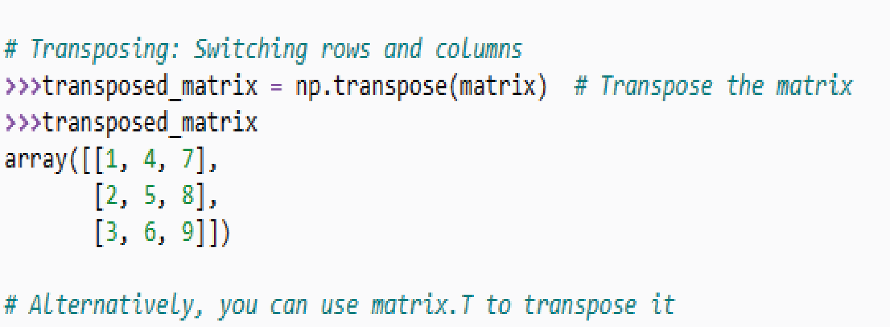
The common convention is to alias NumPy as `np`.
ii. Transposing:
Transposing involves switching the rows and columns of a two-dimensional data structure like a matrix or array. This operation is particularly useful for linear algebra operations or when working with tabular data.

Slide 74
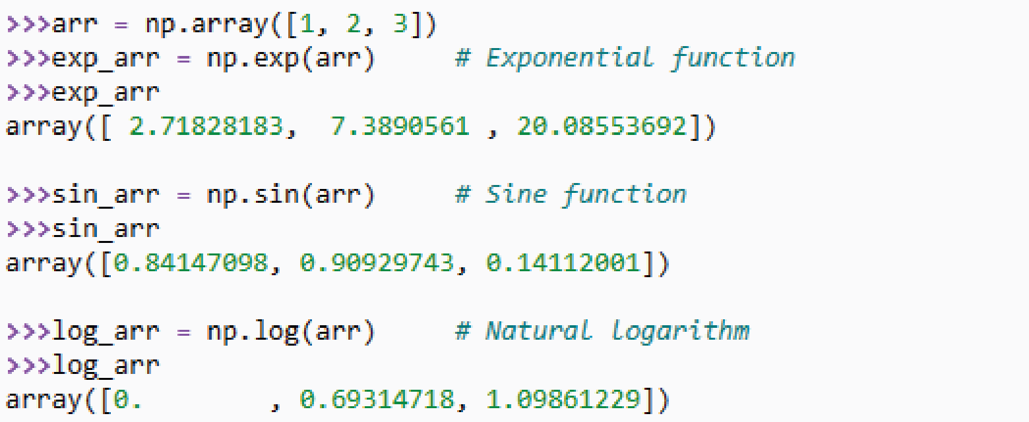
The common convention is to alias NumPy as `np`.
8. Universal Functions (ufuncs)
NumPy provides universal functions that operate element-wise on arrays, including trigonometric, logarithmic, and exponential functions.

Slide 75
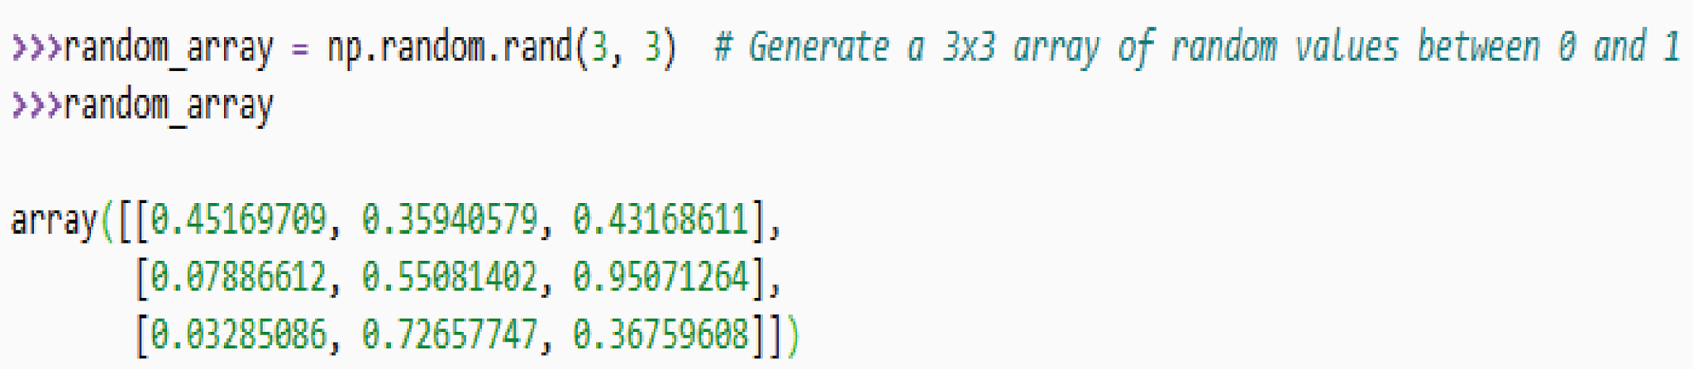
The common convention is to alias NumPy as `np`.
9. Random Number Generation
NumPy includes functions for generating random numbers from various distributions, such as `np. random. rand`, `np. random. rand`, and `np. random. rand`.

Slide 76
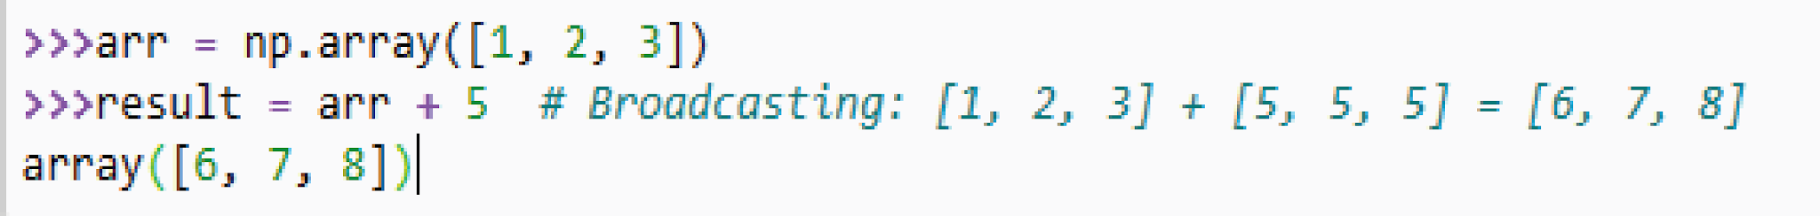
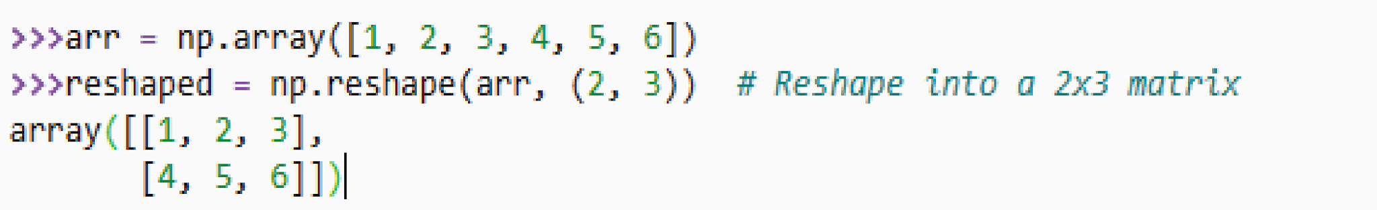
The common convention is to alias NumPy as `np`.
10. Broadcasting
NumPy allows you to perform operations on arrays of different shapes, often automatically aligning their shapes, thanks to broadcasting rules.
11. Reshaping Arrays
Reshape arrays into different dimensions using np. reshape or the reshape method.

Slide 77
Pandas - Data Analysis
Pandas is a Python library used for working with data sets.
It has functions for analyzing, cleaning, exploring, and manipulating data.
The name "Pandas" has a reference to both "Panel Data", and "Python Data Analysis" and was created by Wes McKinney in 2008

Slide 78
Pandas - Data Analysis - Contents
Data Structures
  - Series
  - Data Frame
Data Alignment
Label Based Indexing
Data Cleaning
Data Aggregation
Data Merging and Joining
Data Visualisation Integration

Slide 79
Pandas - Data Analysis
Examples – Creating and Loading Dataframe
Creating Data Frame
- From Dictionary
Loading Data to Dataframe
- From External Data Sources
- CSV
- JSON
- XML
- Excel
- Database (Tally / Access) using Sql

Slide 80
Pandas - Data Analysis - Viewing Data
Examples - Viewing Data
df.head()
df.tail()
df.shape
df.info()
df.describe()
df.sample(~)
These methods are invaluable for getting an initial sense of your data's structure and Content.

Slide 81
Pandas - Data Analysis - Indexing and Selecting Data
Examples - Indexing and Selecting Data
Viewing Data
Name_Column = df[`Name`
Subset = df[[‘Name’, ‘Age’]]
Young_People = df[df[“age”] <30]
Hint : For further reference
https://pandas.pydata.org/Pandas_Cheat_Sheet.pdf

Slide 82
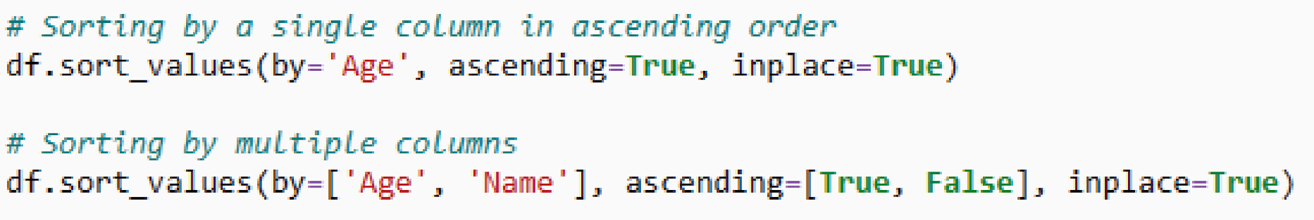
Pandas - Data Analysis – Sorting Data
Examples - Sorting Data
Viewing Data
Hint : For further reference
https://pandas.pydata.org/Pandas_Cheat_Sheet.pdf

Slide 83
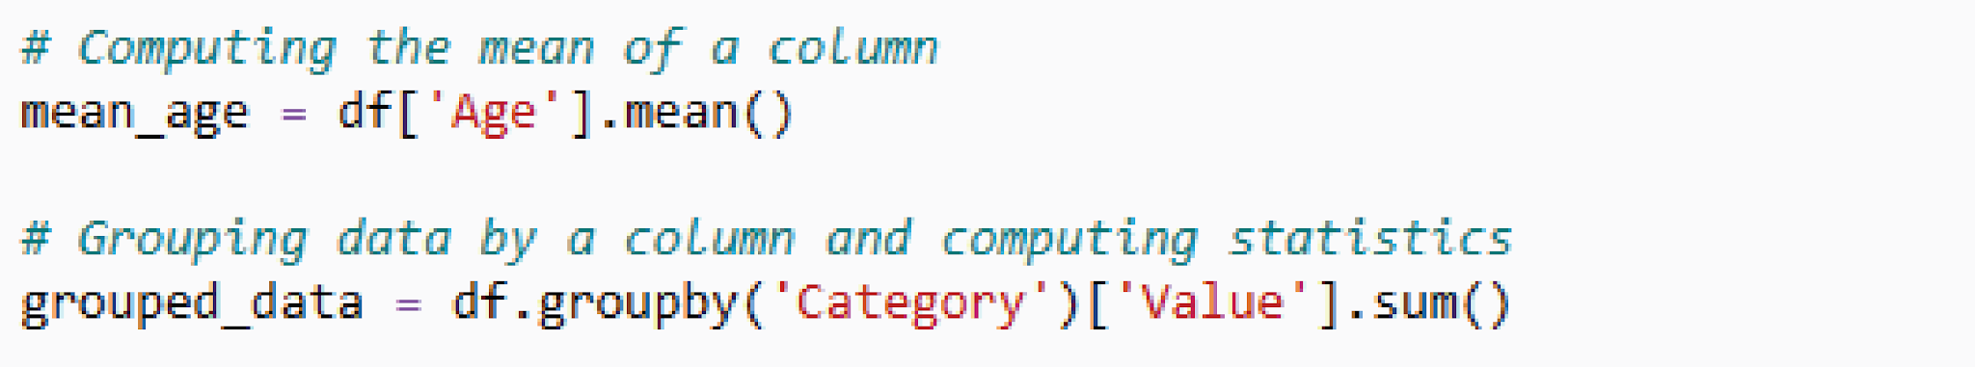
Pandas – DATA AGGREGATION AND SUMMARY STATISTICS

Slide 84
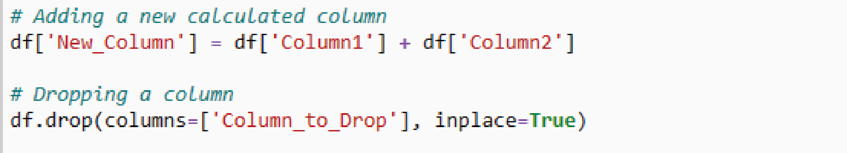
Pandas – ADDING AND DROPPING COLUMNS

Slide 85
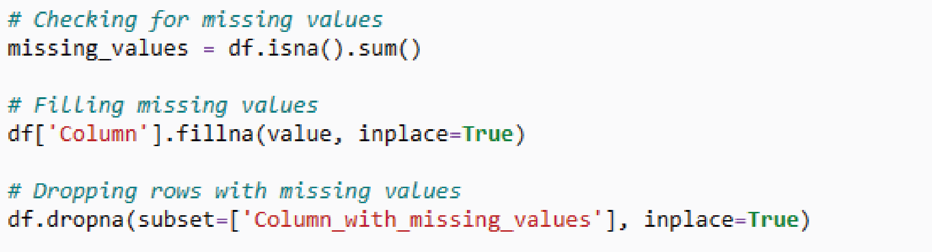
Pandas – Handling Missing Data

Slide 86
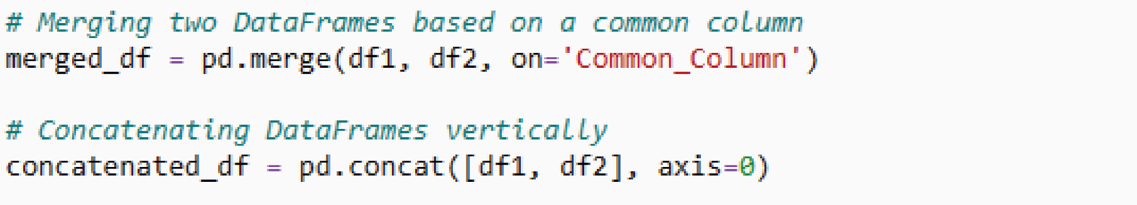
Pandas – Merging and Concatenating Data Frames

Slide 87
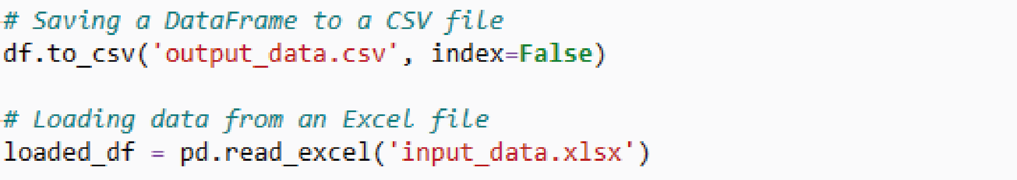
Pandas – Saving and Loading Data

Slide 88
Pandas – Saving Data from Data Frame
Saving the data to a csv file
df.to_csv(r'C:\Users\Ram Office\Desktop\file3.csv’)
Saving the data to a excel file
df.to_excel("output.xlsx")
Further reading on formatting excel file
https://xlsxwriter.readthedocs.io/working_with_pandas.html
Note: Loading data already discussed under Creating and Loading Data Frame

Slide 89
Data Preprocessing Steps
IMPORTANCE OF DATA PREPROCESSING
Data Quality Improvement:
Enhanced Model Performance
Extraction and Engineering
Normalization and Scaling
Handling Categorical Data:
Dimensionality Reduction:
Improved Interpretability:

Slide 90
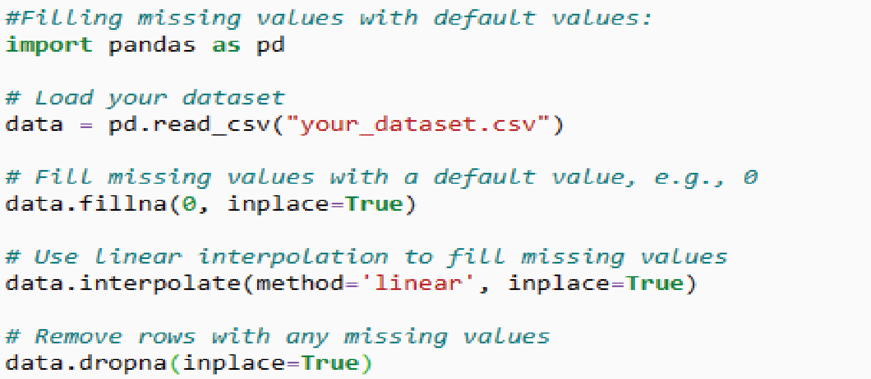
Data Preprocessing Steps
DATA COLLECTION
GATHER THE RAW DATA FROM VARIOUS SOURCES, SUCH AS DATABASES, FILES, APIS, OR SENSORS.
DATA CLEANING
  Handling Missing Values
IDENTIFY AND HANDLE MISSING DATA, WHICH CAN INVOLVE FILLING IN MISSING VALUES WITH DEFAULT VALUES, USING INTERPOLATION, OR REMOVING ROWS/COLUMNS WITH MISSING DATA.

Slide 91
Data Preprocessing Steps
DATA REDUCTION
  Dimensionality Reduction
  Principal Component Analysis (PCA)
  Feature Selection
  Recursive Feature Elimination (RFE)
DATA IMBALANCE HANDLING
  Oversampling
  Undersampling
  Synthetic Data Generation (SMOTE)

Slide 92
Pandas – Extracting data from different data sources
Practical Approach
Module Case Study - 1
Conversion of JSON Data to Excel
Students may use any
GSTR2A or GSTR2 or GSTR3B File to Convert data to Excel
Approach - 1
Using pandas data frame to read Json file and then write to excel
Approach – 2
Using openpyxl library read json parts and write to excel directly

Slide 93
Pandas – Extracting data from different data sources
Practical Approach
Module Case Study - 2
Conversion of XML Data to Excel
Students may use any
Income Tax return file to extract ITR Balance sheet and profit and loss data to excel
Approach - 1
Use XML Element tree Module
https://docs.python.org/3/library/xml.etree.elementtree.html

Slide 94
Pandas – Extracting data from different data sources
Practical Approach
Module Case Study - 3
Consolidate multiple excel files to single file
Students may use the excel file provided to consolidate into single file
Approach :
Use Dataframe in pandas and merging feature.

Slide 95
Pandas – Extracting data from different data sources
Practical Approach
Module Case Study - 4
Convert 26As text file to excel
Approach :
Use Dataframe in pandas and merging feature .
Use Regex

Slide 96
Pandas – Extracting data from different data sources
Practical Approach
Module Case Study - 5
Get Ledger Master Data from Tally data using sql Query
Query
Select $Name, $Parent, $_PRimaryGroup, $OpeningBalance, $_ClosingBalance from Ledger
Libraries used
Pyodbc

Slide 97
DATA VISUALIZATION WITH PYTHON

Slide 98
Learning Objectives
UNDERSTANDING DIFFERENT LIBRARIES USED FOR DATA VISUALIZATION IN PYTHON.
LEARN ABOUT DIFFERENT TYPES OF PLOTS AND THEIR USE.
USE OF MATPLOTLIB, SEABORN, AND PLOTLY FOR DATA VISUALIZATION

Slide 99
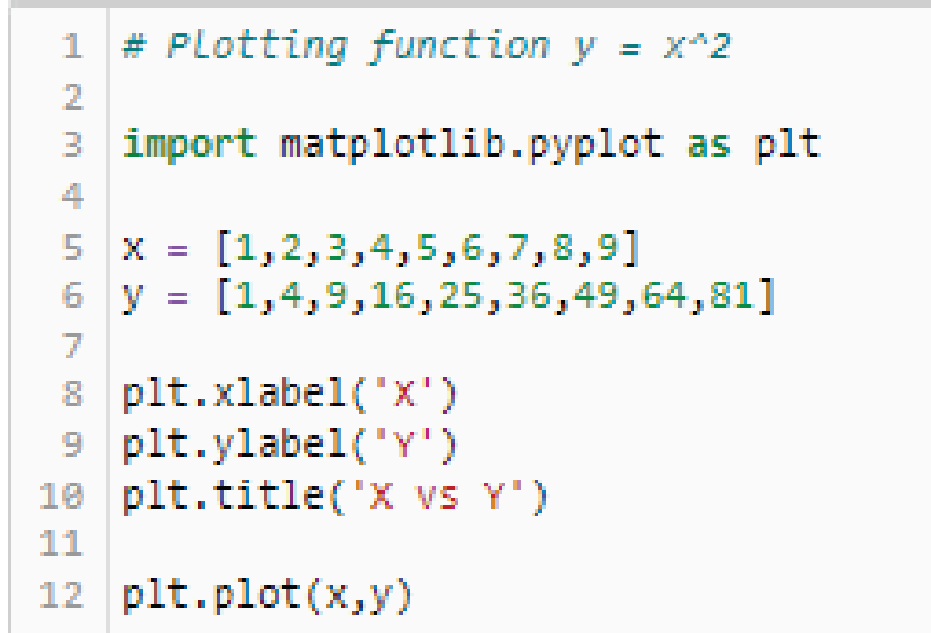
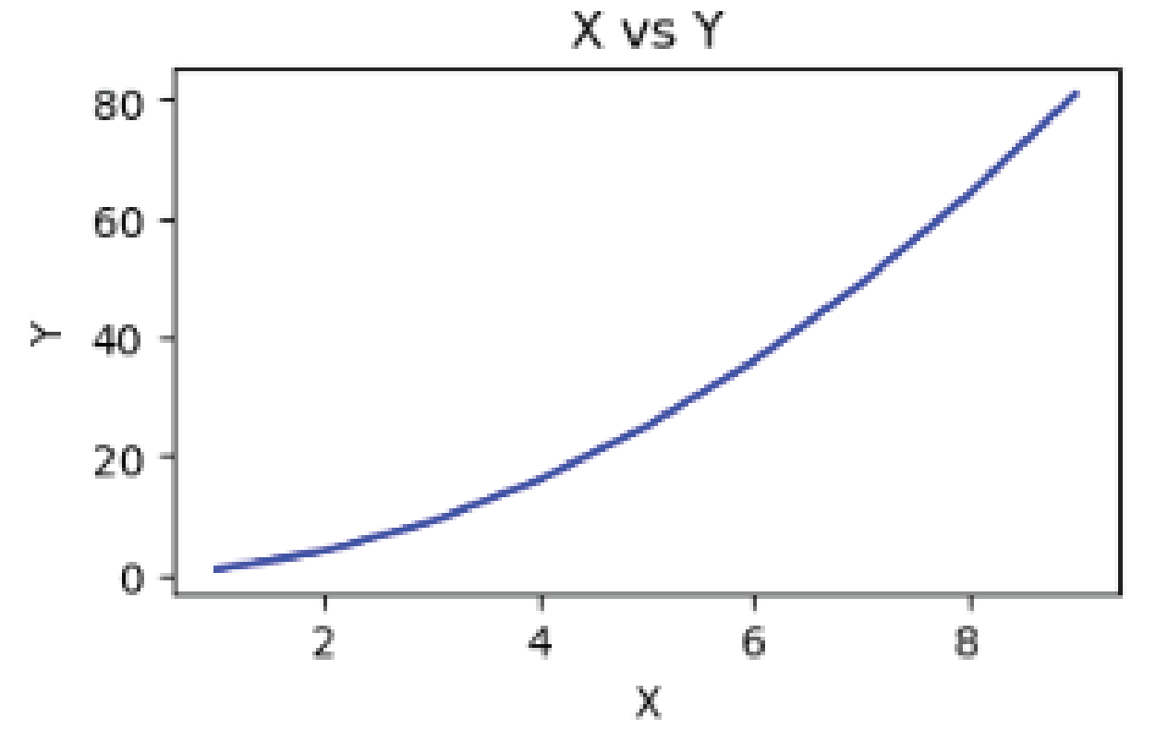
Basic Plots
LINE PLOT

Slide 100
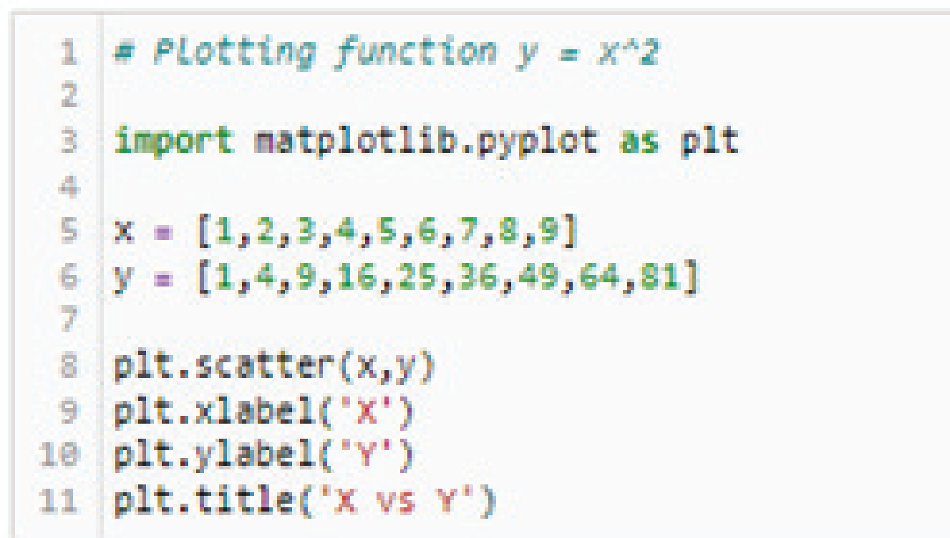
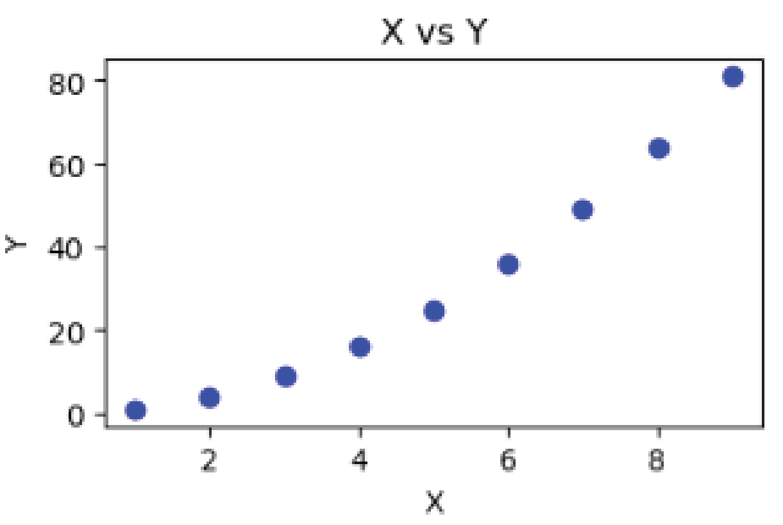
Basic Plots
SCATTER PLOT

Slide 101
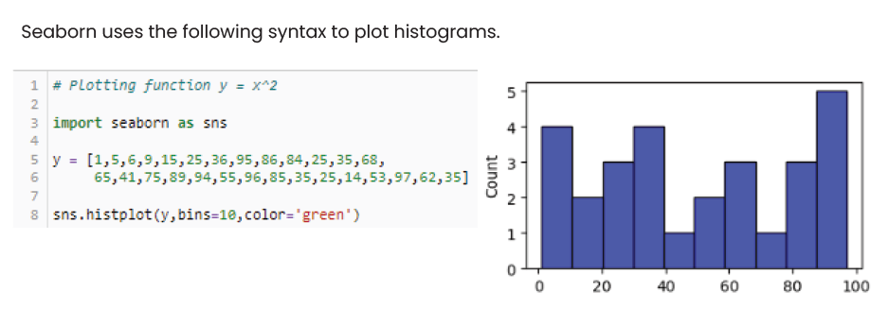
Basic Plots
HISTOGRAM

Slide 102
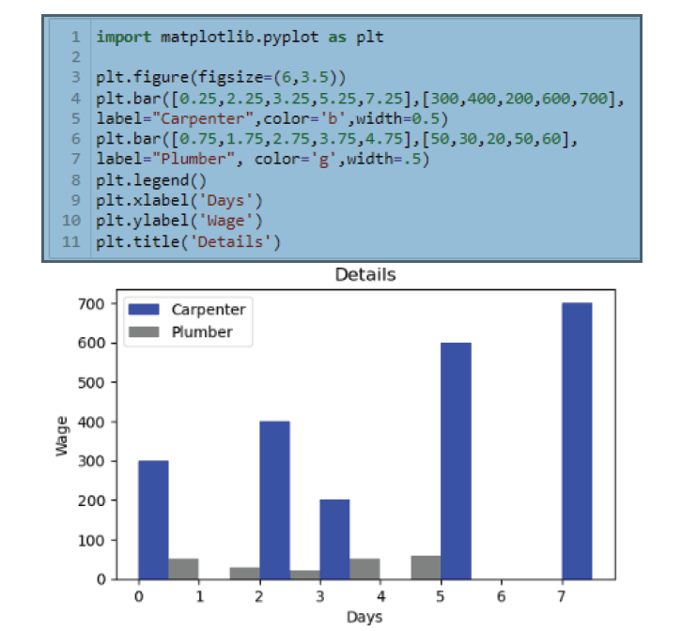
Basic Plots
BAR PLOT

Slide 103
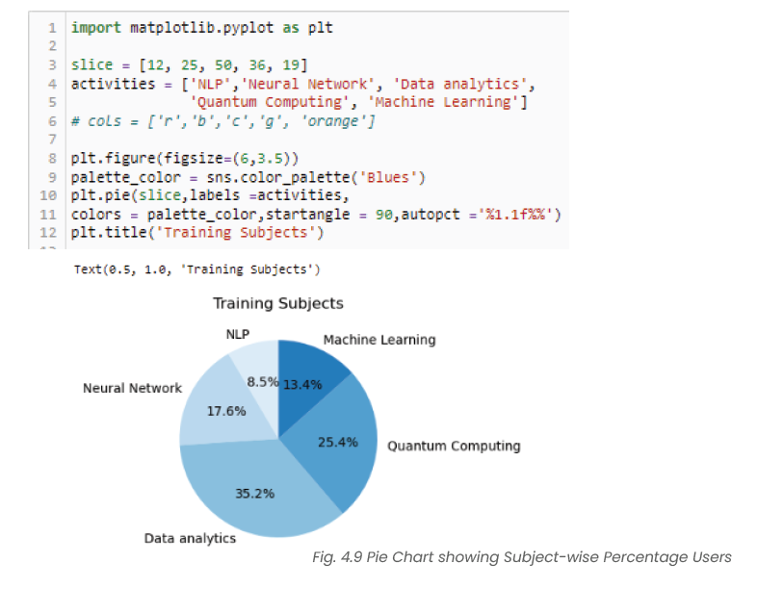
Basic Plots
PIE PLOT

Slide 104
DATA PREPARATION FOR MODEL BUILDING
INDEPENDENT FEATURES
DEPENDENT FEATURES

Slide 105
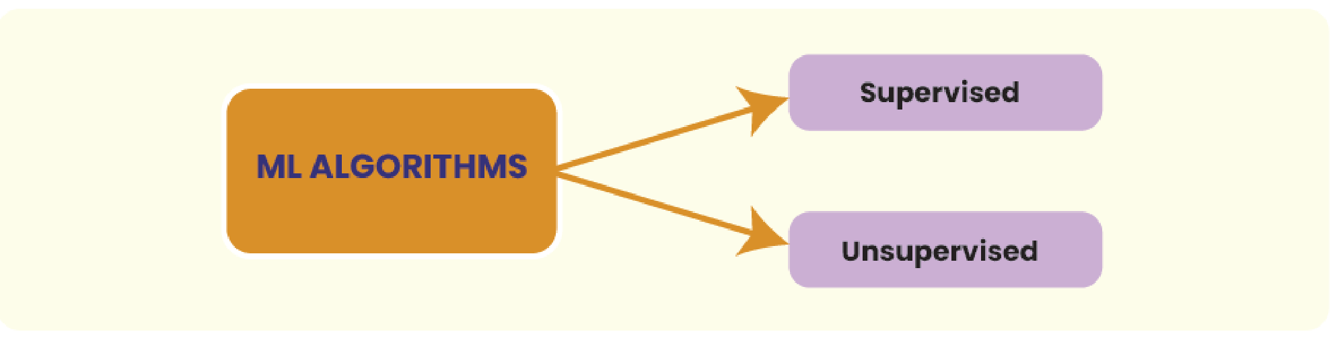
TYPES OF ML ALGORITHMS
SUPERVISED ALGORITHM
UNSUPERVISED ALGORITHM
REINFORCEMENT LEARNING

Slide 106
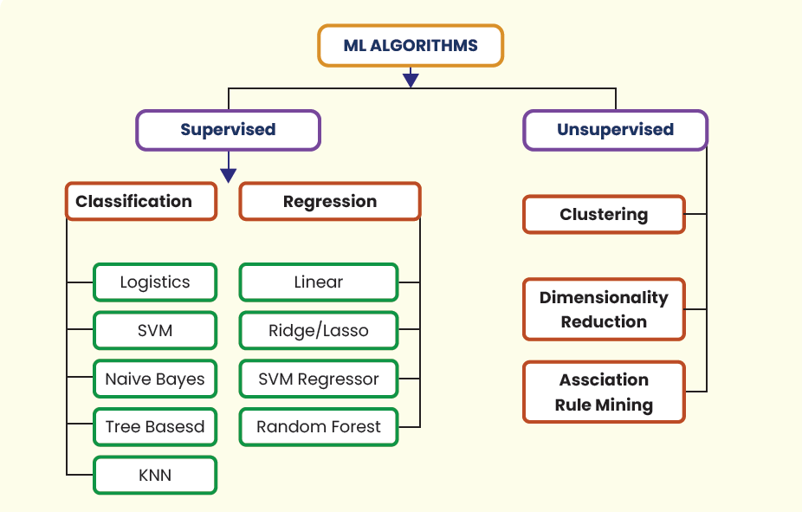
TYPES OF ML ALGORITHMS

Slide 107
DATA VISUALIZATION WITH PYTHON

Slide 108
Learning Objectives
UNDERSTANDING DIFFERENT LIBRARIES USED FOR DATA VISUALIZATION IN PYTHON.
LEARN ABOUT DIFFERENT TYPES OF PLOTS AND THEIR USE.
USE OF MATPLOTLIB, SEABORN, AND PLOTLY FOR DATA VISUALIZATION

Slide 109
Basic Plots
LINE PLOT

Slide 110
Basic Plots
SCATTER PLOT

Slide 111
Basic Plots
HISTOGRAM

Slide 112
Basic Plots
BAR PLOT

Slide 113
Basic Plots
PIE PLOT

Slide 114
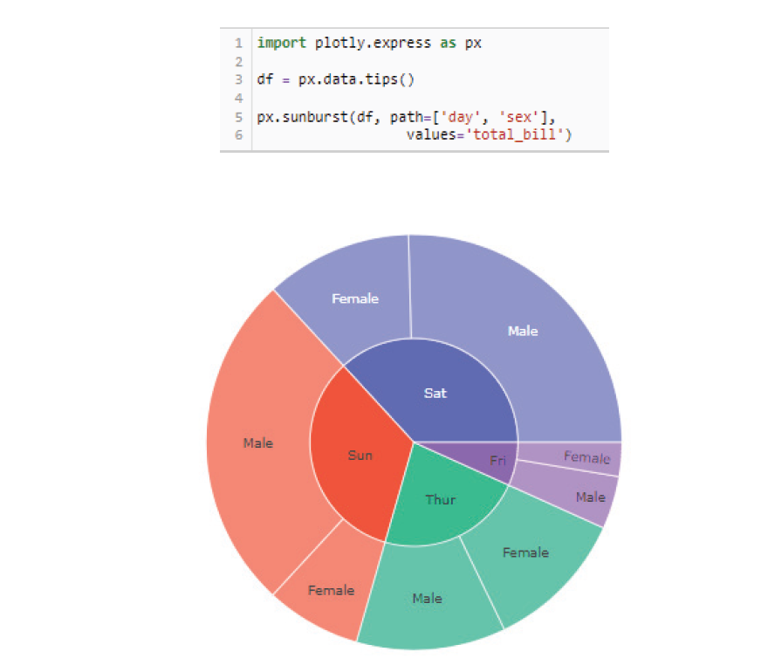
Basic Plots
SUN BURST

Slide 115



THANK YOU

