Slide 1



Robotic Process Automation

Slide 2


Chapter-1 : TECHNOLOGY AND ITS EFFECTIVE USE IN FINANCE & ACCOUNTS
Chapter-2 : INTRODUCTION TO ROBOTIC PROCESS AUTOMATION (RPA)
Chapter-3 : RPA AND ITS PRACTICAL USE CASES
Chapter-4 : IMPACT OF RPA

Slide 3
Introduction
Robotic process automation (RPA) is a form of business process automation that is based on software robots (bots) or artificial intelligence (AI) agents. It is sometimes referred to as software robotics (not to be confused with robot software).
There are varied human tasks that are repeated daily, which do not require intelligent working or processing such tasks can be automated using RPA.
Ex. Opening a browser, going to a stock market website such as BSE/NSE and getting stock data. Such a task can be automated using RPA.

Slide 4
Background
Manual to Computerized Accounting :
Manual accounting was the traditional method used until recent times.
Businesses had to hire accountants to manually record transactions, generate books, and prepare financial statement.
Transition to computerized systems like billing machines improved efficiency.
Introduction of modern computerized systems enabled real-time data entry and recording of sophisticated transactions.
The 1990s saw the advent of Enterprise Resource Planning (ERP) software, integrating accounting with other business functions.

Slide 5
CHAPTER 1
TECHNOLOGY AND ITS EFFECTIVE USE IN FINANCE & ACCOUNTS

Slide 6
Impact of Technology on Finance Functions
Technology automation revolutionized accounting and finance operations.
ERP software facilitated integration of accounting with sales, purchases, and human resources.
Businesses shifted from manual bookkeeping to sophisticated ERP solutions for better control.
Challenges like increased IT costs and change management emerged with ERP adoption RPA emerged as a digital worker automating mundane tasks, allowing humans to focus on value-added activities.

Slide 7
The advantages of ERP for business included :
One business transaction processing system integrated with business operations
One version of truth, no mismatch of data
Control over business transactions and functions
Instantaneous availability of information for better decision-making
ERP brought its own set of challenges as well. The biggest of these challenges was :
The increased cost of IT operations, as organizations were not used to investing in IT Infrastructure, hence with the adoption of ERP the organization needed computers for all and high-cost Infrastructure
Change management, employees working in organizations were not aware of the capability of ERP and started to feel threatened for their jobs
Data entry, ERP being an integrated platform increased data entry task in ERP

Slide 8
CHAPTER 2
INTRODUCTION TO ROBOTIC PROCESS AUTOMATION (RPA)

Slide 9
What is RPA ?
Robotic : The word “Robotic” may sound like a physically shaped strong and bulky BOT but it is all about software, with no physical shape or form. Like any other software “Robotic” also supports human efforts by automating human activities in an enterprise. It is sometimes referred to as software robotics.
Process : Word “Process” can also be misnomer, a better alternative would be “task”, which is what RPA aims to automate. A combination of such “tasks” adds up to a process.

Slide 10
RPA Vs. Normal Coding
RPA :-
Mimics human actions on the UI (clicks, keystrokes).
Great for automating legacy apps that have no APIs.
Fragile when UI changes (window titles, buttons, layouts).
Often requires screen resolution/OS-specific tuning.

Slide 11
RPA Vs. Normal Coding
Normal Coding :-
Uses programmatic libraries (e.g., pandas, openpyxl) and APIs.
More robust and maintainable; fewer flaky UI dependencies.
Faster, scalable, and easier to test.
Preferred when data interfaces (files/APIs/DBs) are available.

Slide 12
RPA Vs. Normal Coding
RPA Style (Excel COM Automation in Python) :-
# Requires: pip install pywin32 (Windows only)
import win32com.client as win32
import time
excel = win32.gencache.EnsureDispatch("Excel.Application")
excel.Visible = True # make it obvious that we're automating the UI
time.sleep(2)
wb = excel.Workbooks.Add()
ws = wb.Worksheets(1)
time.sleep(2)
data = [("Apple", 10), ("Banana", 20), ("Cherry", 15), ("Date", 7)]
for i, (a, b) in enumerate(data, start=1):
ws.Cells(i, 1).Value = a # Column A
ws.Cells(i, 2).Value = b # Column B
time.sleep(1)
save_path = r"D:\ICAI Lec\RPA\class_files\rpa_output.xlsx"
wb.SaveAs(save_path)
wb.Close(SaveChanges=True)
time.sleep(1)
excel.Quit()
print("Saved:", save_path)

Slide 13
RPA Vs. Normal Coding
Normal Coding (pandas → Excel) :-
# Requires: pip install pandas xlsxwriter
import pandas as pd
df = pd.DataFrame({
"A": ["Apple", "Banana", "Cherry", "Date"],
"B": [10, 20, 15, 7]
})
df.to_excel("D:\ICAI Lec\RPA\class_files\pandas_output.xlsx", index=False)
print("Saved: pandas_output.xlsx")

Slide 14
When to Use Which?
Use RPA when there is no API and you must drive the UI of a legacy app.
Use pandas/normal coding when you can read/write files or call APIs.
Hybrid approach: RPA to reach a system, then normal code to process data.

Slide 15
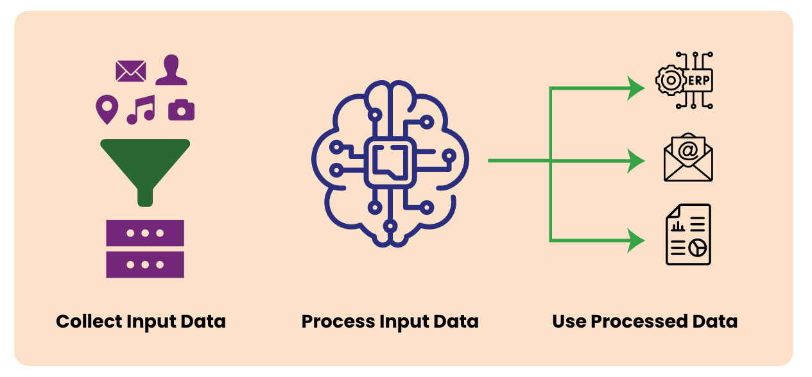
RPA can be better understood as a Digital Worker trained to tasks performed by humans with no or minimal value. It primarily performs below functions (Refer to Figure 1 below) :

Slide 16
Collection of Inputs: RPA can be trained to collect data as input from any digital source.
Processing of raw data collected: RPA has a strong processing engine, coupled with Artificial Intelligence and Machine Learning, it can process volumes of data with unmatched speed and without any errors.
Entering/ Presenting/ publishing the data in the Target application: RPA can use the processed data for variety of ways including:
  Enter the data in any Target application like Tally, SAP etc.
  Filling of forms on web portals like GST portals, Bank portals.
  Sending the formatted data to the target users through mails or any other medium of communication.
  Engaging with Users and respond to their queries in the form of chatbots.
  Publish reports and dashboards based on the processed data to the target users.

Slide 17
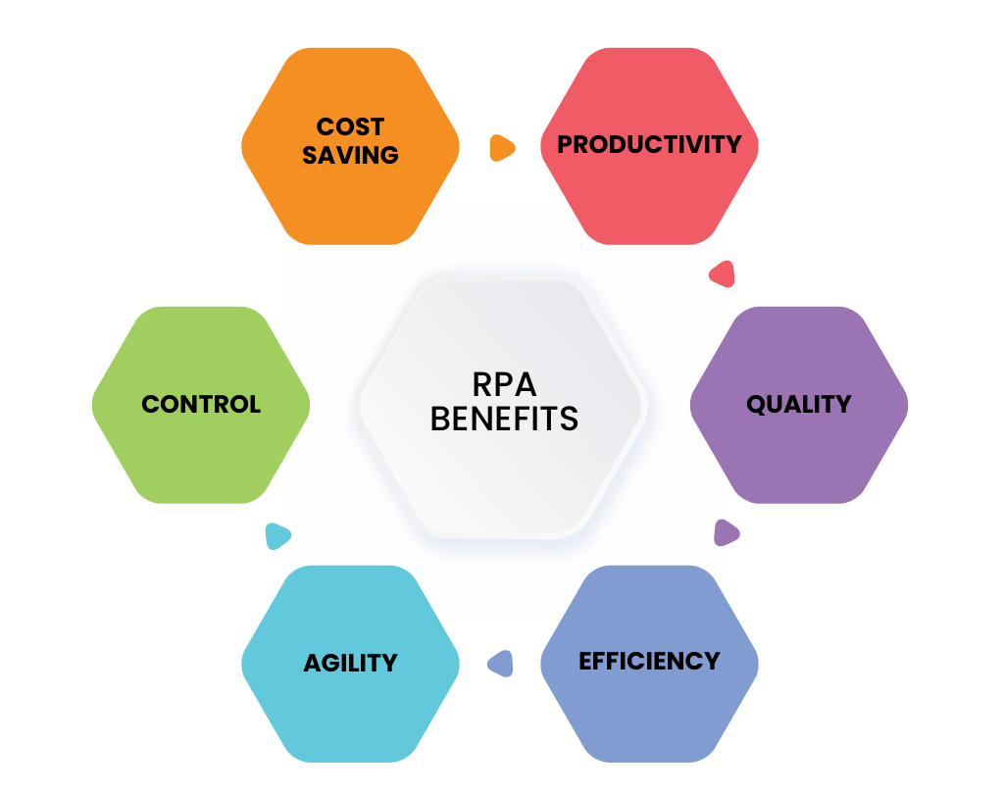
THE BENEFITS OF RPA

Slide 18
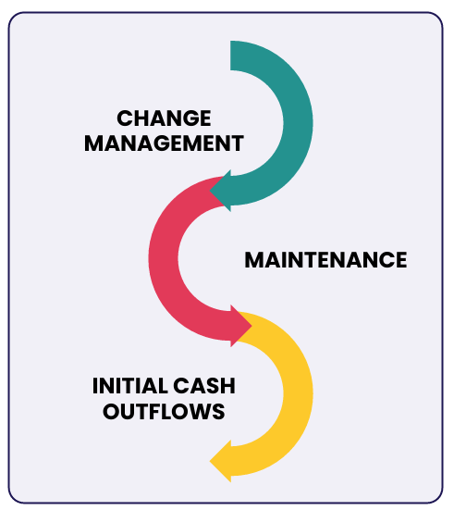
CHALLENGES IN RPA

Slide 19
CHAPTER 3
RPA AND ITS PRACTICAL USE CASES

Slide 20
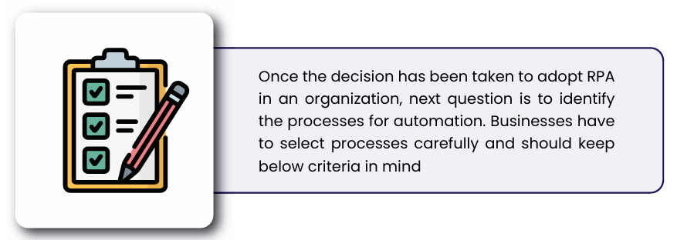
Key Concepts
HOW DOES RPA WORK?
WHERE DOES RPA WORK?
HOW DOES RPA WORK?
WHERE DOES RPA WORK?

Slide 21
Web Scraping

Slide 22
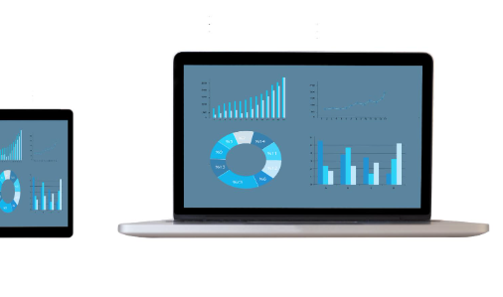
Introduction to Web Scraping
Automating Compliance & Financial Data Collection

Slide 23
What is Web Scraping?
Definition:
Web scraping is the automated process of collecting structured information from websites—saving time, effort, and reducing manual errors.
Why It Matters to CAs:
Streamline compliance checks
Bulk extract GST details, IT data, MCA filings
Enhance due diligence and audits
Integrate real-time data into your accounting systems

Slide 24
Common CA Use Cases
Websites to Target:
GST Portal – Search GSTIN status, return filings
Income Tax Portal – PAN validation, TDS status, refund tracking
MCA Portal – Company master data, filing history, director KYC
MSME Udyam Portal – MSME registration validation
EPFO/ESIC Sites – Establishment search & compliance checks
RERA Portals – Verify builder registrations & project approvals

Slide 25
Example Use Case – GST Portal
Tasks You Can Automate:
Validate bulk GSTINs
Extract return filing status
Check compliance for vendors
Pull contact and business details
Benefits:
Avoid input tax credit mismatch
Vendor compliance verification in bulk
Timely follow-up for non-filers

Slide 26
Common CA Use Cases
Websites to Target:
GST Portal – Search GSTIN status, return filings
Income Tax Portal – PAN validation, TDS status, refund tracking
MCA Portal – Company master data, filing history, director KYC
MSME Udyam Portal – MSME registration validation
EPFO/ESIC Sites – Establishment search & compliance checks
RERA Portals – Verify builder registrations & project approvals

Slide 27
Tools & Libraries for CAs
Python-based Stack:
Selenium : for dynamic portals (e.g. GSTN with CAPTCHA)
Pandas : Store and analyze scraped data (Refer Python PPTs)
Openpyxl : Automate Excel report generation
BeautifulSoup : for static portals (e.g. Vahaan)

Slide 28
Challenges & Handling CAPTCHA (Part-1)
Dynamic Elements:
OTPs or Captchas (e.g. GST & Income Tax Portals)
JavaScript-rendered content
Session management & tokens

Slide 29
Challenges & Handling CAPTCHA (Part-2)
Solutions:
Manual intervention for CAPTCHA
Use Selenium for browser automation
For frequent scraping, consider API alternatives (if available)

Slide 30
Best Practices for CAs
Always respect robots.txt and Terms of Use
Use web scraping only for publicly available data
Store historical snapshots for audit trails
Keep logs for compliance records

Slide 31
Common CA Use Cases
Websites to Target:
GST Portal
Income Tax Portal
MCA Portal
MSME Udyam Portal
EPFO/ESIC Sites
RERA Portals

Slide 32
Real-World Examples for CA Firms
Portal | Use Case
GST Portal | GSTIN validation, return status
Income Tax | PAN/Aadhaar check, refund status
MCA | CIN data, director KYC, filings
MSME Portal | Verify Udyam registrations
PF/ESIC | Check employer compliance
RERA | Real estate audit compliance

Slide 33
Legal and Ethical Considerations
Avoid scraping private/login-only content without authorization
Ensure data privacy and client confidentiality
Prefer official APIs (e.g. GSTN API for GSPs)
Use data only for legitimate professional purposes

Slide 34
Summary for CAs
Web scraping is a powerful tool for automating compliance data collection
Use responsibly to improve audits, reconciliations, and due diligence
Combine scraping with Excel/ERP/API for powerful automations
Add value for clients through faster turnaround & better insights

Slide 35
When to Apply RPA
Ideal Scenarios:
Rule-based, repetitive tasks
Structured input and output
High transaction volume
No API available (works with UI)
Legacy systems without documentation

Slide 36
When NOT to Use RPA
Unstructured data or frequent UI changes
Low-volume or one-off tasks
Processes that require judgment or decision-making
Better solved with APIs or direct DB integration

Slide 37
GST Website Automation
Automated GSTIN Search (For given GST No.)
Automated GSTIN Search Using Excel (For List of GST No.)
Automated GSTIN Search (For given PAN No.)
Automated GSTIN Search Using Excel (For List of PAN No.)

Slide 38
Python Selenium Library
What is Selenium?
A Python library to control web browsers
Automates:
  Form filling
  Clicking buttons
  Downloading data from websites
Works with Chrome, Firefox, Edge, etc.

Slide 39
Typical RPA Task Example
Installing Selenium :- (For pip understanding check python Lecture/PPT)
“pip install selenium”
Download ChromeDriver from :-
https://chromedriver.chromium.org/downloads

Slide 40
Basic Selenium Script Example
from selenium import webdriver
from selenium.webdriver.common.by import By
driver = webdriver.Chrome()
driver.get("https://www.google.com")
search_box = driver.find_element(By.NAME, "q")
search_box.send_keys("Python Selenium")
search_box.submit()

Slide 41
Key Selenium Actions
driver.get(URL) – Open a webpage.
find_element() – Locate input, buttons.
.send_keys("data") – Type in input box.
.click() – Click a button.
.text – Extract data from elements

Slide 42
Key Selenium Find Elements
There are multiple ways in which the function “find_element()” can be used.
Mainly 2 ways are used :-
  By.ID
  By.XPATH
Both can be copied from Browser using F12.

Slide 43
Limitations of Selenium
Struggles with CAPTCHA (needs manual input or OCR)
Not ideal for desktop apps
Website structure changes may break the script
Requires basic debugging skills

Slide 44
Tips for Non-Coders
Start with small tasks (open browser, fill 1 field)
Use print() to debug
Record your screen to trace failures
Practice on familiar websites (GST, MCA, etc.)
Don't fear errors – they're part of learning!

Slide 45
Practical 1 :-
Automated GSTIN Search (For given GST No.)

Slide 46
Steps :-
Open Chrome
Goto GSTIN Search Page
Input GST Number into the GST Field
Inputs Captcha (Take input from User)
Press Submit Button
Copy the details and print on screen

Slide 47
Vibe Coding
Step 1 : Open Chrome
Goto ChatGPT or any AI and give the below Prompt :-
“Please write python selenium code to open a webpage”

Slide 48
Vibe Coding
Step 1 : Open Chrome, Output for the prompt :-
from selenium import webdriver
import time
# Initialize the Chrome WebDriver
driver = webdriver.Chrome()
# Open the desired webpage
driver.get("https://www.google.com")
# Wait for 5 seconds to view the page
time.sleep(5)
# Close the browser
driver.quit()

Slide 49
Vibe Coding
Step 2 : Continue the chat and give the below Prompt :-
“Please update the code to put some gst number in element with ID "for_gstin" after opening the web-page.”

Slide 50
Vibe Coding
Step 2 :
Following Additional Lines will be added to the code :-
# Enter GST number into the input field with ID 'for_gstin'
gst_number = "22AAAAA0000A1Z5"
driver.find_element(By.ID, "for_gstin").send_keys(gst_number)
# Wait for a few seconds to see the result
time.sleep(5)

Slide 51
Vibe Coding
Step 3 : Continue the chat and give the below Prompt :-
“Please update the code to ask user to input the captcha and put it in the ID "fo-captcha" after inputting the gst number”

Slide 52
Vibe Coding
Step 3 :
Following Additional Lines will be added to the code :-
# Ask the user to input captcha manually
captcha_value = input("Please enter the captcha displayed on the webpage: ")
# Enter captcha into the input field with ID 'fo-captcha'
driver.find_element(By.ID, "fo-captcha").send_keys(captcha_value)

Slide 53
Vibe Coding
Step 4 : Continue the chat and give the below Prompt :-
“Please submit the page by clicking the element with ID lotsearch”

Slide 54
Vibe Coding
Step 4 :
Following Additional Lines will be added to the code :-
# Click the search/submit button
driver.find_element(By.ID, "lotsearch").click()

Slide 55
Vibe Coding
Step 5 : Continue the chat and give the below Prompt :-
“Please update the code to cope the web element with ID lottable and print the text on screen”

Slide 56
Vibe Coding
Step 4 :
Following Additional Lines will be added to the code :-
# Click the search/submit button
driver.find_element(By.ID, "lotsearch").click()

Slide 57



THANK YOU

