Slide 1



Robotic Process Automation

Slide 2


Chapter-1 : TECHNOLOGY AND ITS EFFECTIVE USE IN FINANCE & ACCOUNTS
Chapter-2 : INTRODUCTION TO ROBOTIC PROCESS AUTOMATION (RPA)
Chapter-3 : RPA AND ITS PRACTICAL USE CASES
Chapter-4 : IMPACT OF RPA

Slide 3
Introduction
Robotic process automation (RPA) is a form of business process automation that is based on software robots (bots) or artificial intelligence (AI) agents. It is sometimes referred to as software robotics (not to be confused with robot software).
There are varied human tasks that are repeated daily, which do not require intelligent working or processing such tasks can be automated using RPA.
Ex. Opening a browser, going to a stock market website such as BSE/NSE and getting stock data. Such a task can be automated using RPA.

Slide 4
Background
Manual to Computerized Accounting :
Manual accounting was the traditional method used until recent times.
Businesses had to hire accountants to manually record transactions, generate books, and prepare financial statement.
Transition to computerized systems like billing machines improved efficiency.
Introduction of modern computerized systems enabled real-time data entry and recording of sophisticated transactions.
The 1990s saw the advent of Enterprise Resource Planning (ERP) software, integrating accounting with other business functions.

Slide 5
CHAPTER 1
TECHNOLOGY AND ITS EFFECTIVE USE IN FINANCE & ACCOUNTS

Slide 6
Impact of Technology on Finance Functions
Technology automation revolutionized accounting and finance operations.
ERP software facilitated integration of accounting with sales, purchases, and human resources.
Businesses shifted from manual bookkeeping to sophisticated ERP solutions for better control.
Challenges like increased IT costs and change management emerged with ERP adoption RPA emerged as a digital worker automating mundane tasks, allowing humans to focus on value-added activities.

Slide 7
The advantages of ERP for business included :
One business transaction processing system integrated with business operations
One version of truth, no mismatch of data
Control over business transactions and functions
Instantaneous availability of information for better decision-making
ERP brought its own set of challenges as well. The biggest of these challenges was :
The increased cost of IT operations, as organizations were not used to investing in IT Infrastructure, hence with the adoption of ERP the organization needed computers for all and high-cost Infrastructure
Change management, employees working in organizations were not aware of the capability of ERP and started to feel threatened for their jobs
Data entry, ERP being an integrated platform increased data entry task in ERP

Slide 8
CHAPTER 2
INTRODUCTION TO ROBOTIC PROCESS AUTOMATION (RPA)

Slide 9
What is RPA ?
Robotic : The word “Robotic” may sound like a physically shaped strong and bulky BOT but it is all about software, with no physical shape or form. Like any other software “Robotic” also supports human efforts by automating human activities in an enterprise. It is sometimes referred to as software robotics.
Process : Word “Process” can also be misnomer, a better alternative would be “task”, which is what RPA aims to automate. A combination of such “tasks” adds up to a process.

Slide 10
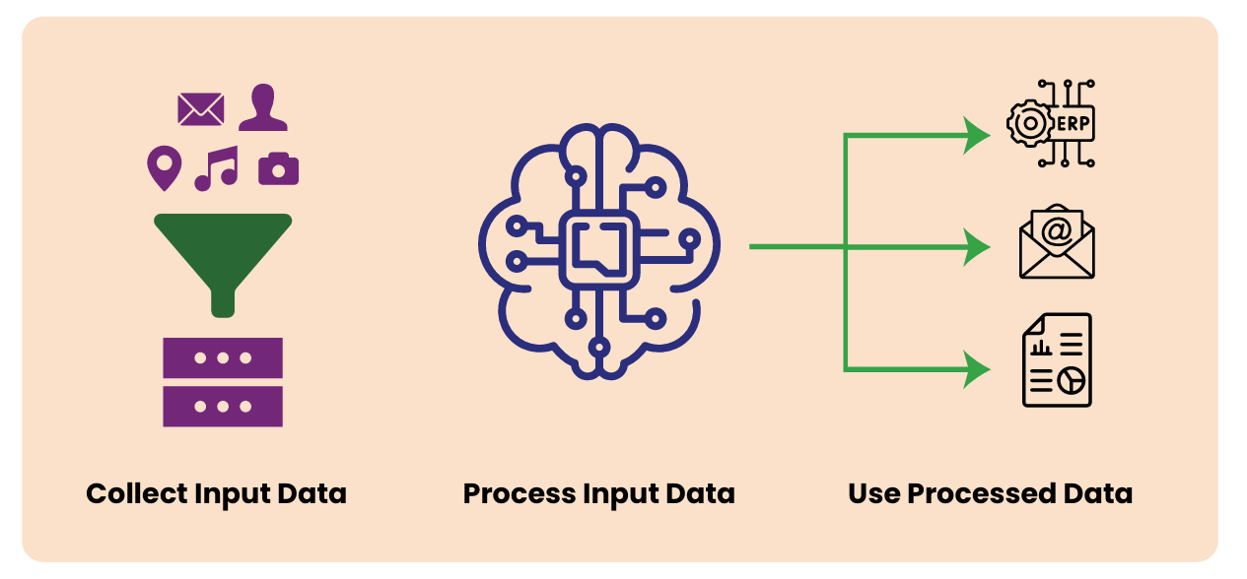
RPA can be better understood as a Digital Worker trained to tasks performed by humans with no or minimal value. It primarily performs below functions (Refer to Figure 1 below) :

Slide 11
Collection of Inputs: RPA can be trained to collect data as input from any digital source.
Processing of raw data collected: RPA has a strong processing engine, coupled with Artificial Intelligence and Machine Learning, it can process volumes of data with unmatched speed and without any errors.
Entering/ Presenting/ publishing the data in the Target application: RPA can use the processed data for variety of ways including:
  Enter the data in any Target application like Tally, SAP etc.
  Filling of forms on web portals like GST portals, Bank portals.
  Sending the formatted data to the target users through mails or any other medium of communication.
  Engaging with Users and respond to their queries in the form of chatbots.
  Publish reports and dashboards based on the processed data to the target users.

Slide 12
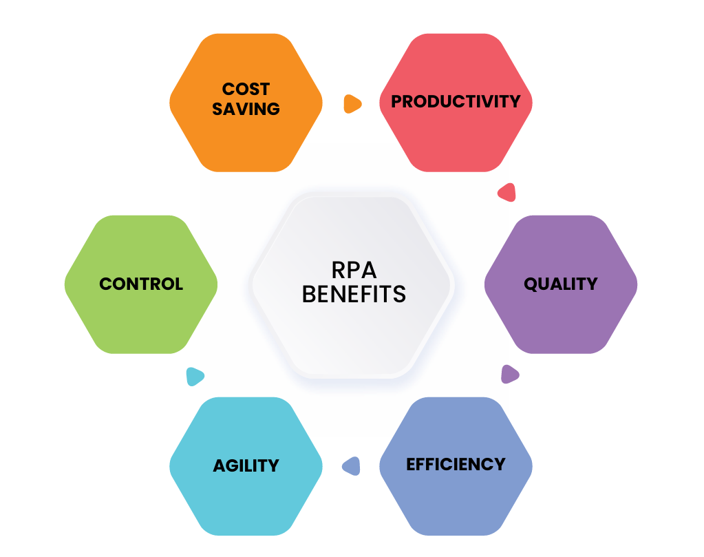
THE BENEFITS OF RPA

Slide 13
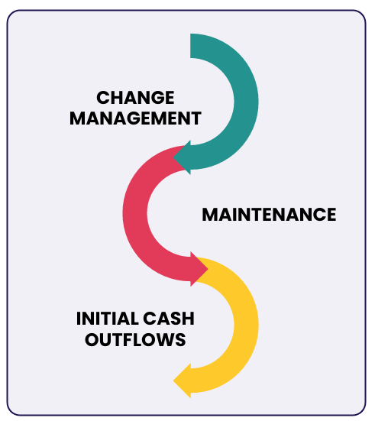
CHALLENGES IN RPA

Slide 14
CHAPTER 3
RPA AND ITS PRACTICAL USE CASES

Slide 15

Key Concepts
HOW DOES RPA WORK?
WHERE DOES RPA WORK?
HOW DOES RPA WORK?
WHERE DOES RPA WORK?

Slide 16
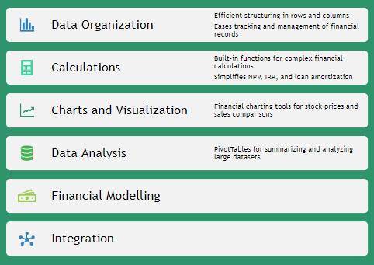
Excel's Importance in Accounting, Finance, and Data Analysis

Slide 17
COMPATIBILITY CONSIDERATIONS ACROSS EXCEL VERSIONS

Slide 18
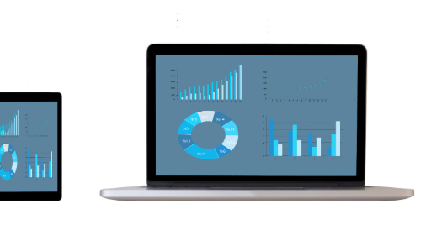
Understanding Excel Versions and Platforms

Slide 19
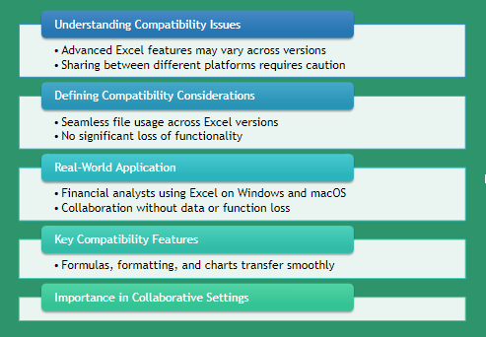
Compatibility Considerations Across Excel Versions

Slide 20

Navigating the Excel Interface

Slide 21
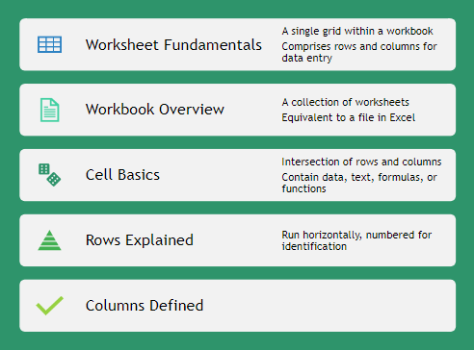
Navigating the Excel Interface: Worksheets and Cells

Slide 22
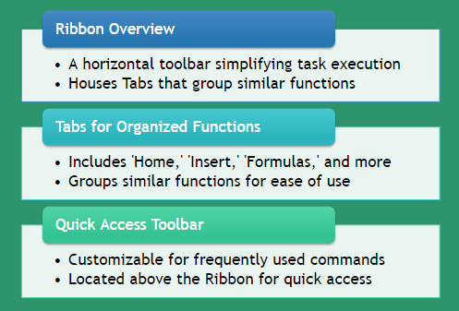
Navigating the Excel Interface: Ribbon, Tabs, and Quick Access Toolbar

Slide 23
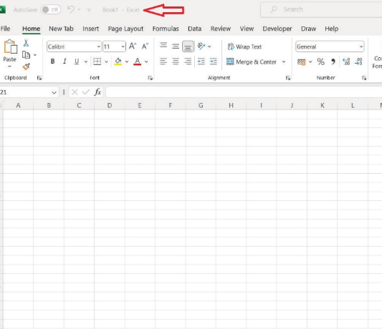
Excel Interface - Visual Guide
Figure: Basic layout of MS Excel
Above is the example of home screen of Excel with multiple sheets added to the default workbook named “ Book1”.
Figure: Basic layout of MS Excel

Slide 24
Navigating Excel: Starting Excel and Opening Workbooks
Key Features of the Excel Start Screen
Feature | Description
Recent Documents | Displays a list of recently opened workbooks for quick access
Templates | Offers various templates for creating new workbooks
New Workbook Creation | Option to start a new workbook from scratch or a template
Initiating Microsoft Excel
  For Windows: Use the Start button and search for 'Excel'
  For macOS: Find Excel in the Applications folder
Using the Excel Start Screen
  Access recent documents and templates
  Create new workbooks from scratch or templates

Slide 25
NAVIGATING EXCEL: SCROLLING AND ZOOMING TECHNIQUES
Scrolling Techniques
  Use scroll bars to navigate through worksheets
  Scroll wheel on mouse allows vertical movement
Zooming Techniques
  Adjust worksheet view with zoom slider
  Ideal for managing large datasets

Slide 26
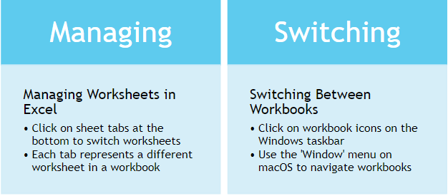

Navigating Excel: Switching Between Worksheets and Workbooks

Slide 27
Navigating Excel: Selecting Cells, Ranges, and Columns
Selecting Individual Cells
  Click directly on the cell to highlight it.
Choosing a Range of Cells
  Click and drag to cover the desired cells.
Selecting Entire Columns
  Click the column header, such as 'A' for the first column.
Selecting Non-Adjacent Cells/Ranges
  Use 'Ctrl' (Windows) or 'Command' (macOS) while selecting each cell or range.

Slide 28
DATA ENTRY AND EDITING IN EXCEL

Slide 29
DATA ENTRY AND EDITING IN EXCEL: METHODS OF DATA ENTRY
Manual Data Entry
  Direct typing into Excel cells
  Useful for individual financial transactions
Copy-Paste Method
  Copying from external sources like PDFs
  Ensures alignment with Excel's layout
Data Import Options
  Importing from CSV files or databases
  Ideal for large datasets or external systems

Slide 30
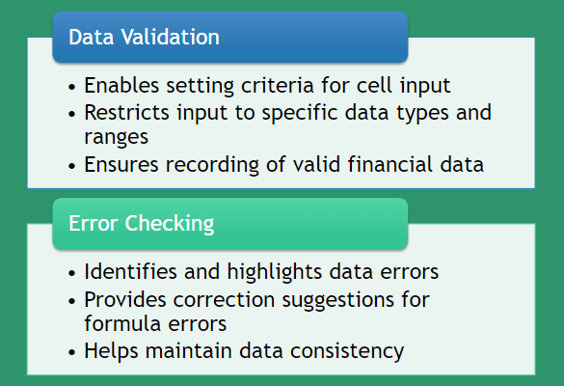
Data Entry and Editing in Excel: Data Validation and Error Checking

Slide 31
Data Entry and Editing in Excel: Editing and Deleting Data
Editing Data in Cells
  Double-click the desired cell
  Modify the data as needed
  Press “Enter” to save changes
Deleting Data
  Select the cell, row, or column
  Press the “Delete” key to remove

Slide 32
AUTOFILL AND FLASH FILL FOR EFFICIENT DATA MANAGEMENT

Slide 33
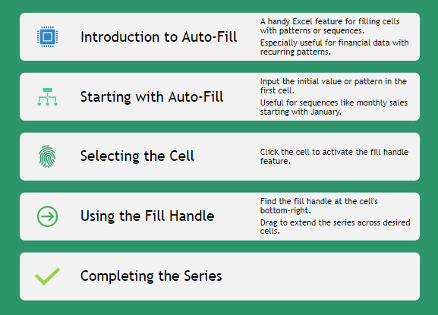
AutoFill and Flash Fill for Efficient Data Management: Utilizing AutoFill for Series and Patterns

Slide 34
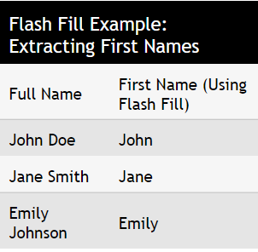
AutoFill and Flash Fill for Efficient Data Management: Introduction to Flash Fill for Data Transformation
Introduction to Flash Fill
  An automated tool for data transformations in Excel
  Useful for financial data extraction and reformatting
Step-by-Step Guide
  Enter the desired pattern for data transformation
  Activate Flash Fill with shortcuts or through the Ribbon
  Watch as Excel applies the pattern to your data
Practical Example
  Extract first names from a list of full names using Flash Fill

Slide 35
Data Formatting for Financial Analysis

Slide 36

Data Formatting for Financial Analysis: Importance of Data Formatting
Significance of Proper Data Formatting
  Boosts readability and interpretability in financial analysis
Benefits of Clear Data Presentation
  Organized data aids stakeholder comprehension and insight extraction
Highlighting Critical Data Points
  Draws focus to vital information and trends

Slide 37
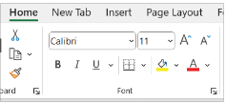
Data Formatting for Financial Analysis: Formatting Options in Excel
Font Customization
  Select readable fonts for clarity
  Font group adjustments for text appearance
Number Formats
  Display numbers with precision
  Includes currency, decimals, symbols
Alignment for Readability
  Position data neatly within cells
  Options for text alignment and orientation
Cell Fill for Emphasis
  Use background colors to highlight data
  Create visual distinctions in cells

Slide 38
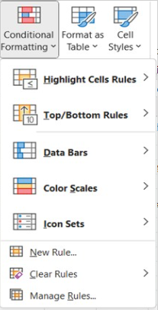
Data Formatting for Financial Analysis: Conditional Formatting
Select the Data Range
  Choose cells for conditional formatting application
Access Conditional Formatting Options
  Find in 'Home' tab on the Ribbon
Set the Rule
  Decide on rule type (e.g., highlight cells above a value)
Define the Rule Parameters
  Specify criteria and formatting details
Example Use Case
  Highlight sales figures above a threshold

Slide 39
UNDERSTANDING DATA TYPES AND CELL REFERENCES: DIFFERENTIATING DATA TYPES
Text Data
  Includes non-numeric and non-date information
  Examples: names, addresses, descriptions
Numeric Data
  Used for mathematical operations
  Types: whole numbers, decimals, percentages
Date Data
  Specific type of numeric data for calendar dates
Other Data Types
  Specialized types like currency, percentages
  Boolean and error values also included

Slide 40
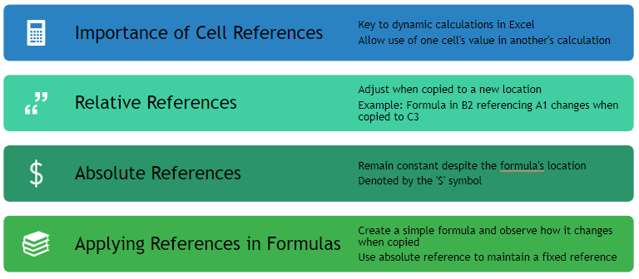
Understanding Data Types and Cell References: Cell References

Slide 41
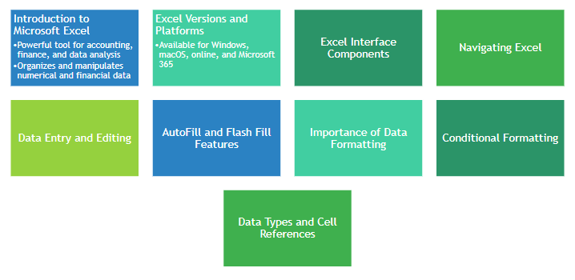
Summary of Microsoft Excel and Data Formatting

Slide 42
Mastering Excel for Financial Analysis
Formatting, Tables, and Formulas

Slide 43
Agenda
Title Slide
Introduction to Excel Tables
Utility of Tables for Chartered Accountants
Formatting Steps and Image
Merging and Centering Cells
Using Borders and Gridlines
Adding Data to a Table
Resizing and Formatting Tables
Formulas in Excel
Summary of Chapter 2
Historical Perspective and Relevance of Data Consolidation
Totalling Across Multiple Sheets

Slide 44
Learning Objectives - Chapter 2
Accurate Data Representation in Finance
  Understanding its importance in financial spreadsheets
Number Formatting Skills
  Applying formats for currency, percentages, and decimals
Date and Time Precision
Conditional Formatting for Visualization
Enhancing Readability with Alignment
Creating Professional Headers
Consistent Cell Styles and Themes
Optimizing Data Presentation
Using Borders and Gridlines
Efficient Data Management with Tables

Slide 45

Introduction to Excel Tables
Introduction to Excel Tables
  Essential for organizing and analyzing data
  Crucial for financial and accounting tasks
Creating Tables in Excel
  Structured information with defined headers
  Intrinsic functionalities for data manipulation
Managing Tables Efficiently
  Guidance through the process
  Enhances spreadsheet tasks

Slide 46

Historical Perspective and Relevance of Tables

Slide 47

Topics at-a-Glance for Excel Tables
Introduction to Table Creation
Structured approach to data management
Adding Data to Tables
Efficient data entry methods
Filtering and Sorting Data
Enhanced data navigation and organization
Integrating Total Rows
Simplified calculations within tables
Resizing and Formatting Tables
Optimizing data presentation
Converting Tables to Ranges
Flexibility in data management

Slide 48
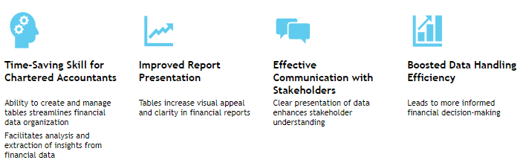
Utility of Tables for Chartered Accountants

Slide 49

Formatting in Excel
Essential Excel Formatting Techniques
  Focus on financial data accuracy and presentation
  Adherence to formal standards for better analysis
Worksheet Structuring
  Organize data for easy comprehension
  Implement formal formatting guidelines
Data Representation
  Ensure data is visually appealing
  Facilitate easier data analysis

Slide 50
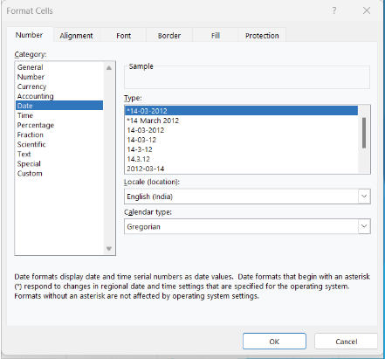
Date and Time Formatting: Formatting Steps and Image
Select Cells for Formatting
  Choose the specific cell or range of cells for date and time formatting.
Accessing Format Options
  Navigate to the 'Home' tab to find formatting tools.
Number Format Dropdown
  Use the dropdown to pick formats like 'Short Date' or 'Long Date.'
Custom Formatting
  For uniformity, apply custom formats such as 'yyyy-mm-dd' for dates.

Slide 51
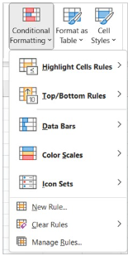
Conditional Formatting
Intelligent Data Visualization
  Automatically highlights cells based on criteria
  Facilitates quick insight discovery
Applying Conditional Formatting
  Select desired cell range
  Use 'Home' tab and 'Conditional Formatting' options
Practical Uses
  Color differentiation for threshold values
  Color scales and data bars for comparison

Slide 52
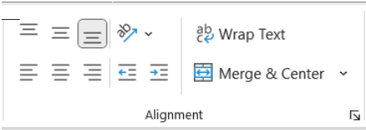
Cell Alignment and Orientation
Selecting Cells for Alignment
  Choose the cell or range to align.
Alignment Options
  Access 'Alignment' options in the 'Home' tab.
  Align text left, center, or right as needed.
Text Orientation for Fit
  Use the 'Orientation' dropdown to rotate text.
  Select an angle for better text fit within cells.

Slide 53
Merging and Centering Cells
Selecting Cells for Merging
  Choose the specific cells you want to merge.
Utilizing the 'Home' Tab
  Navigate to the 'Home' tab for merging options.
Merging & Centering Dropdown
  Click on 'Merge & Center' and select your desired merge type.
Centering Content
  Ensure the content of the merged cell is centered for a clean look.

Slide 54
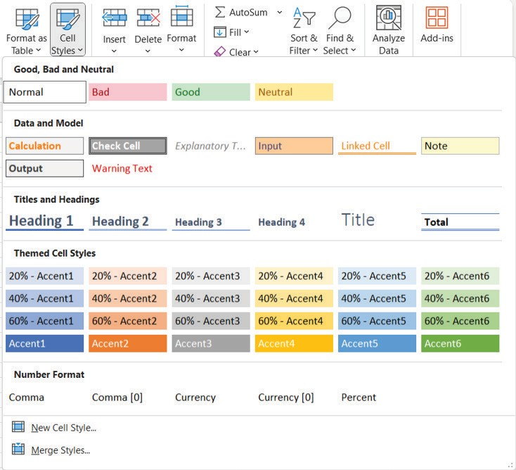
Cell Styles and Themes
Importance of Consistent Formatting
  Essential for professional appearance
  Cell styles ensure systematic uniformity
Applying Cell Styles
  Select cells or range for styling
  Use 'Home' tab in the toolbar
  Choose from 'Cell Styles' gallery

Slide 55
Formatting Columns and Rows
Adjusting Column and Row Dimensions
  Drag column borders to fit content width
  Modify row height by hovering and adjusting at the boundary
Enhancing Spreadsheet Readability
  Optimize column widths for content accommodation
  Adjust row heights to improve content visibility
Autofit Columns for Content Length
  Use the 'Format' menu in the 'Home' tab for autofitting

Slide 56
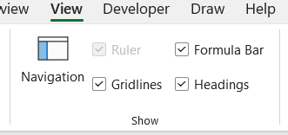
Using Borders and Gridlines
Selecting Cells for Border Formatting
  Choose cells to highlight with borders
  Access 'Home' tab for formatting options
Applying Borders to Cells
  Use 'Borders' dropdown for style selection
Gridlines for Cell Differentiation
  Toggle gridlines in 'View' tab for clarity

Slide 57


Creating and Managing Tables
Excel Table Creation and Management
Enhanced Financial and Accounting Tasks
Essential for organizing and analyzing data
Structured information with defined headers
Intrinsic functionalities for data manipulation
Guidance for adept table management in spreadsheets

Slide 58
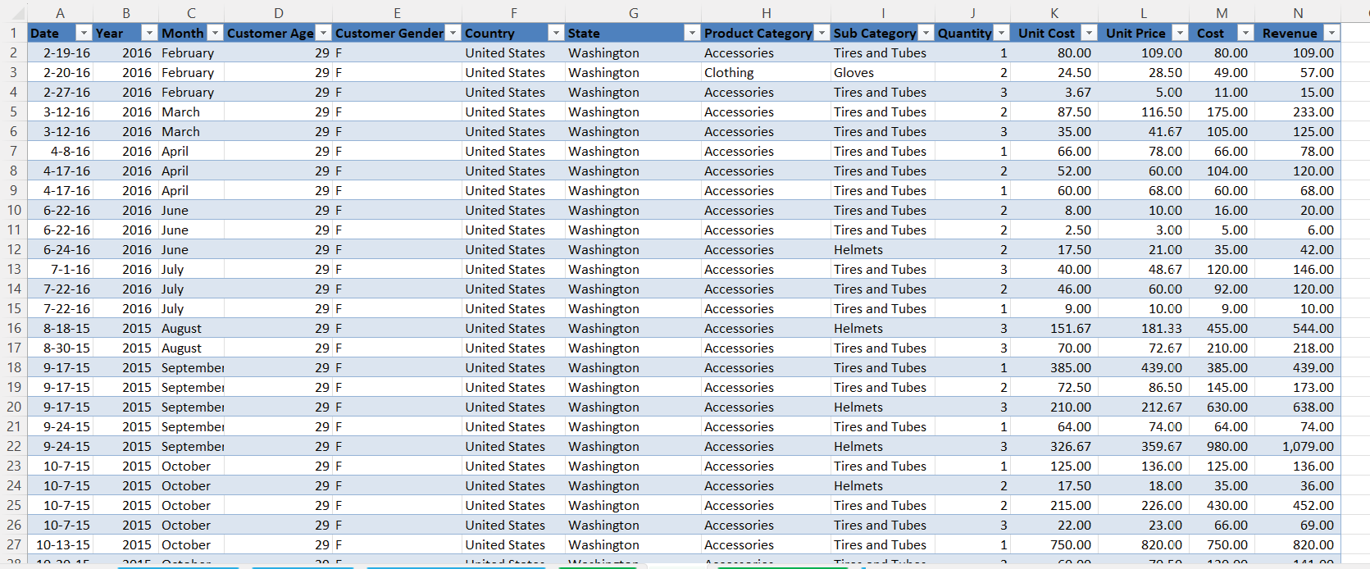
Creating a Table: Image and Explanation

Slide 59
Adding Data to a Table
Seamless Data Addition Process
  Initiate by typing in the last table row
  Automatic table expansion for new data
Step-by-Step Data Entry
  Navigate to the table's end
  Begin typing to include a new row

Slide 60
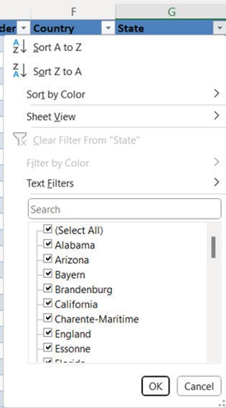
Filtering and Sorting in Tables
Essential Data Analysis Tools
  Tables with filtering and sorting capabilities
  Facilitate extraction of insights
Filtering Data
  Use dropdown arrow on column header
  Select criteria to refine data display
Sorting Data
  Click sort icon on column header
  Arrange data in desired order

Slide 61
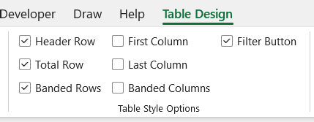
Total Row in Tables
Selecting the Table
  Activate the table to enable total row addition
Accessing Table Design
  Navigate to the 'Table Design' tab for options
Enabling Total Row
  Tick the 'Total Row' checkbox to add a new row
Inserting Calculations
  Click the desired cell in the Total Row for calculations
Choosing Calculations
  Select from sum, average, etc., via the dropdown

Slide 62
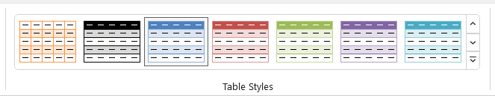
Resizing and Formatting Tables
Adjusting Table Dimensions
  Click on the table to access resize handles.
  Easily modify the table size to fit your needs.
Enhancing Table Appearance
  Utilize the 'Table Design' tab for style options.
  Choose from a variety of styles to improve readability.
Step-by-Step Formatting Process
  Select the table and adjust size with handles.
  Apply styles from the 'Table Design' tab.

Slide 63
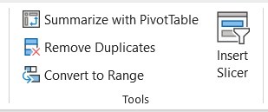
Converting Tables to a Range
Excel Table Conversion Flexibility
  Capability to revert a table back to a range format
Step-by-Step Conversion Process
  Select the table to initiate conversion
  Access 'Table Design' tab for tools
  Use 'Convert to Range' button for action
  Confirm conversion through prompt

Slide 64
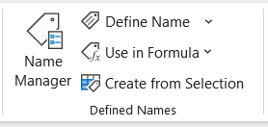
Named Ranges Within Tables
Enhancing Data Analysis
  Named ranges streamline complex formulas
  Facilitate efficient data analysis and calculations
Creating a Named Range
  Select cell range for naming
  Use 'Formulas' tab and 'Create from Selection'
  Opt for 'Top row' with headers
  Confirm with 'OK' to establish named range
Figure Reference
  Defined names group illustration

Slide 65
Formulas in Excel
Essential Excel Proficiency
Formulas and functions are crucial for accounting and finance.
Streamlining Data Tasks
Key operations enhance effective data processing.

Slide 66
Basic Arithmetic Operations
Introduction to Basic Arithmetic in Excel
Essential for calculations within formulas
Begin formulas with equals sign (=)
Core Mathematical Computations
Addition (+) for summing values
Subtraction (-) to deduct values
Multiplication (*) for product calculation
Division (/) to divide values

Slide 67
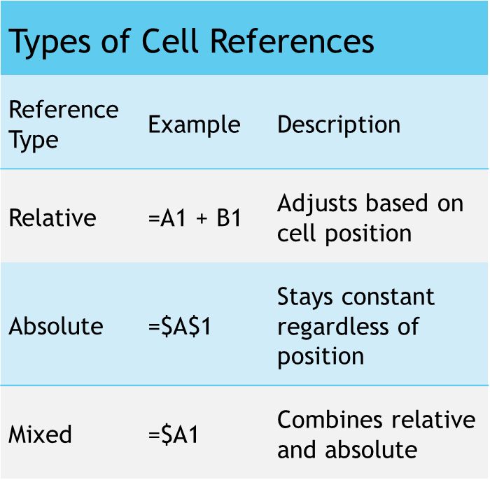
Cell References in Formulas
Consistent Calculations with Cell References
  Use A1, B2 for specific cells
  Relative references like A1 adjust when copied
  Absolute references like $A$1 remain fixed
Types of Cell References
  Relative References: =A1 + B1
  Absolute References: =$A$1
  Mixed References: =$A1
Dynamic Calculations in Formulas
  Referencing cells allows for automatic adjustments
  Mixed references combine relative and absolute aspects

Slide 68
Summary of Chapter 2
Number Formatting
Essential for accurate financial data representation
Includes currency, percentages, and decimals
Date and Time Formatting
Crucial for precise accounting records
Detailed guidance on formatting
Conditional Formatting
Cell Alignment and Orientation
Merging and Centering Cells
Cell Styles and Themes
Formatting Columns and Rows
Using Borders and Gridlines

Slide 69
Learning Objectives - Chapter 3
Comprehensive Data Totalling
Use cell references to total data from multiple sheets.
Excel's Consolidate Tool
Combine data from various sheets for in-depth financial analysis.
Mathematical & Statistical Functions
Learn functions like SUM, AVERAGE, MIN, and MAX.
Text Manipulation Functions
Master CONCATENATE, LEFT, RIGHT, and LEN for text data analysis.
Date & Time Calculations
Handle functions like TODAY, NOW, EOMONTH, DATEDIF.
Specialized Financial Functions
Practical Application

Slide 70
Introduction to Data Consolidation
Essential Financial Analysis Techniques
Consolidation of data from multiple sources is key.
Excel is a vital tool for financial professionals.
Streamlining Data Processes
Excel techniques enhance decision-making.
Professionals gain insights from diverse datasets.
Module Focus
Exploration of totalling across sheets and key functions.
Indispensable for analysts and accountants.

Slide 71
Historical Perspective and Relevance of Data Consolidation
Historical Background of Data Consolidation
Originated from traditional accounting practices with ledgers and manual records.
Required extensive efforts to compile data from different sectors.
Transformation with Spreadsheet Software
Excel introduced in the late 20th century, changing financial reporting.
Enhanced efficiency and accuracy in data analysis.
Modern-Day Economic Implications
Globalized economy demands data consolidation from varied sources.
Crucial for informed decision-making in organizations worldwide.

Slide 72
TOPICS AT-A-GLANCE FOR DATA CONSOLIDATION
Totalling Across Multiple Sheets
Summing data using cell references
Essential for financial professionals
Excel's Consolidation Function
Combines data from multiple sheets
Streamlines data management
Essential Financial Functions
Covers basic to specialized operations
Enables complex financial analyses

Slide 73

Utility for Chartered Accountants - Data Consolidation
Essential Techniques for Chartered Accountants
Consolidation of financial data crucial for audits and statements
Facilitates extraction of insights from large datasets
Impact on Decision-Making
Enables informed decisions for clients and organizations
Enhancing Accuracy and Efficiency
Streamlines complex calculations in financial analysis
Ensures precision in managing financial information
Professional Practice Benefits
Improves proficiency and effectiveness in accounting roles

Slide 74
Using Excel’s Consolidation Functionality
Select the Target Cell
Choose the cell for the total to appear
Navigate to the Data Tab
Find the 'Data' tab on the Ribbon
Utilize the Consolidate Option
Open the 'Consolidate' dialog box via the option
Define Range and Function
Select cell range and desired function (SUM, AVERAGE, etc.)
Identify Reference Sheets
Select sheets for data consolidation
Customize Settings
Execute Consolidation

Slide 75
Functions in Excel
Essential for Excel Proficiency
Key in accounting and finance for accurate calculations
Vast Library of Built-in Functions
From simple arithmetic to complex statistical analysis
Streamlined Calculations with Functions
Ensures accuracy and simplifies complex processes
Using Excel Functions
Start with '=' followed by function name and arguments in parentheses
Example: =SUM(A1:A10) to add values from A1 to A10
Press Enter to execute and display the result

Slide 76
Math and Statistical Functions
SUM Function
Adds up a range of values
Example: =SUM (A1:A10)
AVERAGE Function
Calculates the average of values
Example: =AVERAGE (B1:B10)
MIN and MAX Functions
Identify the smallest and largest values
Examples: =MIN (C1:C5), =MAX (C1:C5)
Function | Description | Example
SUM | Adds up a range of values | =SUM (A1:A10)
AVERAGE | Calculates the average of values | =AVERAGE (B1:B10)
MIN | Finds the smallest value | =MIN (C1:C5)
MAX | Finds the largest value | =MAX (C1:C5)

Slide 77
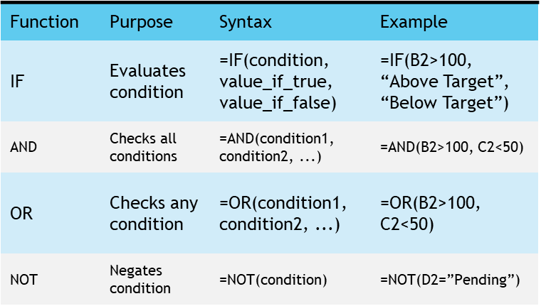
Logical Functions
Essential for Condition-Based Calculations
Automate decisions with specific criteria
IF Function: Decision-Making Tool
Returns values based on a true or false condition
Example: =IF(B2>100, “Above Target”, “Below Target”)
Combining Multiple Conditions
AND checks if all conditions are true
OR checks if any condition is true
NOT Function: Negating Conditions
Inverts the given condition's result
Example: =NOT(D2=”Pending”)

Slide 78
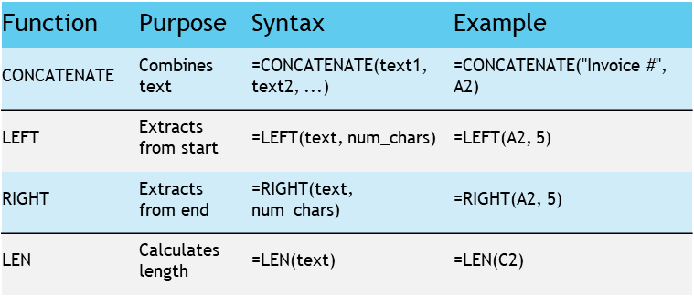
Text Functions
Text Function Utilities
Manipulate, extract, and analyze text data in financial tasks
CONCATENATE Function
Combines text from multiple cells
LEFT & RIGHT Functions
Extract specific characters from text ends
LEN Function
Calculates text string length

Slide 79
Date and Time Functions
TODAY and NOW Functions
Provide current date and time
Syntax for TODAY: =TODAY()
Syntax for NOW: =NOW()
EOMONTH Function
Calculates month-end date from a start date
Syntax: =EOMONTH(start_date, months)
Example: =EOMONTH(A2, 3)
DATEDIF Function
Computes difference between two dates
Syntax: =DATEDIF(start_date, end_date, unit)
Example: =DATEDIF(B2, C2, "d")

Slide 80
Financial Functions
PMT Function for Loan Payments
Calculates periodic payments with a given rate, number of periods, and present value.
FV Function for Investment Future Value
Computes the future value of regular investments over time at a specified rate.
NPV Function for Cash Flow Valuation
Determines the net present value of a series of cash flows at a given discount rate.

Slide 81
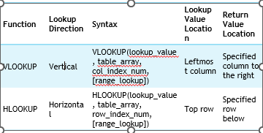
Lookup and Reference Functions
VLOOKUP Function
Searches for a value in the leftmost column
Returns a corresponding value from a specified column
HLOOKUP Function
Searches for a value in the top row
Returns a corresponding value from a specified row
INDEX & MATCH Functions
Provide flexible lookup capabilities

Slide 82
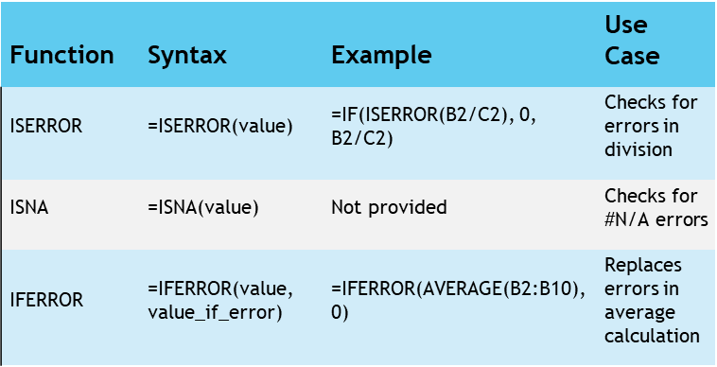
Error Handling Functions
Importance of Error Handling
Crucial for accurate financial calculations
Ensures reliability and precision in accounting
Error Checking Functions
ISERROR and ISNA identify formula errors
IFERROR replaces errors with alternative values
Function Syntax and Examples
ISERROR: =ISERROR(value)
ISNA: =ISNA(value)
IFERROR: =IFERROR(value, value_if_error)
Practical Usage
Example formulas demonstrate error handling in action

Slide 83
Mastering Excel Functions for Financial Analysis

Slide 84
Agenda
Title Slide
Historical Perspective and Relevance
SUMIF and COUNTIF Functions
COUNTIF Function
SUMIFS Function
COUNTIFS Function Example
Image
Utility for Chartered Accountants
LEN Function Example
SEARCH and SUBSTITUTE Functions
Creating Data Validation Rules
Configure Input Message and Error Alert

Slide 85
Overview: Introduction to Advanced Functions
Understanding Advanced Functions
  Learn the purpose and usage of SUMIF, COUNTIF, SUMIFS, COUNTIFS
Calculating with SUMIF
  Sum values based on a single condition
Counting with COUNTIF
  Count cells meeting a specific condition
Multi-criteria Summing with SUMIFS
  Sum values based on multiple conditions
Complex Counting with COUNTIFS
  Count cells that meet multiple criteria

Slide 86
Overview: Learning Objectives
Understanding Advanced Excel Functions
Grasp the purpose and application of functions like SUMIF, COUNTIF, SUMIFS, and COUNTIFS.
Applying SUMIF
Calculate sums based on a single condition.
Utilizing COUNTIF
Count cells meeting a specific condition within a range.
Implementing SUMIFS
Sum values based on multiple criteria.
Applying COUNTIFS
Count cells that meet multiple conditions for complex data analysis.

Slide 87
Introduction to Advanced Functions
Key Excel Functions in Financial Analysis
SUMIF: Performs conditional sum calculations
COUNTIF: Counts cells that meet a specific condition
Advanced Data Aggregation
SUMIFS: Sums data based on multiple conditions
COUNTIFS: Counts cells matching multiple criteria
Enhancing Precision and Accuracy
Enables detailed financial calculations
Facilitates informed decision-making

Slide 88
Historical Perspective and Relevance
Transformation of Financial Analysis
Automated data extraction and summarization
Reduced manual effort and human error
Historical Perspective
Manual, time-consuming tasks in the past
Advancements in Productivity
Excel functions enable swift, accurate calculations
Significant enhancement in analyst productivity

Slide 89
Topics at-a-Glance
SUMIF & COUNTIF Functions
Enable conditional aggregation and counting
SUMIF sums values based on a condition
COUNTIF counts cells meeting a criterion
SUMIFS & COUNTIFS Functions
Crucial for multi-condition financial analysis
Allow application of several criteria
Provide detailed data insights in complex scenarios

Slide 90
Utility for Chartered Accountants
Crucial Financial Reporting Tools
SUMIF and COUNTIF for transaction evaluation
SUMIFS and COUNTIFS for revenue analysis
Ensuring compliance with financial regulations
Advanced Functions for Precision
Handle intricate calculations effortlessly
Indispensable for Chartered Accountants

Slide 91
SUMIF and COUNTIF Functions
Essential Excel Functions
SUMIF: Sums data meeting a specific condition
COUNTIF: Counts data entries that match a given condition
Single Condition Analysis
Both functions operate based on a single criterion
Useful for targeted data analysis within spreadsheets
Streamlining Data Management
Automates calculation processes
Enhances efficiency in handling large data sets

Slide 92



SUMIF Function
Function Purpose
SUMIF sums values based on a condition.
Syntax Overview
Format: =SUMIF(range, criteria, [sum_range])
Parameter Details
range: Cells to check against criteria.
criteria: Condition for summing cells.
sum_range: Cells to sum (optional).

Slide 93
SUMIF Function Example
Understanding SUMIF Function
  Used for conditionally summing values based on criteria
  Applicable in sales data analysis
Calculating Revenue for 'Product A'
  Utilize the formula =SUMIF(A1:A100, “Product A”, B1:B100)
  Targets a specific product within a dataset
Steps for Execution
  Select the range of product names (A1:A100)
  Specify the target product (“Product A”)
  Choose the corresponding revenue range (B1:B100)

Slide 94
COUNTIF Function
Essential Excel Functionality
COUNTIF function is crucial for data analysis in Excel.
Function Purpose
It counts cells that fulfill a specific condition within a range.
Range Specification
User defines the range of cells for the function to assess.
Condition Criteria
Criteria determine which cells are counted.
Application in Data Analysis
Useful for summarizing and extracting insights from data.

Slide 95
COUNTIF Function Example
Definition of COUNTIF Function
Counts cells that meet a specified condition
Syntax Components
Range: Cells to evaluate
Criteria: Condition for counting
Practical Example
Count transactions over $1,000
Use criteria ">1000" for selection

Slide 96


SUMIFS and COUNTIFS Functions
Multiple Conditions in Excel
SUMIFS and COUNTIFS functions allow for applying various criteria.
Essential Excel Functions
These functions are crucial for complex data analysis.

Slide 97

SUMIFS Function
Function Purpose
Sums values based on multiple criteria
Function Syntax
Uses sum_range, criteria_range1, criteria1, etc.
Parameter Details
sum_range: Values to sum
criteria_range1, criteria_range2, ...: Ranges to evaluate
criteria1, criteria2, ...: Conditions for summing

Slide 98



SUMIFS Function Example
Using SUMIFS for Targeted Revenue Calculation
Focus on 'Product A' sales in the 'North' region.
Utilize sales dataset with product names, regions, and revenue details.
Excel Formula Breakdown
Apply =SUMIFS(B1:B100, A1:A100, “Product A”, C1:C100, “North”).
Sum revenue where conditions for product and region match.
Benefits of SUMIFS
Enables precise revenue tracking for specific criteria.
Facilitates data analysis and financial reporting.

Slide 99



COUNTIFS Function
Function Overview
COUNTIFS function is used for counting cells.
It operates based on multiple criteria.
Comparison with SUMIFS
Similar functionality to SUMIFS.
Focuses on counting rather than summing.
Application in Spreadsheets
Essential for data analysis tasks.
Enhances productivity by automating counts.

Slide 100
COUNTIFS Function Example
Syntax of COUNTIFS
criteria_range1, criteria_range2, ...: Ranges to check against criteria
criteria1, criteria2, ...: Conditions to count cells
Example Use-Case
Count transactions over $1,000 in 'January'
Formula: =COUNTIFS(A1:A100, ">1000", B1:B100, "January")

Slide 101
Summary of Advanced Functions
Essential Advanced Functions
Focus on SUMIF and COUNTIF for conditional calculations
Introduction to SUMIFS and COUNTIFS for multi-condition analysis
Module 4 Highlights
Crucial for financial analysis and data management
Enhances efficiency in handling large datasets
Learning Outcomes
Ability to perform complex calculations with ease
Improved analytical skills for financial data

Slide 102


Introduction to Text Functions and Data Validation
Introduction
Learning Objectives
Focus on Text Functions
Understanding Data Validation
Setting the stage for educational goals
Preparing for instructional content

Slide 103



Historical Perspective and Relevance
Essential Text Handling in Financial Analysis
Historical Significance of Text Manipulation
Modern Financial Landscape Demands
Accurate text data management is crucial for financial professionals.
Excel offers powerful text functions and validation tools for data precision.
Textual data volume grew with business expansion, requiring advanced processing.
Excel's development reflects the ongoing need for robust text functions.
Data integrity is critical in current financial analysis.
Excel's tools ensure reliable data for financial modelling and analysis.

Slide 104
Topics at a Glance
Advanced Text Functions
  Crucial for manipulating and analyzing text data
  Key functions: LEN, LEFT, RIGHT, SEARCH, SUBSTITUTE
Data Validation
  Prevents incorrect data entry
  Enforces data type and range rules

Slide 105
Utility for Chartered Accountants
Indispensable Tools for Accuracy
Crucial for maintaining precision in financial data handling
Mandatory for validating textual data efficiently
Key Functions for Chartered Accountants
Verification of invoice numbers and currency codes
Setting stringent rules for data entry processes
Value in a Chartered Accountant's Toolkit
Tools that are invaluable assets for financial professionals

Slide 106
Advanced Text Functions
Essential Tools for Data Management
Advanced text functions are crucial for efficient data manipulation.
They play a significant role in analyzing descriptive financial data.

Slide 107
LEN Function
Function Overview
  LEN function determines character count in a text string.
Syntax Details
  Use: =LEN(text) to apply the function.
Parameter Explanation
  'text' refers to the string for character counting.

Slide 108
LEN Function Example
Invoice Number Verification
  Ensure all invoice numbers meet a specific character length requirement.
Data Validation Rule
  Utilize the LEN function in Excel for this purpose.
Example Character Length
  For instance, verifying that each number has 10 characters.

Slide 109
LEFT and RIGHT Functions
Character Extraction Functions
  LEFT function extracts from the beginning of a text string
  RIGHT function extracts from the end of a text string
Syntax Overview
  LEFT: =LEFT(text, num_chars)
  RIGHT: =RIGHT(text, num_chars)
Function Parameters
  text: The text string for character extraction
  num_chars: Number of characters to extract

Slide 110


LEFT and RIGHT Functions Example
Utilizing the LEFT Function in Excel
Designed to extract specific text from a cell
Useful for isolating currency codes from financial data
Application in Financial Data Analysis
Handles data with currency codes followed by amounts
Example: 'USD 1000, EUR 500'
Step-by-Step Extraction Process
Formula: =LEFT(A1, 3) to extract the first three characters
Efficiently retrieves the currency code from the data

Slide 111
SEARCH and SUBSTITUTE Functions
SEARCH Function Overview
SUBSTITUTE Function Usage
Key Parameters Explained
  Finds the position of a character or substring
  Uses syntax: =SEARCH(find_text, within_text, [start_num])
  Replaces specific text within a string
  Applies syntax: =SUBSTITUTE(text, old_text, new_text, [instance_num])
  find_text: Text to find or replace
  within_text: String to search within
  start_num: Optional start position for SEARCH
  old_text/new_text: Text to be replaced and replacement text

Slide 112




SEARCH and SUBSTITUTE Functions Example
Text Replacement in Product Descriptions
Replace 'Inc.' with 'Incorporated' in dataset
Excel SUBSTITUTE Function
Use formula: =SUBSTITUTE(A1, 'Inc.', 'Incorporated')
Efficient Data Editing
Streamlines text modifications in spreadsheets
Enhanced Readability
Improves clarity of product information
Consistency in Documentation
Ensures uniformity across all product descriptions

Slide 113
Data Validation
Essential for Data Integrity
  Ensures accuracy and consistency in data
Rules for Data Entry
  Allows specification of data types and ranges
Prevents Data Errors
  Minimizes the risk of incorrect data input

Slide 114
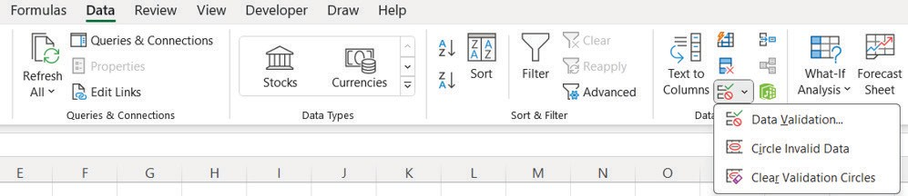
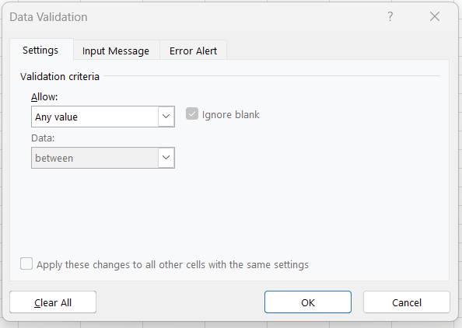
Creating Data Validation Rules: Image

Slide 115
Set the Validation Criteria
Accessing Data Validation Dialog Box
Initiate the dialog box to begin setting criteria
Specifying Criteria
Choose the type of data, such as whole numbers or date ranges

Slide 116
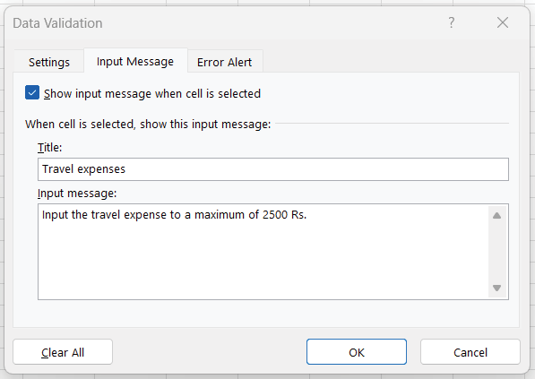
Configure Input Message and Error Alert: Image

Slide 117
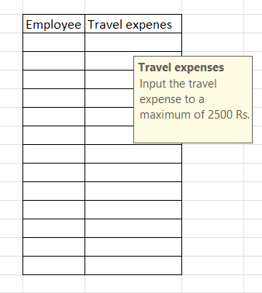
Configure Input Message and Error Alert: Image

Slide 118
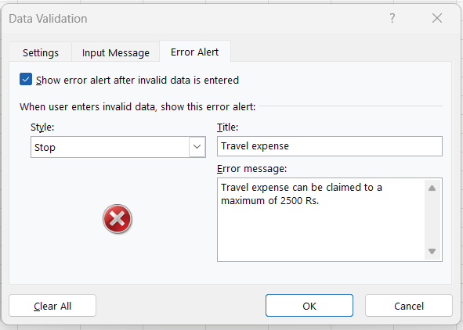
Configure Input Message and Error Alert: Image

Slide 119
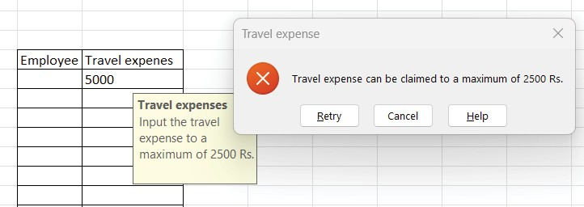
Configure Input Message and Error Alert: Image

Slide 120
Summary of Text Functions and Data Validation
Key Aspects of Financial Analysis
Understanding Text Functions in Excel
Implementing Data Validation for Accuracy

Slide 121
Mastering Lookup Functions in Financial Analysis

Slide 122
Agenda
Title Slide
Overview
Introduction to Lookup Functions
Historical Perspective and Relevance
Topics at-a-Glance
Utility for Chartered Accountants
VLOOKUP (Vertical Lookup)
HLOOKUP (Horizontal Lookup)
INDEX Function
MATCH Function
INDEX and MATCH Functions
Summary of Lookup Functions

Slide 123



Overview
Understanding Lookup Functions
Grasp core concepts and applications in financial analysis
Vertical and Horizontal Data Retrieval
Use VLOOKUP for vertical and HLOOKUP for horizontal data retrieval
Fetching Data with INDEX
Learn to retrieve specific data points using INDEX and criteria
Locating Values with MATCH
Acquire skills to locate precise values in datasets
Real-world Financial Scenarios
Enhance analytical capabilities by applying lookup functions
Critical Evaluation of Lookup Functions
Choose the right function for financial analysis tasks

Slide 124
Introduction to Lookup Functions
Essential Tools for Financial Analysis
  Lookup functions are crucial for efficient data retrieval.
  They enhance the precision of financial analyses.
Swift and Accurate Data Access
  Allows quick pinpointing of specific data within large datasets.
Comprehensive Module Coverage
  Provides skills to navigate and extract relevant financial data.

Slide 125
Historical Perspective and Relevance
Evolution of Computational Tools
Shift from manual calculations to spreadsheet software
Introduction of functions like VLOOKUP, HLOOKUP, INDEX, and MATCH
Impact on Financial Analysis
Streamlined analysis process with improved accuracy and speed
Essential for managing vast datasets in modern finance
Essential Skills for Professionals
Ability to extract specific data quickly
Lookup functions as the backbone of efficient analysis

Slide 126
Topics at-a-Glance
VLOOKUP: Vertical Data Retrieval
  Excels in searching for data in columns
HLOOKUP: Horizontal Data Search
  Specializes in finding data across rows
INDEX: Flexible Value Fetching
  Retrieves values based on specific criteria
MATCH: Precise Value Location
  Identifies exact values within a dataset

Slide 127
Utility for Chartered Accountants
01
02
03
Essential Skills for Chartered Accountants
  Lookup functions enable precise analysis of financial data.
  They play a critical role in reducing errors in data management.
Benefits of Mastery in Lookup Functions
  Allows for efficient dissection of large financial datasets.
  Indispensable for extracting vital financial figures.
Impact on Financial Analysis
  Facilitates in-depth financial analyses.
  Enhances accuracy and reliability in financial reporting.

Slide 128
VLOOKUP (Vertical Lookup): Explanation
Lookup Function Parameters
  lookup_value: Value to find in the table's leftmost column
  table_array: Cell range with data to search
  col_index_num: Column number to return value from
  range_lookup: Specifies exact or approximate match
Lookup Function Parameter Details
Parameter | Description | Optional
lookup_value | Value to find in first column | No
table_array | Range with data to search | No
col_index_num | Column number for return value | No
range_lookup | TRUE for approximate, FALSE for exact match | Yes

Slide 129
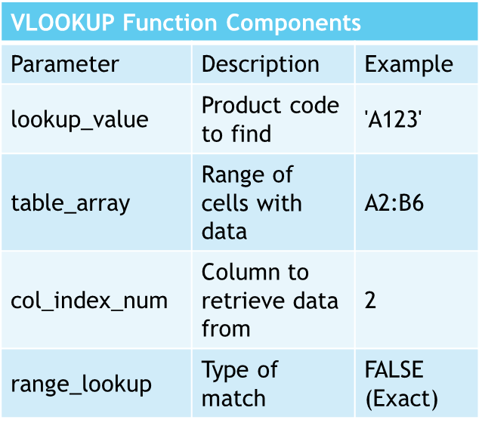
VLOOKUP (Vertical Lookup): Example - Product Prices
Understanding VLOOKUP Function
Locate price with product code 'A123'
Formula: =VLOOKUP('A123', A2:B6, 2, FALSE)
Components of VLOOKUP
lookup_value: 'A123'
table_array: A2:B6
col_index_num: 2
range_lookup: FALSE for exact match
Result Interpretation
Returns price for specified product code

Slide 130
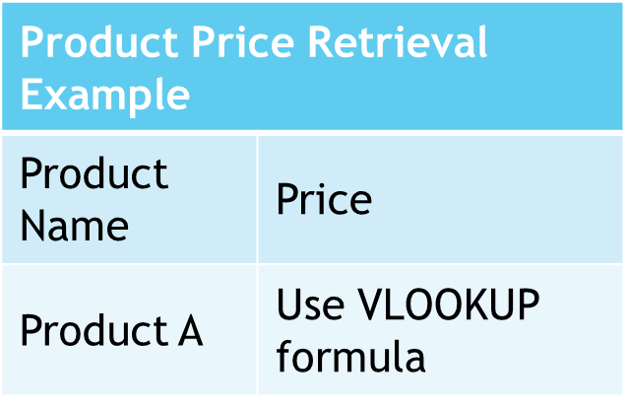
VLOOKUP (Vertical Lookup): Example - Retrieving Product Prices
Excel VLOOKUP Function
Retrieve prices from a table
Column A: Product names, Column B: Prices
Example: Find Price of 'Product A'
Use formula: =VLOOKUP("Product A", A1:B100, 2, FALSE)
Searches in range A1:B100
Returns value from 2nd column

Slide 131
HLOOKUP (Horizontal Lookup): Explanation
Lookup Value Definition
The value to search for in the table's top row
Table Array Explanation
A cell range containing searchable data with the lookup value in the top row
Row Index Number
Specifies the row number from which to return a value, starting from the top
Range Lookup (Optional)
Determines the match type: TRUE for approximate, FALSE for exact

Slide 132
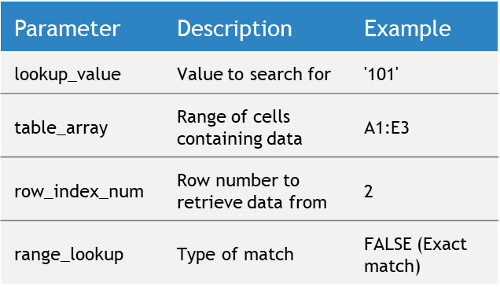
HLOOKUP (Horizontal Lookup): Example - Employee Department
Understanding HLOOKUP Function
Used for horizontal data lookup in Excel
Efficient for finding specific table data
Example Use Case
Locate department of employee with ID '101'
Formula Breakdown
lookup_value: '101' for employee ID
table_array: A1:E3 for data range
row_index_num: 2 to get department info
range_lookup: FALSE for exact match

Slide 133
HLOOKUP (Horizontal Lookup): Example - Retrieving Quarterly Sales Figures
Understanding HLOOKUP Function
Retrieves specific data from a horizontal array
Useful for comparing quarterly sales figures
Spreadsheet Application
Product names as headers in the first row
Sales figures in subsequent rows
Function Syntax
=HLOOKUP(lookup_value, table_array, row_index_num, [range_lookup])
Example Usage
Retrieve 'Product A' sales in Q3: =HLOOKUP("Product A", A1:D100, 3, FALSE)

Slide 134
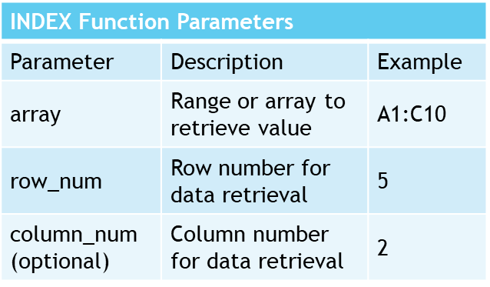
INDEX Function
Function Overview
Fetches specific values from a data range
Designates row and column for data retrieval
Function Syntax
Basic format: =INDEX(array, row_num, [column_num])
Parameter Details
array: Defines the data range
row_num: Specifies the row for data extraction
column_num (optional): Specifies the column, if needed

Slide 135
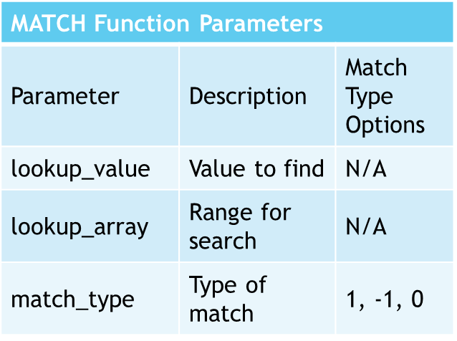
MATCH Function
Function Purpose
Locates specific value within a range
Returns relative position of value
Syntax and Parameters
Standard format: =MATCH(lookup_value, lookup_array, [match_type])
lookup_value: Target value to find
lookup_array: Range to search in
match_type: Defines match criteria
Match Types
1 or omitted: Largest value ≤ lookup_value
-1: Smallest value ≥ lookup_value
0: Exact match

Slide 136
INDEX and MATCH Functions: Syntax and Explanation
Flexible Lookup Capabilities
INDEX function syntax: =INDEX(array, row_num, col_num)
MATCH function syntax: =MATCH(lookup_value, lookup_array, match_type)
Combining INDEX and MATCH
Example formula: =INDEX(C2:E10, MATCH("Product B", B2:B10, 0), 3)
Uses MATCH to determine row number
INDEX retrieves value from specified column

Slide 137

INDEX and MATCH Functions: Example - Retrieving Revenue
Excel Data Retrieval Techniques
Using INDEX and MATCH for precise data extraction
Essential for financial analysts' toolkit
Example: Revenue Lookup
Retrieve 'Product B' revenue in 'Q2' with a formula
Formula structure: =INDEX(range, MATCH(row criteria, row range, 0), MATCH(column criteria, column range, 0))
Advantages of INDEX & MATCH
Allows specific data point retrieval within large datasets
Enhances accuracy and efficiency in financial analysis

Slide 138
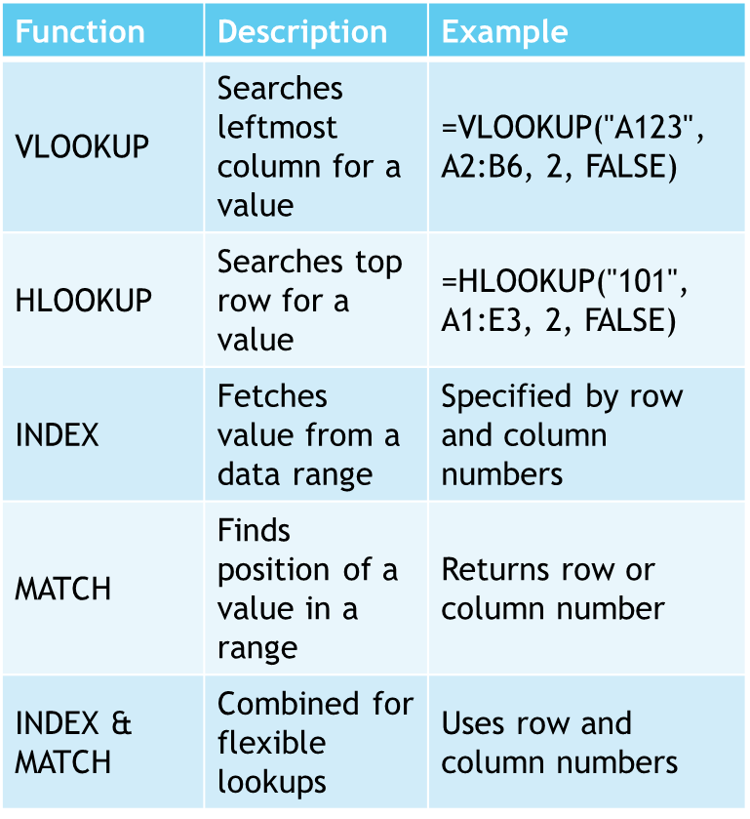
Summary of Lookup Functions
VLOOKUP (Vertical Lookup)
Searches for values in the leftmost column
Retrieves data from specified columns to the right
HLOOKUP (Horizontal Lookup)
Searches for values in the top row
Retrieves data from specified rows below
INDEX Function
Fetches specific values from a data range
MATCH Function
Finds the relative position of a value in a range
INDEX and MATCH Functions
Combined for flexible data retrieval

Slide 139
Data Arrangement, Data Security, and Pivot Tables in Excel

Slide 140
Agenda
Title Slide
Topics at-a-Glance
Sorting Data
Protecting Worksheets
Introduction to Pivot Tables
Introduction to Pivot Tables
Exercise on Pivot Tables
Creating a Pivot Table
Managing Data Source
Custom Calculations and Calculated Fields
Applying Filters
Conditional Formatting

Slide 141
Introduction to Data Arrangement and Data Security
Essentials of Data Management in Finance
Efficient data arrangement as the foundation for analysis
Imperative data security for confidentiality
Historical Shift in Data Handling
From manual errors to transformative spreadsheet tools
Sorting and filtering advancements in Excel
Excel's Role in Modern Financial Analysis
Indispensable techniques for financial analysts
Organizing data for insights and protecting sensitive information

Slide 142

Historical Perspective and Relevance
Historical Shift in Data Management
Transition from manual to software-based data arrangement
Spreadsheet tools like Excel brought accuracy and speed
Increasing Importance of Data Security
Growth in sensitive financial data handling
Need for robust security measures
Excel's Role in Modern Finance
Essential for data-driven financial analysis
Indispensable techniques for financial analysts

Slide 143
Topics at-a-Glance
Data Arrangement Techniques
  Sorting and filtering for efficient data analysis
Data Security and Protection
  Protecting worksheets and workbooks with passwords
Utility for Chartered Accountants
  Streamlining analytical processes and ensuring data integrity
  Crucial for audits, financial reports, and handling sensitive client data

Slide 144



Expertise in Data Arrangement
Security of Financial Information
Skills Vital for Professional Practice
Streamlines analytical processes for financial data.
Enhances efficiency in handling audits and financial reports.
Ensures integrity and confidentiality of client data.
Crucial for maintaining trust in financial services.
Indispensable in managing sensitive financial information.
Contributes to the overall reliability of Chartered Accountants.

Slide 145
Data Arrangement Techniques
Importance of Data Arrangement
Facilitates smoother analysis
Enhances reporting efficiency
Select Data Range
Choose the cells you wish to organize.
Utilize Data Tab
Find the 'Data' section in the menu.
Sorting Order
Opt for 'Sort A to Z' for ascending or 'Sort Z to A' for descending.

Slide 146
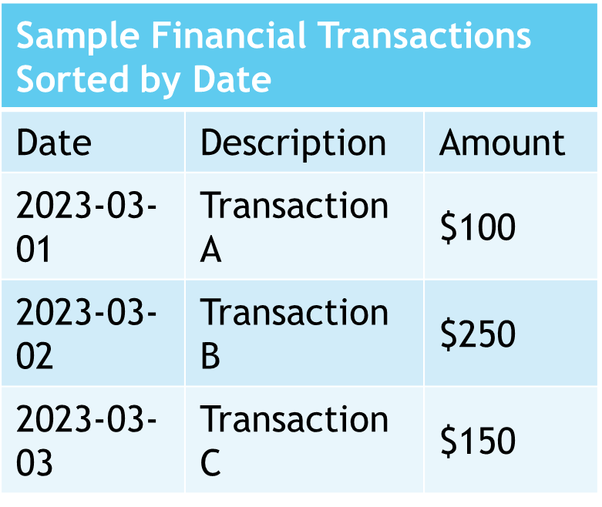
SORTING DATA: EXAMPLE - SORTING FINANCIAL TRANSACTIONS
Financial Transaction Analysis
Sort transactions by date for chronological review
Facilitates better understanding of financial activity over time

Slide 147
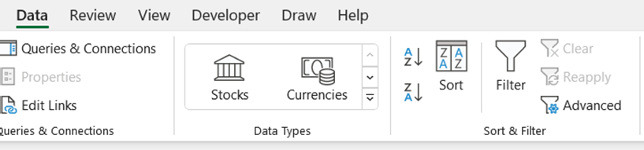
Filtering Data: Steps to Apply Filters
Select Data Range
Choose cells with data for filtering
Access Data Tab
Navigate to the 'Data' tab on the interface
Initiate Filter
Click 'Filter' to apply to selected cells

Slide 148
Filtering Data: Example - Filtering Expenses for a Specific Month
Yearly Expense Dataset Overview
Contains complete financial data for the year
Monthly Filtering Method
Enables focused expense analysis for any given month
Benefits of Filtering
Facilitates targeted financial review and management

Slide 149
Data Security and Protection
Essentiality of Data Security
Crucial for maintaining confidentiality
Especially significant in financial sectors

Slide 150
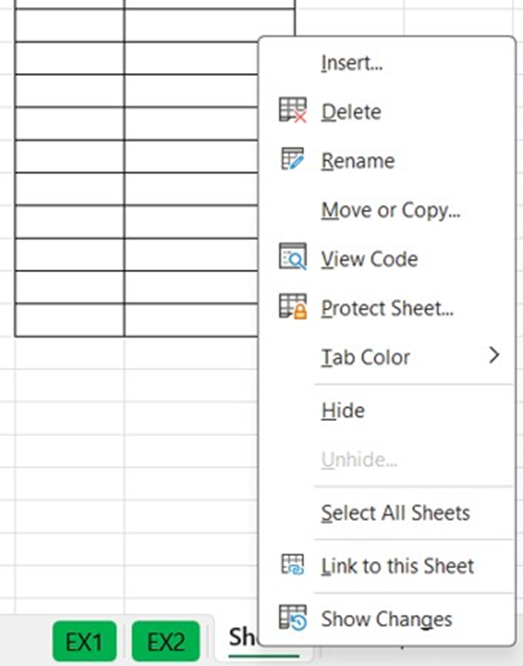
Worksheets: Steps to Protect a Worksheet
Initiate Worksheet Protection
Right-click on the desired sheet tab
Select the 'Protect Sheet' option from the menu
Password and Permissions
Choose to set a password (this is optional)
Specify user permissions for the worksheet

Slide 151
Protecting Worksheets: Example - Protecting a Financial Summary Sheet
Importance of Sheet Protection
Prevents accidental alterations of critical financial data
Viewing Access
Allows users to view essential financial information without editing

Slide 152

Password Protection for Workbooks: Steps to Password Protect a Workbook
Accessing the Protection Feature
Open the Review Tab in the workbook.
Locating the Protection Menu
Find the Protect workbook menu within the Review tab.
Setting a Password
Choose a secure password to protect your workbook.

Slide 153
Password Protection for Workbooks: Example - Password Protecting a Financial Report
Password Protection for Confidentiality
Ensures financial report security
Restricts access to authorized individuals

Slide 154
Summary of Data Arrangement and Data Security
Key Techniques in Excel
Organizing data for accuracy
Securing data for confidentiality
Importance in Financial Analysis
Ensures precise analysis
Facilitates efficient reporting
Module 7 Overview
Focuses on data arrangement skills
Emphasizes data security measures

Slide 155
Introduction to Pivot Tables
Significance of Pivot Tables
Crucial for efficient data analysis in Excel
Benefits of Pivot Tables
Summarize data, offer flexibility, and enable quick analysis
Use Cases for Pivot Tables
Ideal for large datasets, exploratory analysis, and reporting
Creating Pivot Tables
Select data, configure layout, and categorize effectively
Customization and Formatting
Data Management
Conditional Formatting and Pivot Charts
Design and Formatting Principles

Slide 156
HISTORICAL PERSPECTIVE AND RELEVANCE OF PIVOT TABLES
Origins of Pivot Tables
Introduced in the 1980s by Lotus Improv.
Pioneered multidimensional data analysis.
Excel's Contribution
Refined and popularized pivot tables.
Became a key tool for data manipulation.
Modern-Day Relevance
Crucial for handling large, complex datasets.
Enables extraction of insights from data.

Slide 157
Topics at-a-Glance for Pivot Tables
Overview of Pivot Tables
Benefits and applications in data organization
Practical exercises for creation and management
Structure and Components
Detailed layout insights
Techniques for updating and connecting to data sources
Data Handling Techniques
Sorting, filtering, and visualizing data
Working with various data fields
Utility for Chartered Accountants
Efficiency in financial analysis and reporting
Visual representation of financial trends with pivot charts

Slide 158
Introduction to Pivot Tables
Dynamic Data Analysis Tool
Pivot tables allow quick reorganization and summarization of complex datasets.
User-Friendly Interface
Designed for easy use with minimal technical knowledge required.
Efficient Decision-Making
Facilitates understanding of large data volumes for better insights.
Accessible Data Summaries
Transforms data into clear summaries, making analysis accessible to many.

Slide 159



Benefits of Pivot Tables
Efficient Data Summarization
Flexibility in Data Handling
Quick Ad-Hoc Analysis
Automates data aggregation, eliminating manual calculations
Ensures accuracy and time efficiency
Easy modification of data field arrangements
Provides various perspectives and insights
Allows interactive data dissection
Enables refining analysis without changing original data

Slide 160
When to Use Pivot Tables
Handling Large Datasets
Excel in managing substantial data
Impractical for manual analysis
Data Exploration
Discover trends, patterns, and outliers
Indispensable for exploratory analysis
Summary Reporting
Create concise, informative reports
Facilitate communication of insights

Slide 161
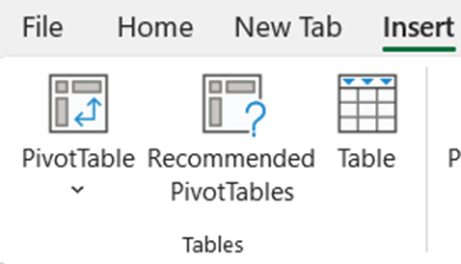
Source Data Selection for Pivot Tables
Select Data Range
Click any cell within your dataset to begin.
Insert PivotTable
Use the 'Insert' tab and select 'PivotTable.'
Define Data Range
Check the 'Table/Range' field for accuracy.
Choose Location
Decide on a new or existing worksheet for the pivot table.
Confirm Creation
Click 'OK' to finalize the pivot table setup.

Slide 162

Creating a Pivot Table
PivotTable Field List
Appears on the right after creating the pivot table
Drag and Drop Fields
Drag fields into Rows, Columns, and Values areas
View the Pivot Table
Excel generates the table based on field selections
Modify Layout and Format
Use 'PivotTable Analyze' tab for customization

Slide 163
Exercise on Managing HR Data
HR Data Management
  Focus on employee details, departments, and salaries
Pivot Table Creation
  Display average salary by department
Salary Analysis
  Examine variations in salary across departments

Slide 164
Pivot Table Layout and Structure
Key Areas of Pivot Tables
  Rows organize data horizontally by criteria
  Columns arrange data vertically as headers
  Values display summarized data
  Filters apply limitations on data
Modifying Pivot Table Structure
  Drag fields between areas in the Field List
Exercise: Analyzing Sales Trends
  Move 'Region' field to analyze trends by region

Slide 165

Managing Data
Updating and Refreshing Data
Automatic refresh upon file opening
Manual refresh via right-click option
Handling Data Changes
Refresh to include added, removed, or modified data
Example: Incorporate new monthly sales data

Slide 166

Connecting to External Data
External Data Source Integration
Link pivot tables to databases or other Excel workbooks
Exercise: SQL Database Connection
Analyze up-to-date sales records by connecting to a SQL database

Slide 167
Working with Pivot Table Fields
Types of Pivot Table Data Fields
Value Fields: Summarized numeric data like total sales
Label Fields: Categorical data for organizing rows/columns such as product categories
Calculated Fields: Custom calculations derived from existing fields

Slide 168

Custom Calculations and Calculated Fields
Understanding Calculated Fields
Utilize mathematical expressions
Involve existing data fields
Profit Margin Calculation
Subtract cost from revenue
Divide the result by revenue
Application in Business Analysis
Enhance data insights
Support decision-making processes

Slide 169

Formatting and Summarizing Values
Value Field Formatting
Apply currency symbols for financial data
Adjust decimal places for precision
Summarization Techniques
Select methods like sum, average, or count
Example: Summarize 'Sales' with sum total
Practical Application
Format 'Profit' as currency for clarity
Enhance data comprehension with summaries

Slide 170

Sorting, Filtering, and Slicing Data
Sorting Data
Organize data within rows or columns
Identify trends effectively

Slide 171

Applying Filters
Focus on Specific Data Subsets
Utilize filters to concentrate on particular segments within the pivot table.
Filtering Sales Data
Example: Implement a filter to isolate sales information from a designated year.

Slide 172

Applying Value-Based Filters
Importance of Value-Based Filters
Allows for displaying specific data ranges
Application in Sales Data
Useful for highlighting products with sales surpassing a threshold

Slide 173

Interactive Data Filtering Tools
Slicers provide visual filters for categories
Timelines enable date field filtering
Enhancing Data Analysis
Insert slicers for fields like regions
Use timelines for efficient date filtering

Slide 174

Conditional Formatting
Visual Enhancement with Conditional Formatting
Highlights cells based on predefined rules
Improves pivot table data readability
Application in Pivot Tables
Identifies high and low-profit areas
Color scales aid in data analysis

Slide 175

PIVOT CHARTS
Introduction to Pivot Charts
Excel's Chart Wizard simplifies chart creation from pivot tables.
Customizable options to meet specific visualization needs.
Chart Creation Process
Follows the concept of normal chart creation.
Applicable to Pivot table data for enhanced data representation.

Slide 176

Steps to Create Charts
Select Data for Your Chart
Highlight both labels and values you wish to include.
Insert Chart from the 'Insert' Tab
Choose a chart type that best represents your data.
Customize Design Elements
Add titles, legends, and data labels for clarity.
Extensive Formatting Options
Adjust colors, styles, and fonts to suit your document.

Slide 177

Chart Design and Formatting
Colors and Themes
Select visually appealing, readable color schemes.
Use Excel themes for design consistency.
Labels and Titles
Include descriptive chart titles and axis labels for context.
Gridlines and Axes
Adjust to match data scale and granularity.
Ensure gridlines are present but subtle.
Data Labels
Display exact values for clarity.
Choose between values, percentages, or custom labels.
Legend Placement

Slide 178

Summary of Pivot Tables
Understanding Pivot Tables
Powerful Excel tool for data analysis
Enables quick reorganization and summarization
Benefits of Using Pivot Tables
Extract insights from complex datasets
Enhances data visualization
Practical Applications
When to utilize Pivot Tables effectively
Exercises for hands-on experience

Slide 179

Macros in Excel
Automating Financial Modelling

Slide 180

Agenda
Overview
Introduction to Macros
Benefits of Macros in Financial Modelling
Handling Large Datasets with Macros
Types of Macros
Enabling Developer Tab in Excel
Recording Macros
Running Macros
Summary of Macros in Excel
Conclusion

Slide 181





Overview: Learning Objectives
Understanding Macros in Excel
Benefits in Financial Modelling
Hands-on Macro Experience
Scalability with Macros
Macro Proficiency
Automating with Macros
Grasp the concept and role of Macros in task automation
Enhance efficiency and accuracy with Macros
Learn to record and run macros for financial data formatting
Handle large financial datasets effectively
Master naming, describing, and shortcut key assignment
Ensure consistent formatting of financial statements

Slide 182
Overview: Introduction to Macros
1
2
3
Macros: Excel's Automation Powerhouse
  Set of instructions for automating repetitive tasks
  Uses simple keystrokes to complex VBA programming
Historical Development of Macros
  Originated from early computing batch processing
  Evolved with spreadsheet software advancements
Macros in Today's Data-Driven World
  Crucial for financial modelling and data analysis
  Enables handling of large datasets efficiently

Slide 183
Overview: At-a-Glance Topics in the Chapter
Introduction to Macros in Excel
Understanding the basics and applications of macros
Types of Macros
Recorded Macros: Capturing a series of user actions
VBA Macros: Involving custom programming for advanced tasks
Hands-On Learning
Practical examples and guides for an interactive experience

Slide 184


Overview: Utility for Chartered Accountants
Essential Skill for Chartered Accountants
Macros provide a strategic edge in accounting tasks.
Essential for precision and timeliness in work.
Enhancing Efficiency
Automate complex financial models.
Speed up data processing tasks.
Error Mitigation
Reduce the risk of human error in calculations.
Applications in Accounting
Macros have diverse uses in analytical and reporting tasks.
Professional Empowerment
Macro proficiency equips accountants for demanding tasks.

Slide 185
Introduction to Macros
Definition of Macros
Automate repetitive Excel tasks
Range from simple keystrokes to complex VBA programming

Slide 186
Benefits of Macros in Financial Modelling
Enhanced Efficiency and Precision
Macros minimize human errors, saving time for consistent, error-free financial models.
Automated Complex Calculations
Macros can swiftly update data and calculations across multiple sheets in complex models.

Slide 187
Handling Large Datasets with Macros
Scalable Financial Modeling
Macros facilitate efficient processing of extensive datasets.
They enhance model scalability for financial analysis.
Automation in Data Handling
Macros automate tasks like data cleansing and sorting.
They enable quick derivation of insights from financial data.

Slide 188
Types of Macros
Recorded Macros
Created by recording actions in Excel
Automates repetitive tasks efficiently
VBA Macros
Uses Visual Basic for Applications language
Enables complex, customized automation

Slide 189

Enabling Developer Tab in Excel
Initiating Developer Tab Activation
Start by opening Excel on your computer
Navigating Excel Options
Click 'File' and select 'Options' from the dropdown
Customizing the Ribbon
Choose 'Customize Ribbon' in the Excel Options dialog
Enabling the Developer Tab
Check the 'Developer' box in the main tabs list
Finalizing the Setup
Save changes by clicking 'OK'

Slide 190

Recording Macros
Navigate to Developer Tab
Enable the tab if it's not visible in the Excel menu
Initiate Macro Recording
Select 'Record Macro' option
Macro Setup
Provide a name and assign a shortcut key if desired
Perform Recorded Actions
Carry out the tasks you want the macro to automate
Finalize Recording
Click 'Stop Recording' to save the macro
Example Use Case
Automate data formatting tasks in financial statements

Slide 191
Running Macros
Executing Macros
  Use shortcut keys or the 'Macros' dialog box for execution
Applying to Financial Data
  Record macro for consistent data formatting
  Apply to new data sets for uniformity and time-saving
Steps for Macro Usage
  Start and stop recording for specific formatting tasks
  Run the macro for instant formatting on similar data

Slide 192
Summary of Macros in Excel: Introduction to Macros
Automating Repetitive Tasks
Practical Application
Macros are designed to simplify repetitive operations in Excel.
They range from basic keystroke recordings to advanced VBA scripts.
For instance, macros can automate the monthly formatting of extensive financial datasets.

Slide 193
Summary of Macros in Excel: Benefits of Macros in Financial Modelling
Efficiency and Accuracy
Reduces human error and saves time
Ensures consistent, error-free financial modelling
Automates data updates and calculations
Handling Large Datasets
Processes large financial datasets effectively
Enhances scalability of financial models
Automates data cleansing, sorting, and analysis

Slide 194
Summary of Macros in Excel: Types of Macros
Recorded Macros
Automate repetitive tasks in Excel
Created by recording a sequence of actions
VBA Macros
Enable complex, customized automation
Utilize VBA programming language

Slide 195
Summary of Macros in Excel: Recording and Running Macros
Enabling
Recording
Running
Enabling Developer Tab in Excel
  Follow steps to access macro tools via Developer tab
Recording Macros
  Guidance on naming and assigning shortcut keys
  Automate tasks like data formatting in financial statements
Running Macros
  Use shortcut keys or Macros dialog box for execution
  Apply macros to new financial datasets efficiently

Slide 196



THANK YOU

