Slide 1


PART-A
INFORMATION TECHNOLOGY
MODULE 2
INTEGRATED COURSE ON INFORMATION TECHNOLOGY AND SOFT SKILLS (ICITSS)

Slide 2
OVERVIEW OF ACCOUNTING PACKAGES
ZOHO BOOKS
CHAP 1 > INTRODUCTION TO ZOHO BOOKS AND ERP
CHAP 2 > BUSINESS PROCESSES – P2P ,O2C , H2R
CHAP 3 > GETTING STARTED WITH ZOHO BOOKS
CHAP 4 > DAILY POSTING & PERIOD END CLOSING IN MANAGEMENT ACCOUNTING
CHAP 5 > GL, AP, AR, ASSET ACCOUNTING
CHAP 6 > MAINTAINING CHART OF ACCOUNTS & INVENTORY
CHAP 7 > MAINTAINING ACCOUNTING & INVENTORY TRANSACTIONS
CHAP 8 > BANK RECONCILIATION IN ZOHO BOOKS
CHAP 9 > FINANCIAL STATEMENT VERSION (FSV) IN ZOHO BOOKS
CHAP 10 > PAYROLL AND INCOME TAX
CHAP 11 > MULTI CURRENCY , VOUCHER ENTRY USING FOREIGN CURRENCY
CHAP 12 > AUDIT FEATURES

Slide 3


CHAPTER-1
Introduction to ZOHO Books and ERP
•
ZOHO Books and ZOHO ERP are powerful business management tools that can revolutionize the way your organization operates. ZOHO Books is a comprehensive accounting and invoicing platform, while ZOHO ERP provides a full-fledged enterprise resource planning solution. Together, these ZOHO products offer a seamless, integrated approach to managing your business finances, operations, and more. In this presentation, we'll explore the key features, benefits, and advantages of incorporating ZOHO Books and ZOHO ERP into your business strategy.

Slide 4
ZOHO Books is a cloud-based accounting software that simplifies financial management for businesses of all sizes. It offers a wide range of features, including invoicing, expense tracking, bank reconciliation, and reporting. ZOHO Books' intuitive interface and powerful automation tools make it easy to stay on top of your finances, allowing you to focus on running your business. With real-time insights and customizable dashboards, ZOHO Books provides business owners and financial teams with the information they need to make informed decisions and drive growth.
What is ZOHO Books?

Slide 5
Key Features of ZOHO Books
Invoicing & Billing
ZOHO Books' robust invoicing system allows you to create professional-looking invoices, set recurring billing, and track payments with ease. You can also send automatic late payment reminders and accept online payments.
Expense Management
Easily track and categorize your expenses, reconcile bank transactions, and generate expense reports. ZOHO Books also allows you to capture receipts and attach them to expense entries.
Reporting & Analytics
Gain valuable insights into your business with ZOHO Books' comprehensive reporting features. Generate financial statements, cash flow reports, and custom reports to make data-driven decisions.

Slide 6
Benefits of using ZOHO Books
1. Streamlined Accounting
ZOHO Books automates many tedious accounting tasks, such as invoicing, expense tracking, and bank reconciliation, freeing up your time to focus on more strategic business activities.
2. Improved Productivity
With centralized financial data, real-time insights, and powerful collaboration tools, ZOHO Books helps your team work more efficiently and make better-informed decisions.
3. Enhanced Compliance
ZOHO Books ensures your financial records are accurate and up-to-date, making it easier to comply with tax regulations and audit requirements.
4. Anytime, Anywhere Access
As a cloud-based solution, ZOHO Books can be accessed from any device, allowing you to manage your finances on the go and collaborate with your team remotely.

Slide 7
ZOHO ERP is a comprehensive enterprise resource planning (ERP) platform that streamlines and integrates various business functions, including finance, inventory, customer relationship management (CRM), and more. By centralizing your data and automating essential processes, ZOHO ERP helps organizations improve efficiency, reduce operational costs, and make better-informed decisions. With its modular design, ZOHO ERP allows you to customize the solution to fit your specific business needs, making it a scalable and versatile choice for organizations of all sizes.
What is ZOHO ERP?

Slide 8
Key Features of ZOHO ERP
Financial Management
ZOHO ERP's robust financial management tools include general ledger, accounts payable and receivable, budgeting, and forecasting, allowing you to maintain a clear view of your organization's financial health.
Inventory Management
Efficiently manage your inventory levels, track stock movements, and generate reports to optimize your supply chain and minimize wastage.
CRM Integration
Seamlessly integrate ZOHO ERP with ZOHO CRM to gain a 360-degree view of your customers, streamline sales and marketing processes, and enhance customer service.
Project Management
Manage projects, track tasks, and monitor team productivity with ZOHO ERP's comprehensive project management capabilities.

Slide 9



Integrating ZOHO Books with ZOHO ERP
Financial Data Sync
Automatically sync financial data, such as invoices, expenses, and bank transactions, between ZOHO Books and ZOHO ERP, ensuring your financial information is always up-to-date and accurate.
Automated Workflows
Streamline your business processes by setting up automated workflows that connect ZOHO Books and ZOHO ERP, reducing manual data entry and improving efficiency.
Consolidated Reporting
Generate comprehensive reports that leverage data from both ZOHO Books and ZOHO ERP, providing you with a holistic view of your organization's financial and operational performance.

Slide 10
CHAPTER-2
Optimizing Business Processes –P2P,O2C,H2R
•
Business processes are a series of activities and task that organization perform to achieve specific objectives. Three crucial business process are-
Procure –to-pay (P2P)
Order-to-cash (O2C)
Hire-to-retire (H2R)
Each process plays a distinct role in managing different aspects of an organization’s operations

Slide 11
Introduction to ZOHO Books P2P Process
ZOHO Books is a powerful accounting software that streamlines the procure-to-pay (P2P) process. This introduction outlines the key steps in the ZOHO Books P2P workflow, from vendor onboarding to invoicing and payments, enabling businesses to efficiently manage their financial operations.

Slide 12
Vendor
On
Boarding
Vendor Information
Capture detailed vendor profiles, including contact details, banking information, and tax IDs, to ensure seamless transactions.
Vendor Approval
Implement a structured vendor approval process to vet new suppliers and maintain a reliable, trustworthy network.
Vendor Portal
Provide vendors with a secure portal to submit invoices, track payments, and access important documentation.

Slide 13
Purchase Order Approval Workflow
Create PO
Efficiently generate purchase orders based on predefined templates and approved vendor information.
Approval Process
Implement a multi-level approval workflow to ensure purchase orders align with company policies and budgets
PO Tracking
Monitor the status of purchase orders, from creation to approval, seamlessly within the ZOHO Books platform.

Slide 14
Receiving Goods and Services
Receiving Reports
Easily create and manage receiving reports to track the delivery of ordered goods and services.
Quality Checks
Implement robust quality control processes to ensure received items meet the specified requirements.
Inventory Management
Seamlessly integrate the receiving process with inventory management, maintaining accurate stock levels

Slide 15
Invoice Processing
Invoice Capture
Automate the capture of vendor invoices, extracting key data such as amounts, due dates, and item details.
Invoice Matching
Match received invoices to the corresponding purchase orders and receiving reports, ensuring accuracy and compliance.
Invoice Approval
Streamline the invoice approval process with customizable workflows and email notifications.
Invoice Archiving
Securely store and organize invoices within the ZOHO Books platform for easy retrieval and auditing.

Slide 16
Vendor Payment Automation
Scheduled Payments
Schedule vendor payments based on due dates, ensuring timely remittance and maintaining strong supplier relationships.
Payment Methods
Offer a range of payment options, including electronic funds transfer, credit card, and more, to accommodate vendor preferences.
Payment Reporting
Generate comprehensive payment reports for detailed tracking and reconciliation of vendor transactions.

Slide 17
Reporting and Analytics
Financial Reporting
Access a suite of financial reports, including income statements, balance sheets, and cash flow statements, to gain valuable insights.
Spend Analysis
Analyze spending patterns, identify cost-saving opportunities, and optimize procurement processes using detailed spend data.
Vendor Performance
Monitor vendor performance metrics, such as on-time delivery, quality, and pricing, to make informed decisions about supplier relationships.

Slide 18
Conclusion and Key Takeaways
Streamlined P2P Process
ZOHO Books' comprehensive P2P module streamlines vendor management, purchase order approvals, invoicing, and payments, improving efficiency and visibility.
Data-Driven Decisions
Detailed reporting and analytics empower businesses to make informed decisions, optimize procurement strategies, and enhance financial management.
Improved Supplier Relationships
ZOHO Books' vendor-friendly features, such as the self-service portal and automated payments, help build stronger, more collaborative supplier partnerships.

Slide 19
ZOHO Books is a powerful cloud-based accounting software that helps businesses streamline their financial operations and improve efficiency. In this presentation, we'll explore the key business processes that ZOHO Books can help you manage, with a focus on the Order-to-Cash (O2C) cycle. From creating sales orders and invoices to tracking inventory and generating financial reports, we'll dive into how ZOHO Books can transform your business and set you up for success.
Introduction to ZOHO Books O2C Process

Slide 20
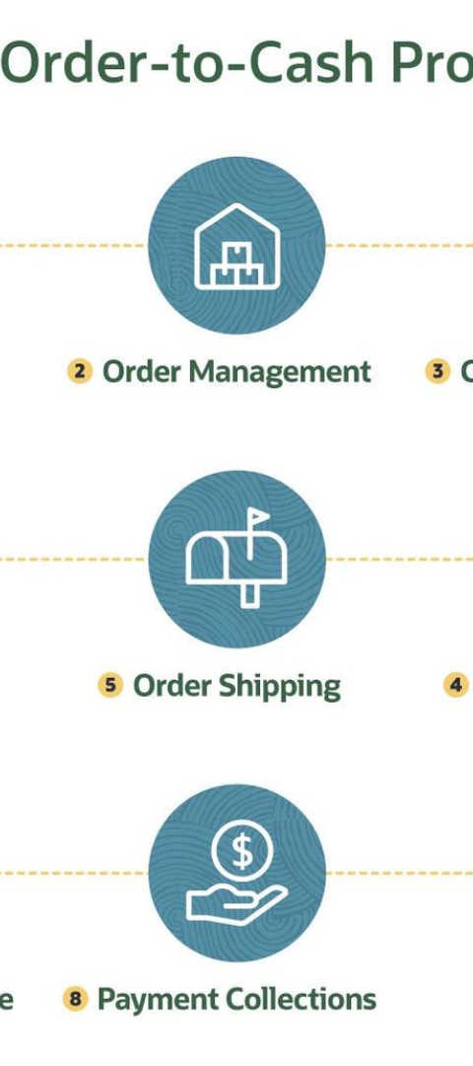
The Order-to-Cash (O2C) Process
Order Placement
The O2C process begins with a customer placing an order for your products or services. This can be done through various channels, such as your website, phone, or in-person. Efficient order processing is crucial to ensure a smooth customer experience and timely fulfillment.
Invoicing and Billing
Once the order is placed, ZOHO Books helps you create and send professional invoices to your customers. This step ensures accurate billing and streamlines the payment collection process.
Payment Collection
ZOHO Books offers multiple payment options, including online payments and integration with popular payment gateways. This helps you get paid faster and improve your cash flow.

Slide 21
Creating Sales Orders and Invoices
Sales Orders
ZOHO Books makes it easy to create and manage sales orders. You can customize order forms, track order status, and even set up recurring orders for your regular customers. This helps you maintain a clear record of your sales and ensure accurate order fulfillment.
Invoicing
Generating professional invoices is a breeze with ZOHO Books. You can create custom invoice templates, schedule recurring invoices, and even set up automatic late payment reminders. This streamlines your billing process and helps you get paid on time.
Inventory Management
ZOHO Books seamlessly integrates with your inventory, allowing you to track stock levels, generate purchase orders, and even set up low-stock alerts. This helps you maintain optimal inventory levels and avoid stock outs, ensuring a positive customer experience.

Slide 22
Managing Customer Payments and Collections
Payment Options
ZOHO Books offers a variety of payment options, including online payments, credit card processing, and integration with popular payment gateways. This makes it easy for your customers to pay their invoices and improves your chances of getting paid on time.
Automated Reminders
ZOHO Books can automatically send payment reminders to your customers, helping you stay on top of your accounts receivable. You can customize the frequency and content of these reminders, ensuring that your customers are aware of their outstanding balances.
Collections Tracking
ZOHO Books provides tools to help you track and manage your collections efforts. You can view aging reports, set up collection workflows, and even collaborate with your team to ensure that outstanding payments are resolved in a timely manner
Dispute Resolution
ZOHO Books offers features to help you manage customer disputes and credit notes. This helps you maintain positive customer relationships while ensuring that your books remain accurate and up-to-date.

Slide 23
Tracking Inventory and Stock Levels
Inventory Tracking
ZOHO Books allows you to track your inventory in real-time, including stock levels, item details, and supplier information. This helps you make informed purchasing decisions and avoid stock outs.
Low-Stock Alerts
With ZOHO Books, you can set up low-stock alerts to be notified when your inventory levels fall below a certain threshold. This helps you proactively reorder items and maintain a healthy supply chain.
Inventory Reporting
ZOHO Books provides comprehensive inventory reports, allowing you to analyze sales trends, identify slow-moving items, and optimize your inventory management strategies.

Slide 24
Financial Reporting and Analytics
Profit and Loss
ZOHO Books generates detailed profit and loss statements, allowing you to track your company's financial performance and identify areas for improvement.
Balance Sheet
The software provides up-to-date balance sheets, giving you a clear picture of your company's assets, liabilities, and equity.
Cash Flow
ZOHO Books' cash flow reports help you manage your liquidity and ensure that your business has the necessary funds to operate effectively
Customizable Reports
The platform allows you to create custom financial reports and dashboards, tailored to your business needs and preferences.

Slide 25
Automating the O2C Process
Automated Workflows
ZOHO Books offers a range of automated workflows, such as recurring invoices, approval processes, and integration with other business tools. This helps you save time, reduce errors, and focus on more strategic tasks.
Integration Capabilities
ZOHO Books seamlessly integrates with a wide range of business applications, including CRM, ecommerce, and inventory management systems. This enables you to create a streamlined, end-to-end solution for your O2C process.
Mobile Access
With ZOHO Books' mobile app, you can manage your business on the go. This allows you to approve invoices, track payments, and stay on top of your financial operations from anywhere.

Slide 26
In today's fast-paced business environment, managing human resources (HR) and payroll processes can be a daunting task. That's where ZOHO Books, a leading cloud-based accounting software, comes in. ZOHO Books' Hire-to-Retire (H2R) module is a comprehensive solution that streamlines the entire employee lifecycle, from onboarding to retirement. In this comprehensive presentation, we'll explore the key features and benefits of the H2R workflow within ZOHO Books, empowering your organization to optimize its HR and payroll operations.
Introduction to H2R Business Process in ZOHO Books

Slide 27
Understanding the H2R Workflow
Onboarding
The H2R workflow in ZOHO Books streamlines the employee onboarding process, allowing you to easily manage new hires, collect essential documents, and set up employee profiles with all the necessary information
Time and Attendance
Accurately track employee time and attendance, whether your team is working in the office, remotely, or a hybrid model. ZOHO Books' time-tracking features ensure you have a clear and comprehensive record of hours worked.
Expense Reimbursement
The expense reimbursement module within the H2R workflow simplifies the process of submitting, approving, and tracking employee expenses, ensuring timely and accurate reimbursements.

Slide 28
Setting up the H2R Process in ZOHO Books
Employee Database
Establish a centralized employee database within ZOHO Books, where you can store and manage all employee information, including contact details, job roles, and employment history.
Automated Workflows
Streamline your HR processes by setting up automated workflows for tasks such as onboarding, time-off requests, and performance reviews. This ensures consistency, reduces manual effort, and improves efficiency.
Customizable Policies
Tailor the H2R module to your organization's specific needs by configuring custom policies, approval workflows, and reporting templates. This flexibility allows you to align the system with your business requirements.

Slide 29
Automating Expense Reimbursements
Simplified Submission
Employees can easily submit expense claims through the ZOHO Books mobile app or web interface, uploading receipts and providing relevant details. This streamlines the entire reimbursement process, reducing administrative overhead.
Automated Approvals
The H2R module in ZOHO Books includes configurable approval workflows, ensuring that expense claims are reviewed and approved efficiently. This helps maintain financial control and transparency within the organization.
Real-time Reporting
Gain complete visibility into your organization's expenses with real-time reporting and analytics. ZOHO Books' comprehensive expense management features provide valuable insights to help you make informed financial decisions.
Seamless Integration
The H2R module seamlessly integrates with ZOHO Books' accounting features, automatically recording approved expense claims and updating your financial records, ensuring accurate and consistent data across your organization.

Slide 30
Tracking Time and Attendance
Time Tracking
Employees can easily log their work hours, whether they're in the office, working remotely, or on-the-go, using ZOHO Books' intuitive time-tracking features. This provides a comprehensive record of hours worked for payroll and reporting purposes.
Attendance Management
Efficiently manage employee attendance, including tracking time-off requests, sick leave, and vacation days. ZOHO Books' attendance management features ensure compliance with labor laws and company policies.
Reporting and Analytics
Generate detailed reports on employee time and attendance, providing valuable insights into productivity, overtime, and other workforce metrics. These reports can be used for informed decision-making and optimizing your HR processes.

Slide 31
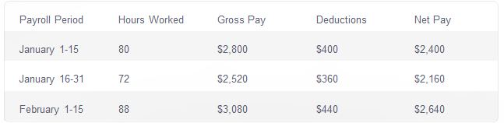
Generating Payroll Reports
The H2R module in ZOHO Books provides comprehensive payroll reporting capabilities, allowing you to generate detailed reports on employee earnings, deductions, and net pay. These reports can be customized to suit your organization's needs and seamlessly integrated with your accounting and invoicing processes.

Slide 32
Integrating with Accounting and Invoicing
Accounting Integration
Seamlessly integrate the H2R module with ZOHO Books' robust accounting features, ensuring that all payroll-related transactions and expenses are automatically recorded in your financial records, maintaining accurate and up-to-date books.
Invoicing Integration
Streamline your invoicing process by connecting the H2R module with ZOHO Books' invoicing capabilities. This allows you to easily bill clients for employee-related services, ensuring a smooth and efficient billing workflow.
Comprehensive Reporting
Leverage ZOHO Books' advanced reporting and analytics tools to gain a holistic view of your business, including HR-related data and financial performance. This helps you make informed decisions and optimize your overall operations.

Slide 33
Optimizing the H2R Process for Efficiency
Automation
Leverage the H2R module's automation features to streamline repetitive tasks, such as onboarding, time-off requests, and expense approvals, freeing up your HR team to focus on more strategic initiatives.
Data-driven Insights
Utilize the comprehensive reporting and analytics capabilities of ZOHO Books to identify areas for improvement in your HR processes, enabling you to make data-driven decisions and optimize your overall efficiency.
Customization
Tailor the H2R module to your organization's specific needs by configuring custom workflows, policies, and reporting templates. This ensures that the system aligns with your business requirements and maximizes its effectiveness.
Employee Engagement
Empower your employees by providing them with user-friendly tools and mobile access to the H2R module, enabling them to take an active role in managing their own HR-related tasks and enhancing overall engagement.

Slide 34
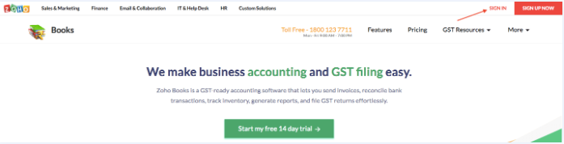
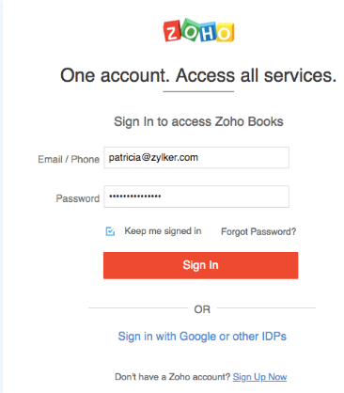
If you are already signed up, follow these steps to log in
Go to home page
Click sign in in the top right corner of the page
CHAPTER-3
LOGGING IN TO ZOHO BOOK
Enter your registered email address or phone number.
Enter your password.
Click Sign In.

Slide 35
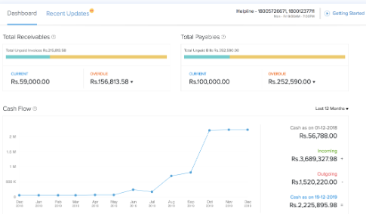
DASHBOARD OVERVIEW
The Dashboard is the first thing you will see when you log in to your ZOHO Books organization. It will give you a clear picture of the financial health of your business.
Let us have a look at the various sections In the Dashboard.
  Total receivables
  Total payable
  Cash flow
  Income and expense
  Your top expenses
  Project
  Bank and credit cards

Slide 36
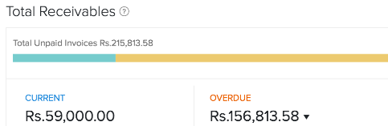
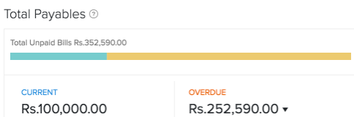
Total Receivables
The Total Receivables section displays the amount your customers owe you. The section is divided into two parts:
Current - The amount you’re yet to receive for invoices that haven’t crossed the payment due date.
Overdue - The amount you’re yet to receive for invoices that have crossed the payment due date.
Total payables
The Total Payables section displays the amount of money you owe your vendors. This section is divided into two parts:
Current - The amount you’re yet to pay for purchase transactions that haven’t crossed the payment due date.
Overdue - The amount you’re yet to pay for purchase transactions that have crossed the payment due date.

Slide 37
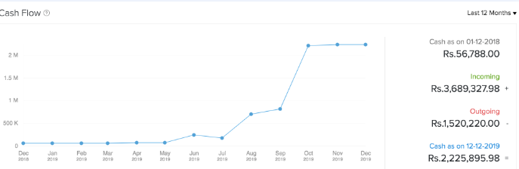
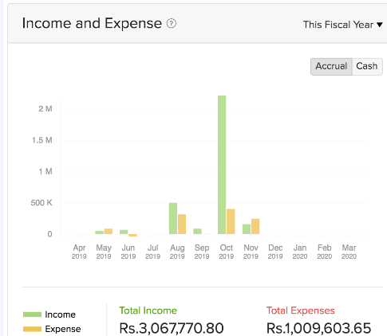
Cash Flow
The Cash Flow section helps you analyze the cash flowing in and out of your organization. The Cash Flow graph is generated based on the cash flow report of your organization.
Income and Expense
The Income and Expense section displays the Total Income and the Total Expenses of your organization.

Slide 38
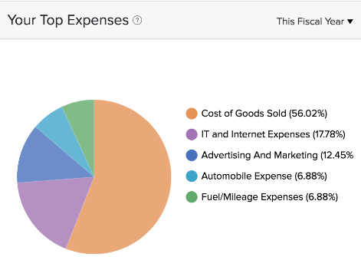
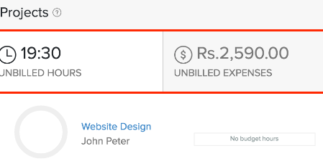
Your Top Expenses
This pie chart displays all the top expenses recorded in ZOHO Books. You can click the different sections of the pie chart to view the corresponding transactions in reports.
Projects
The Projects section displays the following information:
  Project Name
  Client Name
  Number of unbilled hours
  Number of unbilled expenses

Slide 39
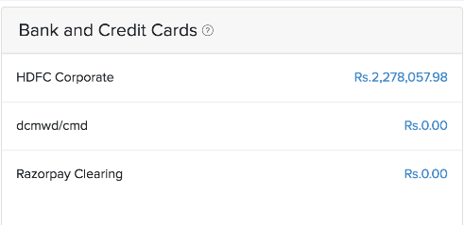
Bank and Credit Cards
The Bank and Credit Card section displays the list of all your bank accounts and credit cards added in your ZOHO Books organization. You can select any one of the bank accounts to view your bank transactions.

Slide 40
SELF-EXAMINATION QUESTIONS FOR PRACTICE
EXPLAIN THE PROCESS OF ACCESSING OF ZOHO BOOKS FOR BOTH NEW AND EXISTING USER
WHAT ARE THE KEY COMPONENTS OF THE PROCURE – TO – PAY(P2P) PROCESS
DESCRIBE THE INFORMATION PROVIDED ON THE ZOHO BOOKS DASHBOARD AND ITS IMPORTANCE IN FINANCIAL MANAGEMENT
WHAT ARE THE STEPS INVOLVED IN MANAGING OPENING BALANCE IN ZOHO BOOKS
WHAT IS THE PURPOSE OF THE TRANSACTION APPROVAL PROCESS,AND HOW DOES IT CONTRIBUTE TO FINANCIAL CONTROL WITH IN AN ORGANIZATION

Slide 41
CHAPTER-4
•
DAILY POSTING & PERIOD END CLOSING IN MANAGEMENT ACCOUNTING

Slide 42
In ZOHO Books, manual journals can be used to record these unique financial transactions which cannot be recorded normally otherwise.
E.g: Depreciation rates for a month cannot be recorded normally, in this case a manual journal for the depreciation rate can be recorded for the particular month.
Creating Manual Journals
Importing Manual Journals
Manual Journal for Bank Accounts
Exporting Manual Journals
Other Actions
Edit, Download a PDF Copy, Print and Attach Files
Bulk Print Journals

Slide 43
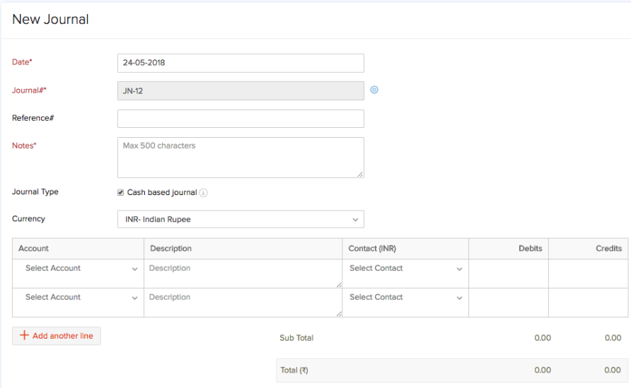
Creating Manual Journals
In the manual journal section, select the +New Journal button to create a new journal.

Slide 44
Creating Manual Journals
Enter the Date on which the adjustment needs to be made by creating a journal.
Enter the journal number for this journal entry.
You cannot auto-generate journal numbers for journal entries that were created earlier.
Enter a Reference Number with which the journal will be associated.
Notes are a mandatory field for a journal to be recorded. Mention the reason for creating a journal as it is always a unique reason.
Check the Journal Type as Cash based Journal if your account adjustment has been done by cash transaction.
Choose the currency in which you wish to make the journal entry.
Select the Account from which the amount is debited and an account to which the amount is credited.
Choose the contact whom you wish to associate to the journal entry.
Enter the Debit and Credit amount that needs to be recorded.
Click either Save and Publish or Save as Draft.

Slide 45
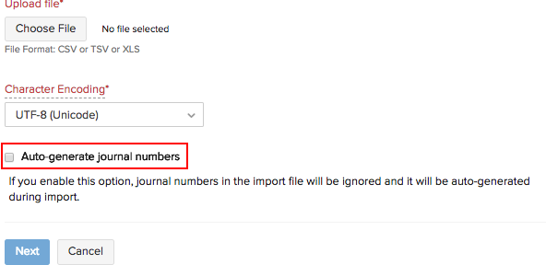
Importing Manual Journals
You can import manual journals by clicking the More button.
Select Import Journals.
Choose the file from which you want to update the data. Data can be uploaded either as a CSV (Comma Separated Value), a TSV (Tab Separated Value) or an XLS (Excel Spreadsheet) file from your hard drive.
Select the character encoding based on your import file.
Enable the option Auto-generate journal numbers to let ZOHO Books generate the journal numbers for you and ignore the numbers in the file.
Click Next.
Map the fields accordingly and click Import.
Reports
Generally the Balance Sheet & Profit and Loss reports gets affected on recording manual journals. For more reports you can navigate to Reports > Accountant and view the General Ledger, Journal Report and Trial Balance

Slide 46
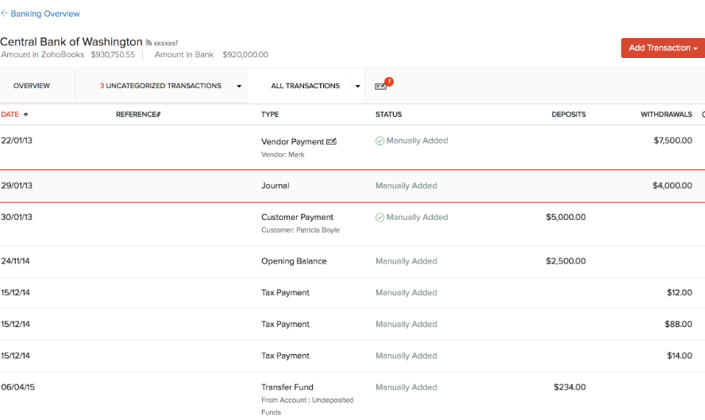
Manual Journal for Bank Accounts
You can create a manual journal using the bank accounts that you’ve added in the Banking module. After you create a manual journal, the recorded transaction will be listed as a Manually Added transaction in the respective bank accounts as a deposit or a withdrawal.

Slide 47
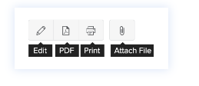
Exporting Manual Journals
You can export your manual journals in ZOHO Books to your device in a file that can be password protected.
The exported file will include the status of the journals (Published or Draft)
Other Actions
Edit, Download a PDF Copy, Print and Attach Files
To edit your manual journals, download them as a PDF, print them or attach files to them
Select a manual journal and click the corresponding button from the manual journal’s details page.
Clone or Delete Manual Journals
Select a manual journal.
Click the More dropdown and select either Clone or Delete to clone or delete your selected manual journal.
Note: You can also delete your manual journals in bulk by selecting multiple manual journals and then clicking the Delete icon.

Slide 48
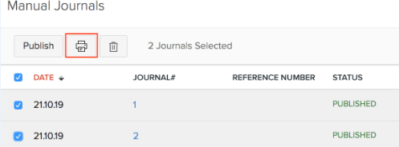
Bulk Print Journals
To bulk print a journal:
Go to Accountant > Manual Journals.
Select the journals you would like to print.
Click the Print icon.
Click Print.

Slide 49
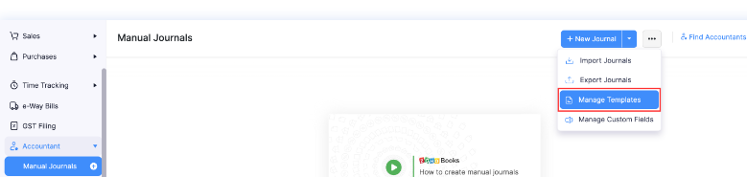
Journal Templates
Creating multiple journals entries whose debit and credit accounts are usually repeated over and over again can be quite monotonous. Using Journal Templates, you can pre-populate the note, journal type, account, reference number, project name, currency and tax.
Create new journal templates
Use journal templates
Manage journal templates
Edit journal templates
Delete journal templates
Create New Journal Templates
Steps:
Accountant modules > Manual journal > click dropdown button > select manage templates >click new template

Slide 50
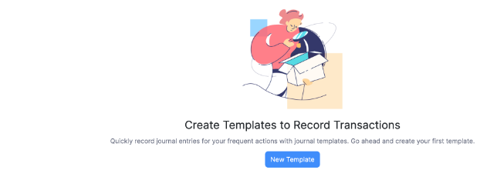
Create New Journal Templates
Enter the required details for creating the journal template:
Field | Description
Template Name | Enter a name for your template. (Mandatory)
Reference# | Enter an identification number or code for your journal entries.
Notes | Mention the reason for creating a journal. (Mandatory)
Journal Type | Check the Cash based Journal option if your account adjustment is by cash.
Project Name | Select the project that you want to associate with the journal entry.
Currency | Choose the currency in which you wish to make the journal entry.

Slide 51
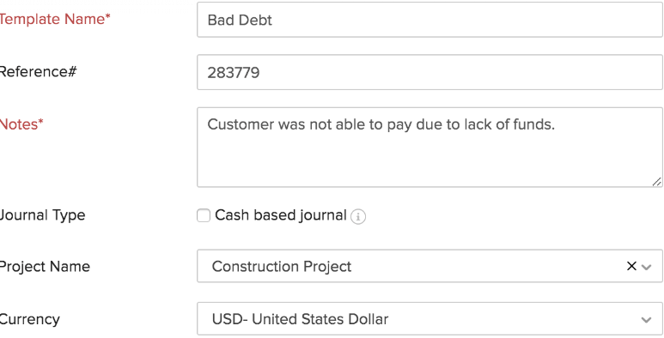
Create New Journal Templates
Select the journal template type. You can create two types of templates:
  Based on types
  Based on amount

Slide 52
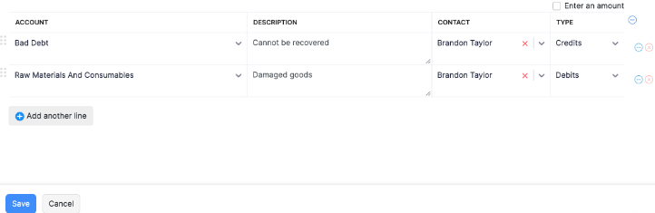
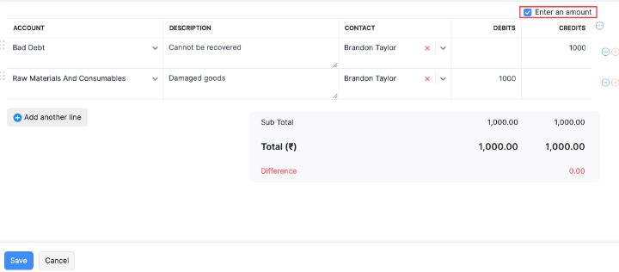
Based on Type: When you create journal templates based on type, the credit and debit account will not be auto-filled in the journals. So, the credit and debit amount will have to be entered manually in the journal.
To create journal entries based on type, uncheck Enter Amount.
Based on Amount : When you create journal templates based on amount, the credit and debit account along with the amount will be auto-filled in the journals. So, the debit and credit amount will be pre-populated.
To create journal entries based on amount, check Enter Amount.
Click Save

Slide 53
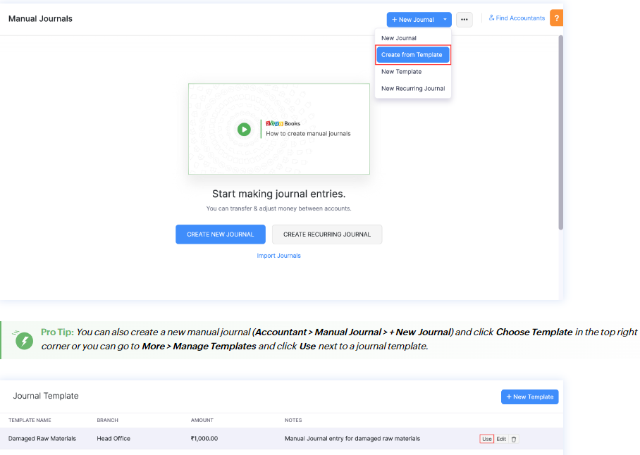
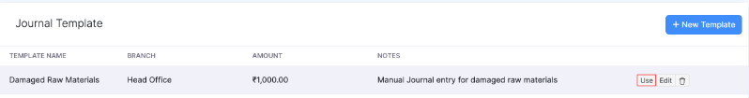
Journal Entry using Journal Template
Step
Accountant > manual journal > click the + New journal > select > create from template

Slide 54
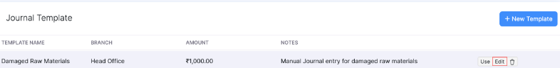
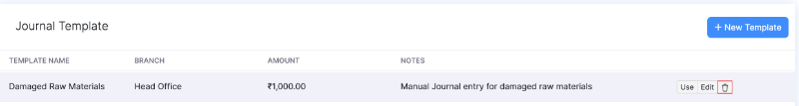
Manage Journal Template
You can also perform certain actions on your journal templates. You will be able to:
Edit journal template
Delete journal template
Steps: Accountant > manual journals > click settings drop down buttons > manage templates > edit next to modify template
Steps: Accountant > manual journals > click settings drop down buttons > manage templates > Delete next to modify template

Slide 55
SELF – EXAMINATION QUESTIONS FOR PRACTICE
EXPLAIN THE PROCESS OF CREATING A NEW MANUAL JOURNAL IN ZOHO BOOKS
2) HOW CAN MANUAL JOURNALS BE IMPORTED IN ZOHO BOOKS
3) DESCRIBE THE PROCEDURE FOR CREATING JOURNAL TEMPLATES IN ZOHO BOOKS
4) EXPLAIN THE AUTOMATIC HANDLING OF CLOSING AND REOOENING ACCOUNT IN ZOHO BOOKS DURING A FISCAL YEAR TRANSITION . HOW DOES IT BENEFIT ORGANIZATIONS
5) HOW DOES ZOHO BOOKS ENSURE CONTINUITY IN INVOICE NUMBERING ACROSS FISCAL YEARS? CAN USER CUSTOMIZE INVOICE NUMBERING PREFERENCES?

Slide 56
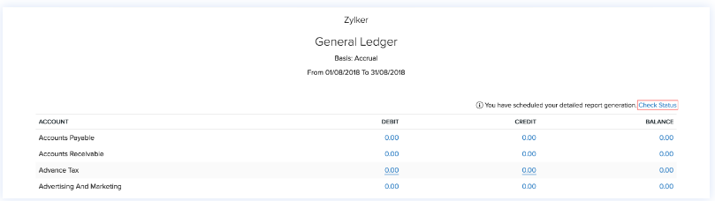
CHAPTER-5
GL, AP, AR, ASSET ACCOUNTING
The general ledger is a core accounting component that serves as a central repository for recording all financial transaction of a business.
In ZOHO Books, the ledger is referred to as the “Chart of accounts”.
Steps: accountant > chart of accounts > add/edit account with relevant details (account name, account type, opening balance etc)

Slide 57
Introduction - Customers & Vendors
In ZOHO Books, managing your business relationships with customers and vendors is essential.
Customer represent individuals to whom you sell the goods or services
Vendors are individuals from whom you purchase goods or services
There are two methods to add customer and vendors in ZOHO Books
Create from customer and vendor creation page
Import customer /vendors
Create from Customer and Vendor creation page
Go to Sales > Customers.
Click the + New button in top right corner of the page.
Select the Customer Type as Business for B2B customers, or Individual for B2C customers.
Enter the details of your customer.
Select the Currency they deal in.
You can add other details such as their Billing Address and Shipping Address by navigating through the different tabs at the bottom of the page.
After entering all the details, click Save.

Slide 58
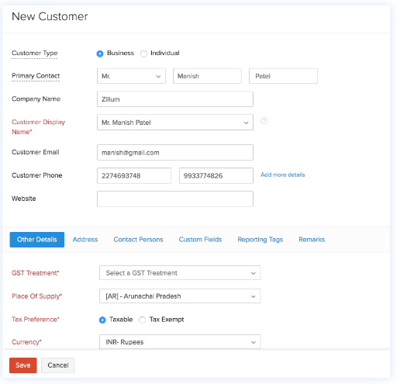
Create from Customer and Vendor creation page

Slide 59
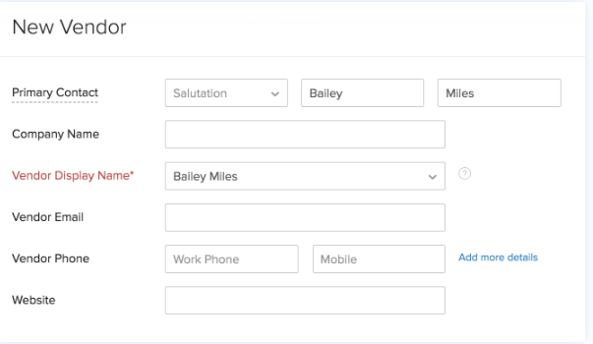
To Add a New Vendor:
Steps: Purchase > vendors > click the >+ button > fill in the details of your vendor . Select the currency they use for transaction

Slide 60
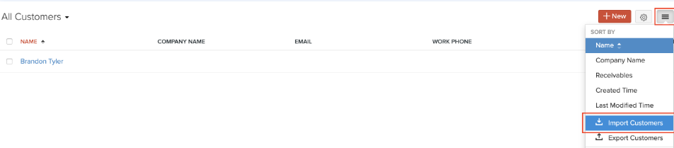
Import Customers/Vendors
Steps: Sales > Customer (for customer) or purchase > vendors (for vendors) > click the menu icon in the top right corner of the page > choose import customer or import vendors > click continue > select the file you wish to import by clicking choose file “you can refer to a sample file for guidance” > click next > review the field mapping and click next > finally click import to complete the process.

Slide 61
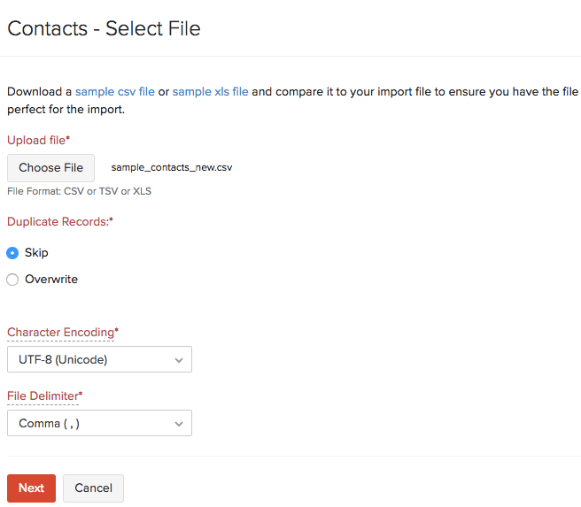
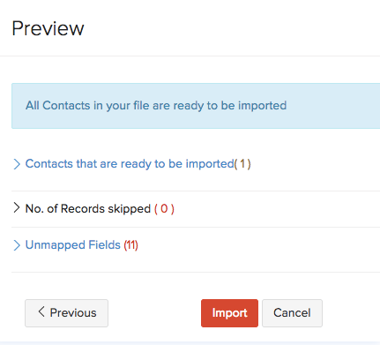
Import Customers/Vendors
Steps: Sales > Customer (for customer) or purchase > vendors (for vendors) > click the menu icon in the top right corner of the page > choose import customer or import vendors > click continue > select the file you wish to import by clicking choose file “you can refer to a sample file for guidance” > click next > review the field mapping and click next > finally click import to complete the process.

Slide 62
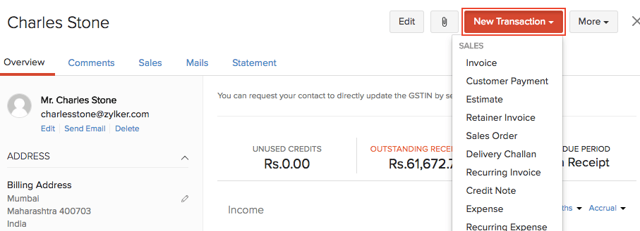
Record Transactions For Customers/Vendors
Once you have created customers/vendors in ZOHO Books, you can start invoicing your customers or record bills for your vendors.
Steps:
Go to Sales > Customers (for customers) or Purchases > Vendors (for vendors).
Select the customer/vendor for whom you wish to record a transaction.
Click the New Transaction button on top of the page and select the desired sales/purchase transaction.
Fill in the details in the transaction page and save it.

Slide 63
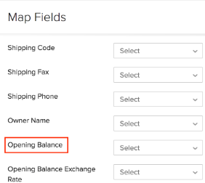
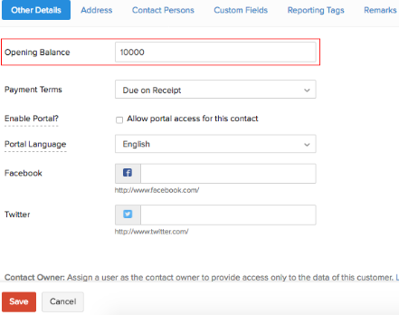
Opening Balance for Customers/Vendors
You can enter the opening balance for your customers/vendors in one of the following ways:
Import customers/vendors along with their opening balances in the Customers/Vendors module
Navigate to the Customer /vendors module(individually)
Steps:
Go to Sales in the left sidebar and select Customers (for customers) or click Purchases in the left sidebar and select Vendors (for vendors).
Click + New to create a new contact.
Enter the required details and enter the Opening Balance in the Other Details section.

Slide 64
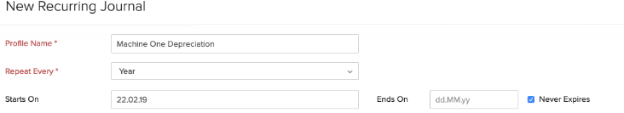
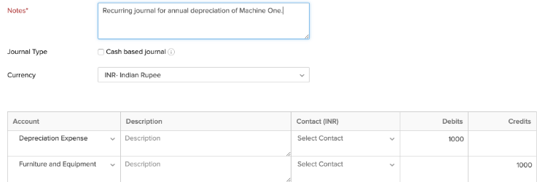
How do I record an Asset Depreciation
Steps:
Click the Accountant tab on the left sidebar and go to Recurring Journals.
Click + New in the top right side of the page.
Enter the Profile Name.
Give a short note for the journal entry and add other necessary details.
Select the frequency of the recurring journal under the Repeat Every dropdown
Select Depreciation Expense as the Debit account and the account under which the asset was recorded as the Credit account.
Click Save and Publish or Save as Draft to record the asset depreciation.

Slide 65
SELE-EXAMINATION QUESTIONS FOR PRACTICE
EXPLAIN THE PROCESS OF ADDING A NEW CUSTOMER IN ZOHO BOOK
HOW CAN YOU IMPORT CUSTOMER/VENDORS IN ZOHO BOOK
EXPLAIN THE STEPS TO CUSTOMIZE AN INVOICE TEMPLATE IN ZOHO BOOK
WHAT ARE THE DIFFERENT METHODS TO INPUT OPENING BALANCE FOR CUSTOMER AND VENDORS
HOW CAN YOU RECORD A FIXED ASSET PURCHASE IN ZOHO BOOK
EXPLAIN THE PROCESS OF RECORDING ASSET DEPRECIATION IN ZOHO BOOKS

Slide 66
CHAPTER-6
•
UNIT-3: ZOHO BOOKS
MAINTAINING CHART OF ACCOUNTS & INVENTORY

Slide 67
Understand the significance of the General Ledger for recording financial transactions.
Learn to manage the Chart of Accounts in ZOHO Books for structured financial overview.
Explore customization options for sales and purchase transactions.
Learn efficient inventory management techniques in ZOHO Books.
LEARNING OBJECTIVES:

Slide 68
CREATING A NEW ACCOUNT
MODIFYING ACCOUNTS
DELETING AN ACCOUNT
CHART OF ACCOUNTS IN ZOHO BOOKS

Slide 69
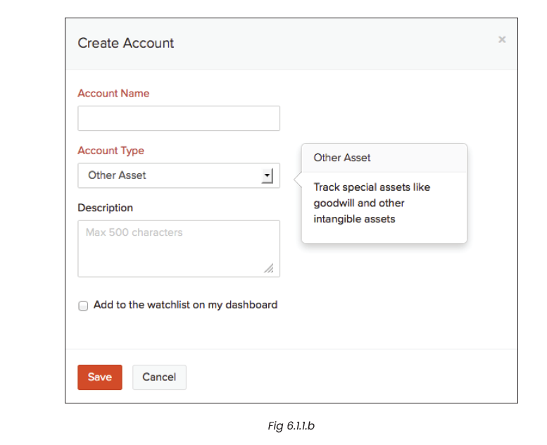
CREATING A NEW ACCOUNT
1. Navigate to Accountant > Chart of Accounts.
2. Select +New Account
CHART OF ACCOUNTS IN ZOHO BOOKS

Slide 70
MODIFYING ACCOUNTS
1. Go to Accountant > Chart of Accounts.
2. Locate the account you wish to modify and select Edit.
3. Make the necessary changes in the provided fields.
4. Click Save to confirm the modifications.
CHART OF ACCOUNTS IN ZOHO BOOKS

Slide 71
DELETING AN ACCOUNT
1. Go to Accountant > Chart of Accounts.
2. Find the account slated for deletion and select Delete.
3. Confirm the action by clicking OK in the prompt.
CHART OF ACCOUNTS IN ZOHO BOOKS

Slide 72
ITEMS
INVENTORY ADJUSTMENTS
PRICE LISTS
OTHER ACTIONS FOR ITEMS
REPORTS
MAINTAINING INVENTORY

Slide 73
Creation of Stock items / Service item
Steps
1. Navigate to the Items module on the left sidebar and select Items.
2. Click on + New located on the right side of the page.
3. Enter the Type, Name, and other pertinent details.
MAINTAINING INVENTORY

Slide 74
Price List
Steps
Enabling Price Lists
Creating a Price List
Applying Price Lists
Managing Price Lists
Deleting Price Lists
Importing Price Lists
Exporting Price Lists
MAINTAINING INVENTORY

Slide 75
REPORTS
1. Sales by Item
2. Purchases by Items
3. Inventory Summary
4. Inventory Valuation Report
5. FIFO Cost Lot Tracking
MAINTAINING INVENTORY

Slide 76
CHAPTER-7
•
UNIT-3: ZOHO BOOKS
MAINTAINING ACCOUNTING
&
INVENTORY TRANSACTIONS

Slide 77
Record and categorize financial activities like sales, purchases, expenses, and payments efficiently.
Understand the workflow for creating, confirming, and converting Sales Orders into invoices.
Learn to create and manage Purchase Orders, enabling smooth buyer-vendor transactions.
Gain proficiency in viewing and importing transactions for better business management
Master the process of inventory transactions, including buying, selling, and adjustments.
LEARNING OBJECTIVES:

Slide 78
CREATING A NEW TRANSACTION
CATEGORIZE TRANSACTION
SAVE THE TRANSACTION
MAINTAINING ACCOUNTING TRANSACTION

Slide 79
CREATING A NEW TRANSACTION
Go to the relevant module (e.g., Sales, Purchases, Expenses) from the dashboard.
Click on “+ New” to create a new transaction
Fill in the necessary details like Date, Account, Amount, etc.
MAINTAINING ACCOUNTING TRANSACTION

Slide 80
Categorize Transactions:
Assign appropriate accounts to each transaction for proper categorization
MAINTAINING ACCOUNTING TRANSACTION

Slide 81
Save the Transaction:
Once all details are entered, save the transaction
MAINTAINING ACCOUNTING TRANSACTION

Slide 82
7.1.1. SALES ORDER
The workflow for a sales order in ZOHO Books involves the following steps:
Create a Sales Order
Confirmation of Sales Order
Conversion to Invoice
Low Stock Scenario
MAINTAINING ACCOUNTING TRANSACTION

Slide 83
7.1.2. PURCHASE ORDERS
Enabling Purchase Orders
Creating a Purchase Order
Adding Items in Bulk
Creating Purchase Orders from Vendors Module
Viewing Purchase Orders
Importing Purchase Orders
MAINTAINING ACCOUNTING TRANSACTION

Slide 84
INVENTORY TRANSACTIONS
Record a Purchase
Record a Sale
Adjust Inventory Levels
MAINTAINING ACCOUNTING TRANSACTION

Slide 85
CHAPTER-8
•
UNIT-3: ZOHO BOOKS
BANK RECONCILIATION IN ZOHO BOOKS

Slide 86
Understand the importance of bank reconciliation in maintaining accurate financial records
Learn how to navigate to the “Banking” module in ZOHO Books
Know the steps involved in reconciling an account, including setting start and end dates, and providing closing balance.
Learn how to select and reconcile specific transactions and adjust cleared amounts if necessary.
Understand the process of adding additional details and completing the reconciliation process.
Learn how to undo a reconciliation in case of incorrect transactions
Understand the steps to delete a reconciliation if needed for record correction or adjustment.
LEARNING OBJECTIVES:

Slide 87
To reconcile an account in ZOHO Books, follow these steps:
1. Navigate to the “Banking” module located in the left sidebar of your ZOHO Books account.
2. Select the specific bank account for which you want to reconcile transactions.
3. Click on the “Settings” dropdown located in the top right corner of the page.
4. From the dropdown menu, select “Reconcile Account.”
8.1 RECONCILE ACCOUNT

Slide 88
1. Access the “Banking” module from the left sidebar.
2. Select the specific account for which you want to undo the reconciliation.
3. Click on the “Settings” dropdown in the top right corner.
4. Choose “Reconcile Account.”
5. In the following page, you will see a list of all reconciliations you’ve recorded. Hover your cursor over the reconciliation period you want to undo and click “Undo Reconciliation.”
6. Confirm your choice by clicking “Proceed.”
8.2
UNDO RECONCILIATION

Slide 89
1. Access the “Banking” module from the left sidebar.
2. Select the account for which you want to delete the reconciliation.
3. Click on the “Settings” dropdown in the top right corner.
4. Choose “Reconcile Account.”
5. In the following page, you will see a list of all reconciliations you’ve recorded. Hover your cursor over the reconciliation period you want to delete and click the “Trash” icon.
6. Confirm your choice by clicking “Proceed.”
8.3
DELETE RECONCILIATION

Slide 90
CHAPTER-9
•
UNIT-3: ZOHO BOOKS
FINANCIAL STATEMENT VERSION ( FSV) IN ZOHO BOOKS

Slide 91
Understand the purpose and process of creating Financial Statement Versions (FSVs) in ZOHO Books.
Learn to configure FSVs by selecting report type, date range, defining rows, columns, and applying filters.
Gain proficiency in adding, editing, and customizing rows to include specific accounts or groups in FSVs.
Master the application of filters to refine data in FSVs based on account type, tags, and other criteria
Learn to preview, save, view, and export customized FSV reports effectively in ZOHO Books.
Familiarize with the customization of specific financial reports, including Profit and Loss, Balance Sheet, and Cash Flow Statement, according to specific business needs.
LEARNING OBJECTIVES:

Slide 92
GUIDE TO CREATE FSV FOR REPORTS
1. Accessing Financial Statement Version
2. Creating a New Financial Statement Version
3. Configuring the FSV
4. Adding Rows
5. Editing Rows
6. Defining Columns
7. Applying Filters
8. Preview and Save
9. Viewing and Exporting FSV

Slide 93
9.1 PROFIT AND LOSS ACCOUNT
Sections in the Report
Operating Income: Money received from sales transactions between your customers and your organization.
Cost of Goods Sold: Costs incurred in buying or manufacturing the goods sold to your customers.
Operating Expense: Expenses incurred in your business, categorized based on selected Expense accounts.
Non - Operating Income/Expense: Income or expenses from activities not related to business operations (e.g., dividends received or currency exchange losses).

Slide 94
9.2 HORIZONTAL PROFIT AND LOSS STATEMENT
To view this statement:
Go to ZOHO Books > Reports > Business Overview.
Find Horizontal Profit and Loss and click to view. By default, it generates for the current month.
Details in the Statement
Expenses: Opening Stock, Purchases, Vendor Credits, Inventory Adjustments, Operating, and Non-operating expenses.
Income: Closing Stock, Sales, Operating, and Non-operating income.

Slide 95
9.3 CASH FLOW STATEMENT
Sections in the Report:
• Cash Flow from Operating Activities: Money from day-to-day business operations.
• Cash Flow from Investing Activities: Cash flow resulting from investments in assets.
• Cash Flow from Financing Activities: Transactions related to raising funds or clearing debts.
• Net Change in Cash: Sum of cash flow from all activities.

Slide 96
9.3 CASH FLOW STATEMENT
Cash Flow Forecasting
To Forecast Cash Flow:
Go to Reports > Cash Flow Forecasting.
ZOHO Books will forecast the cash flow for the selected period.
Dashboard Insights:
• Total Money In: Cash earned through sales transactions.
• Total Money Out: Cash spent on purchase transactions.
• Beginning Actual Balance: Balance at the start of the period.
• Ending Projected Balance: Forecasted balance at the end of the period.
Customize Forecast Inputs:
• Click Customise Forecast Inputs.
• Include/exclude recurring profiles.

Slide 97
9.4 BALANCE SHEET
To view this report:
1. Go to Reports > Balance Sheet.
Sections in the Report:
• Assets: Value of all assets, including current assets.
• Liabilities & Equities: All recorded liabilities and equities.
Customizing the Report:
1. Navigate to Reports > Balance Sheet.
2. Click Customize Report at the top of the page.
3. Customize the report based on Date Options, Compare With, Report Basis, and Reporting Tags.
4. Click Run Report

Slide 98
9.5 HORIZONTAL BALANCE SHEET
To view this statement:
1. Go to ZOHO Books > Reports > Business Overview.
2. Find Horizontal Balance Sheet and click to view.
Details in the Statement:
1. Assets: Current Assets (Cash, Bank, etc.), Fixed Assets, Other Assets.
2. Liabilities and Equities: Current Liabilities, Other Liabilities, and Equities.
Customizing the Report:
1. Go to Reports > Business Overview > Horizontal Balance Sheet.
2. Click Customize Report.
3. Apply filters like Date Options, Report Basis, Zero Accounts, and Compare Based on Period/Year.
4. Click Run Report.

Slide 99
9.6 BUSINESS PERFORMANCE RATIO
To view this report:
1. Go to Reports > Business Performance Ratio.
2. Select a ratio analysis from the dropdown from the dropdown below your organization name
Customizing the Report:
1. Navigate to Reports > Business Performance Ratio.
2. Select a ratio analysis from the dropdown below your organisation name.
3. Click Customize Report.
4. Set date range, report basis, and add filters.
5. Click Run Report.

Slide 100
9.7 MOVEMENT OF EQUITY
To view this report:
1. Go to Reports > Movement of Equity.
2. Select the period you want to view.
Sections in the Report:
1. Opening Balance
2. Changes in Equity (Capital Stock, Current Year Earnings, etc.)
3. Closing Balance

Slide 101
CHAPTER-10
•
UNIT-3: ZOHO BOOKS
PAYROLL AND INCOME TAX

Slide 102
Process payroll in ZOHO Books, including setup, employee addition, and payment processing.
Integrate ZOHO Payroll with ZOHO Books for accurate recording of payroll expenses and tax liabilities
Understand the key functions in ZOHO Payroll, such as adding employees, setting up statutory components, and processing pay runs.
Learn to configure accounts for recording payroll transactions in ZOHO Books.
Note that ZOHO Books does not directly calculate income tax and advises consulting tax professionals or using dedicated tax software
LEARNING OBJECTIVES:

Slide 103
10.1 PAYROLL PROCESSING
Steps for Processing Payroll in ZOHO Books:
1. Set Up Payroll:
• Go to Settings > Preferences > Payroll and configure payroll settings including pay frequency, payroll period, etc.
2. Add Employees:
• Under Payroll > Employees, add employee details, including salary, deductions, etc.
3. Process Payroll:
• Navigate to Payroll > Run Payroll to process payments to employees.

Slide 104
10.2. PAYROLL MANAGEMENT WITH ZOHO BOOKS
Setting Up Your Organisation
Tax Information and Pay Schedule
Configuring Statutory Components
Completion of Setup

Slide 105
10.2. PAYROLL MANAGEMENT WITH ZOHO BOOKS
Key Functions in ZOHO Payroll
Adding Employees
Setting up Statutory Components
Processing Pay Runs
Creating Salary Templates
Direct Deposit of Salaries
Employee Portal

Slide 106
10.2. PAYROLL MANAGEMENT WITH ZOHO BOOKS
Key Functions in ZOHO Payroll
Adding Employees
Setting up Statutory Components
Processing Pay Runs
Creating Salary Templates
Direct Deposit of Salaries
Employee Portal

Slide 107
10.3. INCOME TAX CALCULATION
Note: ZOHO Books does not provide direct income tax calculation. It’s recommended to consult a tax professional or use dedicated tax software for accurate income tax calculations. You can only file your GST returns directly from ZOHO Books.

Slide 108
CHAPTER-11
•
UNIT-3: ZOHO BOOKS
MULTI CURRENCY, VOUCHER ENTRY USING FOREIGN CURRENCY

Slide 109
Understand multi-currency transactions and their importance in global financial operations.
Learn to manage currencies, including adding, editing, and deleting them in ZOHO Books.
Master the handling of exchange rates, both automatic and manual, for accurate financial reporting.
Gain proficiency in recording transactions in foreign currencies and voucher entry processes.
Comprehend practical use cases of multi-currency functionality in business operations.
LEARNING OBJECTIVES:

Slide 110
11.1. MULTI CURRENCY IN ZOHO BOOKS
Base Currency: Understanding the default currency of your organization.
Adding New Currency: How to incorporate additional currencies.
Editing Currency Settings: Customizing currency properties.
Exchange Rates: Automatic and manual exchange rate management.
Deleting Currencies: Removing unused currencies.
Use Cases: Practical scenarios where multi-currency functionality is utilized

Slide 111
11.1.1 & 2 BASE CURRENCY & NEW CURRENCY
Steps to View Base Currency:
1. Navigate to “Settings” > “Currencies”.
2. The displayed currency is your base currency
1. Navigate to “Settings” > “Currencies”.
2. Click on the “+ New Currency” button in the top right corner.
3. Fill in the required details:
• Currency Code
• Currency Symbol (modifiable)
• Decimal Places
• Format (comma/dot placement)

Slide 112
11.1.3 EDIT CURRENCY
Steps to Edit a Currency:
1. Navigate to “Settings” > “Currencies”.
2. Hover over the currency you wish to edit.
3. Click “Edit” on the right side of the currency
4. Make the necessary changes in fields like Currency Code, Currency Symbol, Decimal Places, and Format.
5. Click “Save”.

Slide 113
11.1.4 EXCHANGE RATES
Steps to Disable Exchange Rate Feeds:
1. Go to “Settings” > “Currencies”.
2. Click “Disable Exchange Rate Feeds” in the top right corner.
3. Confirm by clicking “Disable”.

Slide 114
11.1.4 EXCHANGE RATES
Adding Exchange Rates Manually (if feeds are disabled):
1. Go to “Settings” > “Currencies”.
2. Ensure exchange rate feeds are disabled.
3. Hover over the currency for which you want to add an exchange rate.
4. Click “View Exchange Rates”.
5. Click “+ Add Exchange Rates” in the top right corner.
6. Enter the exchange rate for the specific day.
7. Click “Save”.

Slide 115
11.1.5 DELETE CURRENCY
Steps to Delete a Currency:
1. Go to “Settings” > “Currencies”.
2. Hover over the currency you want to delete.
3. Click the Trash icon on the right side of the currency.
4. Confirm by clicking “OK”.

Slide 116
11.2. VOUCHER ENTRY USING FOREIGN CURRENCY
Steps for Voucher Entry using Foreign Currency in ZOHO Books:
1. Create a New Transaction:
• Navigate to the relevant module (e.g., Expenses, Sales).
2. Select Foreign Currency:
• In the transaction details, select the foreign currency from the currency dropdown.
3. Enter Transaction Details:
• Fill in the necessary details like Date, Account, Amount, etc., in the foreign currency.
4. Review and Save:
• Review the transaction details and save the entry.

Slide 117
CHAPTER-12
•
UNIT-3: ZOHO BOOKS
AUDIT FEATURES

Slide 118
Understand the purpose and types of audits in ZOHO Books.
Learn how to enable and customize audits based on organizational needs
Recognize the significance of audit violations and their resolution.
Gain proficiency in using the Audit feature for accurate expense management
LEARNING OBJECTIVES:

Slide 119
12.1 TYPES OF AUDITS
1. Receipt Verification
2. Card Statement Verification
3. Exchange Rate Verification
4. Merchant Verification
5. Mileage Verification
6. Unauthorized Expense
7. Duplicate Invoice Number
8. Manually Recorded Expense

Slide 120
12.2. ENABLING PREFERRED AUDITS
1. Click on “Admin View”.
2. Go to “Settings” on the left sidebar or click the Gear icon at the top right.
3. Navigate to “Policies” under “Users and Control”.
4. Click the desired policy.
5. Go to the “Audit” tab.
6. Enable or disable audits as needed.
7. Click “Save”.

Slide 121
12.3. VIEWING AUDIT VIOLATIONS
1. Click on “Admin View”.
2. Go to “Reports”.
3. Navigate to the “Awaiting Approval” tab.
4. Select the report you want to view
5. Audit violations will be displayed as “Warning Violations”.
6. To view more details, click “View”. To update, click “Update”, make changes, and click “Save”.

Slide 122



THANK YOU

